Slide 1

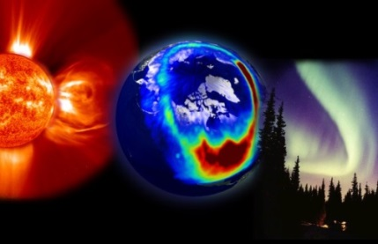
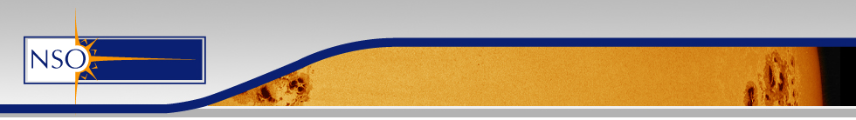


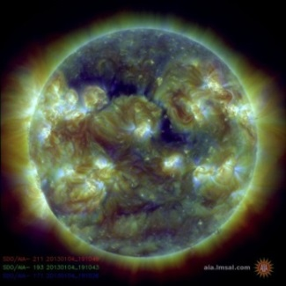
WG3: Complementary Ground-Based Instrumentation/Data to Space-Weather Missions
Mario M. Bisi (1), Alexei A. Pevtsov (2,3), and a multitude of colleagues (over 30) from around the World (under various collaborative endeavours)…
(1) STFC RAL Space, Harwell Campus, UK.
(2) US National Solar Observatory.
(3) University of Oulu, Finland.

Slide 2
A Plethora of Complementary
Ground-Based Space-Weather Data
Here are just some examples:
  Ground-based magnetograph networks (e.g. the Global Oscillation Network Group – GONG).
  Ground-based solar coronagraphs/coronameters (e.g. Mauna Loa Solar Observatory – MLSO – instrumentation).
  Big Bear Solar Observatory (BBSO) including the New Solar
  Telescope (NST).
  Synoptic Solar Observations (e.g. Pevtsov, ASP Conf. Series, 2016).
  The future Daniel K. Inouye Solar Telescope (DKIST).
  The Worldwide Interplanetary Scintillation (IPS) Stations (WIPSS) Network.
  The e-CALLISTO International Network of Solar Radio Spectrometers.
  Several Radio Heliographs (e.g. Nançay, Nobeyama, Chinese Spectral Radio Heliograph – CSRH).

Slide 3
Complementary
Ground-Based Radio Observations…
Radio-burst monitoring at higher (coronal) frequencies as potential warnings ahead of energetic solar events (e.g. Type II coronal shocks – often associated with CME eruptions, Type III precursors to flares/CMEs, Type IV emission): these could be used as triggers to implement higher-cadence modes (e.g. on the L5 spacecraft remote-sensing instrumentation where spacecraft telemetry could be a problem).
Astronomical radio-source observations (and reconstructions) of velocity, density-proxy, and potentially B_parallel throughout the corona and inner heliosphere to complement coronagraph and heliospheric imaging imagery as well as solar-surface magnetic-field measurements, three-dimensional (3-D) MHD modelling, etc…

Slide 4
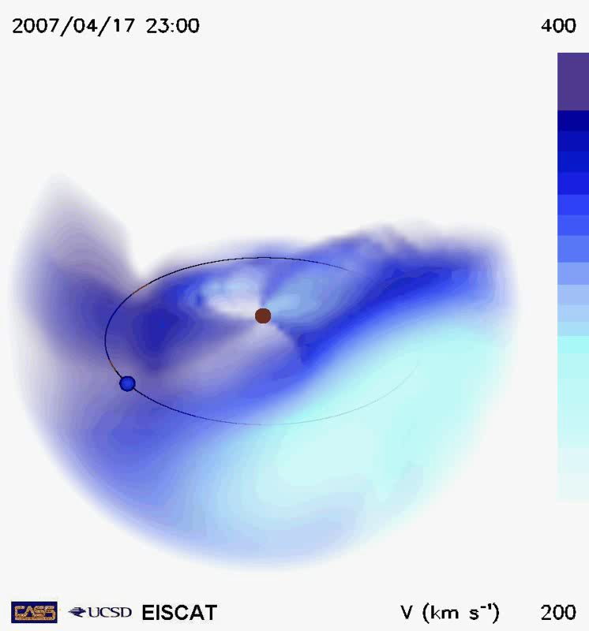
Radio Heliospheric Imaging
The disentangling of heliospheric structures
between the Sun and Earth is no simple task.
There are many different features: different solar-wind streams, stream interaction regions (SIRs), CMEs, etc…
Remote-sensing heliospheric imaging via visible-light (Thomson scattered sunlight off of heliospheric structures) or radio (indirect via changes in signals from background sources) frequencies enables us to get a good handle on the large space between Sun and Earth (and beyond the Earth).
Observations can be input into the University of California, San Diego (UCSD) 3-D tomography for reconstruction (movie – top) of the whole inner-heliospheric structure in several parameters…

Slide 5
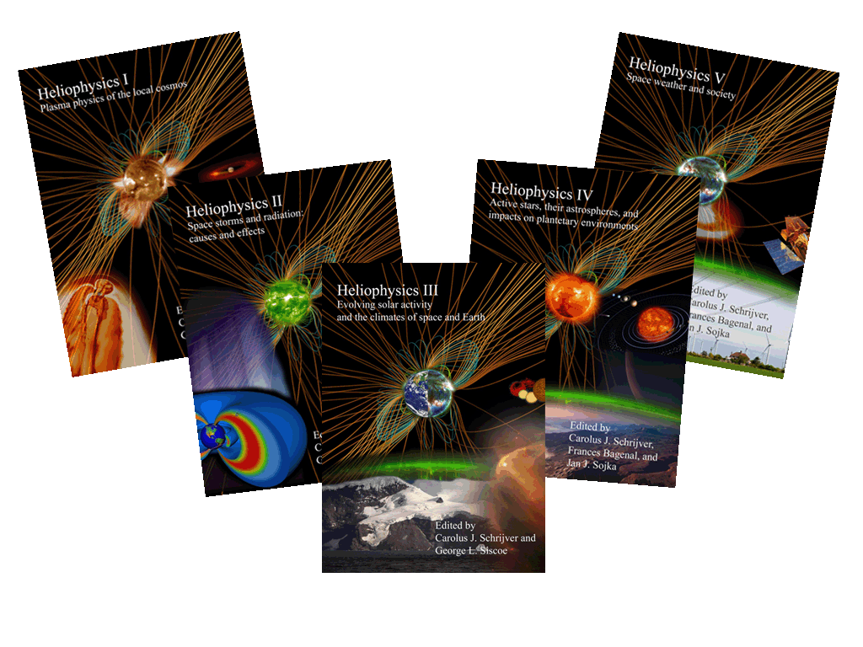
Interplanetary Scintillation (IPS) and Heliospheric Faraday Rotation (FR)
- e.g. see M.M. Bisi, “Planetary, heliospheric, and solar science with radio scintillation”,
Chapter 13 of Heliophysics Volume IV “Active stars, their astrospheres, and impacts on planetary Environments”, Editors C.J. Schrijver, F. Bagenal, and J.J. Sojka,
Cambridge University Press, 16 March 2016, and references therein.

Slide 6

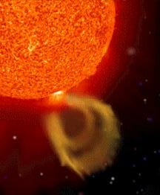
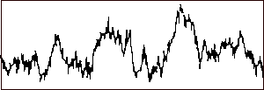

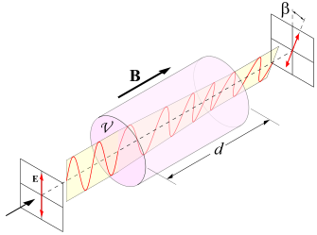
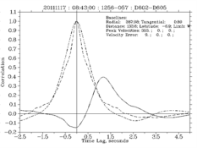
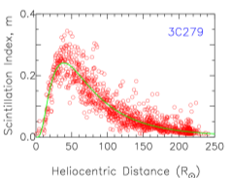
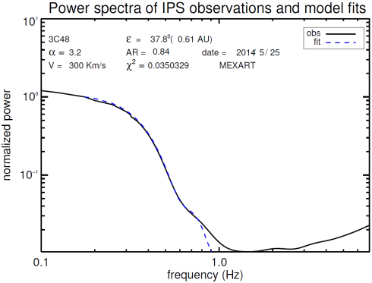
IPS and Heliospheric FR
Interplanetary
magnetic field
Faraday rotation from
polarised radio source
Solar wind velocity, density/ turbulence, and signatures of field rotation and SIRs
Interplanetary scintillation
from compact radio source
Cross-correlation of power spectra → velocity
Variation in amount of scintillation → density proxy
IPS is most-sensitive at and around the P-Point of the LOS to the Sun and is only sensitive to the component of flow that is perpendicular to the LOS; it is variation in intensity of astronomical radio sources on timescales of ~0.1s to ~10s that is observed.
Fit to individual power spectra → velocity etc…

Slide 7










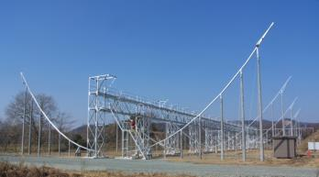
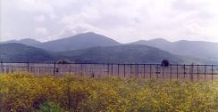


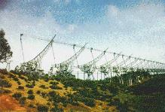

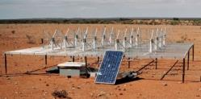
Worldwide IPS Stations
(WIPSS) Network
Pushchino 111 MHz
70,000 ㎡
ISEE Multi-Station 327 MHz
2000 ㎡ × 3, 3500 ㎡
MEXART
140 MHz、10,000 ㎡
Mexico
High-Band Tiles
110 to ~250 MHz.
Low-Band Dipoles
~10 to 90 MHz.
Japan
UK/Europe –
EISCAT/LOFAR
Russia
WIPSS
India
South Korea
Ooty 327 MHz、16,000 ㎡
MWA
80-300 MHz
(USA-Australia)

Slide 8
WIPSS Core Members
M.M. Bisi – STFC RAL Space, UK.
J.A. Gonzalez-Esparza, E. Aguilar-Rodriguez, O. Chang,
J.C. Mejia-Ambriz, V.H. De la Luz, P. Corona-Romero, and E. Romero-Hernandez – SCIESMEX/MEXART/UNAM, Mexico.
B.V. Jackson, and Hsiu-Shan Yu – CASS-UCSD, USA.
M. Tokumaru, and K. Fujiki – ISEE, Nagoya University, Japan
I.V. Chashei, S.A. Tyul’Bashev, V. Shishov – Pushchino Radio Astronomy Observatory, Russia.
R.A. Fallows – ASTRON, The Netherlands.
P.K. Manoharan – Ooty Radio Telescope, India.
Future expected additions (some are much more science focused) from the Republic of Korea (South Korea) (2016/2017), Ukraine (2017), China (2017), Australia (2017), and perhaps South Africa (TBC).

Slide 9
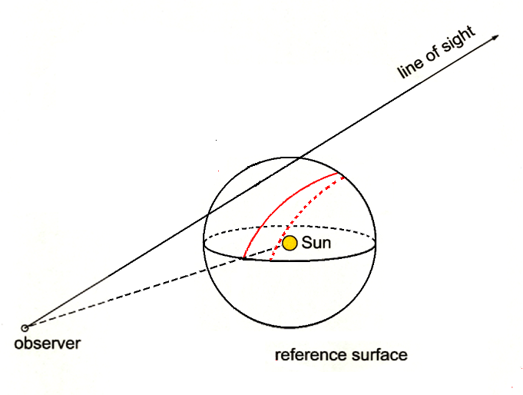
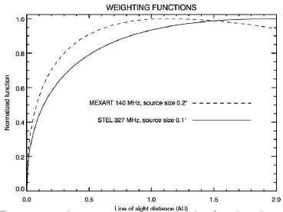
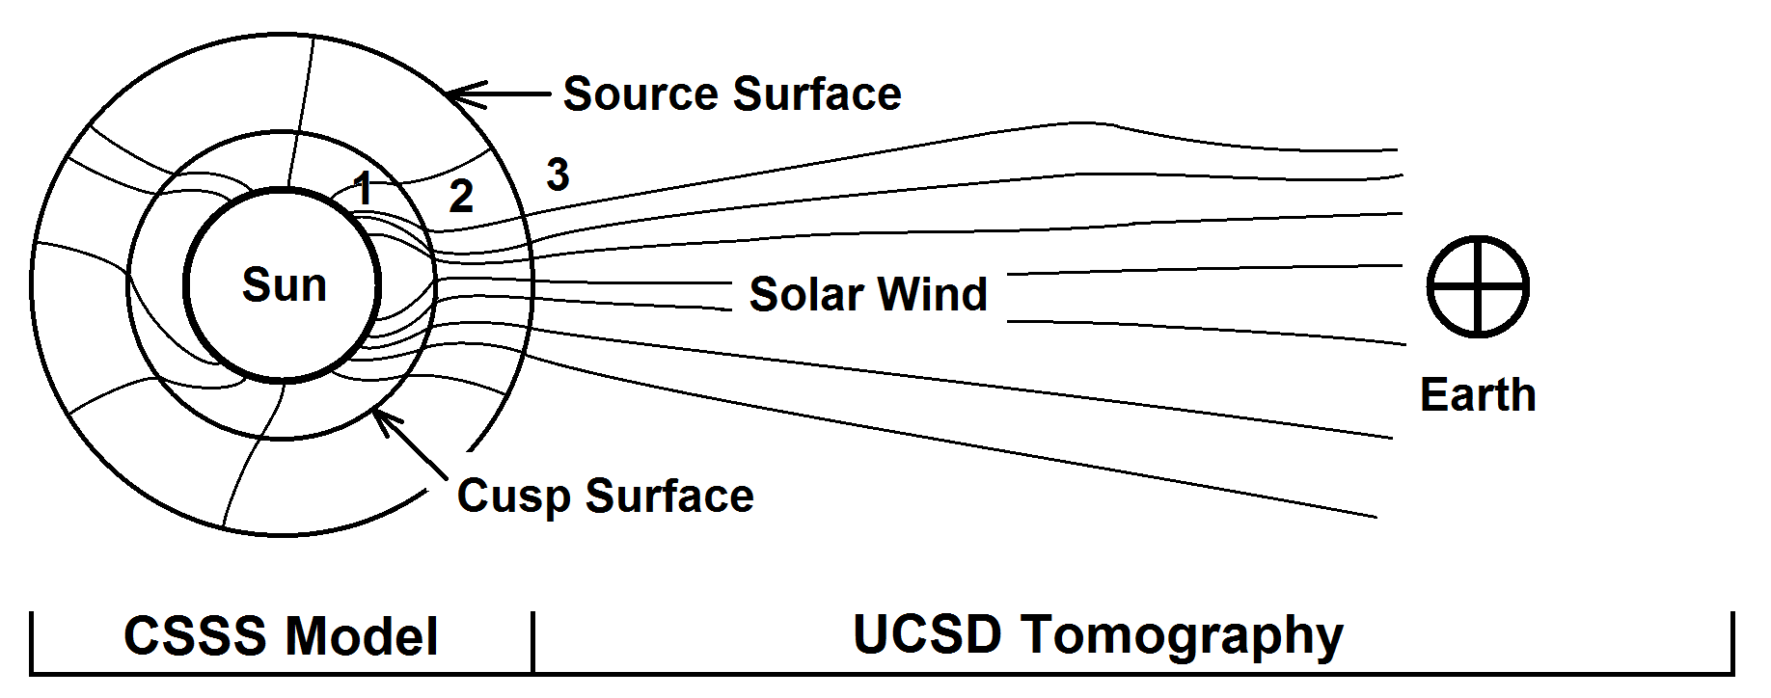
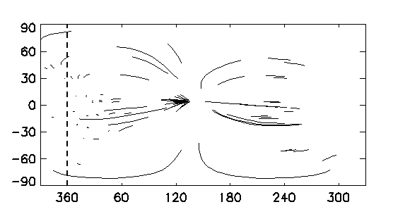
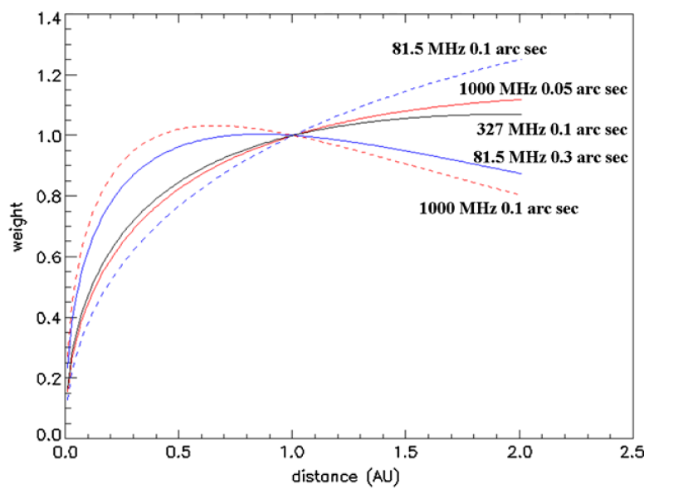
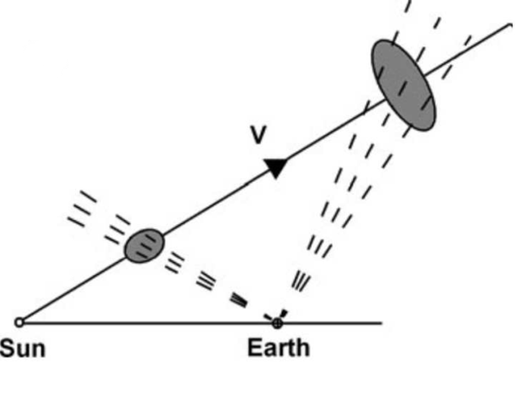
University of California, San Diego (UCSD) IPS (and B) Tomography

Slide 10
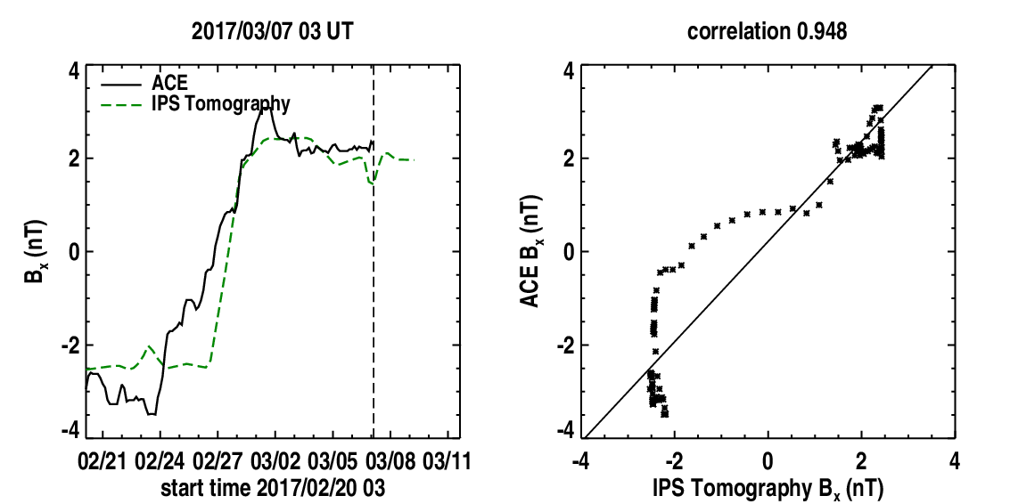
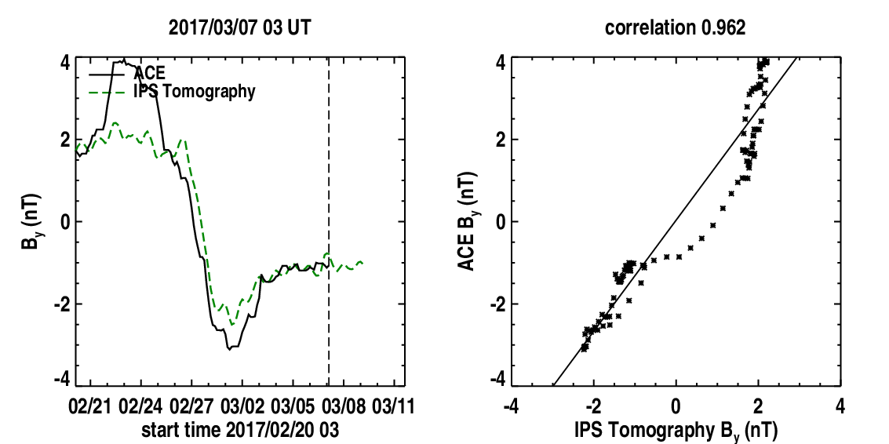
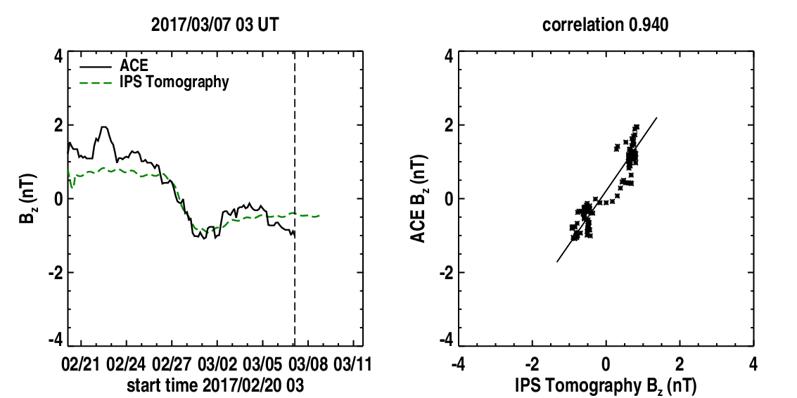
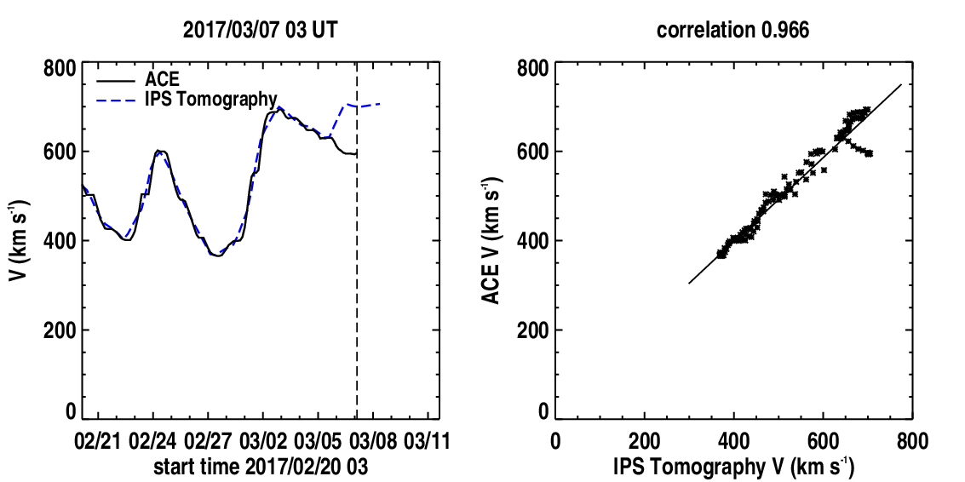
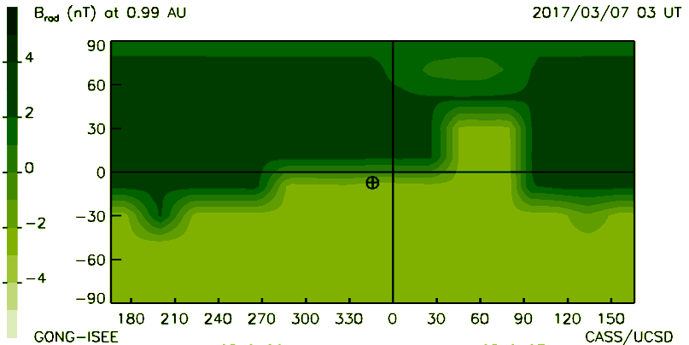
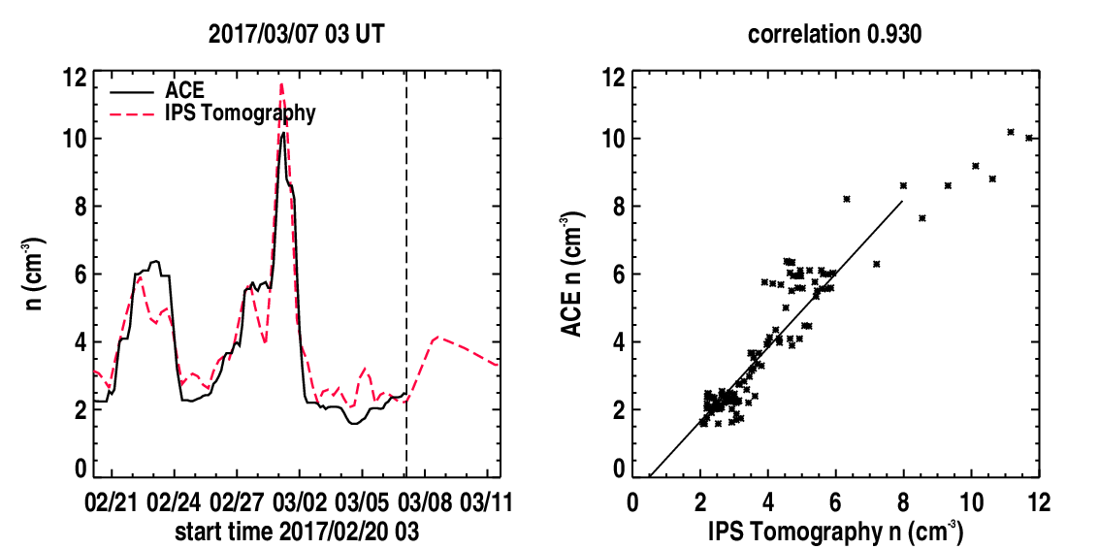
Reconstructions Using Only
ISEE IPS and GONG Data…
Today’s Bx, By, Bz, v, Br, and n values/forecast…
Courtesy of Bernard V. Jackson et al. at UCSD.
Taken from the 2016 UCSD IPS Workshop Pages (http://ips.ucsd.edu/ips_workshop_2016).

Slide 11
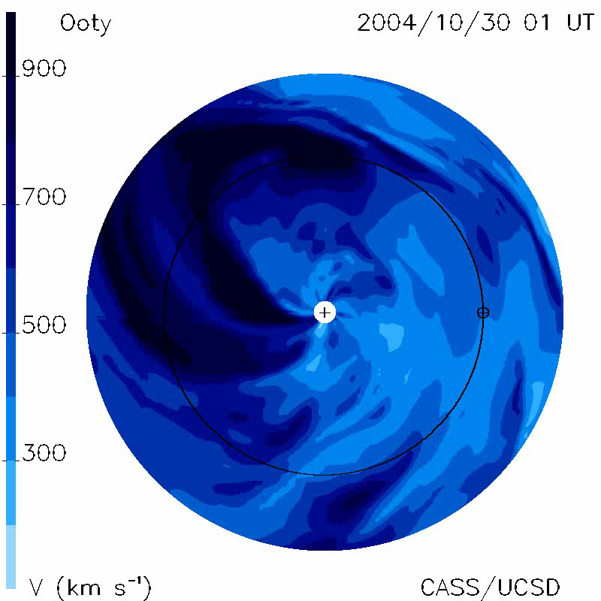
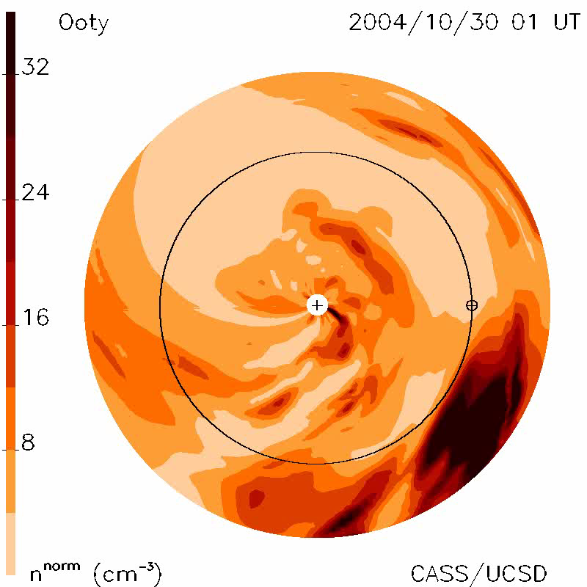
What we want from WIPSS (1)
Using the UCSD 3-D Tomography for real-time heliospheric reconstruction and space-weather forecasting in this detail…

Slide 12
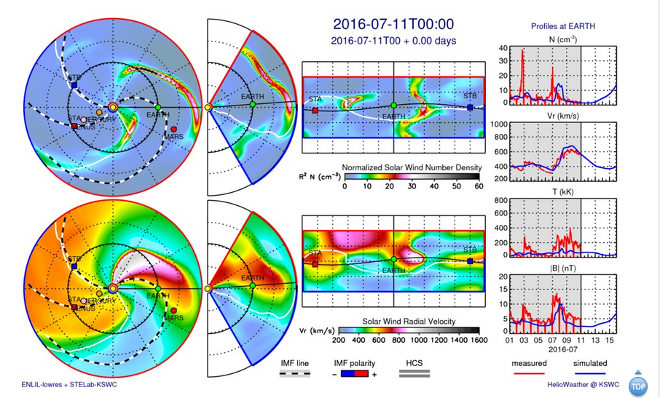
What we want from WIPSS (2)
And to drive MHD using IPS data as input (in progress)…

Slide 13
Key WIPSS Complementary
Space Weather Predictions (and fillers)
IPS Tomographic Analyses:
  The UCSD iterative kinematic prediction technique; Used primarily with ISEE observations, ready for WIPSS.
  Could be implemented using L1 and L5 heliospheric imagers data.
IPS tomographic analysis, displays:
  Combined analysis from multiple IPS data sets (WIPSS) (and/or L1/L5 spacecraft); 3D-MHD modelling and driving MHD models.
Magnetic-field component forward-modelling – B_{x}, B_{y}, B_{z}:
  Part of the modelling effort developed at UCSD (with others).
Key new development:
  B_{z} predicted in GSM coordinates at low resolution at Earth
  (higher resolutions would be possible with L1/L5 imagery/data).
© 2017 RAL Space

Slide 14
WIPSS Overall Summary
WIPSS (ground-based) Network: IPS is an extremely-powerful and unique technique with a wide international interest for making complementary heliospheric imaging observations of the inner heliosphere as well as now having validation for space-weather forecasting underway (RAL Space/Met Office US Air Force EOARD project as well as several other international efforts); combined with heliospheric FR and the UCSD tomography, this allows for huge potential in obtaining 3-D magnetic-field forecasts as well as those in velocity and density.
Mario M. Bisi acknowledges his contribution to this material is based upon work supported by the Air Force Office of Scientific Research, Air Force Material Command, USAF under award number FA9550-16-1-0084DEF.

Slide 15
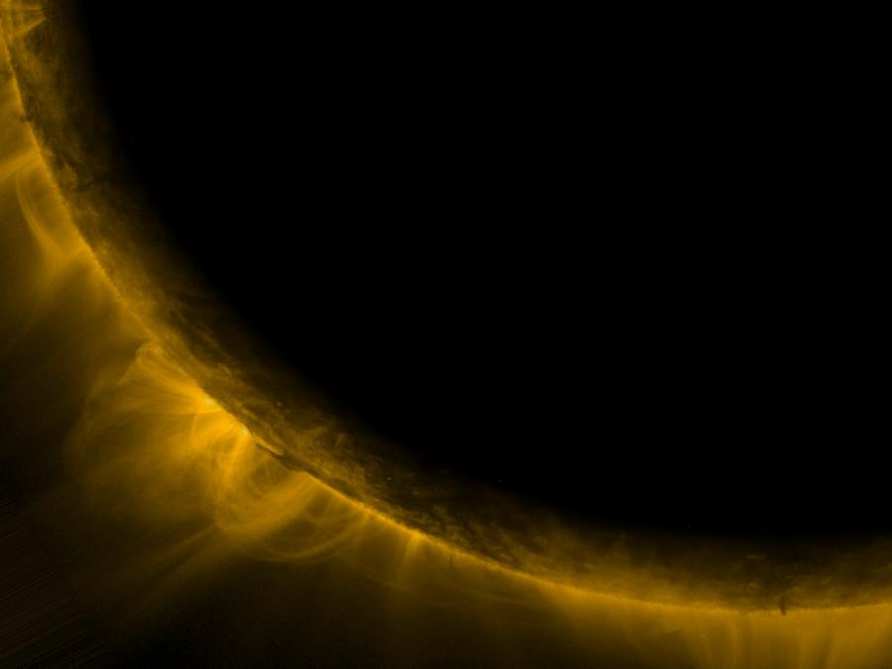
Solar and Magnetic-Field
Ground-Based Observations…
Alexei A. Pevtsov and 12 WG3 team members.

Slide 16
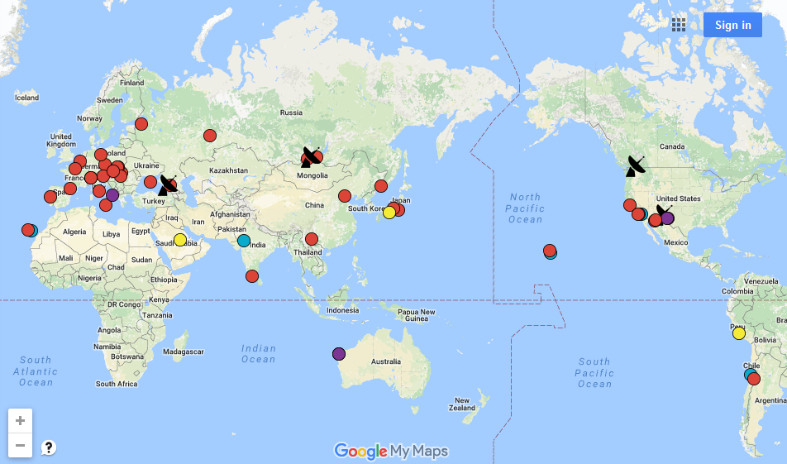
Existing Solar Observatories/instruments
IAU WG on Coordination of Synoptic Observations of the Sun
http://www.nso.edu/IAU-Com12/resources

Slide 17
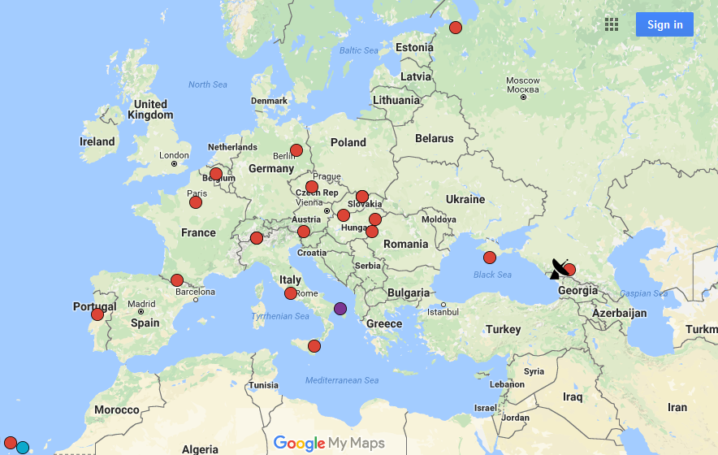

Slide 18
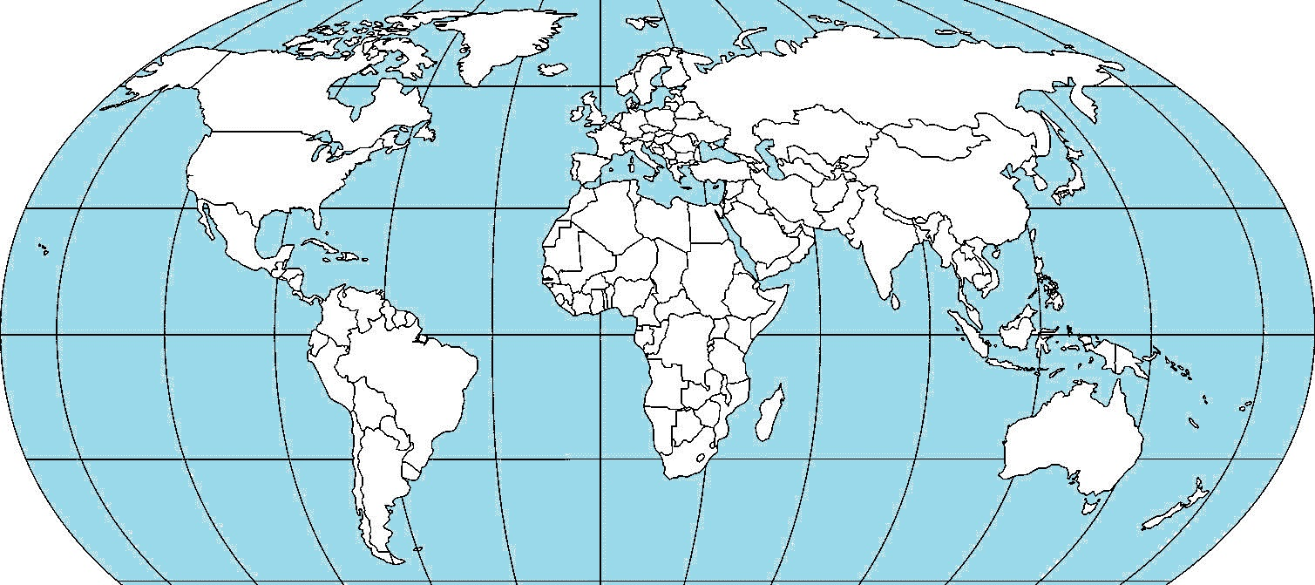
Existing Networks (2023??)
ISTP
KMAS
GONG; GHN; SOON; KMAS-ISTP (STOP); DRAO; CHAIN; PSPT
Some current plans: GONG refurbishment (Frank Hill), SPRING (Markus Roth), Brazilian magnetograph (Luis E. A. Vieira, Alisson Dal Lago), “Solar Service” in Russia (Yu. Nagovitsyn, A. Tlatov)

Slide 19
Available Ground-based Data
Moderate spatial resolution imaging data in visible (Hα, CaK, He10830, WL, visible corona), NIR and radio.
Fill disk LOS and vector magnetograms (photo-/chromosphere) + spectral information
Synoptic maps data products (flux, vector field, uncertainties, limb maps of prominences), polar fields.
Sun-as-a-star (high spectral resolution spectra, magnetic flux and imbalance, radio-flux).
High spatial resolution imaging and spectral data in visible and NIR (SST, VTT, GREGOR, DST, NST, DKIST).
http://www.nso.edu/IAU-Com12/resources

Slide 20
Type of Observations
Monitoring observations that provide a routine suite of data products that can be used for modeling, forecasting, planning, and context (ex: GONG, SOLIS, Hα GHN, SOON) – WG4/some WG3.
Campaign observations that deploy a broader, more diverse suite of instruments that are not necessarily otherwise available to address specific L1-L5 objectives – WG3.

Slide 21
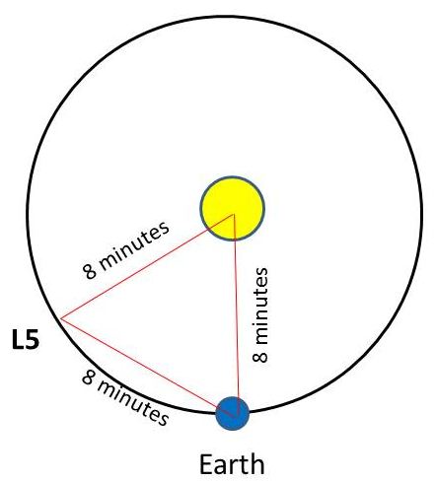
Examples of Synergy between L1-L5 and Ground-based Observatories
Near pre-flare; early flare/CME eruption stages (instruments at L5 will not be very useful for that anyway because:
  Eruptions in far-East are less geoeffective
  8-minute delay in receiving data from L5
Early signature of AR emergence and identifying “bad” active region
  High-/moderate spatial resolution observations of various magnetic, thermodynamic, topological properties, helioseismology data

Slide 22
Examples of Synergy between L1-L5 and Ground-based Observatories
Improvement of prediction of “routine” space weather forecast (PFSS, WSA-Enlil).
  Better polar field representation
Determining magnetic topology of erupted CMEs; Source regions of “stealth” CMEs; Large-scale magnetic connectivity, better mag. flux estimates
Routine and campaign data for continuing development of new data products and methods for future space weather (science and R2O)
Explore unknown (science data applicable for SW research).

Slide 23
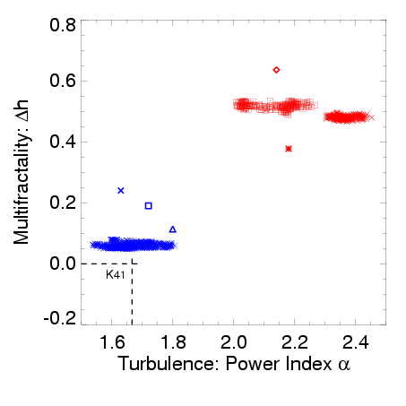
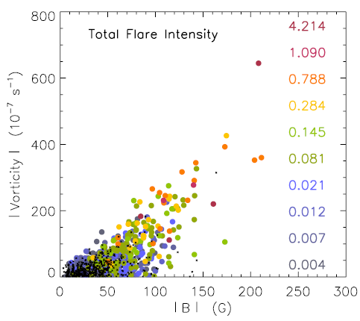
Early Identification of “Bad” Active Regions
Flaring ARs
9773/M9.5
9077/X5.7
Jul 14
Jul 13
9866/M5.7
0515/ -
9851/ -
0061/C2
0306/C1
Flare-Quiet
ARs
Komm & Hill, 2009, 1009 ARs
Classical Kolmogorov Turbulence state
Helioseismology and high-res observations
Abramenko, 2004-2014

Slide 24
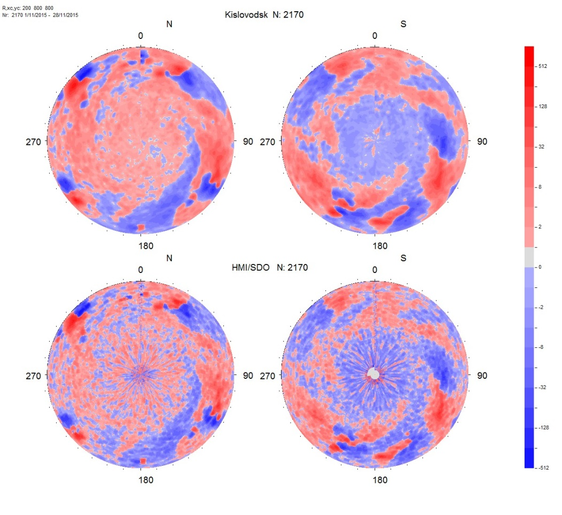
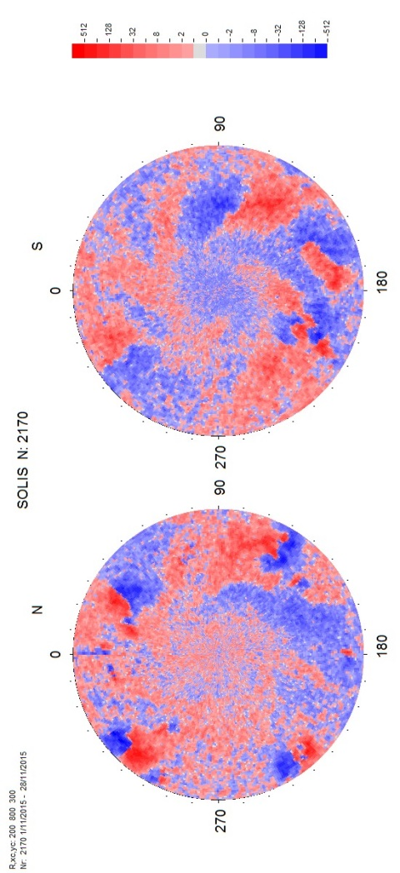
Polar Field CR2170
STOP/Kislovodsk
HMI/SDO
SOLIS
Tlatov (2017)

Slide 25
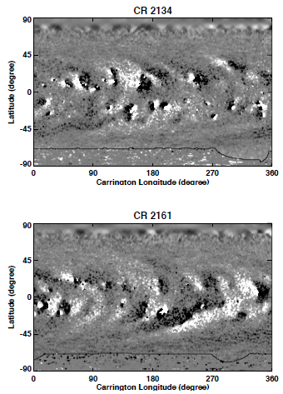
Clumpy Nature of Polar Fields
Composite Hinode/SOLIS synoptic magnetogram.
Routine SW observations could be supplemented by
DKIST (polar area scans), SOLIS (area scans in photo- and chromo-spheres), imaging telescopes/PSPT-type

Slide 26
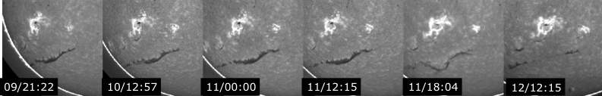
Large-scale magnetic connectivity
Mature AR
new AR
Filament arcade
9 June 2003
11 June 2003
Magnetic field of emerging AR reconnects with mature AR, which in its turn, “steals” field lines from magnetic arcade above filament.

Slide 27
Some current issues
Lack of coordination between national programs/observatories (non-uniform/ duplicate data).
No critical evaluation (what do we need to observe, what is missing etc…).
Lack of long-term planning (no well-defined goals, diminishing funding, aging facilities).
Data preservation.

Slide 28
Overall Summary
Ground-based (GB) observations will provide both mission-critical and supplemental data for space weather forecasting.
GB data will play important role in developing new SW-related data products (science) and in R2O transition.
It is necessary to develop a strategy and close coordination between the observatories on the long-term goals, data requirements and data sharing.
Add. reading - white paper on “The Solar Probe Plus Ground Based Network”, http://sppgway.jhuapl.edu/ sites/default/files/Pubs/SPP-GBN-WhitePaper-v5.0.pdf

