Slide 1
Towards a MHD instability tool for space weather forecasting
Francesco P. Zuccarello
Centre for mathematical Plasma-Astrophysics, KU Leuven, Belgium
Mullard Space Science Laboratory, University College London, UK
francesco.zuccarello@wis.kuleuven.be

Slide 2
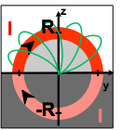
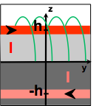
The trigger of solar eruptions
External magnetic field
Magnetic tension of the external field
VS
Magnetic pressure of the MFR
Negative sunspot
Rupture of equilibrium
Filament
resistive instability
Positive sunspot
Magnetic flux rope (MFR)
ideal-MHD instability
Current-wire models
coronal Bex
coronal current
image current
Instability if
≥1-1.5
based on morphology
Notes:
In highly idealized and symmetric systems the decay index for circular flux ropes is 1.5, but if we want to use it as a forecast tool we need to move to a less idealized configuration

Slide 3
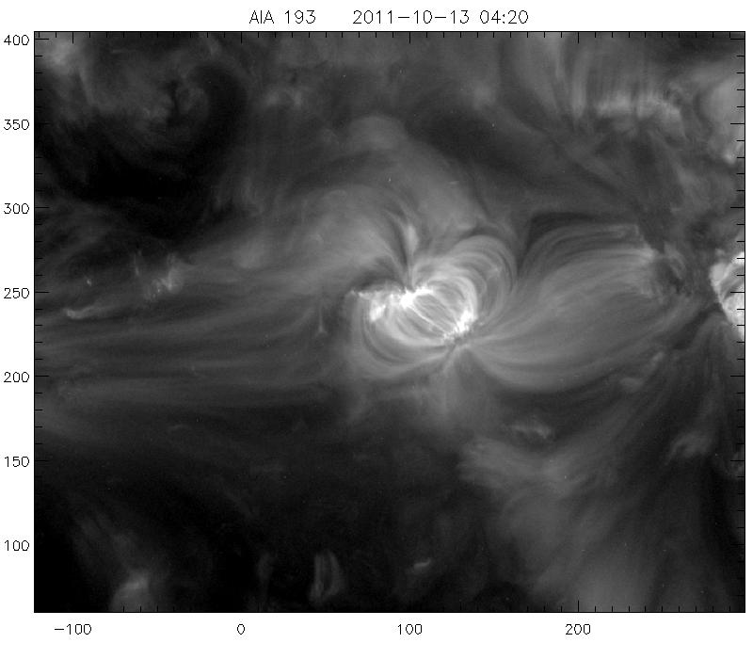
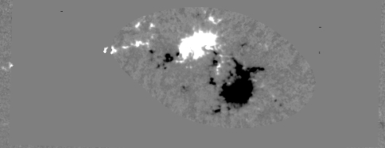
Towards observation inspired MHD simulations
SDO/AIA
SDO/HMI
PIL
Romano, Zuccarello et al. (2014)
Simulated photospheric magnetic field evolution
Zuccarello, Aulanier & Gilchrist (2015)
SDO/AIA

Slide 4
Coronal response
(tether-cutting) magnetic reconnection between highly sheared bald-patches field lines sets-in resulting in the formation of a magnetic flux rope and a sigmoid
Zuccarello, Aulanier & Gilchrist (2015)
Notes:
Briefly convergence, reconnection formation of the flux rope, its rise and finally its eruption

Slide 5
Coronal response
Perform relaxation runs to determine the time of the onset of the eruptions
Zuccarello, Aulanier & Gilchrist (2015)
Notes:
At different times during the evolution we freeze the photospheric boundary and let the system evolve. This is the same setup as before but the flows have been stopped 4 tA earlier

Slide 6
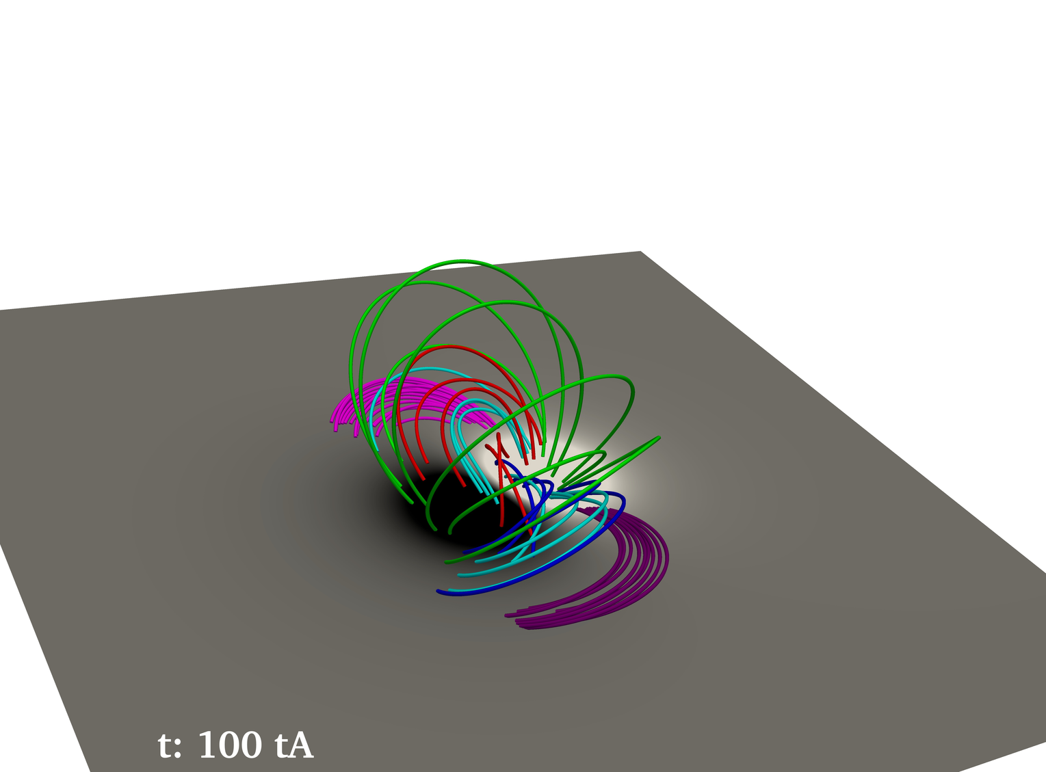
Coronal response
Asymmetric bipolar active region
From the different photospheric flows and coronal resistivities
→ ncrit=1.4 ± 0.1
Zuccarello, Aulanier & Gilchrist (2015)
Notes:
Discuss the initial condition an asymmetric quasi force free equilibrium

Slide 7
How to use this criterion in observations ?
… and for space weather tools … ?
Notes:
In highly idealized and symmetric systems the decay index for circular flux ropes is 1.5, but if we want to use it as a forecast tool we need to move to a less idealized configuration

Slide 8
Towards observations
Key ingredients:
Potential field extrapolations to compute the decay index
The height of the axis of the magnetic flux rope
External magnetic field
Negative sunspot
Filament
Positive sunspot
Magnetic flux rope (MFR)
Notes:
In highly idealized and symmetric systems the decay index for circular flux ropes is 1.5, but if we want to use it as a forecast tool we need to move to a less idealized configuration

Slide 9
Towards observations
Key ingredients:
Potential field extrapolations to compute the decay index
The height of the axis of the magnetic flux rope
From observations we have info on the filament not on the MFR
→do the same with the MHD simulation
External magnetic field
Simulated filament (magnetic dips)
Negative sunspot
Filament
Positive sunspot
Magnetic flux rope (MFR)
Notes:
In highly idealized and symmetric systems the decay index for circular flux ropes is 1.5, but if we want to use it as a forecast tool we need to move to a less idealized configuration

Slide 10
Towards observations
Key ingredients:
Potential field extrapolations to compute the decay index
The height of the axis of the magnetic flux rope
From observations we have info on the filament not on the MFR
→do the same with the MHD simulation
Simulated filament (magnetic dips)
→ apparent ncrit=1.1± 0.1
Zuccarello, Aulanier & Gilchrist (2016)
Notes:
In highly idealized and symmetric systems the decay index for circular flux ropes is 1.5, but if we want to use it as a forecast tool we need to move to a less idealized configuration

Slide 11
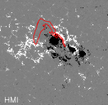
Application to observed filament eruptions
Torus instability criterion can be tested from observations
→ limb observations
→ stereoscopic observations
Before the M6 flare
After the M6 flare
Zuccarello et al. (2014)
Notes:
In highly idealized and symmetric systems the decay index for circular flux ropes is 1.5, but if we want to use it as a forecast tool we need to move to a less idealized configuration

Slide 12
Application to observed filament eruptions
Before M6 flare
Decay index along the magenta plane
Yellow-green: region where n ≃ 1.1 ± 0.1
When the M6.0 flare occurred the filament was in a torus stable region and did not erupt
The filament erupts when reaches the height where n ≃ 1 ± 0.1
During convergence motions
Before eruption
Zuccarello et al. (2014)

Slide 13
Conclusion
Torus instability is a robust mechanism to trigger filament eruptions
Consistent results with different approaches: analytical, observational & 3D MHD
ncrit depends on MFR’s morphology, photospheric flows and coronal diffusion,
→ for usable onset criterion a critical decay index range [1.1-1.5 ?] should be used
… but how to make it operational ?
Essentially ones needs:
Potential field extrapolations to compute the decay index at different heights
A way to estimate/track the height of the axis of the magnetic flux rope
→ Vector (LOS ) magnetograms (lat ± 30°/35°)
→ Stereoscopic observations (L5 mission)
Notes:
In highly idealized and symmetric systems the decay index for circular flux ropes is 1.5, but if we want to use it as a forecast tool we need to move to a less idealized configuration

Slide 14
Thank you !
Francesco P. Zuccarello
Centre for mathematical Plasma-Astrophysics, KU Leuven, Belgium
Mullard Space Science Laboratory, University College London, UK
francesco.zuccarello@wis.kuleuven.be
AIA 304 Å

