Slide 1
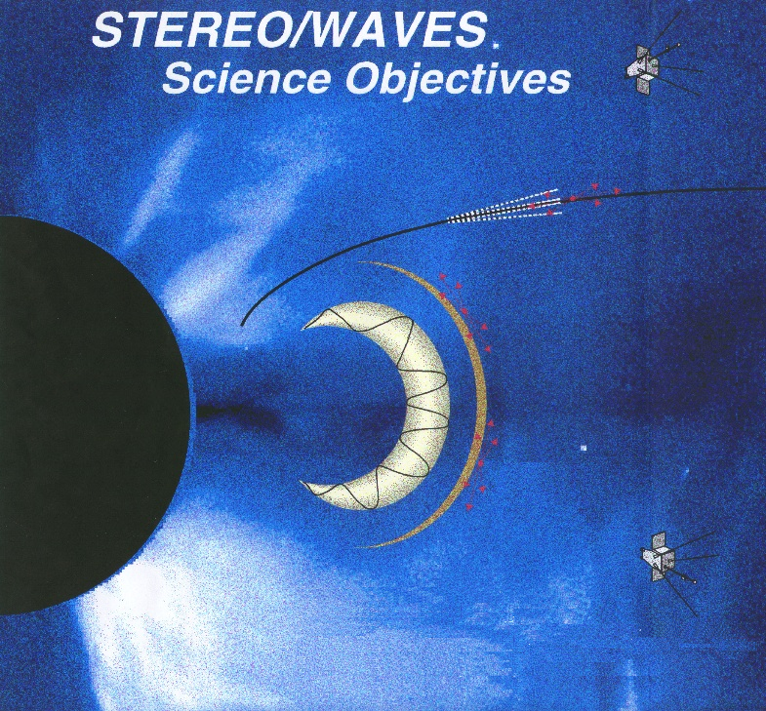
SWAVES-like radio instrument?
Jasmina Magdalenić
Mario M. Bisi
Royal Observatory of Belgium
STFC RAL Space (UK)
Notes:
This is the adapted figure from the STEREO WAVES page.

Slide 2
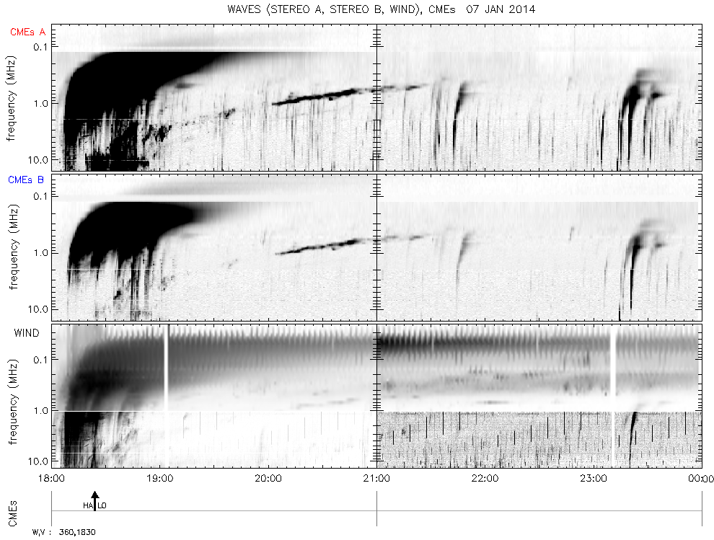
SWAES like radio instrument in L5 and L1?
What products/data we what to obtain?
Solar radio observations: Dynamic radio spectra & Direction finding observations
Dynamic radio spectra by STEREO/WAVES & WIND/WAVES showing type II and type III bursts on 2014 January 07.
Type II bursts:
1D shock wave speed → gives indication on the CME speed.
Prediction of the shock arrival at 1 AU (Cremades et al., 2007, 2015).
Type III bursts:
Indication on the open field lines.
Adapted from: http://secchirh.obspm.fr/
Notes:
Here I have mentioned only the straight forward use of type II bursts, it is a bit hard to list down all the options – like the one I have mentioned on my talk at Jeju…
The reference of Cremades et all, is because she demonstrated how the prediction of the shock arrival at 1 AU using interplanetary type II radio bursts is actually quite good. I like the first article better.

Slide 3
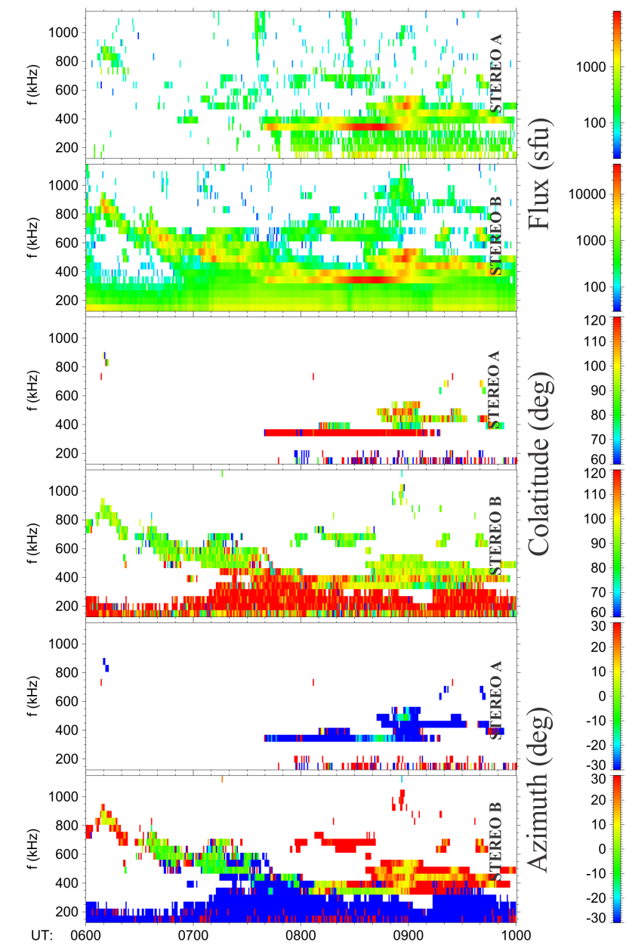
Solar radio observations: Dynamic radio spectra & Direction finding observations
Radio measurements of STEREO/WAVES showing type II burst on 2012 March 05.
Radio flux density, Colatitude of wave vector and Azimuth of wave vector.
Signal to noise ration for SWAVES A observations is too low to obtain reliable results or radio triangulation.
Type II bursts – 3-D shock wave speed and position in space of the radio-loud part of the shock wave.
Type III bursts – indication on the open field lines.
Adapted from: Magdalenić et al., 2014
Notes:
I did not list the relevant publications, it would overcrowd the presentations, and it does not seem so important to me.

Slide 4
Instrument specifications 1:
Physical range:
Solar radio spectra from 10 kHz to 60 MHz.
Split into a few sub-bands, i.e. a few receivers.
The high frequency part (10 − 60 MHz range), should be used for inter-calibration with ground-based observations.
Can we go up to 60 MHz?
WAVES-like instruments typically go up to about 20 MHz only.
Time range & Latency:
Continuous coverage.
Updated every 10 – 40 min.
Dynamic range:
Depends on the frequency range.
< 150 kHz, 110 dB.
> 150 kHz, 80 dB.
> 30 MHz, 50 dB.
All the specification are concerning the SWAVES-like radio instruments.

Slide 5
Instrument specifications 2:
Time resolution:
Depends on the frequency range.
< 150 kHz; 10 s // 20 s // 30 s
> 150 kHz; 1 s // 3 s // 5 s
> 30 MHz; 0.1 s// 0.2 s // 0.4 s
Frequency resolution:
Depends on the frequency range.
< 125 kHz; ∆f/f =9%
125 kHz – 15 MHz; 100 kHz
> 15 MHz; 10 kHz
Resolution of 1 min is not sufficient, in particular for direction finding observations!
Interplanetary type II bursts have patchy structure and substructures lasting less then 1 min and having bandwidth of less than 0.1 MHz (for frequencies ≤ 1 MHz where direction finding observations are usually considered).
Direction finding below 400 kHz with SWAVES instruments gives somewhat unreliable results (Krupar et al., 2014, Magdalenić et al., 2014).
All the specification are concerning a SWAVES-like radio instrument.
Notes:
The brown values are wanted, then// medium level, then // threshold level.

Slide 6
Waves like radio instrument in both L5 and L1.
Why the same instrument for both missions?
For the space weather forecasting purposes:
Intensity of the radio emission, as seen from two different spacecraft is directly comparable → straightforward idea on the direction of the propagation of the CME-driven shock and CME itself (using only dynamic spectra).
Better, i.e. more exact, results of the radio triangulation (errors are usually considerably large for a single instrument).
Easier to cross-calibrate two identical instruments.
Some recent evidence has shown that the near-Sun detections of shocks (at higher frequencies) have provided a better proxy for CME speed (since the shock and CME front are still travelling at approximately the same speed close-in to the Sun) and with two simultaneous detections, a measure of the direction can also be given.
On the space-weather science side, there is evidence that some Type II emission doesn’t come from the nose of the CME/shock, but from the flanks, and this needs further investigations.

