Slide 1
Questions/avenues to be addressed by all of the instrument-related sessions throughout this day:
Questions/avenues to be addressed by all of the instrument-related sessions throughout this day:
How well can we define, observe, and measure those phenomena that are crucial to space- weather situational awareness and what do we really need going forward?
What are the barriers to delivery of the crucial observations/measurements?
What are the critical trade-offs between observations/measurements and cost?
How do we future-proof these data sets and link to improvements in modelling capabilities?

Slide 2
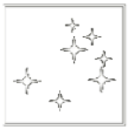
advocating for identical magnetographs in l5 and l1
manolis k. georgoulis
RCAAM of the Academy of Athens
L5 in Tandem with L1
London, UK. 5 - 9 March, 2017

Slide 3
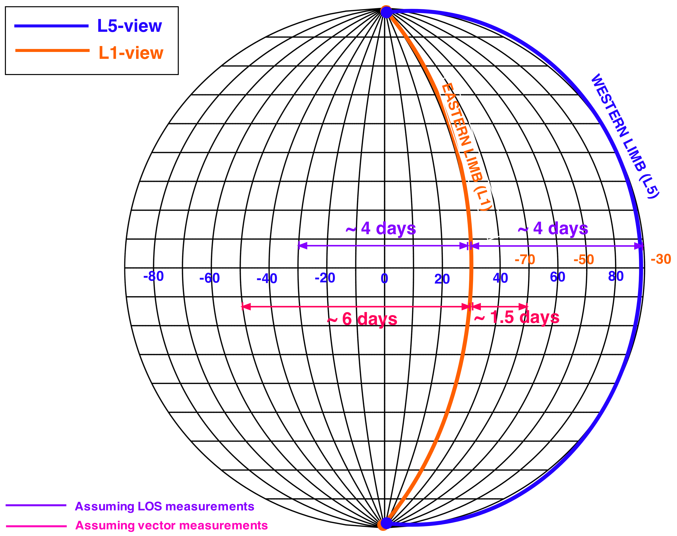
what do we gain : VECTOR Magnetograph
l5 in tandem with l1 manolis k. georgoulis
Assuming reliable obs. due to projection effects up to ±50º EW:
Start of reliable obs. ~6 days prior to crossing the L1 Western Limb
~1.5 days after crossing the L1 W limb, still reliable obs. from L5. Then, about ~1.5 days before reliable obs. are taken from L1

Slide 4
what do we gain: LINE-OF-sight magnetograph
l5 in tandem with l1 manolis k. georgoulis
Assuming reliable obs. due to projection effects up to ±30º EW:
Start of reliable obs. ~4 days prior to crossing the L1 Western Limb
Then, another ~4 days before reliable obs. are taken from L1. But a pretty good idea from L5, already

Slide 5
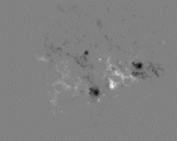
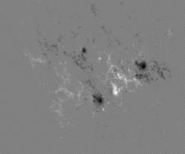
magnetogram specifications
l5 in tandem with l1 manolis k. georgoulis
Keeping in mind that this is an operational mission:
MDI-type magnetograph:
full-disk, 96-min cadence
~2” per pixel; 4” spatial resolution
HMI-type magnetograph:
full-disk, 12-min cadence
~0.5” per pixel; 1” spatial resolution
… or perhaps “HMI-type” spatial res. in an “MDI-type” cadence

