Slide 1
Observing the Corona and the Solar Magnetic Field for Space Weather Forecasting
James Lemen, Alan Title, Neal Hurlburt, & Cathy Chou
Lockheed Martin Advanced Technology Center

Slide 2
Outline
An L5 observing position provides information about status of the solar magnetic field and solar region activity that will soon rotate towards the Sun-Earth line
A compact magnetograph concept for L5
Early GOES-16 SUVI results – considerations for L5 EUV

Slide 3
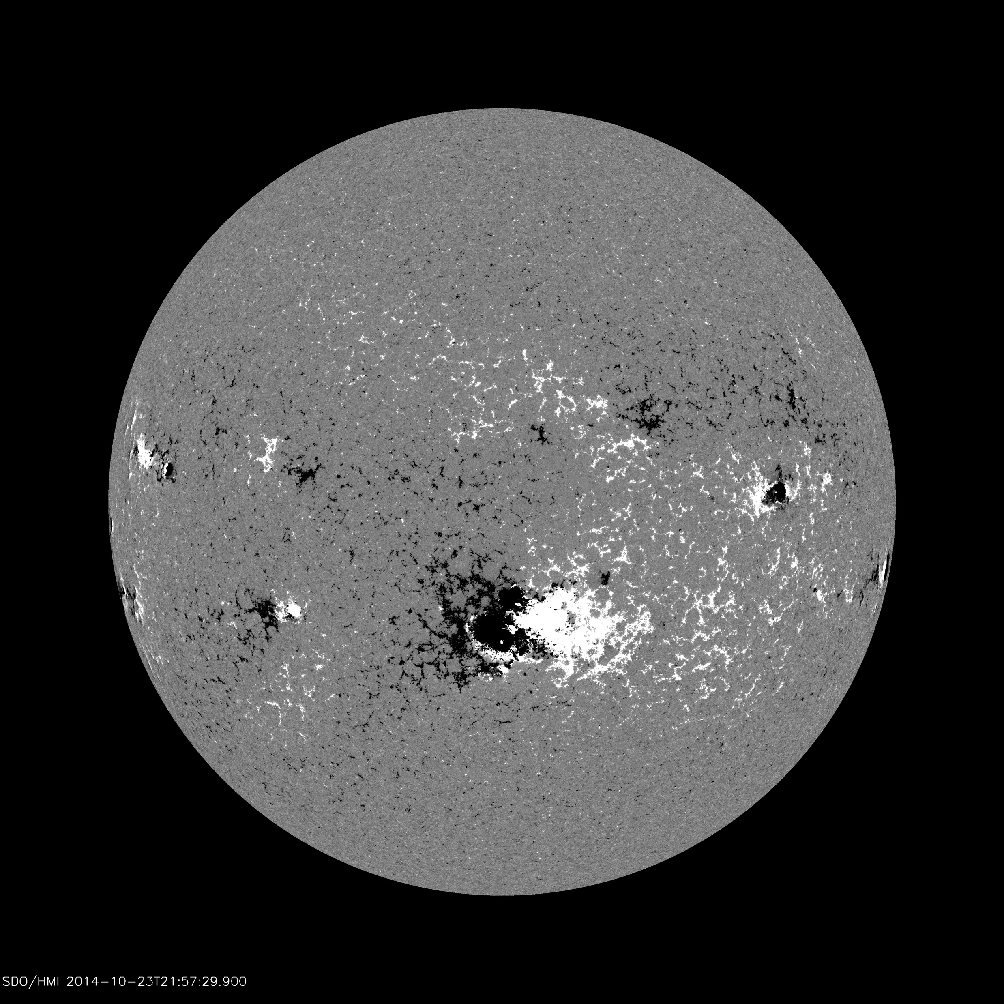
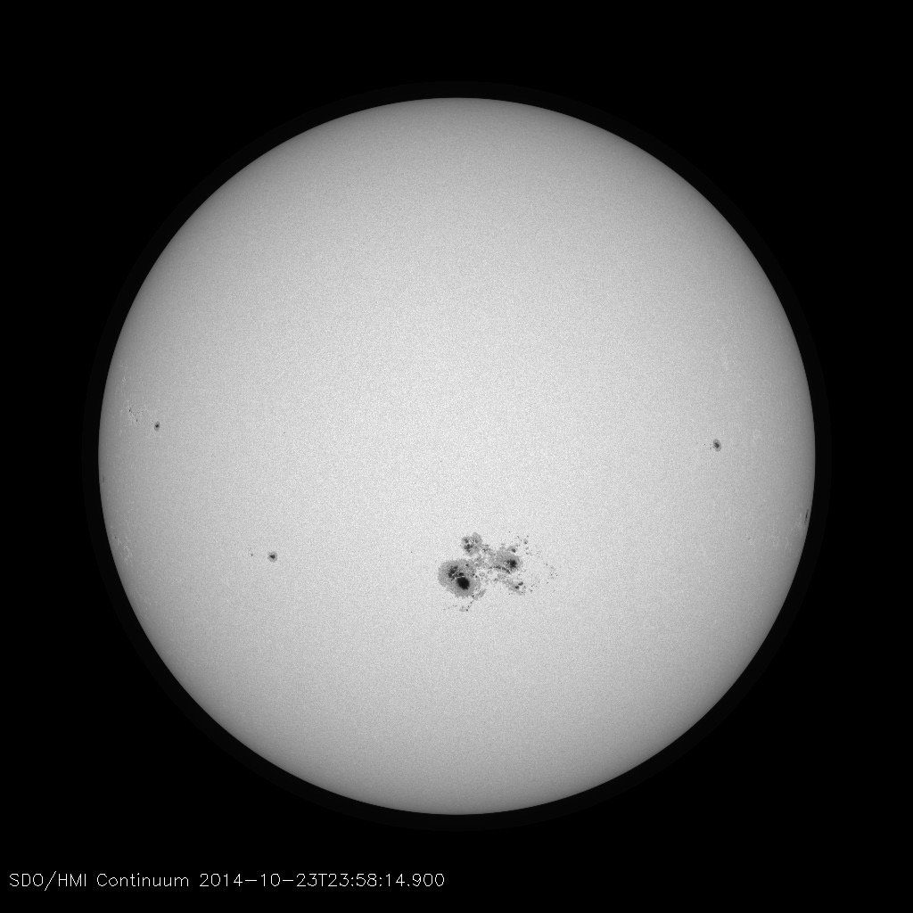
What is a magnetograph?
from HMI Science Nugget #26
Gathers narrow-band filtergraph images of Sun, usual near photospheric or chromospheric lines
Combined images use Zeeman Effect to reveal longitudinal (shown) or vector magnetic field

Slide 4
What do magnetograms do for SWx?
Magnetic field strength and complexity (gradients, etc) in active regions are the two most effective predictors for 24-hour flare forecasts
The global field distribution is the driver of space weather
Energy source of solar eruptions
Modulates solar wind speed and direction
Shapes CME and SEP trajectories
Predicting Space weather requires
Understanding solar eruptions in a global context
Coronal models with knowledge of the solar magnetic field over the entire solar surface
Seeing what is coming around the corner
from Jin, M. et al. 2016, Astrophys J

Slide 5
What is available now?
All current magnetograph observations are along Sun-Earth line with 25% coverage of the solar surface
No data for far side (50%)
Poor data for 25% due to loss of magnetic signal, and long lines of sight near photosphere
Any given solar region is only observed for <33% of a solar rotation
Little warning of what will rotating onto visible disk
GEO/L1
~27 day rotation
Magnetograph coverage as viewed from Earth
Not to Scale!

Slide 6
Limitation of only L1/Benefit of L5
Magnetograms of solar regions can be measured for only 5 days prior to entering/leaving geo-effective positions
Magnetic flux outside measurable view is currently extrapolated using heuristic surface transport models which typically assume:
Flux diffusion during 18 days when region is out of view
Flux migration towards the poles (which provides estimates of polar flux)
As a result:
Modeled regions only produce about 40% of observed magnetic flux when the region returns to view
The modeled corona displays long-range connectivity that “feels” the absence of this flux
Errors compounded by indirect assessment of polar flux
L5 observations, compared to L1, increases the number of days to 8 or 9 for the region to be observed prior to entering the geo-effective positions

Slide 7
Assimilated Synoptic Chart Movies Jan 2000 - Jan 2001
Movie runs continuously
Surface Flux Transport Model
Movie runs continuously, but only shows data when the Sun Center point is at 180º.

Slide 8
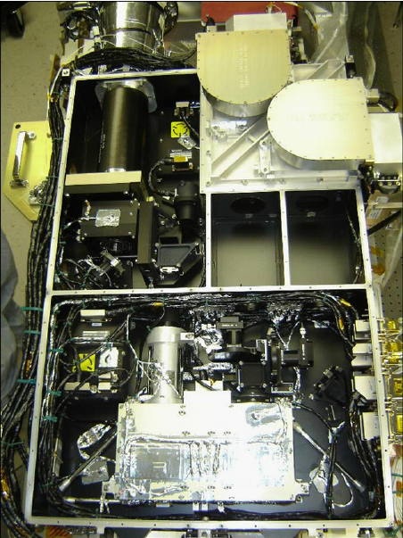
The Helioseismic and Magnetic Imager (HMI)
Continuous operations at GEO since launched in 2010 on Solar Dynamics Observatory
Produces 16M pixel longitudinal magnetograms every 45 seconds and vector magnetograms every 720 seconds
Over 100M images collected to date
Measured Instrument Properties:
Mass: 46.8 kg
Electronics Box: 42.2 kg
Power: 100.5 W
Technology is a good start for L5 mission
NASA Instrument Cost Model (NICM)
Cost ~ $\sqrt{mass}×\sqrt{power}$

Slide 9
Compact Magnetic Imager (CMI) optimized for SWx
 | HMI | CMI
Telescope Diameter | 14 cm | 7 cm
Diffraction Limited Resolution | 0.91 arcsec | 1.82 arcsec
Sensor | 4096 X 4096 pixels 0.5 X 0.5 arcsec/each pixel | 2048 X 2048 1 X 1 arcsec/each pixel
Spatial Resolution (Over entire Solar Disk) | 1 arcsec | 2 arcsec
Capabilities of both HMI and the Compact Magnetic Imager (CMI):
Operate in Fe I 6173 Angstroms
Bandpass 0.05 Angstroms Tunable
Measure linear and circular polarization
Produce Line of Sight and Vector magnetograms
Produce Full Disk Line of Sight Velocity Maps
Velocity and Magnetic Field Maps are made with the same set of images
CMI for L5
Sufficient resolution for SWx modeling and forecasting with reduced bandwidth requirements
Compatible resolution with the Solar Ultraviolet Imager (SUVI) on GOES-R
On-board processing can be developed to reduce telemetry requirements

Slide 10
Compact Magnetic Imager (CMI)
Derived from HMI design using similar components
Optimized for Space Weather
SWaP comparable to existing SWx instruments (e.g. GOES-R/SUVI, STEREO/EUVI)
TRL: 5+
 | Structure Envelope (cu in) |  | Optics Package Mass
HMI | 4,687.0 |  | 46.8 kg
CMI | 1309.5 |  | 22.0 kg
Total mass (with electronics) = 33.5 kg Power = 63W

Slide 11
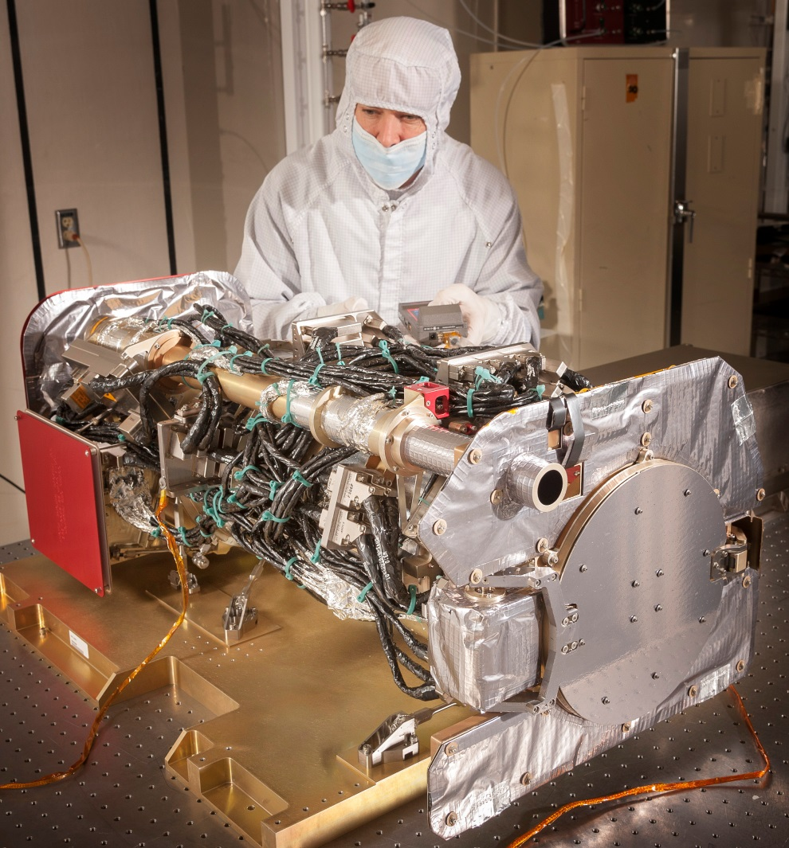
L5 EUV observations – SUVI will be at GEO
SUVI launched in Nov 2016 on GOES-16 into GEO
20 cm primary, f=173.3
2.5 arcsec pixels
53 arcmin FOV, ~f/8.66
RESOURCE | SUVI
Power | 171 W
Mass Telescope Ebox/Harness | 35.7 kg 23.6 kg/6.4 kg
Data | 2.9 Mbps
Volume Telescope Ebox | 37.2 x 37.5 x 91.5 cm 20.8 x 31.5 x 51.4 cm
94.8 A | 6.8 | Fe XVIII
131 A | 7.0, 7.2 | Fe VIII, XXI
171 A | 5.8 | Fe IX
195 A | 6.1, 73. | Fe XII, XIV
284 A | 6.3 | Fe XV
304 A | 4.7 | He II
L5 mission needs can be met with between 2 and 4 bandpasses

Slide 12
SUVI First Light Movie 171Å
Log Scaled
12 Feb 2017 00:02
To
16 Feb 2017 19:01

Slide 13
Conclusions
How well can we define, observe, & measure those phenomena that are crucial to space weather situational awareness & what do we really need going forward?
Need global observations of magnetic field. Probably need 2 arcsec spatial resolution to constrain the flux transport models, but his should be confirmed
Need “back-side” EUV observations to observe trigger events and to provide early warning of active regions and coronal holes
What are the barriers to delivery of the crucial observations/measurements?
Telemetry bandwidth. Different on-board processing algorithms are possible for both magnetograph (build on-board) and EUV
What are the critical trade-offs between observations/measurements and cost?
Magnetograph: required resolution, telemetry, on-board processing, reliability
EUV: Number of wavelengths, data cadence, reliability
Technology is mature for both of these observations
How do we future-proof these data sets and link to improvements in modelling?
EUV: Match SUVI capabilities (which will fly for next 20 years)
Magnetograph: SOHO + SDO = 20 years of historical observations. Ensure that the L5 capabilities consistent with SOHO/MDI. Develop OSSEs to test use of 2 arcsec data input to models to predict observations

Slide 14
Thanks

Slide 15
Possible Viewpoints: Lagrange Points
Three spacecraft viewpoints at GEO, L4 & L5
Increase accurate coverage area from 25% to >60% of solar surface
No data for 1/6 of equator on far side
Poor data for 1/6 of equator & poles due to loss of magnetic signal, long lines of sight near photosphere, and ambiguous positioning
Overlap provide multi-instrument calibration and validation of inversions
L4
GEO/L1
L5
Coverage as
viewed from Earth
Not to Scale!

Slide 16
Possible Viewpoints: Complete Equatorial Coverage
L4
Three spacecraft viewpoints with 120 degree separation
Slight increase in accurate coverage (75%)
Full coverage along equator
Poor coverage for 25% of surface mostly near poles
GEO/L1
L5
Coverage as
viewed from Earth
Not to Scale!

Slide 17
Possible Viewpoints: And out of the Ecliptic…
30º off-ecliptic
orbits
L4
L5
GEO/L1
L4
Orbits 30º off ecliptic increases accurate coverage to >90% of solar surface
Overlap regions provide multi-instrument cross-calibration and validation of inversions
GEO/L1
L5
Coverage as
viewed from Earth
Conceptual
orbits

Slide 18
Compact Magnetorgraph and SUVI SWAP
Power
Mass & Envelope
Subsystem | CMI | SUVI
Optics Package | 31.6 | 94
CEB | 13.3 | 9.2
Oven | 2.8 | N/A
Heaters | 15.6 | 84.8
Electronic Box | 30.4 | 34.7
Harness | 1.2 | -
Total Avg Power | 63.2 | 128.7
Subsystem | CMI | SUVI
Mass (kg)
Optics Package | 22 | 35.6
Electronic Box | 6.5 | 23.6
Harness & MLI | 5 | 6.5
Total Mass | 33.5 | 65.7
OP Envelope | 0.66m L X 0.45m W X 0.25m H | 0.91m L X 0.38m W X 0.37m H
EB Envelope | 0.23m D X 0.11m W X 0.19m H | 0.31m D X 0.51m W X 0.21m H
OP = Optics Package
EB = Electronics Box
SUVI and CMI spatial resolutions are approximately 5 and 2 arcsec

