Slide 1
WG2: Magnetographs and solar-disk white-light imagers
Alexei A. Pevtsov^{1,2}
¹US National Solar Observatory
²University of Oulu, Finland
and 35 team members (Vourlidas, A., Berger, T., Scherrer, P., Hoeksema, T., Schou, J., Hudson, H., Xinlin Li, Title, A., Leibacher, J., Biesecker, D., Mackay, D., Singh, J., Deng Y. […]).

Slide 2
Some Critical Questions
Is the L5 magnetograph priority 1 (baseline) or priority 2 (enhanced) payload
Objectives of L5 mission (Carrington-type of event? → P2; Or improvement of prediction of “routine” space weather forecast? → P1
L5 Objectives (from S. Kraft presentation):
[…] providing improved inputs to SW models
[…] monitoring development of ARs 3-4 days before L1 vantage.
LOS or Vector magnetograph?

Slide 3
L5 magnetograph – priority 1 (baseline) instrument
Data will improve modeling of solar wind (Mackay et al 2016), Pevtsov et at 2016) and the estimates of global quantities: polar flux, total mag. energy, elec. current, open flux, solar wind speed etc.
Will provide information on emerging ARs, and allow evaluating their potential for flare/CME eruption.
In combination with L1 (and maybe L4?) will provide better representation of global magnetic field topology, polar field, may help with 180-deg. disambiguation of magnetic field.

Slide 4
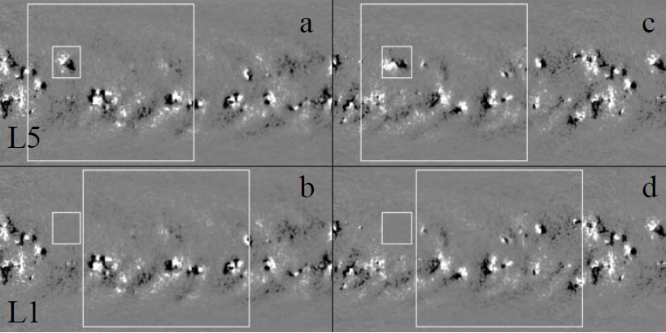
Effect of L5 data on Modeling of Solar Wind (WSA-Enlil)
+L1
Parameter | Case 1 | Case 2
Solar wind speed | 70-75 km s⁻¹ (20%). | 100-120 km s⁻¹ (30%)
Electron density | 3 cm⁻³ (40%) | 3-4 cm⁻³ (60-70%)
Magnetic field strength | 1 nT (15%) | 1 nT (20-25%)
Electron temperature | 5 KK (10-15%) | 15-20 KK (45-50%).
Pevtsov et al (2016)

Slide 5
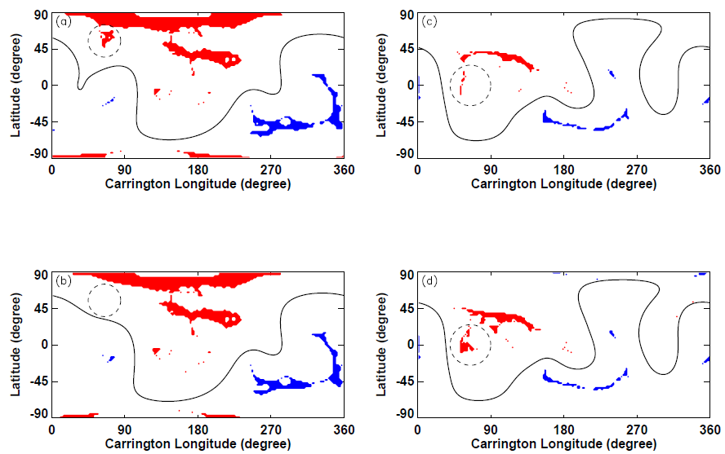
Areas of Open Fields/Coronal Holes
L1+L5
Missing CH
Incorrect prediction of CHs
L1 only
Pevtsov et al (2016)

Slide 6
LOS or Vector magnetograph?
Current SW forecast uses only LOS, moderate resolution data.
Vector data products and their use in SW modeling are not mature enough (recent meeting in Oulu: www.nso.edu/node/1510).
Forward looking → VMs have potential to significantly improve SW forecast; for mission in 2023, preference is for VM.
Should include both Doppler and WL (come with magnetograph data)

Slide 7
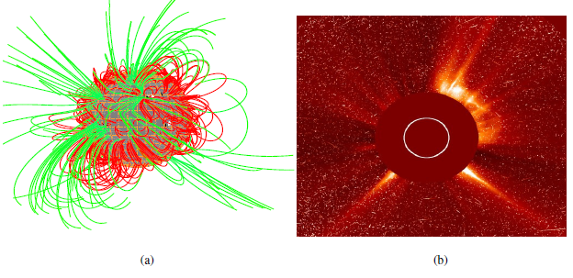
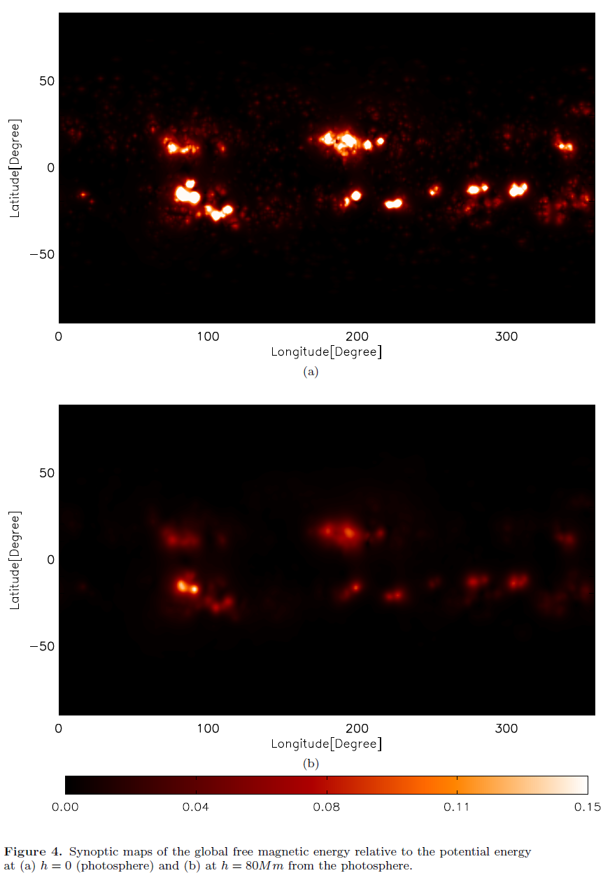
Synoptic Vector Maps in NLFFF Global Modeling (SOLIS/VSM)
NLFFF global model
EIT image
EIT image
Magnetic free energy
Magnetic free energy
CR2124
photosphere
photosphere
Vector maps are necessary for NLFFF extrapolation of coronal fields
Magnetic free energy can be used to characterize flare/CME potential of active regions.
TFE=11
124
80 Mm above photosphere
80 Mm above photosphere
Tadesse et al (2013-2015)

Slide 8
Need Additional Modeling
Quantify improvements in SW forecast.
Evaluate effects of merging data from different instruments (L1, L5)
Polar field improvements
Utility for disambiguation, stereo-diagnostics
Derivation of vector information from multiple LOS observations.
????

Slide 9
Draft instrument requirements
Strong preference for identical instruments at L1 and L5
On board processing
Photospheric spectral line (to cross-calibrate with groundbased instruments)
Doppler data, white light/continuum (WL imager), also see Kraft et al. (2016) and Vourlidas (2015)

Slide 10
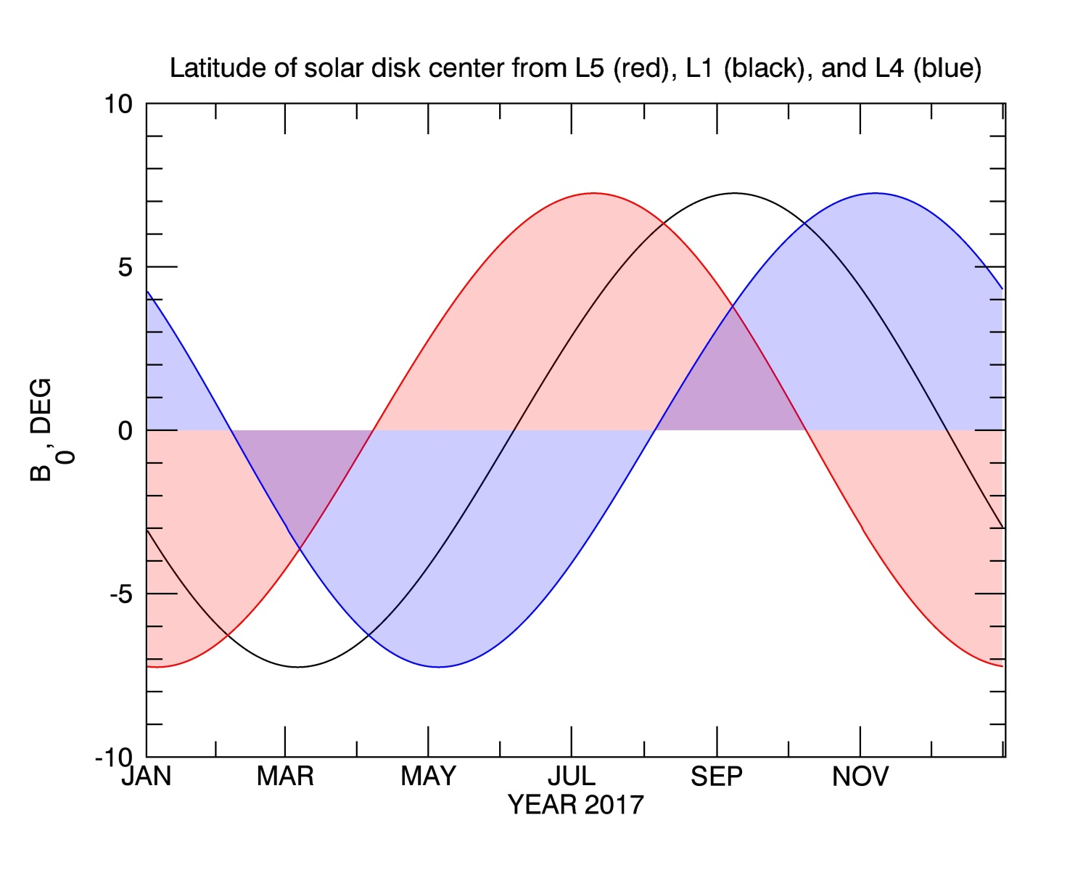
Polar Field from L1-L5-L4
Knowledge of polar fields is critical for many SW models (e.g., PFSS, WSA-Enlil).
Combination of L1 and L5 will improve polar field representation.

Slide 11
Helioseismology from L5?
Signature of pre-emergence of ARs (SW)
Probing deep (dynamo?) layers at the base of the convection zone (new science).

Slide 12
Telemetry, cost, other considerations
Tests with SDO/HMI magnetograms with mp4 compression: one 2K by 2K (40 mins) and 256 by 256 (Doppler, 1 min) - 10Kbps.
Lev1- onboard, full inversion on the ground
Vector - only for strong field areas (ARs).
10-20 Kbps may be a hard requirement to get around. Would require DSN.
Drifters (limited instruments) vs. “Galactica”-class (suite of instruments); multiple back-ups, $100M s/c + (2-3 instr. x $30M) + $70M launcher = $230-260M

Slide 13
Summary
Magnetograph should be a priority 1 (baseline) instrument
Strong preferences:
Identical instruments on L1 and L5
Vector magnetograph
Doppler and WL will come with magnetograph data
Helioseismology is enhancement for scientific outcome

Slide 14
Useful articles
Kraft, S., Puschmann, K.G., Luntama, J.P., “Remore Sensing Optical Instrumentation for Enhanced Space Weather Monitoring from the L1 and L5 Lagrange Points”, ICSO, 2016
Mackay, D.H., Yeates, A.R., & Bocquet, F.X. 2016, "Impact of an L5 Magnetograph on Non-potential Solar Global Magnetic Field Modeling“, APJ, 825, 131 ,10.3847/0004-637X/825/2/131
Pevtsov, A.A., Bertello, L. , MacNeice, P., and Petrie, G.: 2016, "What if we had a magnetograph at Lagrangian L5?", Space Weather, 14, 1026-1031, DOI: 10.1002/2016SW001471
Vourlidas, A.: 2015, “Mission to the Sun-Earth L5 Lagrangian Point: An Optimal Platform for Space Weather Research”, Space Weather, 13, 197–201. 10.1002/2015SW001173

