Slide 1
Preparing for When the Sun Wakes Up:
Workshop on Deep-Space Sun-Earth L5/L1 Space-Weather Missions
Overview of Space Weather Impacts
Mike Hapgood
mike.hapgood@stfc.ac.uk

Slide 2
Solar flares & the prophets of doom
Severe space weather is an emerging risk
  Rare, but now dangerous because we have become critically dependent on vulnerable technologies over past 60 years
  But, as with all big risks, it appeals to our love of scare stories
  So public discussion spans whole range of ideas from end-of-civilisation-as-we-know-it to it-can’t-happen-here.
So we have to work hard to provide balance
  Deep dive into the technology and its interactions with space weather to assess the real level of risk - and what can we do about it
  Show how scientific knowledge transcends personal and organisational experience (20-year horizon?)
  Beware of silver bullets: oversimplification, half-baked solutions (e.g. magnetic shield @ L1)

Slide 3
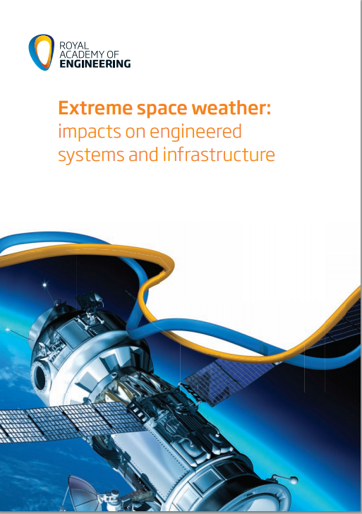
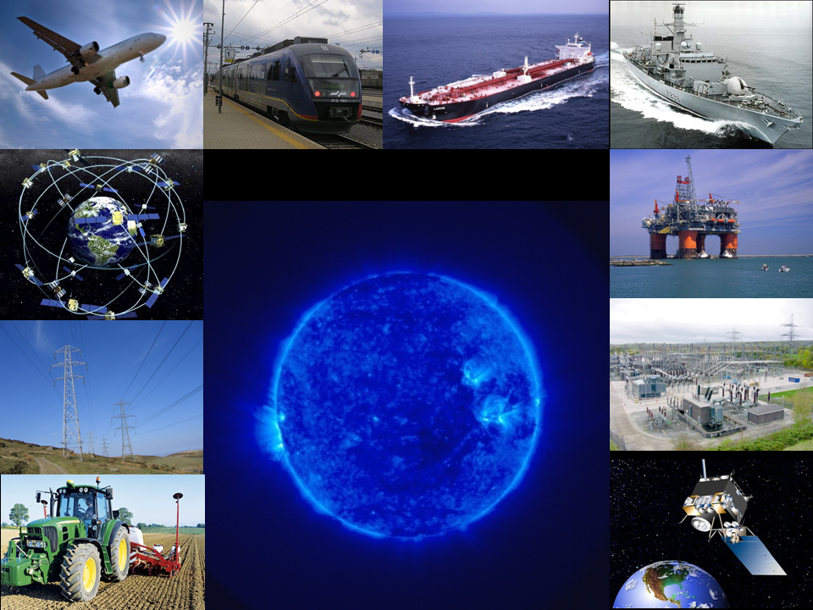
Space weather: a multitude of impacts
published Feb 2013, update?
Notes:
Old technologies are Evening Star (last BR steam engine, 1960), Concorde (1960s) and Battersea Power Station (1930s)
Modern technologies are high speed rail, Airbus 380, and National Grid lines across North Wales (power from remote hydro and nuclear stations)

Slide 4
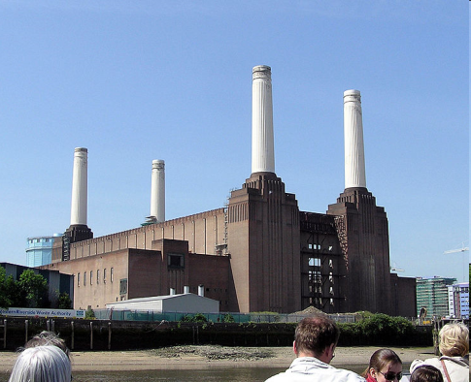
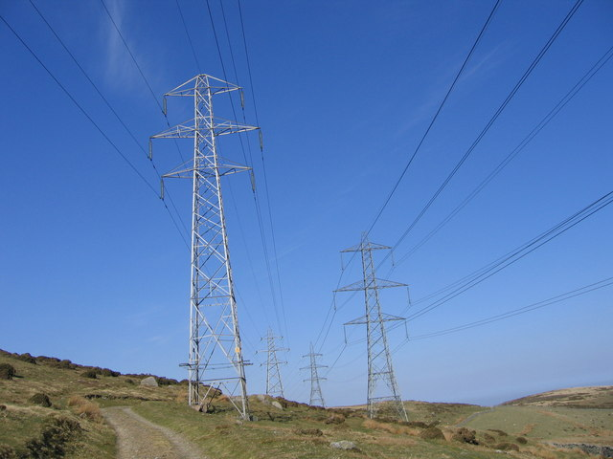
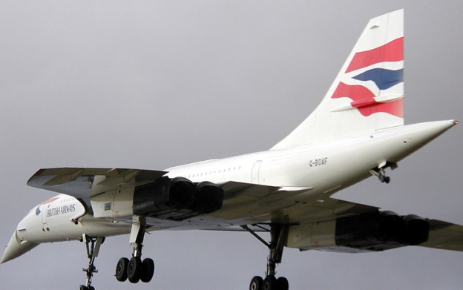

Technology exposes us to space weather risks
Space weather phenomena are as old as the Earth – but:
Geomagnetically induced currents (GIC) first reported as problem in 1847 on telegraph lines; in power grids from 1940, but particularly since 1960s expansion of grid
Aviation: problems with radio systems since 1920s, now issues from GNSS and electronic control (instead of astro-nav & hydraulic)
Also other transport systems, agriculture, satellites, ground electronics, use of GNSS timing in finance and communications systems, …
Notes:
Old technologies are Evening Star (last BR steam engine, 1960), Concorde (1960s) and Battersea Power Station (1930s)
Modern technologies are high speed rail, Airbus 380, and National Grid lines across North Wales (power from remote hydro and nuclear stations)

Slide 5

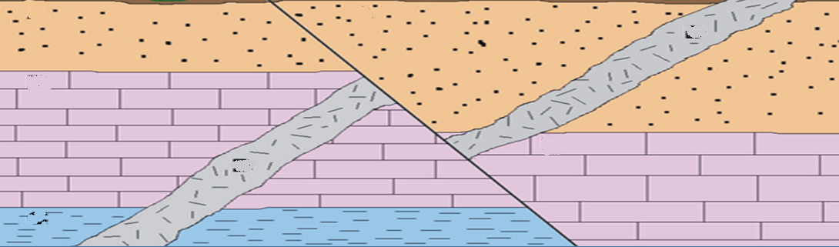
Earth currents (GIC) – a space weather hazard
Profile of subsurface with mixed geology
Magnetic fluctuations, generated by space weather, penetrate to, and into, the surface of the Earth:
driving magnetic induction inside electrically conducting Earth.
Induces geoelectric fields at surface, up to 10 V km⁻¹, depending on underlying geology:
Induction loop has scale sizes of 100s of km
Deep into Earth.
Skin depth is 100s of km for mHz frequencies
Now add technology – nature drives currents in infrastructure:
~10s-100s of A in power lines
~100s of mA in control lines
... if there is an electrical circuit, e.g. via electrical grounding (safety)

Slide 6
Why is GIC bad for grounded systems?
Power grids – GIC unbalances electrical behaviour of transformers
  “half-phase saturation”, half of each 50/60 Hz AC cycle saturates transformers
  Transformers consume extra (reactive) power => heating & reduced voltage
  Main severe risk is voltage collapse, some potential to damage transformers
  Generates harmonics => noisy transformers, disrupts other grid systems
  Everyday GIC risks subject of scientific debate: wear & tear on transformers, grid congestion, loop flows?
Rail
  Track circuits - central to rail safety since 1870s – GIC can give false indications
  Control lines for signals, block control, bell signals – interference from GIC
Pipelines
  Pipe-to-soil voltage changes – leading to corrosion, potential for early failure
Trans-ocean (optical fibre) cables
  Excess voltages (100s of volts) observed on power systems

Slide 7
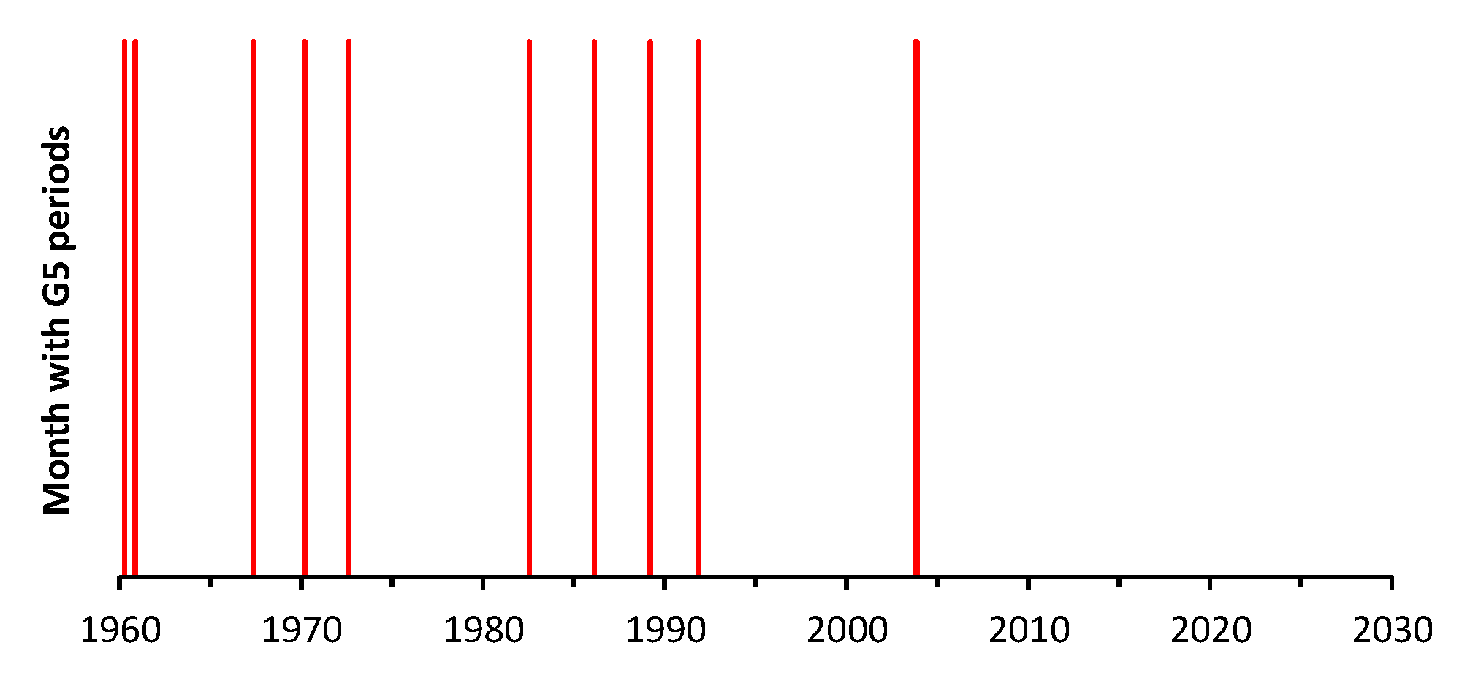
A timeline of major “G5” events & UK impacts
System disturbance in Scotland
2 transformer failures in UK (next slide)
Also impacts on pipelines & trans-ocean cables
UK System disturbances
Large (~40A) GIC measured at sites in Scotland
Limited awareness
GIC measurements
The Sun has been quiet
When will it
Wake up?

Slide 8
Key points from 1989 storm: transformer impacts
Night of 13/14 March
Many hours after Quebec failure
Factory inspection showed damage to core-bolt insulation. Also lead joint failure?
Transformers returned to factory
Transformer SGT4 off due to gas alarm at 21:34 and 01:27
“Reports of unusual transformer noise”
~500 km
Later CEGB/NG analysis focused on extremities of grid, e.g. Pentir, etc.
Transformer SGT1 off due to gas alarm at 01:52

Slide 9
Current state of play on GIC impacts
Power grid
  Better engineering: NG installing more resilient (3-limb) transformers since 1999
  NG has procedures (e.g. “all-on” to spread GIC; recovery from voltage collapse and transformer loss) to manage severe events
  Uses space weather services from Met Office and BGS (<= L5 /L1 data)
  Science:
    wealth of work to exploit L5/L1 data;
    historical evidence of large geoelectric fields (e.g. 1921);
    where can local geology enhance geoelectric fields?
    occurrence of very intense, spatially-localised magnetic activity (spike-events).
Rail & pipelines
  DfT Atkins rail study, 2015 international workshop on rail @ 1VS
  Both topics included in NERC-funded SWIGS study (as well as power grid)
Trans-ocean cables
  Unknown. Are power systems resilient? But no challenging events for many years.

Slide 10
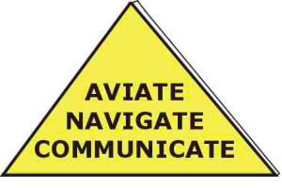
Space weather & aviation: the pilot’s mantra
Single event effects in avionics
Ionospheric effects on GNSS: range error, scintillation
Solar interference with radar & GNSS
HF blackout
Scintillation on satcom
Radiation/
Human dose

Slide 11
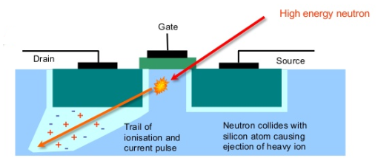
Single event effects from atmospheric neutrons
High energy ions bombard Earth’s atmosphere
Intensified during solar radiation storms
Produce significant flux of energetic & thermal neutrons
Generate energetic ions in substrate of electronic devices
Charge & E-fields can disrupt or damage device (right)
Single event effects:
Single-event upsets
Single-event transient
Single-event gate rupture
Single-event induced burnout
Single-event latchup
…
SEEs can be mitigated via resilient engineering:
Error correction codes
Parallel redundancy & voting
Very good for background radiation levels, but may be challenged during intense events

Slide 12
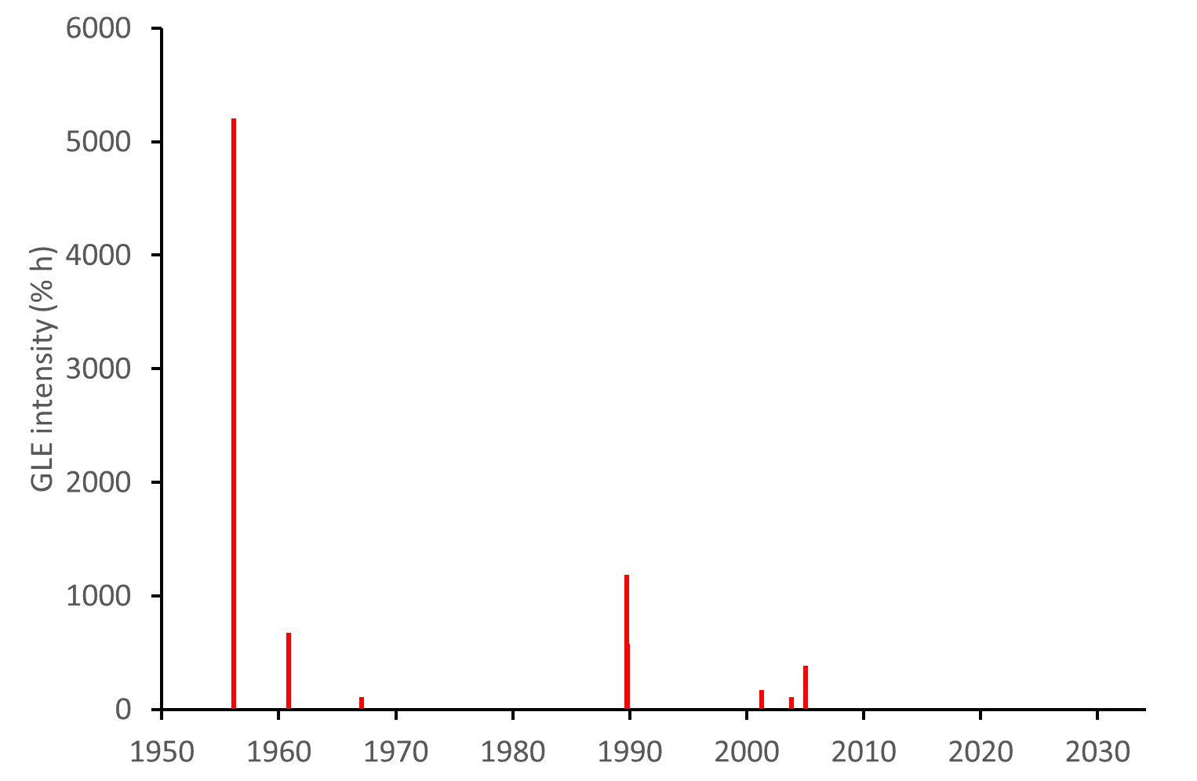
A timeline of major radiation storms
Ground-level enhancements (GLEs) = solar radiation storms detectable on surface of Earth
Showing 10 strong events (out of 49) in Oulu database
3 events in autumn 1989; also worst event experienced by satellites
Compelling evidence for much worse (x10?) on 1-in-1000 year timescales
23 Feb 1956
Quiet Sun:
2 small events in 2012 & 2017
When will it
Wake up?
2 events in Nov 1960

Slide 13
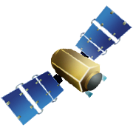
Space weather, ionosphere and aircraft comms
Plasmaspheric plume
GNSS, SBAS, ACARS,
CPDLC, Satcom, …
SPACE WEATHER CHANGES THE IONOSPHERE
Scintillation
Negative storm
IONOSPHERE
D-region blackout
HF: (fast) voice, datalink
AVIATION USES MANY RADIO TECHNOLOGIES:
Long-range systems (e.g. over oceans) send signals through the ionosphere

Slide 14
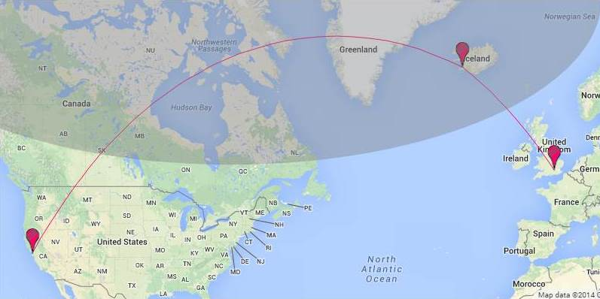
Space weather, ionosphere and aircraft comms 2
Key issues
  Blackout of HF on dayside due to large solar flares
  Magstorm-driven changes in usable HF frequencies
  Severe scintillation leading to protracted loss of signal lock for HF & L-band Satcom
  Blackout of HF in polar regions due to radiation storms
RAEng worst-case estimate is persistent loss of comms over a wide area for several days
In worst case ionosphere may be severely disturbed above 60°geomagnetic latitude
This is grey area above
LHR-SFO route also shown

Slide 15
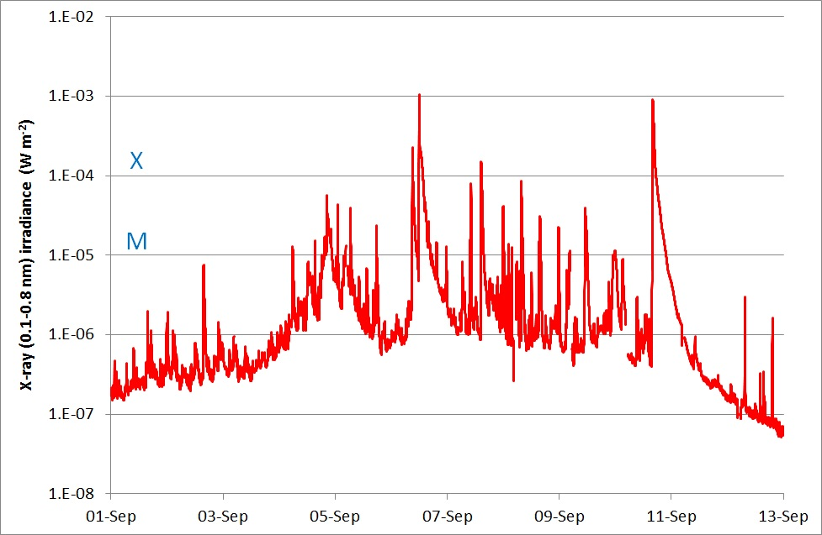
September 2017 impacts on aircraft comms & GNSS
Severe blackout of HF over UK: but no apparent impacts on despatch of flights to North America
Severe blackout of HF: disrupted emergency comms in Caribbean, AF plane lost comms for 90 mins.
NATS Oceanic control loss HF comms with significant number of aircraft
EGNOS availability impacted by radio burst, but no loss of integrity (i.e. safe)

Slide 16
Current state of play on aviation impacts
ICAO promoting space weather services for aviation
  Feed into pre-flight briefings => pilot awareness, airline awareness
  Statistical forecasting of risk of disruption (e.g. blackout) (<= L5 /L1 data)
Radiation studies
  Ongoing UK work to better understand radiation impacts on avionics (& ground)
  ChipIR facility @ RAL enabling testing of electronic systems
  Reviewing impacts on humans (also much interest in US & Germany)
  Science – work on physics (energisation & transport of radiation, forecast models)
GNSS and comms
  Rich heritage of coping with disruption from many sources (incl. space weather)
  Diversity of systems is key to resilience, e.g. multiple methods for nav & comms
  Situational awareness is a critical tool (<= L5 /L1 data)
  Science – much work to improve understanding of impacts:
    newer technologies, over all different regions of world
    case studies on (modest) 2015 and 2017 space weather events

Slide 17
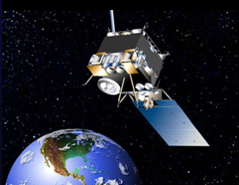
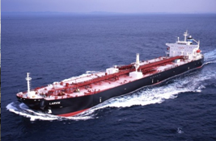
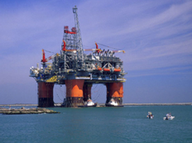


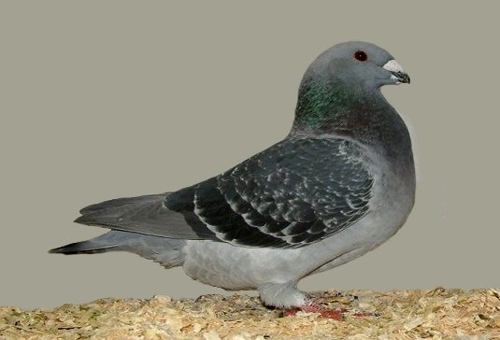
Some other impacts
Satellites: surface & internal charging, atmospheric drag, radiation, GNSS nav,
Maritime: GNSS nav, comms, telemetry (AIS @ ~162 MHz)
Resource exploitation: directional drilling, GNSS nav,
Precision agriculture: GNSS nav,
Finance: GNSS timing
Animal migration: geomagnetic activity (whales, pigeons, …)

Slide 18
Summary of key impacts & forecastable origins
Magnetospheric activity (solar wind, CMEs, high speed streams)
  Geomagnetic activity => power grids, rail, pipelines, …
  Thermospheric circulation => satellite drag
  Ionospheric storms => aviation & other transport, resource exploitation, precision agriculture, finance,
  Magnetospheric plasmas & particles => satellite charging
Radiation storms (active regions/CME shocks)
  Atmospheric radiation
  Satellite radiation effects
Solar flares/radio bursts (active regions)
  X-ray flares: hours break aircraft comms
  EUV & radio: minutes break in GNSS (common problem)
L5/L1 can track travel to Earth
L5/L1 can monitor source region => likelihood of event

Slide 19
SPARES

Slide 20
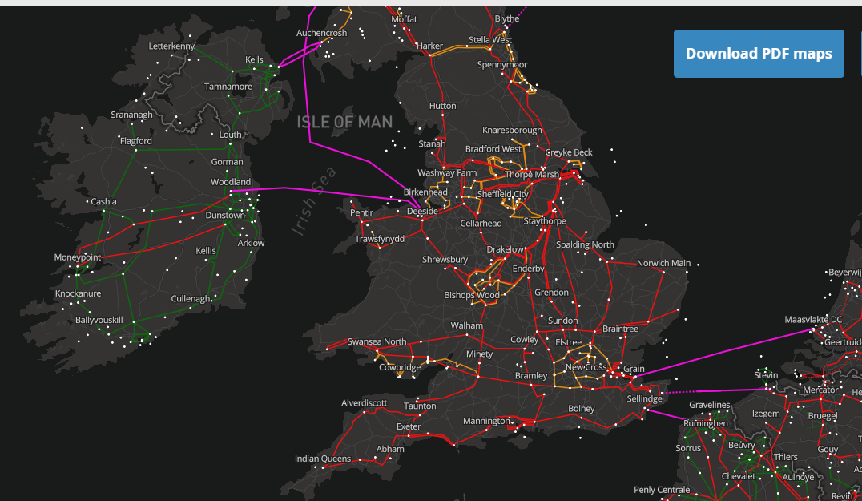
UK and neighbouring grids 2019

Slide 21
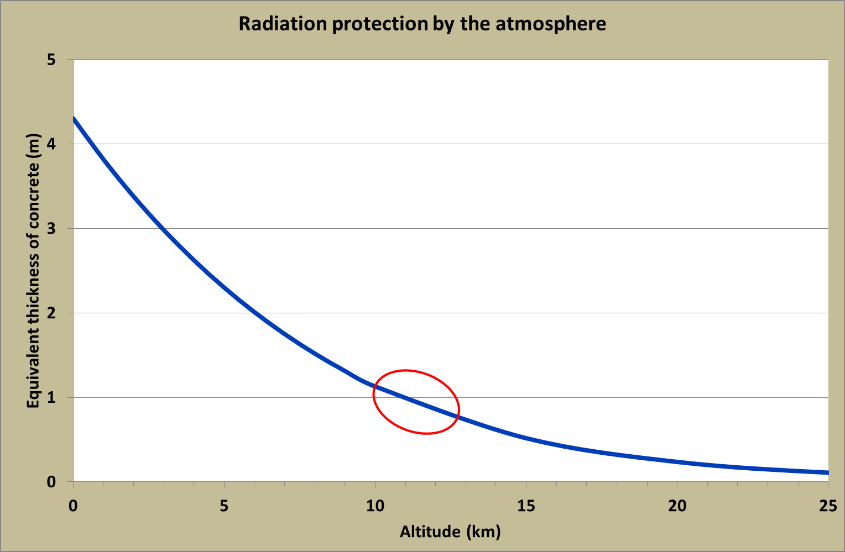
Galactic cosmic rays
Galactic cosmic rays
Solar energetic particles
RADIATION DOSES VARY WITH SPACE WEATHER/CLIMATE
Pfotzer maximum
illustrative, not definitive
AIRCRAFT FLY IN A SIGNIFICANT RADIATION ENVIRONMENT:
Natural radiation from space, more intense than natural ground environment

