Slide 1
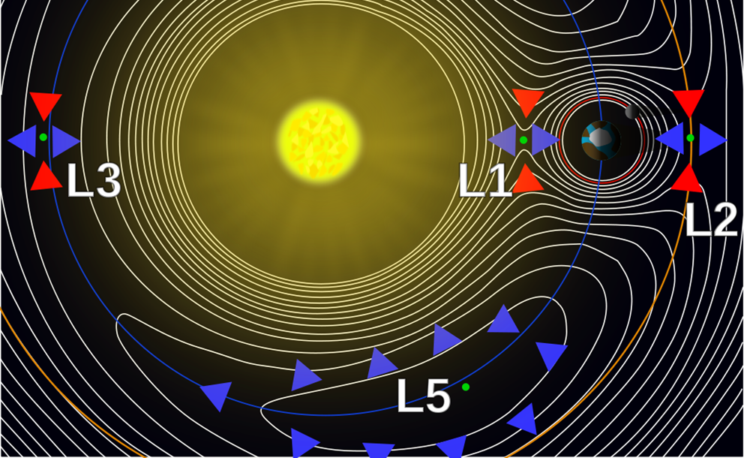

L5 in Tandem with L1: Future Space-Weather Missions Workshop – Introductions/Logistics/Welcome
Location: Department for Business, Energy & Industrial Strategy (BEIS), 1 Victoria Street, London, SW1H 0ET – 06-09 March 2017
Mario M. Bisi (1), Mark Gibbs (2), and Doug Biesecker (3)
(1) RAL Space, Science and Technology Facilities Council (STFC), Rutherford Appleton Laboratory (RAL), Harwell Campus, Oxfordshire, OX11 0QX, UK.
(2) Met Office Space Weather Operations Centre (MOSWOC), Met Office, FitzRoy Road, Exeter, Devon, EX1 3PB, UK.
(3) National Oceanic and Atmospheric Administration (NOAA ), Space Weather Prediction Center (SWPC), 325 Broadway, Boulder, CO, 80305, USA.

Slide 2
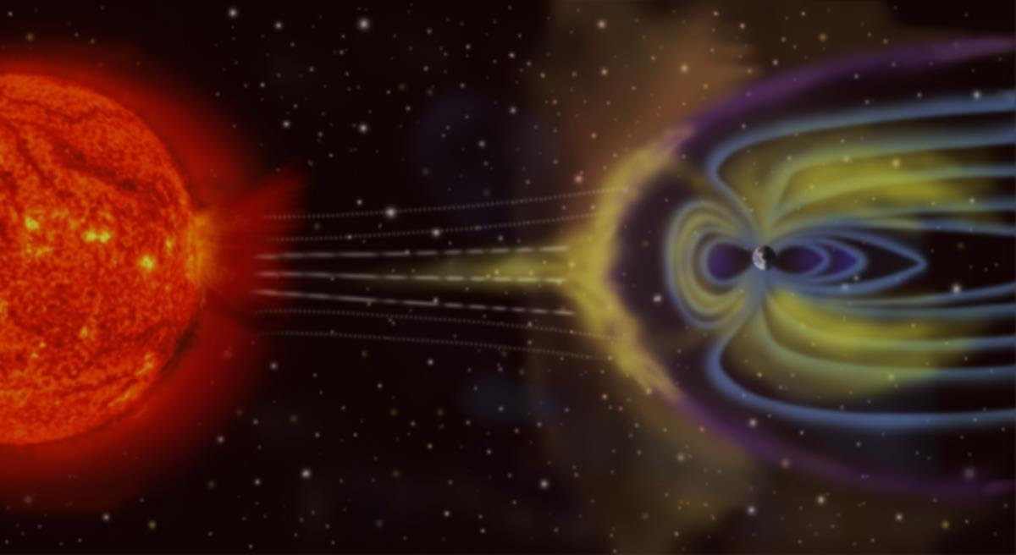
Reminder!!!
This is NOT a Conference – it is a Workshop – it’s about Operational Space-Weather Missions – so please make sure you have interaction throughout and feel free to interrupt speakers and ask questions following the talks to generate relevant discussions… Thanks! ☺

Slide 3
Goals of the Workshop?
To set the path for a dedicated L5 space-weather mission and how it might operate in tandem with a dedicated L1 DSCOVR follow-on mission.
To better define the requirements for these missions and explore how data from these missions can be effectively used to maximise their benefit in forecasting.

Slide 4
Welcome and Logistics

Slide 5
Fire/Emergency Procedures
Follow the Emergency Exit Signs.
Do not use the lifts.
Gather outside at the designated points as marked.
Wait for official advise before re-entering the building.

Slide 6
Thanks!
Thanks to the whole of the WOC and all those that helped in putting the programme together and for organising the Media Coverage and Social Media aspects of the Workshop.
Most importantly – thanks to you all for being here and for wanting to take an active part in the workshop over the next 3½ days…

Slide 7
Wi-Fi
Please connect to the SSID: _The Cloud – no password is needed to connect.
You will have to quickly create an account/register if you don’t already have a _The Cloud account – it’s free!

Slide 8
Posters, Today’s Presentations, and Notes
Posters: in here Tuesday and Thursday – please put them up using only the white tack provided by the Conference Centre and please take them down at the end of each day – thanks!
We’re still missing the next session’s presentation from: Elsayed – please quickly put them on the USB pen in the relevant session number in the break – thanks…
Session Chairs: please get someone to write-up notes for your session (to put online) and ensure that all talks/discussions are focussed on the aims of the session and the overall L5-L1 together remit; if anyone wants to redact anything from the slides and/or from the write-ups, please say so at the time.

Slide 9
Social/Online Media etc…
The Workshop #tags are: #L1L5Together #SpaceWeather – please use them both on all social-media postings.
If anyone is against photographs/videos being taken and potentially posted online – please state clearly at the start of your talk(s); similarly, as already noted, if you want anything redacted from your slides or the notes, please say (or if you want to say anything “off the record”)…

Slide 10
The Next L5 Consortium (Science) Meeting

Slide 11
Change of Dates and Location…
The next L5 (Science) Consortium Meeting will take place at the Max Planck Institute in Göttingen, 17-20 October 2017.
Please contact Nat Gopalswamy for more information: nat.gopalswamy@nasa.gov (SOC is currently being put together).

Slide 12
The Workshop Dinner…

Slide 13
Workshop Dinner (1)
This is only for those that registered for this event – there is assigned seating for the dinner – so please look at the table plans on arrival…
It is in the Milton & Keats Room at the Kingsway Hall Hotel, Great Queen Street, Holborn, London, WC2B 5BX – please arrive by 18:45h for 19:00h sit down dinner to finish by 22:30h.
From Westminster underground station, take the Jubilee (silver) Line North (or West) to Bond Street and change to the Central (red) Line East and get off at Holborn; the hotel is near to the Holborn underground station…

Slide 14
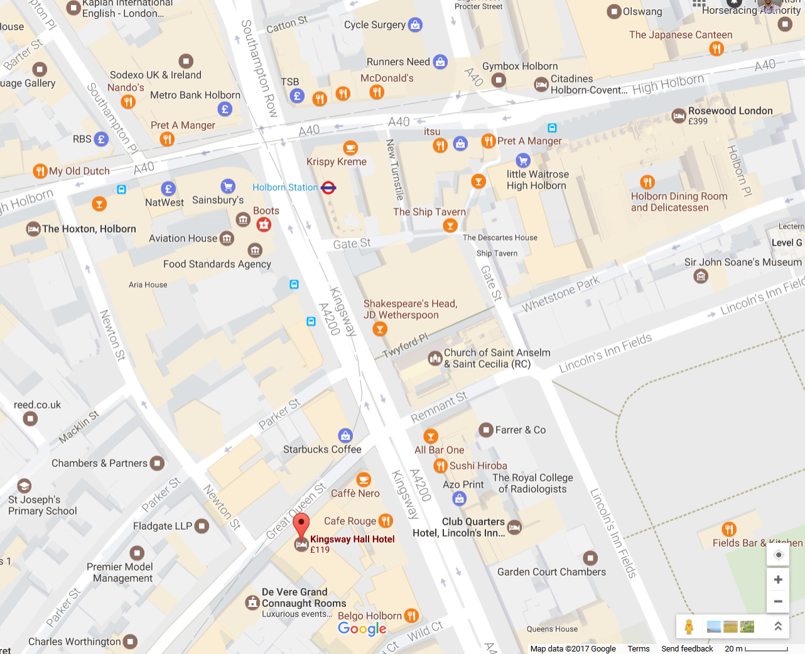
Workshop Dinner (2)

Slide 15
Have a good workshop!!! ☺

