Slide 1
Cambridge Centre for Risk Studies
Quantifying the daily economic impact of extreme space weather due to failure in electricity transmission infrastructure
Edward Oughton
06th March 2017
e.oughton@jbs.cam.ac.uk
Future Space-Weather Missions Workshop

Slide 2
Presentation Overview
Background
and motivation
Methodology
Results and
conclusions

Slide 3













Cambridge Centre for Risk Studies
Research Supporters and Academic Collaborators:

Slide 4





















Standardised Approach to All Threats
Finance, Economics and Trade
Geopolitics and Security
Market
Crash
Sovereign
Crisis
Commodity
Prices
Interstate
Conflict
Terrorism
Separatism
Conflict
Social
Unrest
Natural Catastrophe and Climate
Earthquake
Tropical
Windstorm
Temperate
Windstorm
Tsunami
Flood
Volcanic
Eruption
Drought
Freeze
Heatwave
Technology and Space
Health and Humanity
Nuclear
Accident
Power
Outage
Cyber
Attack
Solar
Storm
Human
Pandemic
Plant
Epidemic
Focus on trillion dollar scenarios

Slide 5







A Toolkit for Risk Science: Quantifying Resilience
Threat Maps
Risk Models & Output Data
Scenarios
Software Platform (Cambridge Risk Framework)
Exposure Data
Use Cases – Business Applications
Network Models
Private Portals, APIs and modeling interfaces

Slide 6
Standard Disclaimer
The scenarios presented are not predictions
They do not try to highlight any specific vulnerability in any power grid system
Exploring sensitivity to the storm impact area
A stress testing tool for risk management purposes

Slide 7

Context from the Regulator:
PRA General Insurance Stress Test 2015
  US/UK Power Outage:
  Transformer replacement time >1 month

Slide 8
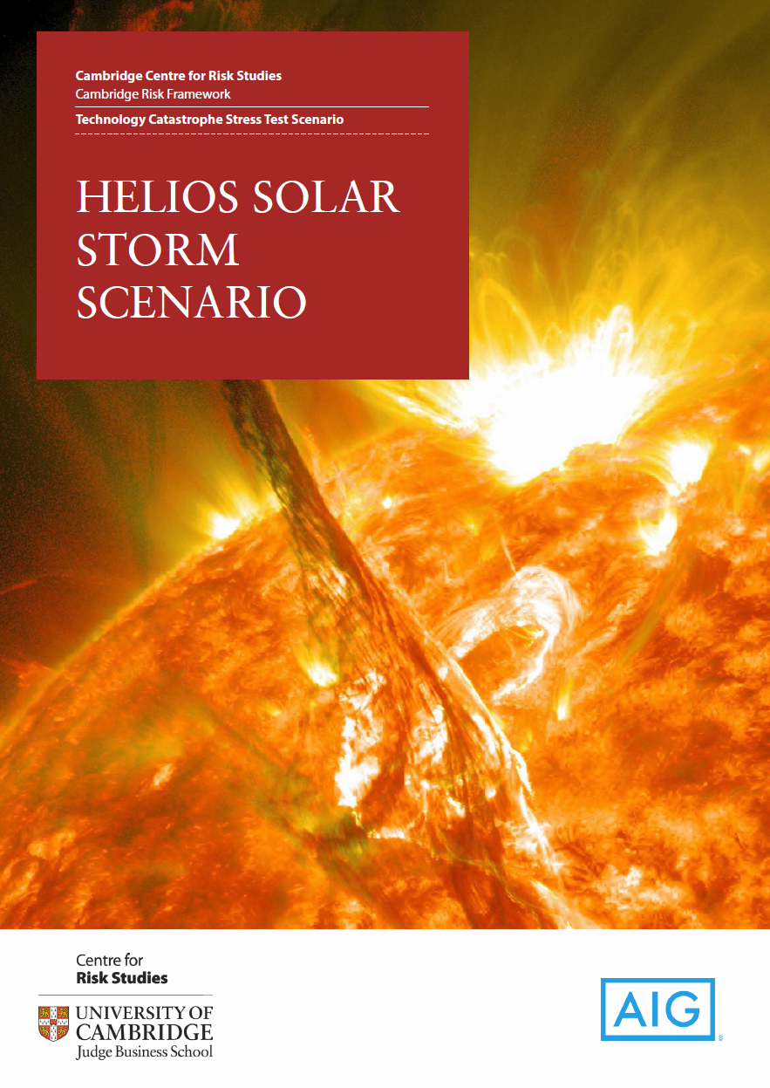
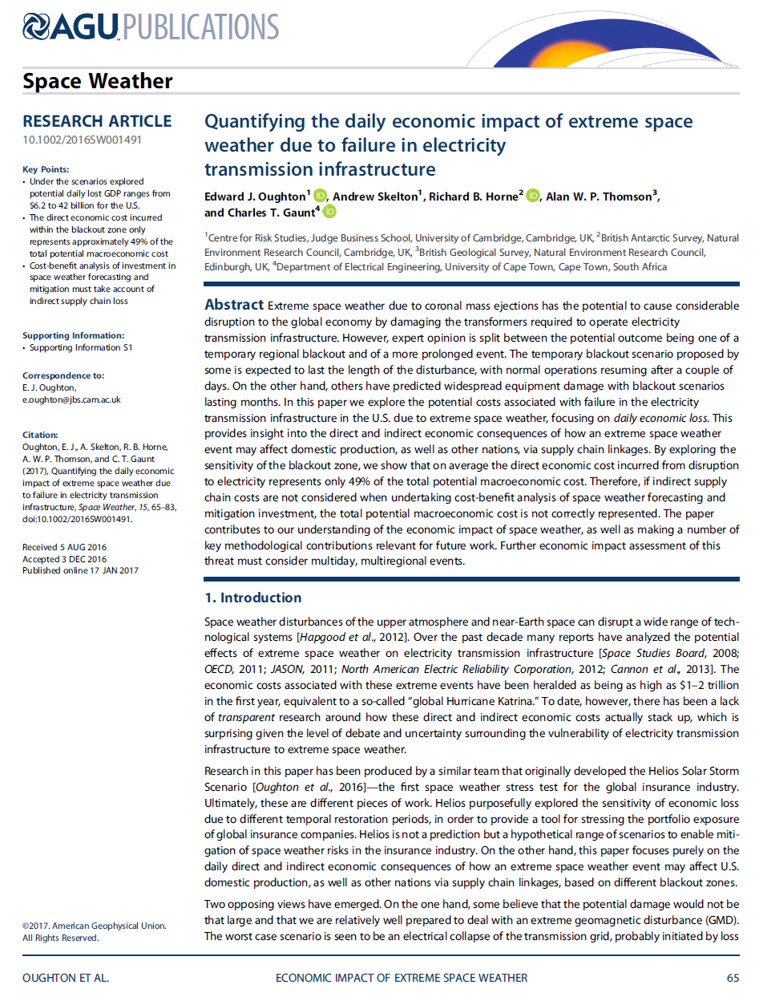
Background
Helios global insurance stress test
Academic paper
The academic paper is very different from the Helios Scenario
Helios reflects the most extreme expert opinions on space weather
It produces large numbers – the most extreme scenario is a trillion dollar event
The working paper is a more rigorous, scientific contribution
It focuses on daily economic loss, avoiding the debate over temporality
www.cambridgeriskframework.com/downloads

Slide 9
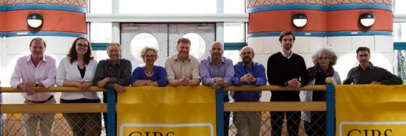
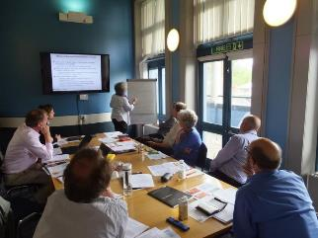
Workshop: The Economics of Space Weather
This event gathered representatives from:
Space physics
Economics
Catastrophe modelling
Actuarial science
Engineering
Law
Property, casualty and space insurance
Cambridge, 29th July 2015
Subject Matter Experts
consulted in this process:
- Richard Horne (BAS)
- Helen Mason (Cantab)
- Alan Thomson (BGS)
- Trevor Gaunt (UCT)
David Boteler (NRCan)
Mark Clilverd (BAS)

Slide 10
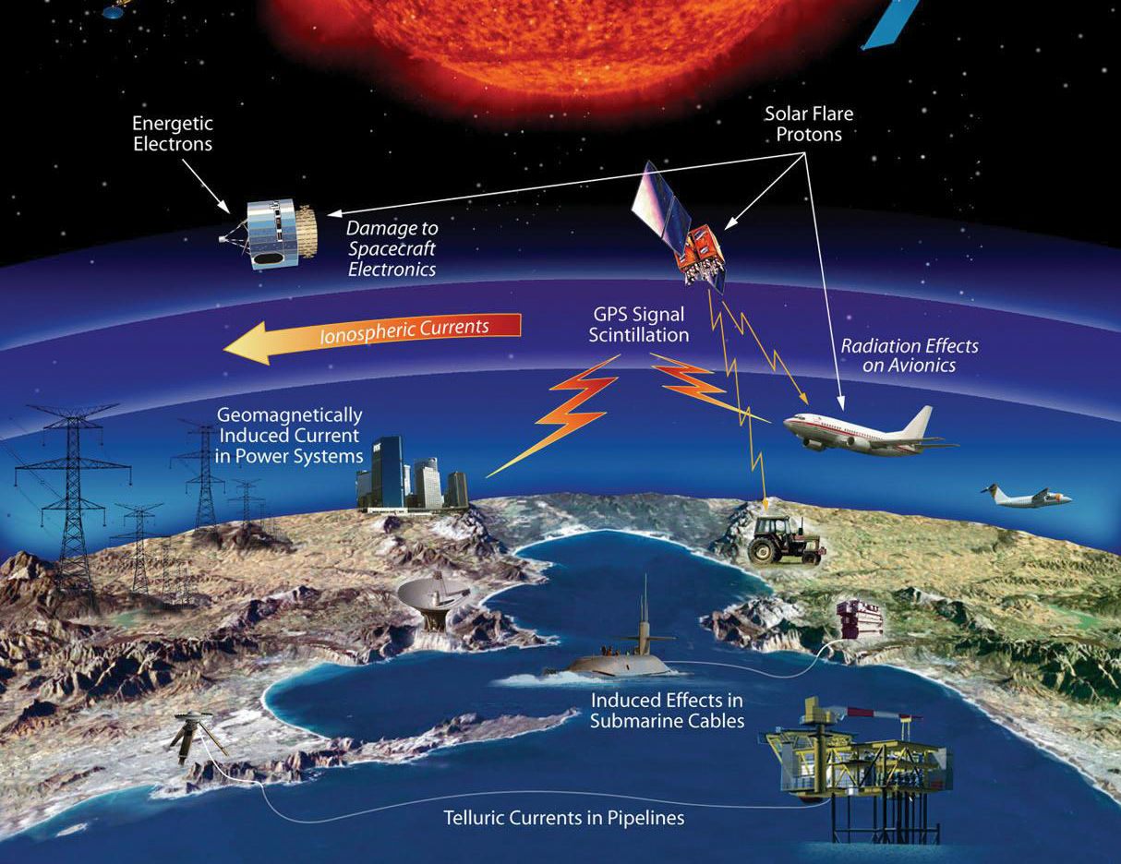
Focus: GIC Risk to Electricity Transmission Infrastructure
Credit: NASA
Notes:
GIC – potentially the most catastrophic threat to the global economy
May lead to an event in excess of $30billion for the insurance industry

Slide 11
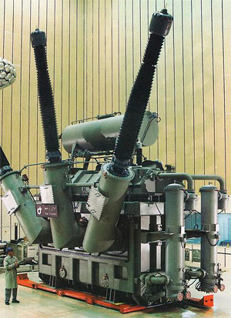
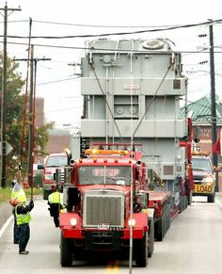
EHV Transformers: Many Supply Chain Issues

Slide 12
Motivation: Expert Opinion is Split
Extreme GIC
Temporary regional blackout
No grid instability
Wide-area grid instability / blackout
No wide-area blackout
EHV transformer assets protected
Widespread EHV transformer assets exposed
Grid back to business-as-usual within a few days
Subsequent replacement of failing transformers, lower grid resilience, local blackouts

Slide 13
Methodology
Determining blackout zone by scenario;
Calculating the direct economic impact by state;
Aggregating the direct economic impacts by state to national industry-specific impacts;
Estimating indirect domestic and global economic impact.
We focus on the USA for a number of reasons including absolute economic size, insurance penetration, regulatory emphasis etc.

Slide 14
Step 1: Determining Blackout Zone by Scenario
dBh/dt = 435 nT/min
(Natural Resources Canada, 2016)
Notes:
Ottawa is used as an example of a mid latitude station in the region affected by the 1989 Quebec event.
Here we can see the variation of the magnetic field during the GMD event
The network failed in the early morning when the dB/dt measurement was approximately 435 nT/min.
Although larger measurements above 435 nT/min were recorded later in the day without progressing to complete voltage collapse in other networks, several large transformers were damaged.
Large modern networks appear to be less robust than 30 years ago, therefore we assume that dB/dt values above 400 nT/min (well below the values expected in extreme events) lead to equipment damage or power system voltage collapse or both.

Slide 15
Step 1: Determining Blackout Zone by Scenario
During a major magnetic storm, multiple substorms can take place (Tsurutani et al. 2015)
Rapid changes in the ionosphere lead to the large dB/dt values inducing GICs
Auroral electrojet: enhanced channel of electrical conductivity
dB/dt assumed to be ~ 5,000nT/min at 50° geomagnetic latitude
Therefore, for the purposes of our model we assume that the region of maximum dB/dt occurs inside the auroral electrojet.

Slide 16
Step 1: Determining Blackout Zone by Scenario
The latitudinal width of the most intense disturbance in the auroral region is narrow (Pulkkinen et al. 2012)
Electrojet location: Usually near 72° geomagnetic latitude (Rostoker and Duc Phan, 1986)
Even under extreme conditions where the region moves equatorward, the latitudinal width remains almost constant at 5.5° - 6° (Ibid.)
We assume that dB/dt for these extreme event scenarios is large enough to affect the power grid across a 5.5° GMD footprint.

Slide 17
Step 1: Determining Blackout Zone by Scenario
dBh/dt could be larger at sub-auroral latitudes than auroral latitudes (Wintoft et al. 2016)
Observations suggest that the electrojet extended down to 54°-55° geomagnetic latitude during the intense magnetic storm of May 1992 (Feldstein et al. 1997)
Extreme storms: Difficult to assess electrojet movements equatorward
Electrojet may move to 50°, with the magnitude of the geoelectric field dropping significantly between 40°-50° (Pulkkinen et al. 2012).
Given this uncertainty we assume four scenarios in geomagnetic latitude bands 55°±2.75° (S1), 50°±2.75° (S2) and 45°±2.75° (S3), 50°±7.75° (S4)

Slide 18
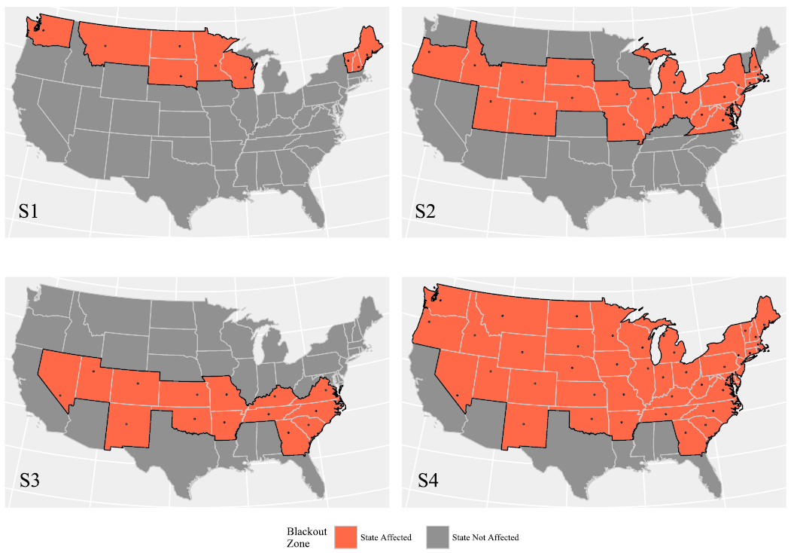
Step 1: Blackout Zone by Scenario
States included in each scenario based on the geomagnetic latitude of the (weighted) population centre

Slide 19

Direct and Indirect Economic Impacts
Blackout Zone
Firm 2a
(no power)
Disrupted electricity supply
Electricity
Network
Operator
Disrupted electricity supply
Firm 2b
(no power)
Blackout zone

Slide 20
Direct and Indirect Economic Impacts
Upstream
Blackout Zone
Downstream
Firm 1a
Cannot sell
to Firm 2a
Firm 2a
(no power)
Firm 3a
Cannot buy from
Firm 2a
Domestic supply chain
Disrupted electricity supply
Electricity
Network
Operator
Disrupted electricity supply
Firm 2b
(no power)
Blackout zone

Slide 21
Direct and Indirect Economic Impacts
Upstream
Blackout Zone
Downstream
Firm 1a
Cannot sell
to Firm 2a
Firm 2a
(no power)
Firm 3a
Cannot buy from
Firm 2a
Domestic supply chain
Disrupted electricity supply
Electricity
Network
Operator
Upstream
Disrupted electricity supply
Downstream
International supply
chain
Firm 1b
Cannot sell
to Firm 2b
Firm 2b
(no power)
Firm 3b
Cannot buy from
Firm 2b
Blackout zone

Slide 22
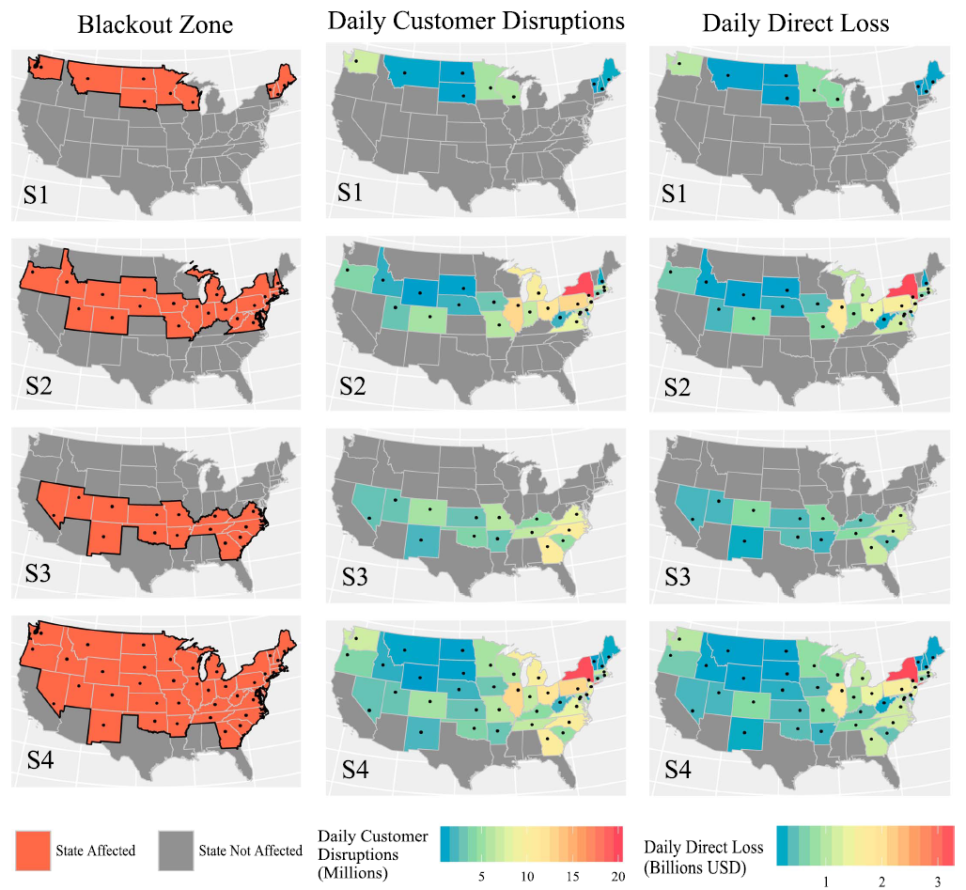
Step 2: Calculating the Direct Economic Impact

Slide 23
Step 2: Calculating the Direct Economic Impact
Step 3:
Aggregation

Slide 24
Step 4: Estimating Indirect Economic Impact
Intermediate purchases ($)
Intermediate purchases ($)
Final
purchases ($)
Businesses
Businesses
Businesses
Households
+ Government
+ Capital investment
Payments for labour ($)
Payments for labour ($)
Payments for labour ($)
+ other VA
+ other VA
+ other VA
Production layer 3
Production layer 2
Production layer 1
Final demand

Slide 25

Step 4: Estimating Indirect Economic Impact
Supply-side
Ghosh IO model
Classic Leontief
IO model
Intermediate purchases ($)
Intermediate purchases ($)
Final
purchases ($)
Businesses
Businesses
Businesses
Households
+ Government
+ Capital investment
Payments for labour ($)
Payments for labour ($)
Payments for labour ($)
+ other VA
+ other VA
+ other VA
Production layer 3
Production layer 2
Production layer 1
Final demand

Slide 26
Daily Economic Loss by Scenario
$7 bn
$42.4 bn
$18.7 bn
$48.5 bn
Economic loss ($bn)

Slide 27
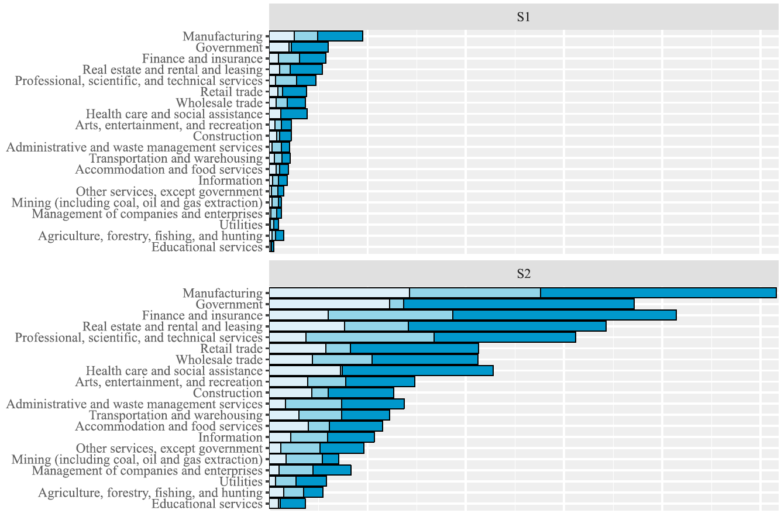
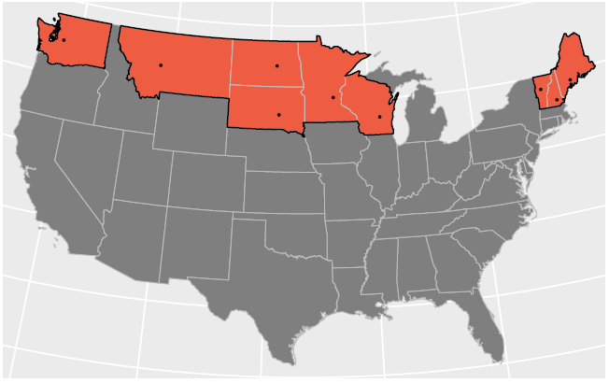
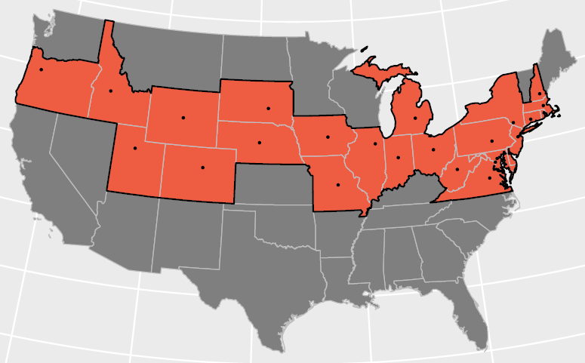
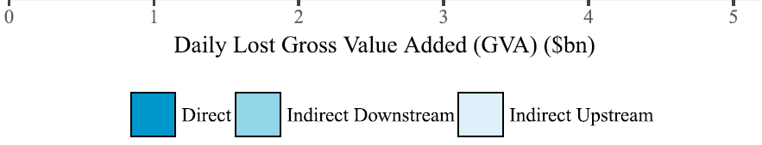
S1/S2 Impact by Industrial Sector
55°±2.75° Geomagnetic
50°±2.75° Geomagnetic

Slide 28
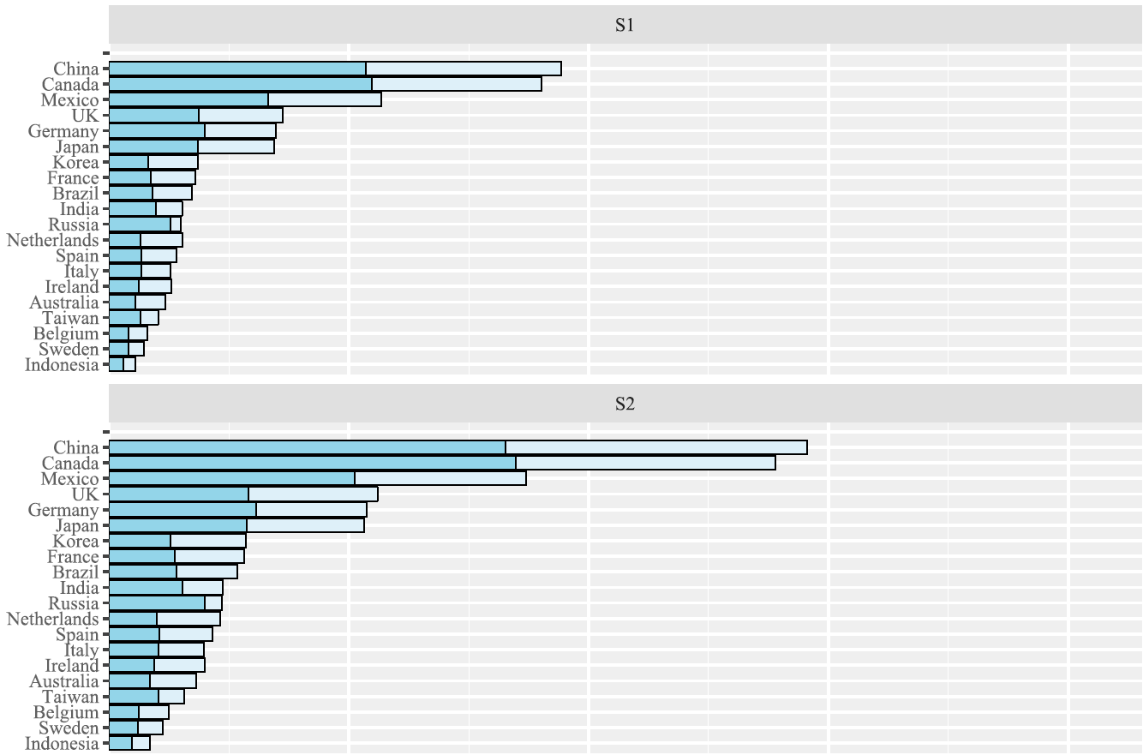
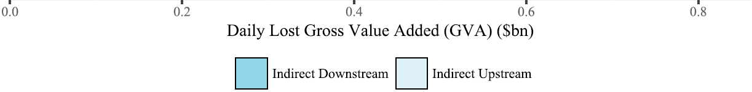
S1/S2 Impact by International Supply Chain
55°±2.75° Geomagnetic
50°±2.75° Geomagnetic

Slide 29
Conclusions of the Academic Paper
The direct economic cost incurred within the blackout zone only represents approximately half of the total potential macroeconomic cost
Cost-benefit analysis of investment in space weather forecasting and mitigation must take account of indirect domestic and international supply chain loss

Slide 30
Threat Cascade Matrix – Cascading Threats
Consequential Threat
Finance,
Economics
& Trade
Geopolitics
& Security
Natural
Catastrophe
& Climate
Primary Trigger
No causal linkage
No significant ability to exacerbate
No causal linkage, but would exacerbate consequences if they occur
Weak potential
to trigger threat occurrence
Technology
& Space
Strong potential
to trigger threat occurrence
Ability to trigger
Other threats within same type class
Health
& Humanity

Slide 31
Conclusions
The contribution of this research includes:
  A tool for industry and government to understand potential daily loss
  Kick-starting more dialogue between physicists, geophysicists, electrical engineers and economists, insurers, actuaries etc.
  Framing space weather impact in monetary terms makes this accessible to a whole new audience who want to know the potential risk
Work in progress: Multi-region global scenarios

Slide 32
e.oughton@jbs.cam.ac.uk

