Slide 1


P2-SWE-X Enhanced Space Weather Monitoring System
Reuben Wright
Deimos Space UK Ltd.
06.03.2017, London

Slide 2
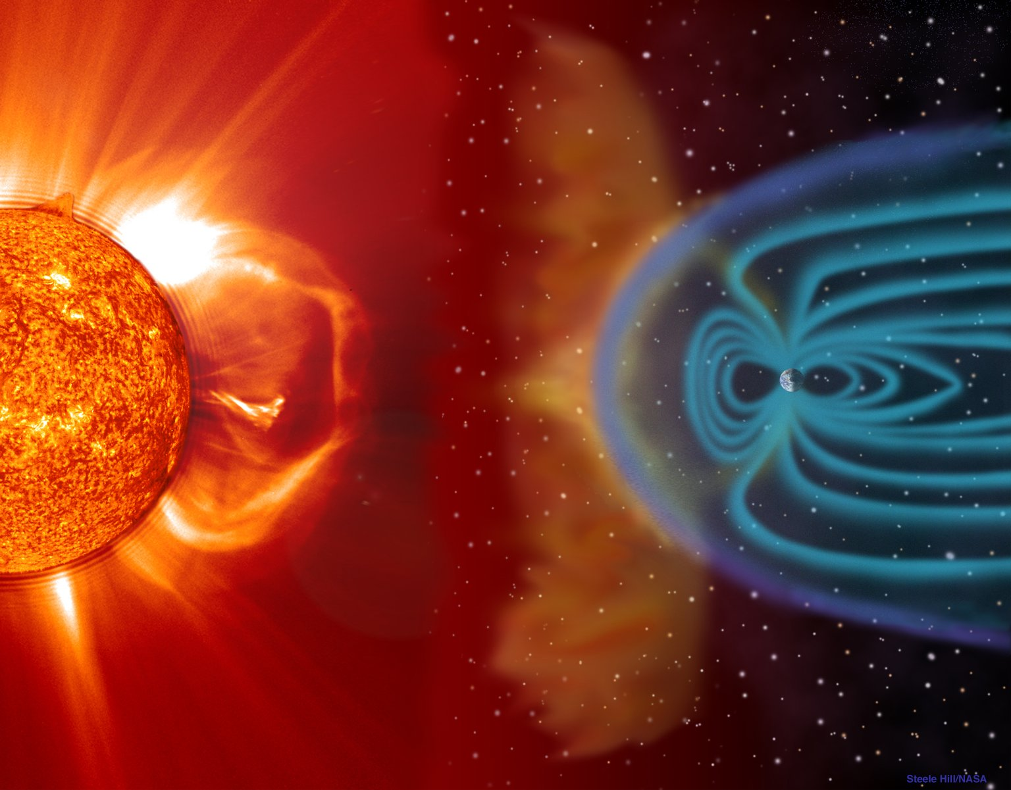



P2-SWE-X
Study Overview

Slide 3
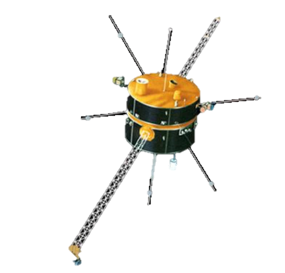
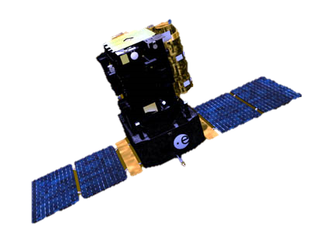
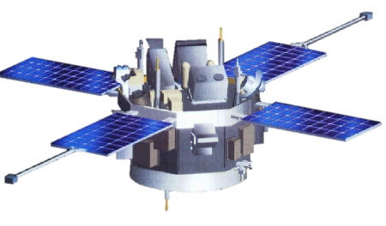
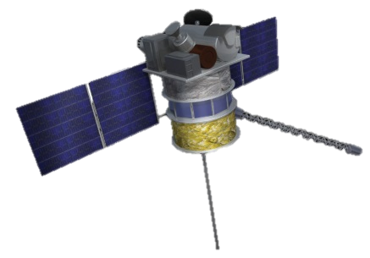
P2-SWE-X
Mission Heritage
Spacecraft that currently enable monitoring of solar events and/or the IMF and solar wind from the L1 point are beyond their original design life time
Wind (NASA)
SOHO (NASA/ESA)
ACE (NASA)
DSCOVR (NASA)
Image Credit: NASA
Image Credit: ESA
Image Credit: NASA
Image Credit: NOAA
Launch Date
1994
1995
1997
2015
Continuous observations from L5 have not been implemented thus far
Would significantly enhance space weather forecasting capabilities by observing the state of that region of the solar surface yet to rotate in the L1 field of view

Slide 4
Enhanced Space Weather Monitoring System
L1 Mission Objectives
Primary Objectives:
To enable geomagnetic storm forecasting with lead times of up to 12 hours and sufficient forecast accuracy to enable end users and emergency managers to take concrete preparatory actions to mitigate the potential impact
To monitor solar energetic particles impacting the terrestrial system.
To enable quicker identification of the above space weather types through real-time operational data flow.
Secondary Objectives:
To enable the monitoring of developing solar activity that might be associated with potentially Earth-impacting events, allowing assessment of the likelihood of impact.
To provide stable, continuous space weather data for additional model development and underpinning space weather research, such as potential transient activity predictions.

Slide 5
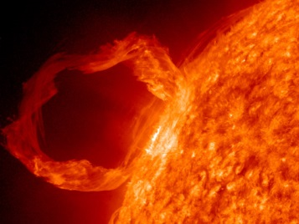
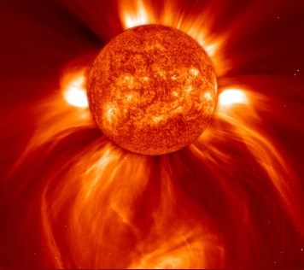
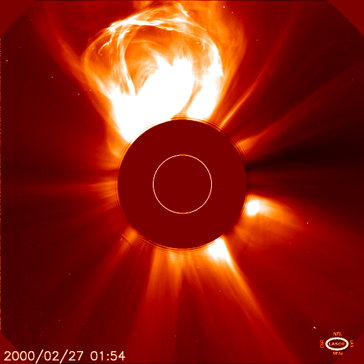

Enhanced Space Weather Monitoring System
L5 Mission Objectives
Primary Objectives:
To enable geomagnetic storm forecasting with lead times of up to 12 hours and sufficient forecast accuracy to enable end users and emergency managers to take concrete preparatory actions to mitigate the potential impact.
To enable the assessment of developing solar activity with the potential for Earth-impact, including the assignment of likelihood of flaring and, in particular, through the monitoring of active regions development up to 4-5 days beyond the East limb as viewed from near-Earth.
To enable quicker assessment of Earth-directed CMEs through real-time operational data flow.
Secondary Objectives:
To monitor low energy ion signatures at L5 that may indicate an Earth-directed CME shock.
To provide stable, continuous space weather data for additional model development and underpinning space weather research, such as potential transient activity predictions.

Slide 6
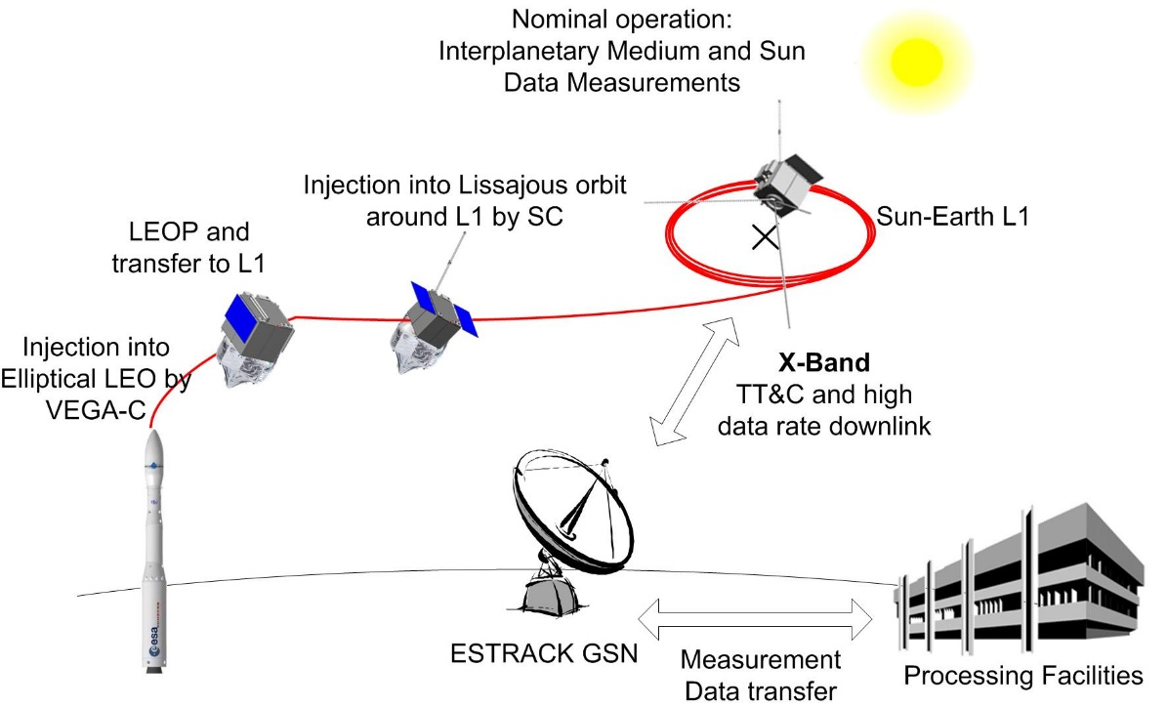
L1 Mission Architecture: Overview
P2-SWE-X

Slide 7
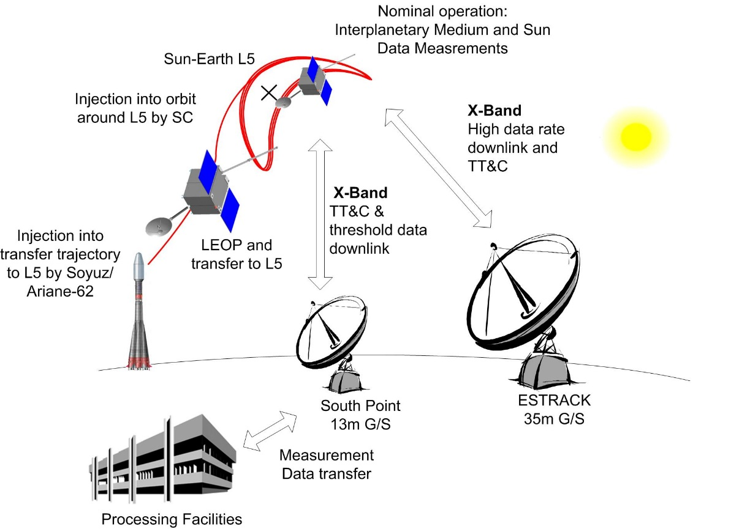
L5 Mission Architecture: Overview
P2-SWE-X

Slide 8
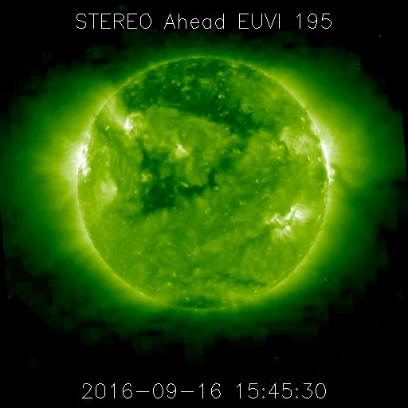
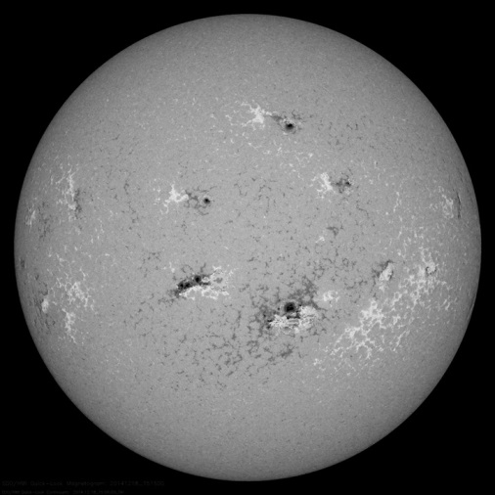
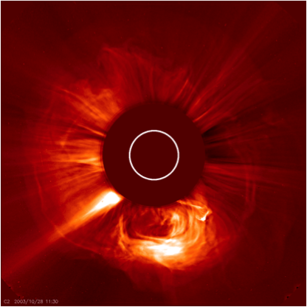
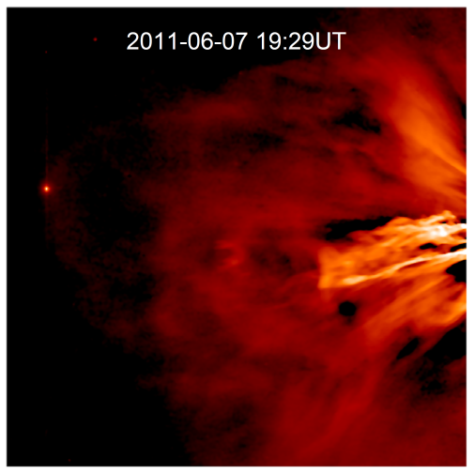
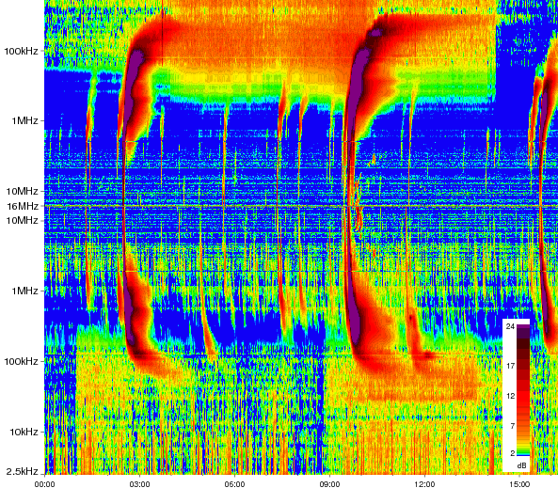
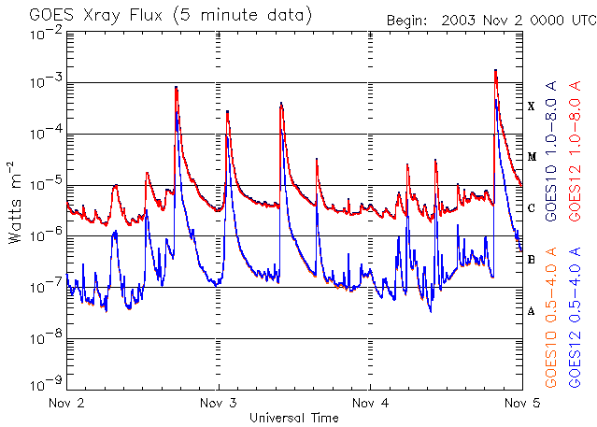
Enhanced Space Weather Monitoring System
Observations and Instruments
EUV Imager
Magnetograph
The payloads are designed to:
Monitor solar activity and active regions,
Monitor CME and SIR prorogation from the Sun to the Earth
Monitor radiation storms, and
Provide data for forecasting modelling
Coronagraph
Heliospheric Imager
Radio Spectrometer
X-ray Detector

Slide 9
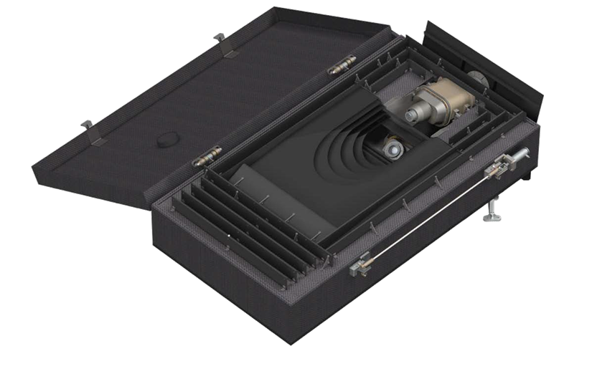
Enhanced Space Weather Monitoring System
Instruments
The following instruments have been selected to deliver the required mission observations:
Magnetometer
Solar Wind Plasma Analyser.
Magnetograph
EUV Imager
Coronagraph
Heliospheric Imager
X-Ray Detector
Radio Spectrometer
Energetic Particle instruments
HI Instrument

Slide 10
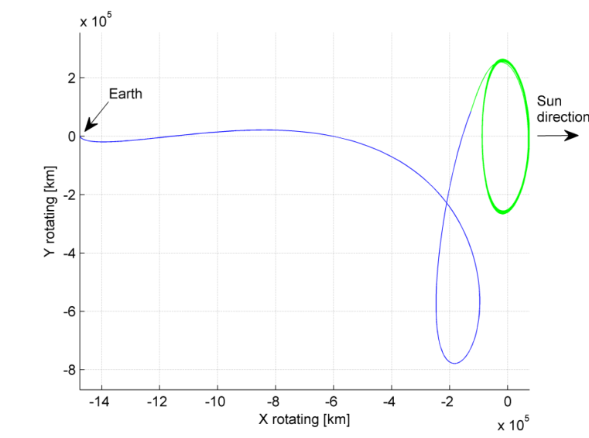
Enhanced Space Weather Monitoring System
L1 Baseline Orbit
The orbit has been chosen based on the following constraints :
Remain within 60 Earth radii of the Sun-Earth line to get the most representative in situ measurements
Avoid orbits too close to the Sun-Earth line to minimize inferior conjunctions leading to communication black-outs
A Lissajous orbit with amplitude < 60 RE is therefore chosen as the baseline
Transfer trajectory optimised to reach the small amplitude orbit while still minimising orbit injection delta-V

Slide 11
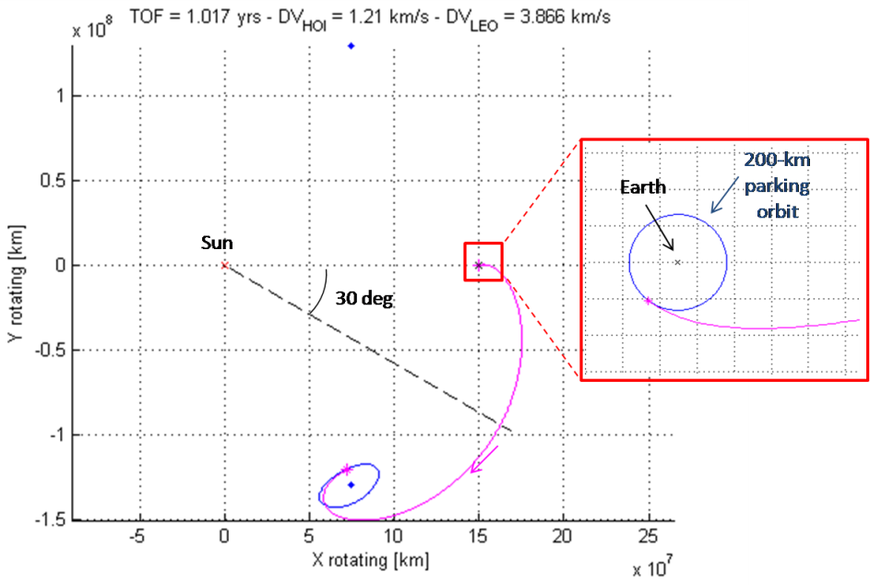
Enhanced Space Weather Monitoring System
L5 Baseline Orbit
Observations require an orbit located at least 30° away from the Sun-Earth line such as: heliocentric drifting orbits, horseshoe orbits and short period L5 orbits.
The short period L5 orbits were chosen as baseline primarily due to their long-term stability
A transfer time of 1 year is selected to reach a small amplitude orbit at L5:
This was established as a good compromise between transfer time and delta-V

Slide 12
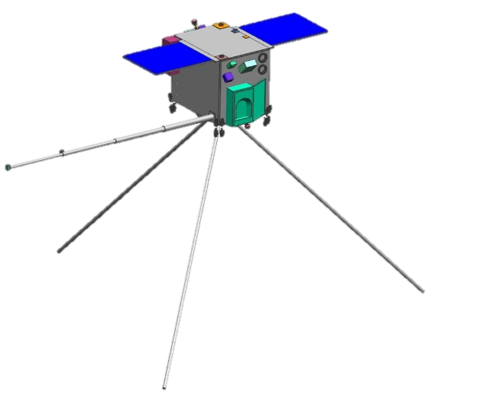
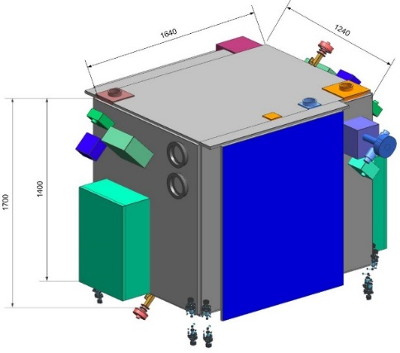
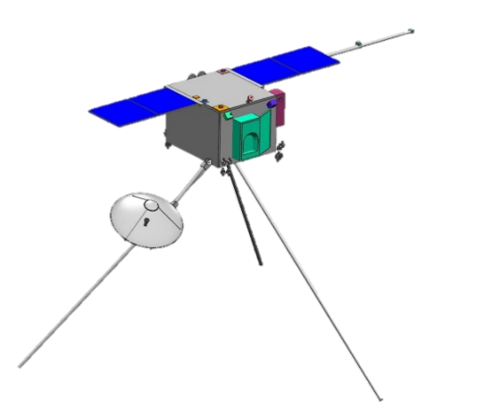
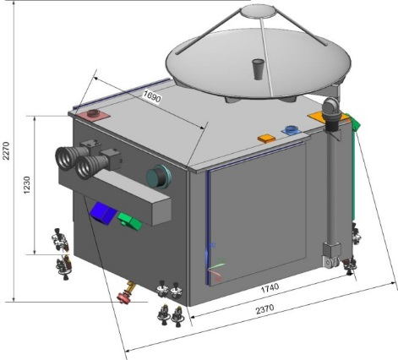
Enhanced Space Weather Monitoring System
Spacecraft Design Constraints
The design is able to accommodate all instruments so that the mission objectives can be fulfilled:
The remote sensing instruments need an unobstructed field of view towards the Sun and no straylight in aperture
The HI instruments have a deployable door and an internal radiator
The magnetometers have to be accommodated far away from the S/C body due to magnetic cleanness reasons
The radiation monitor and high energetic particle instruments have to be accommodated on the outside of the S/C in order to capture radiations traveling along from the Parker Spiral
L1 Spacecraft
L5 Spacecraft

Slide 13

Enhanced Space Weather Monitoring System
Spacecraft Key Features
 | L1 S/C | L5 S/C
Total mass (w. margin) | 551,5 kg | 948,6 kg
Structure | 937 mm interface ring with double shear web structure
Propulsion | Monoprop Hydrazine | Biprop MON and MMH
TTC | X-band, 2 LGA, 1 MGA, >213 kbps | X-band, 2 LGAs, 1 HGA, >190 kbps
OBDH | OBC (w. Flash MMU), RTUs, SW router
AOCS | 3-axis stabilized, full set of sensors + actuators
Thermal | MLI, radiators, heaters
Power | 3,17 m² solar array, 28V, Li-ion battery | 4,05 m2 solar array, 28V, Li-ion battery
L1 Spacecraft
L5 Spacecraft

Slide 14
Implementation Schedule
P2-SWE-X
Assumptions:
Decision at MC16 for A/B1 & B2
Phase A/B1 12 months
Phase B2 12 months
Decision at MC19 for implementation
Phase C/D 36 months
Contingency 3 months
Launch in November 2023
2017
2018
2019
2020
2021
2022
2023
Start Do 01.12.16
SWE-X Phase A/B/C/D 01.12.16 - 08.11.23
Finish Mi 08.11.23
Phase A/B1 22.05.17 - 26.07.18
Phase B2 14.01.19 - 18.03.20
Phase C/D 15.06.20 - 27.06.23
Contingency 28.06.23 - 14.09.23
Kick-Off Phase A/B1 19.05.17
SRR K/O 01.10.18
Kick-Off Phase C/D 12.06.20
CDR K/O 27.05.21
FAR K/O 31.03.23
MC16 01.12.16
MC19 01.10.19
Launch 08.11.23

Slide 15



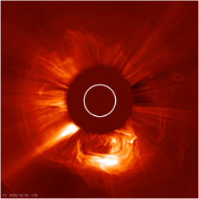

P2-SWE-X
Conclusions
The study has derived mission and P/L requirements
Architectures for both missions have been selected and analysed after detailed trade-offs
Launch strategies and orbits were clearly identified
It was shown that the current outline of the satellite and ground stations system definition can be based mostly on European heritage, and a start of the mission is feasible as soon as 2023
Both spacecraft have been designed so that the missions can fulfil their primary and secondary objectives, and enable a continuous and timely downlink of the data acquired by the payloads

Slide 16
P2-SWE-X
QUESTIONS?
reuben.wright@deimos-space.com

