Slide 1
Off Sun-Earth line data usage in CCMC/SWRC space weather service to NASA robotic mission operators
Pulkkinen, A., M. Kuznetsova, Y. Zheng, L. Mays and A. Wold
Notes:
Off Sun-Earth line data usage in CCMC/SWRC space weather service to NASA robotic mission operators
Pulkkinen, A., M. Kuznetsova, Y. Zheng, L. Mays and A. Wold
CCMC/SWRC operating at NASA Goddard Space Flight Center addresses NASA’s unique space weather needs. One of the unique needs pertains to the fact that NASA operates assets throughout the heliosphere thereby necessitating a service that characterizes solar system-wide space weather conditions. For this, off Sun-Earth line STEREO imaging and in situ observations together with heliospheric CME simulations have played a major role in allowing CCMC/SWRC to build the service to its end-users.
In this presentation, we will discuss the key elements of the CCMC/SWRC service to NASA missions and outline the key challenges posed by the end-user’s unique space weather needs. We will also demonstrate how the team has used off Sun-Earth line observational capacity to move toward heliosphere-wide space weather characterization and forecasting capacity. Implications of possible future L5 mission executed in conjunction with “sister” L1 platforms are discussed as well.

Slide 2
Outline
Overview of research-based space weather services at CCMC/SWRC
Lessons learned from monitoring & forecasting space weather conditions throughout the solar system
The significance of L5 measurements for improving space weather forecasting & analysis
Notes:
The usefulness/significance of L5 measurements for improving space weather forecasting/monitoring
Will be detailed through our existing practice and future needs

Slide 3

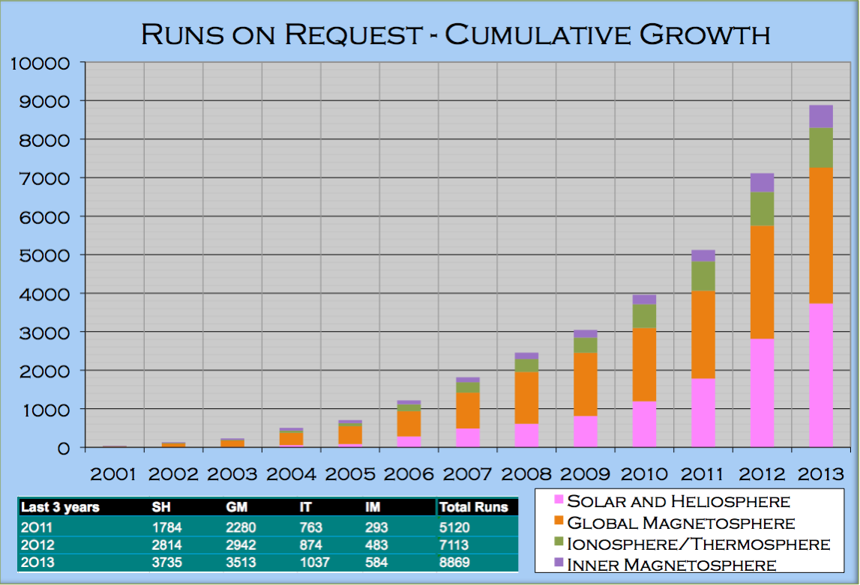



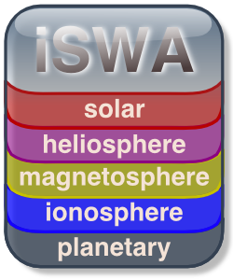

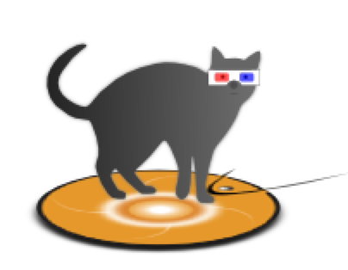


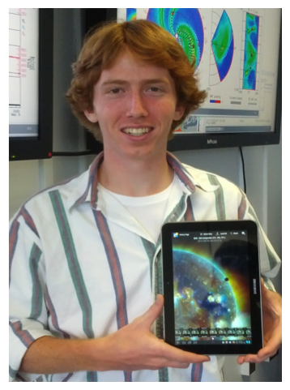

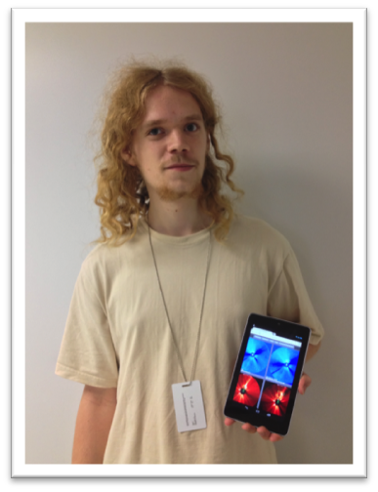

CCMC Assets & Services
Models
Simulation
Services
Assessment
Skill Score
(> 16,000 runs)
(expanding collection: > 80)
Scoreboard
SWx Tools
Flexible Infrastructure Databases
Actionable Displays
Space Weather
Services
for NASA’s missions
Hands-on
Education
Space Weather Research Center
Notes:
SWRC established in 2010 as research-based operations team to provide customized space weather services to NASA’s robotic missions. In addition:
- interfaces with end users of all stripes to determine what CCMC needs to develop
- leads educational and outreach efforts (e.g., Space Weather Boot camp)
- test drivers of CCMC models and products
- gives feedback to model developers

Slide 4
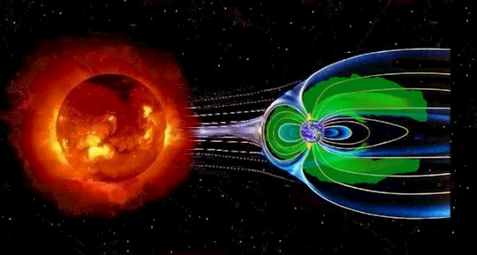
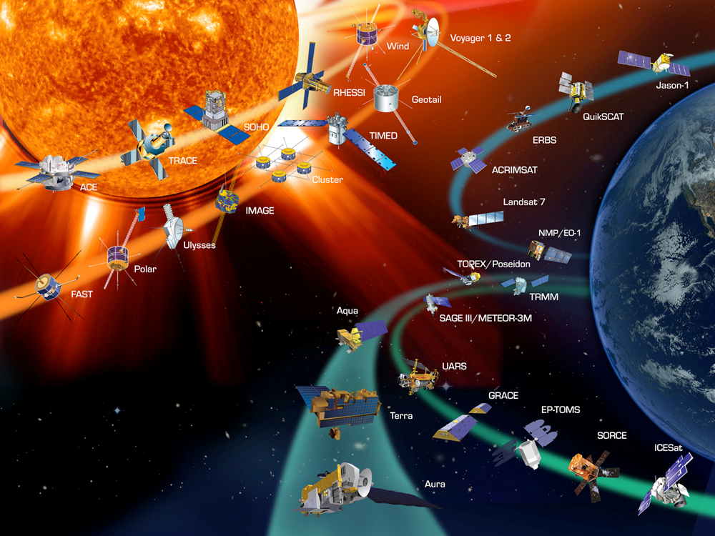
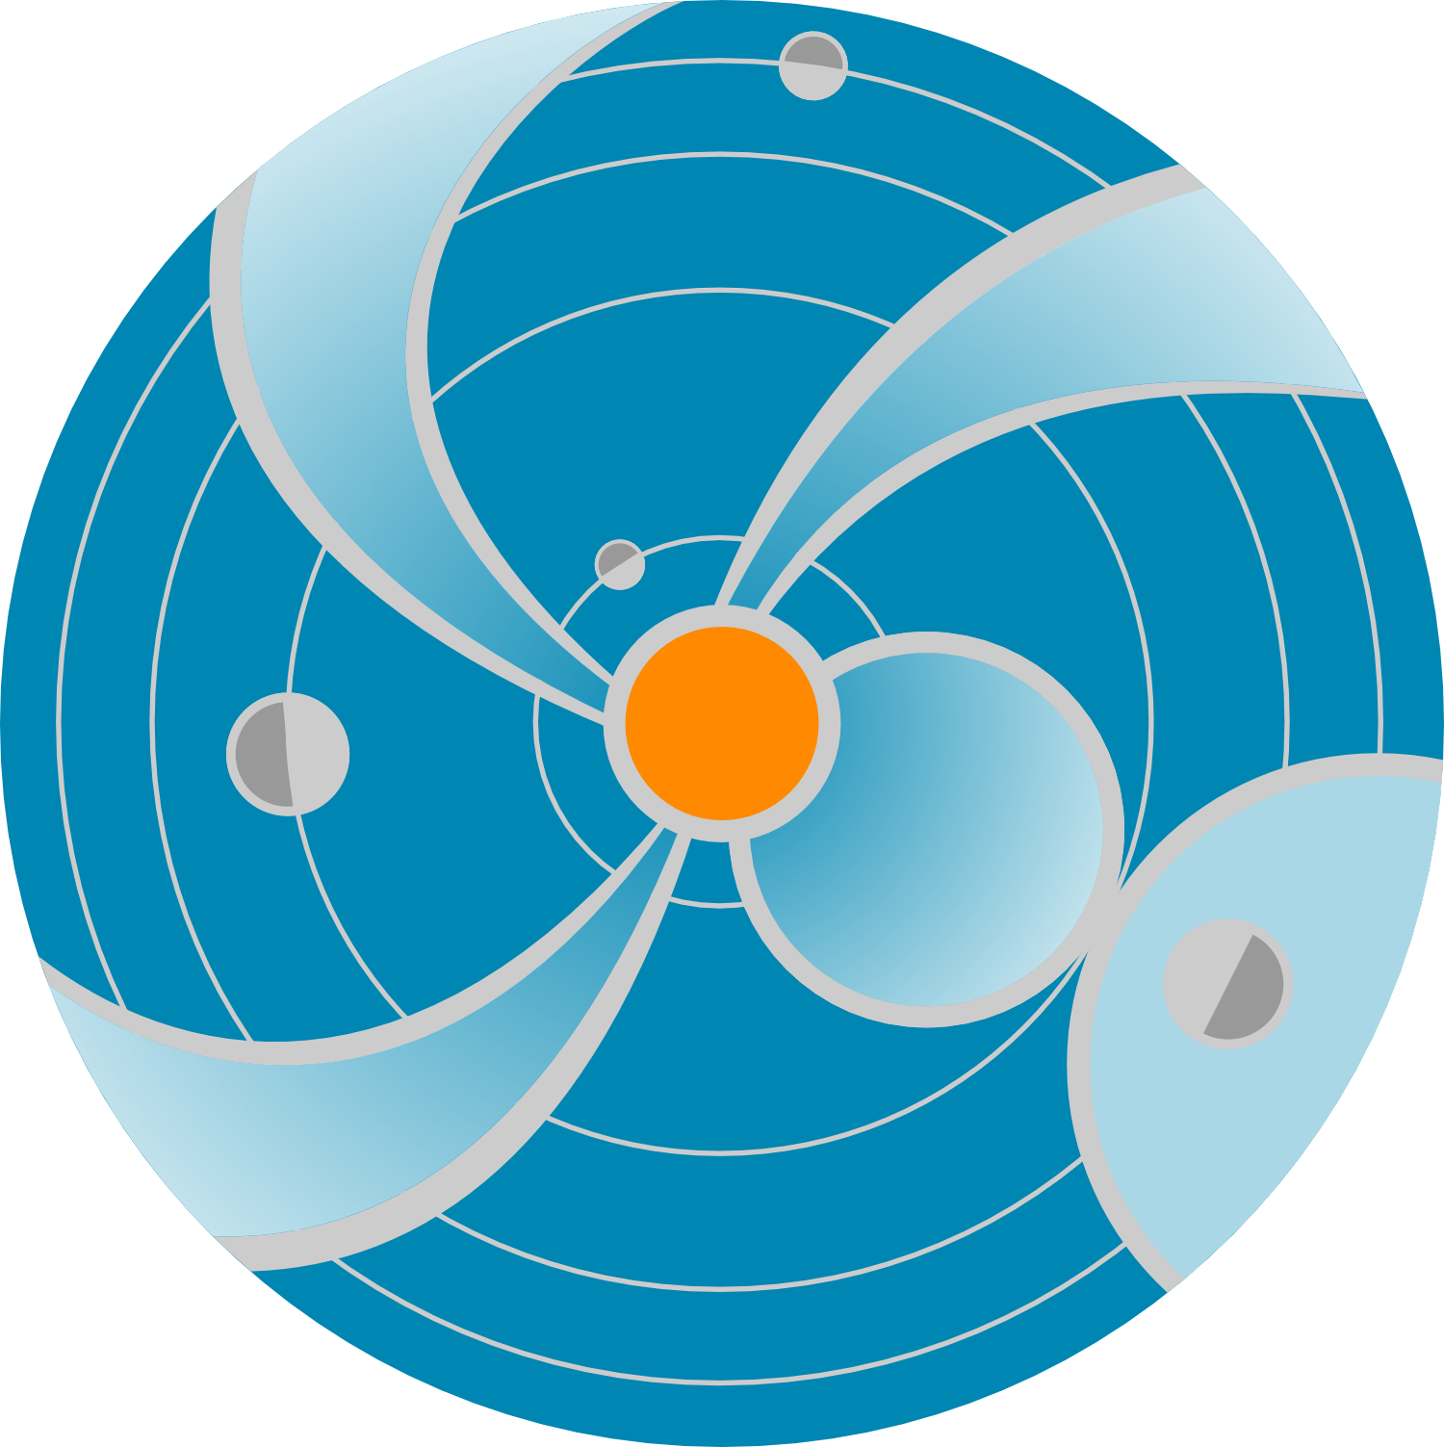
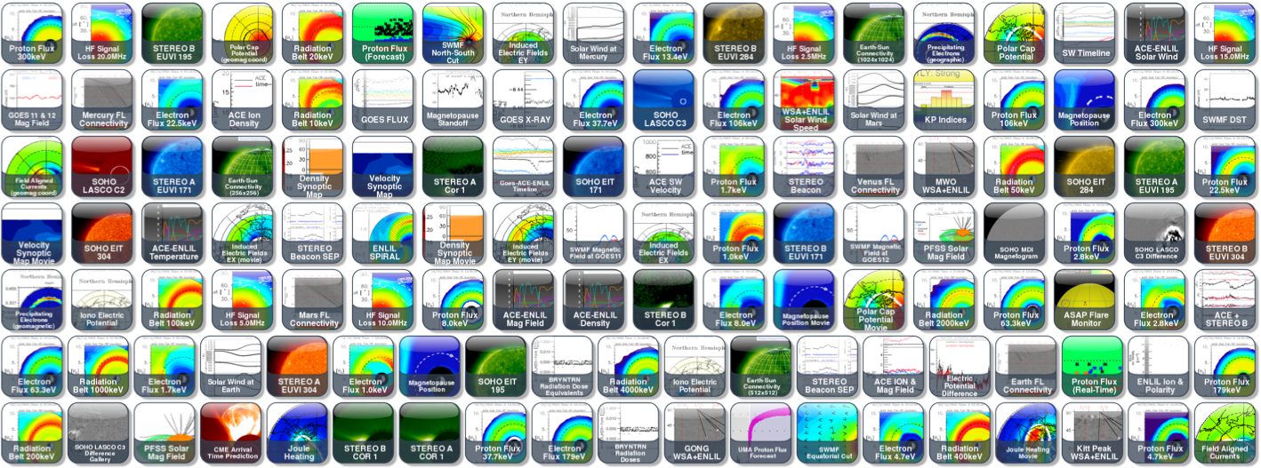

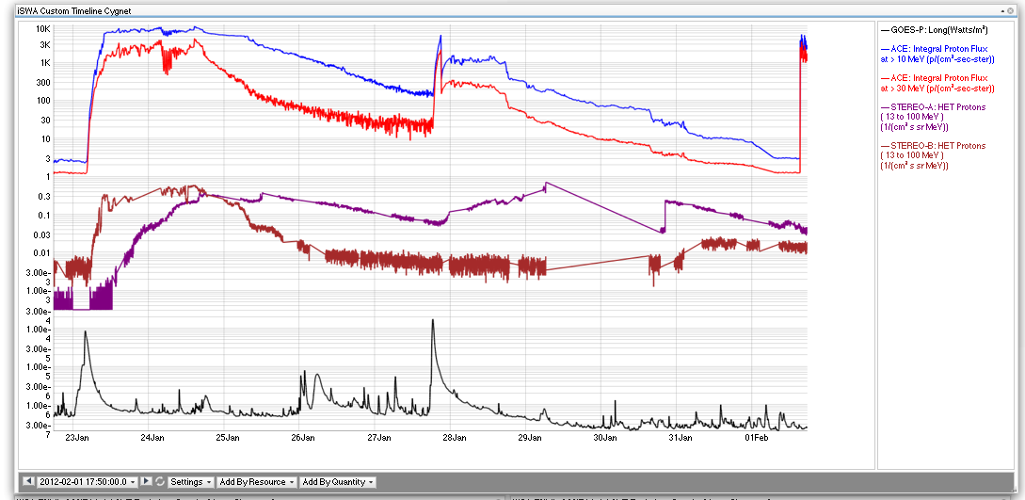
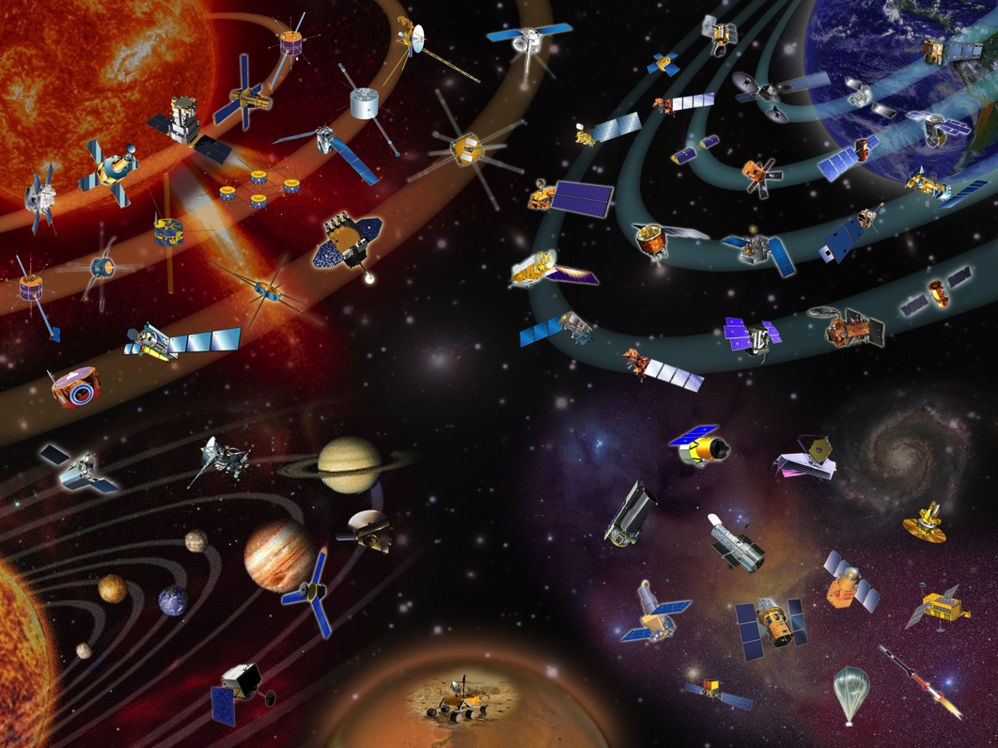





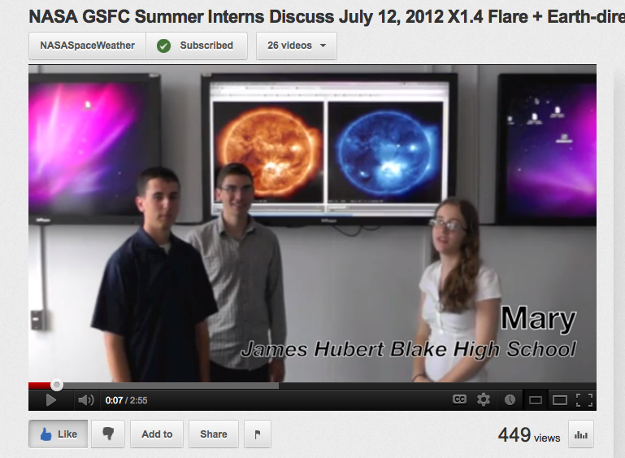








SWRC Functional Diagram
Notifications
Weekly Reports
Anomaly Analysis Support
Workshops
n Scientists
Need for Interplanetary Space Weather monitoring/forecasting
Space Weather Research Center
CCMC
World-leading Modeling
Provide unique sw service to NASA’s Missions
Building space weather knowledge bases
n Scientists
SWx Tools
Partnering
Space Weather Related Research and Prototyping
NASA, Other,
Data Streams
Education and Training
Notes:
SWRC addressed unique NASA need by providing unique space weather information and services.
Need to characterize solar system-wide space weather conditions

Slide 5
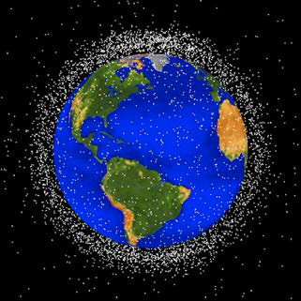

NASA End-User Needs
Primary impacts pertain to charged particle radiation
Deep dielectric charging due to energetic electrons (300 keV- few MeV)
Surface Charging (0.1-40 keV)
Single Event Effects (SEPs and GCRs)
Total dose effects
SEP characterization (>10 kev protons and heavier ions) is a robotic mission need that is also a big concern for human space exploration (partnership with NASA/JSC Space Radiation Analysis Group)
Collision avoidance at LEO orbit: a growing issue
The core benefit of the service: space weather as a part of general situational awareness and anomaly assessments.

Slide 6
Challanges

Slide 7
Validation Results of CME Arrival Prediction (Wold et al., 2016)
Error is larger with only two spacecraft instead of three
During the period post
Sept 2014
(without STEREOB
and reduced STEREO A coverage) a reduction in skill of 2.3 hours

Slide 8
Benefits of L5 missions for interplanetary space weather forecasting
Magnetograms would reduce errors background solar wind prediction, in CME arrival time prediction, and be useful for flare prediction models.
EUV observations and magnetograms would track active region development with longer lead times.
Heliospheric Imager observations could be used to update CME arrival time forecasts, and subselect ensemble forecasts.
Solar wind observations would provide high speed stream forecast, can be used to subselect ensemble solar wind predictions.
Coronagraphs and EUV observations would reduce CME measurement errors.
Solar energetic particle observations can be useful for SEP models, and provides connectivity information relevant for forecasting and for constraining CME parameters.

Slide 9
Summary
CCMC/SWRC team have a lot of experience doing solar system wide space weather analysis and forecasting
Data needs for covering entire solar system are quite different from Earth-centric forecasts.
Emphasis on developing new techniques for utilizing L1- L5 missions data and maximizing return on investments.
Notes:
Definitely in need of an L5 mission due to obvious benefits
Emphasis on developing both science and operational tools/methods/understanding in maximizing an L5 mission (more needs to be done) in conjunction with existing assets
More innovative ways of utilizing an L5 mission than previously done

