Slide 1
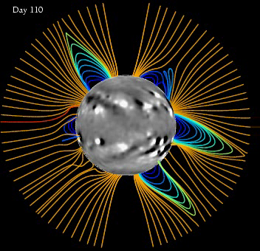
Impact of an L5 Magnetograph on Non-Potential Solar Global Magnetic Field Modelling
Duncan H Mackay (University of St Andrews)
Results published in Mackay, Yeates and Bocquet (2016), APJ, V825

Slide 2
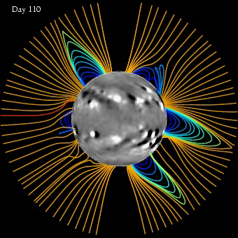
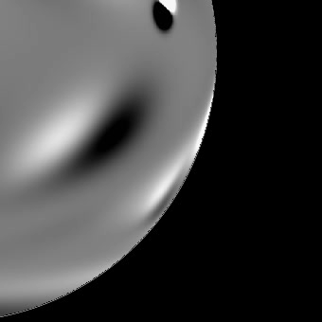
Global Non-Potential Model
6 month: May-Aug 1999
Long Term continuous simulations (months to
years).
- Build up free magnetic energy and
helicity
Two coupled components:
Photosphere: Flux Transport Model
- accurately reproduces B_{r} obs. on Sun.
- includes flux emergence (+/- ve helicity).
Corona : Magnetofrictional Relaxation
- quasi-static evolution
- non-linear force-free states, j x B = 0
- development of sheared fields along PIL
(van Ballegooijen and Martens 1989)
Development and Application:
van Ballegooijen et al 2000;
Mackay and van Ballegooijen 2006a,b;
Yeates et al. 2007, 2008a,b, 2009a,b.

Slide 3
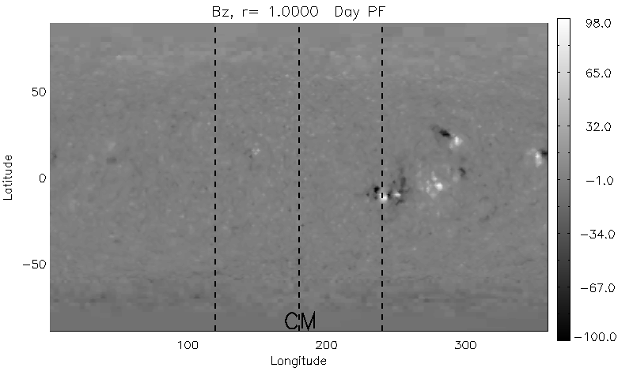
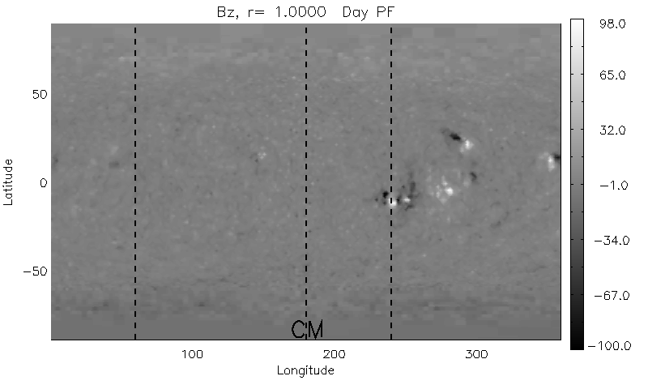
L5 Simulations
Aim: Determine what effect having increased magnetogram data will have on the
accuracy of global NLFFF simulations - three simulations
1. Reference Simulation: 22yr 3D NLFFF simulation with random
emergences of bipole at all longitudes (“real Sun”).
2. Limited Data simulations: 22yr simulations but bipole emergences in limited
FOV – taken to be 30º from limb.
Earth based Earth & L5
Consider: (i) Real Time emergences in window of observations.
(ii) Rotational updates- new flux emerged outside FOV rotates into FOV.

Slide 4
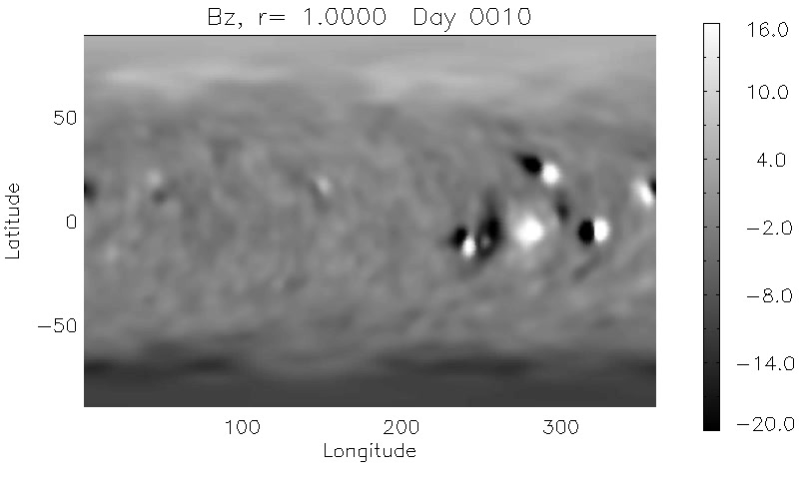

Reference Sun Simulation
22yr 3D NLFFF simulation with random emergences of bipole at all longitudes.
No. of Bipoles : 4770
Flux Emerged : 3.21 e25 Mx

Slide 5
Limited Data Simulations
Need to determine which bipoles emerge in FOV or rotate into FOV.
* - emerged in real time.
- emerge late (up to 7 days).
- missing (assumed decayed).
Example: 5.12 years
Earth – 3 late (1.22,2.0,5.6 days), 1 missing.
Earth & L5 – 2 real time, 1 late (1.5 days),
1 missing
Number of Bipoles:
Simulation | Real Time | Late | Missing
Earth Only | 1427 | 1152 | 2146
Earth & L5 | 2140 | 1178 | 1407

Slide 6
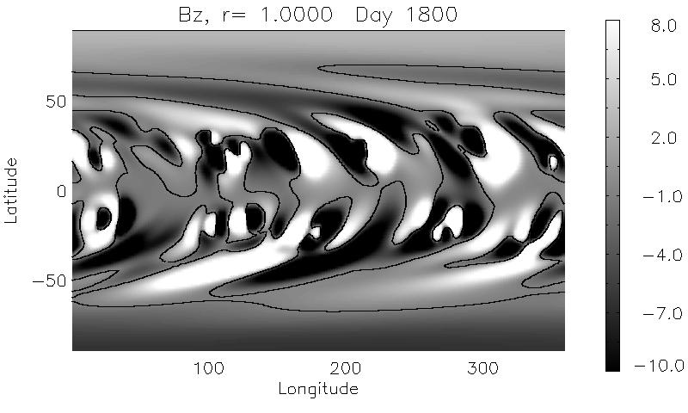
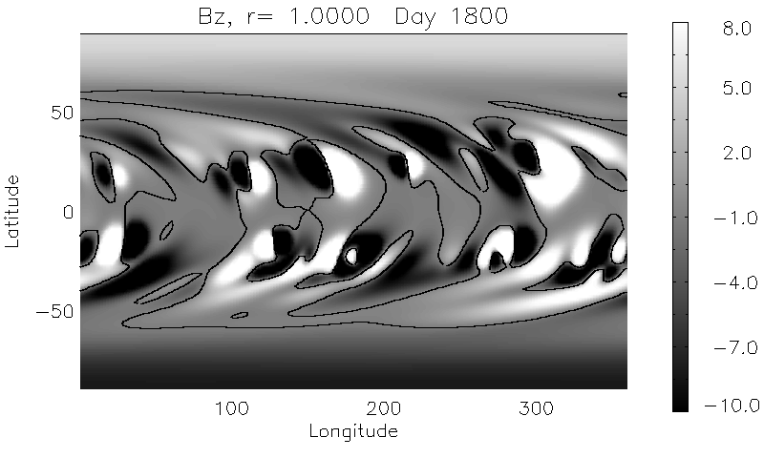
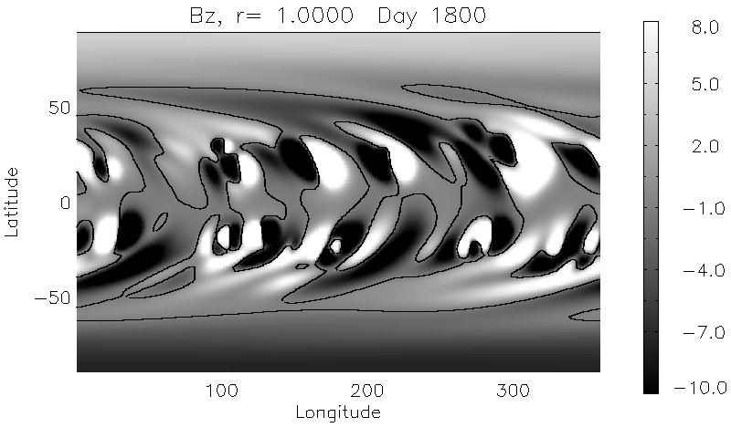
Br comparison
Reference Sun
Earth Only
Earth & L5

Slide 7
Global Properties
0.73 0.55 : 33%
Number of flux ropes
0.78 0.46 : 26%
0.65 0.46 : 41%
0.74 0.57 : 30 %
Red – Earth plus L5 FOV
Black – Earth only FOV
Blue - % improvement with L5

Slide 8
Summary
Considered what improvements can be expected in the accuracy of global non-potential models if L5 magnetograph data exists.
Used a reference sun simulation & two limited data simulations.
Limited data: Earth only
Earth & L5
Earth & L5 simulation gives improvements of between 26-40% in global quantities dominated by low latitude contributions compared to Earth only.
Earth & L5 attains an accuracy of 65-78% of reference global quantities (46-57% for Earth only).
Full details given in published paper along with a comparison of other quantities and outline of future studies that are presently underway.
Mackay, Yeates and Bocquet (2016), APJ, V825

Slide 9
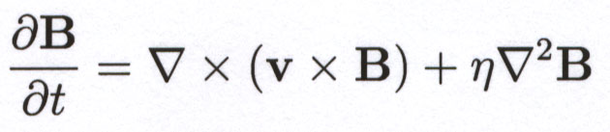

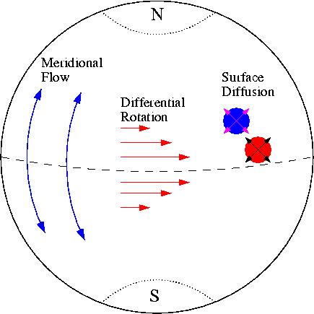



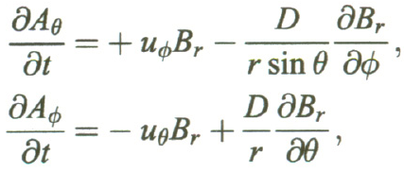
Two Component Model
Evolve, Suns large-scale field, B, through the induction equation.
Photospheric BC : Flux Transport Model
Differential Rotation
Meridional Flow
Surface Diffusion
Shears the surface fields ~ coronal
field diverges from equilibrium.
Physical time scale.

Slide 10
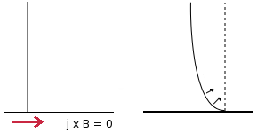
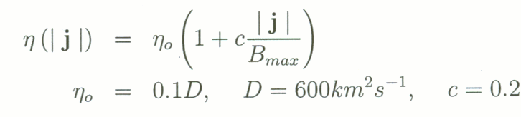
Coronal Model : Magneto-Frictional Relaxation (velocity ∝ lorentz force.)
Coronal field evolves through a series of quasi-static force-free states
(j x B = 0).
Relaxation time scale ~ not
physical.
Alt. non-ideal term

Slide 11
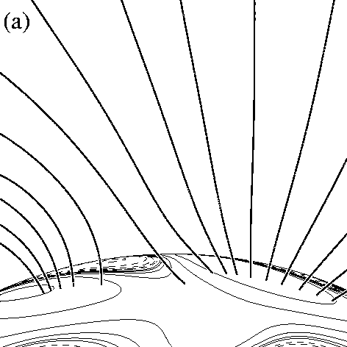
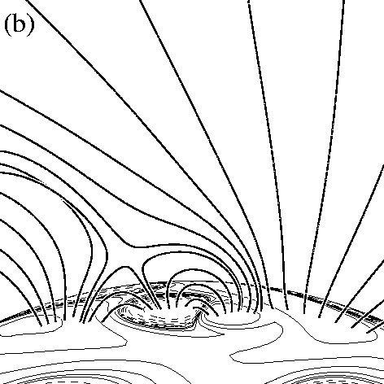
3D Inserting Bipoles
Bipoles are inserted as an isolated field containing either zero, +ve or –ve helicity (alpha) both in the photosphere and corona.
Day 250
Day 251

Slide 12
Forward Evolution of Bipole Parameters
All late emergences of bipoles must have their properties updated to represent how they would be seen when rotating into the FOV
Location:
Tilt Angle:
Seperation:
Flux: analytical solution of flux transport equation in lagrangian coordinates.

Slide 13
Reference Sun Simulation

