Slide 1
Next-Generation modelling of SEPs: L5-L1 observations and SEP forecasting
T. Laitinen, S. Dalla
Jeremiah Horrocks Institute, UCLan, UK

Slide 2
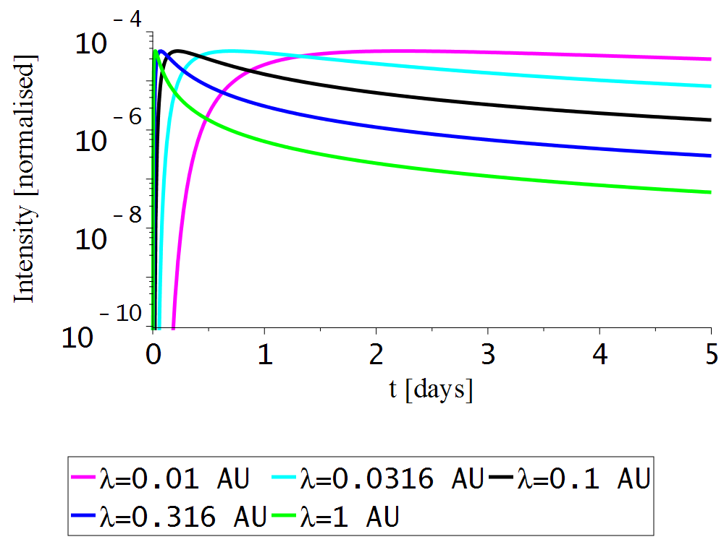
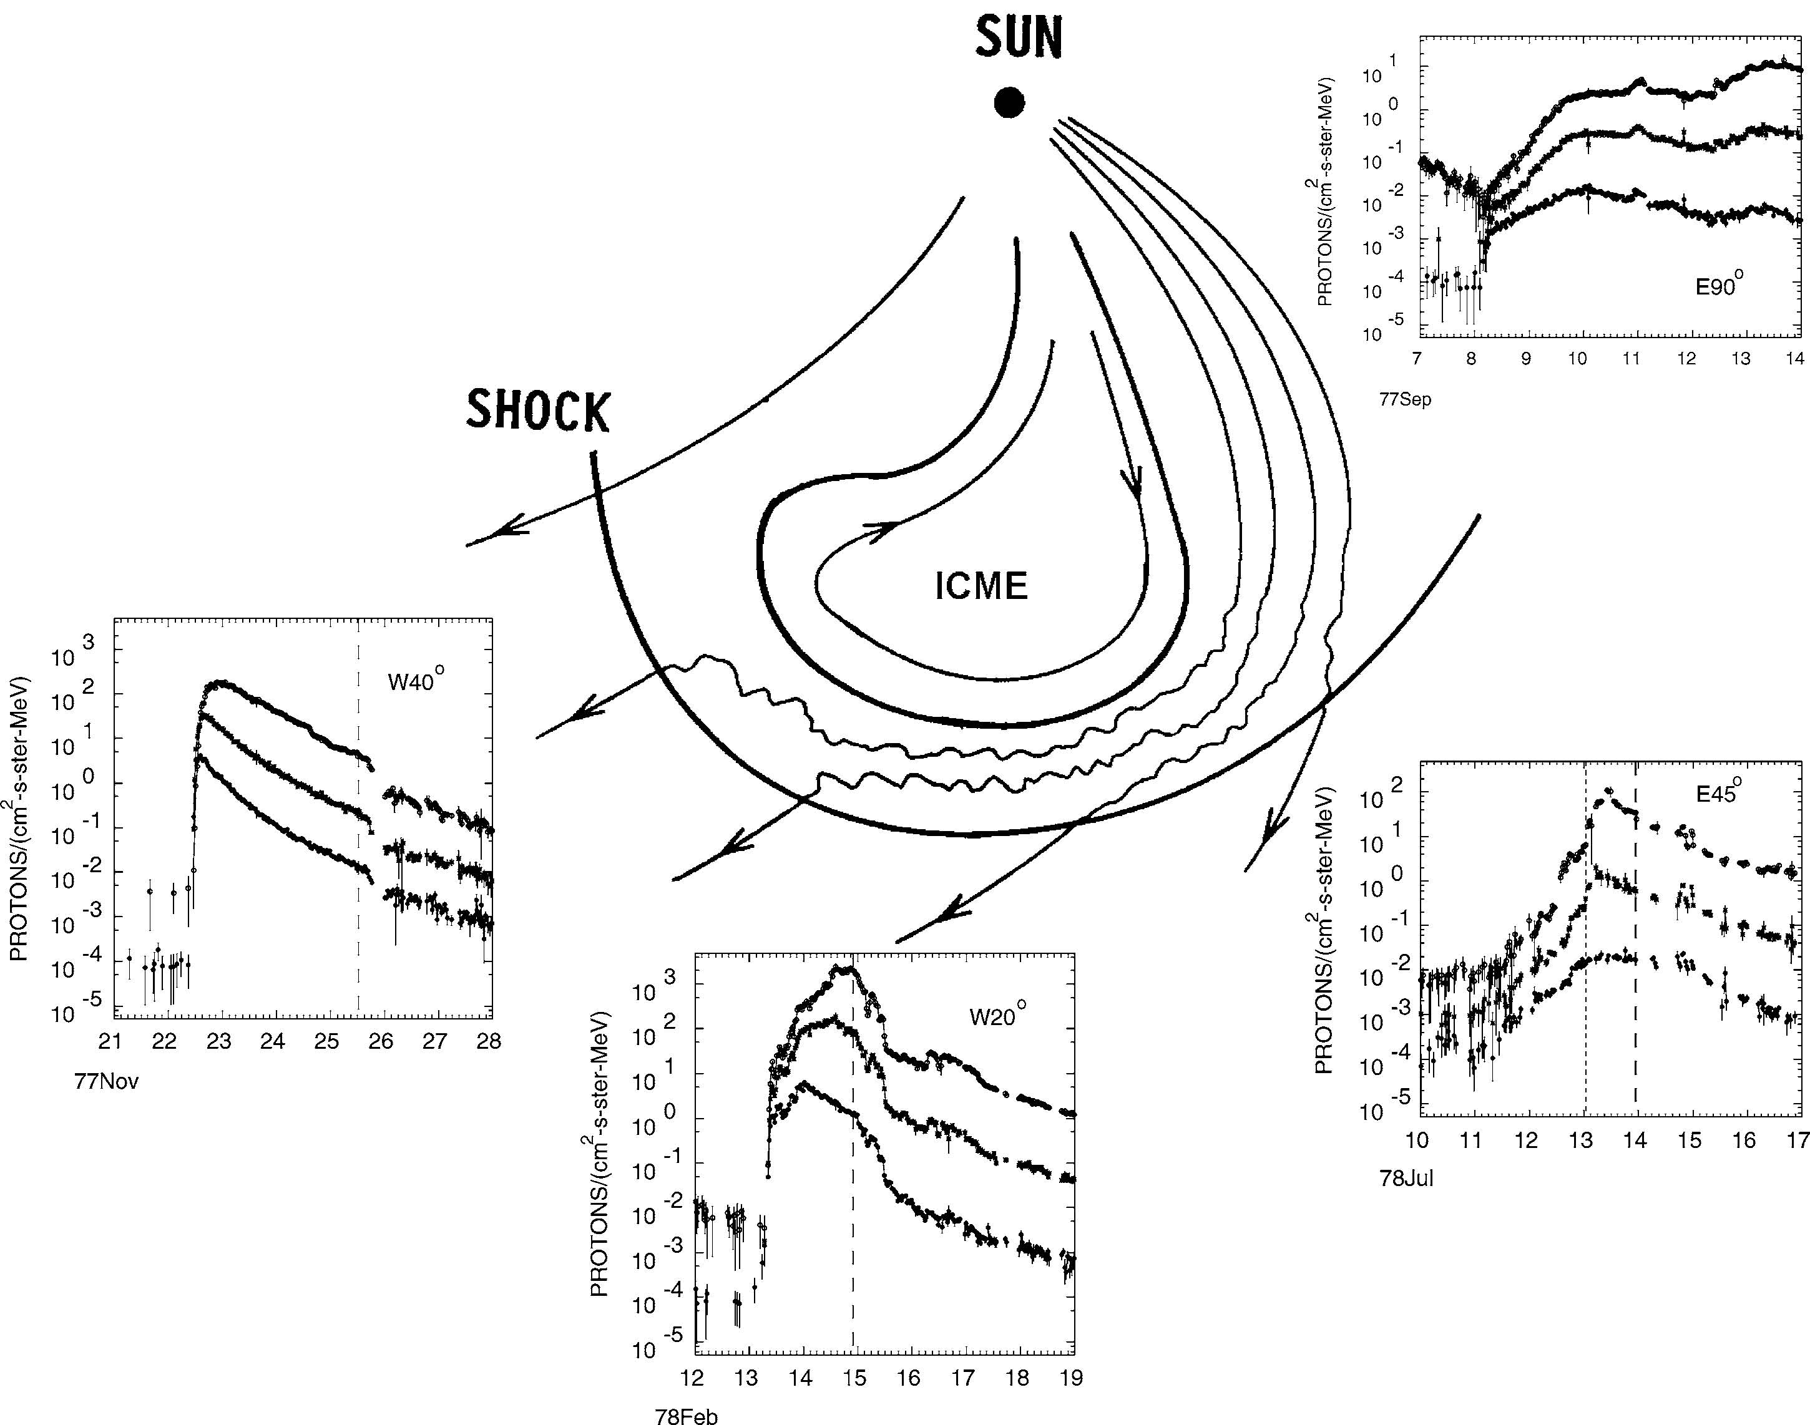
SEP events: 1D view in 3D
1D view: SEPs along field lines
SEPs at 1 AU: Diffusive transport convolves the injection
Profiles result from acceleration?
Single-point measurements:
  No global view of the SEP event
Cane+ 1988

Slide 3
Multi-Spacecraft observations: 3D view of the whole event
SEP event width: Multi-spacecraft observations give σ_{longitude}=30-50º
  Advanced modelling needed to explain the width
Width similar to L5/L1 separation, 60º
  Implies 10-fold difference in L1/L5 flux
Similar to corotation timescale, 60º in 4 days
  -> Spacecraft motion important for fluxes
Corotation effect significant (e.g. Giacalone+ 2012, Marsh+ 2015)
Statistical studies possible with latest STEREO observations
Dresing+ 2012
Richardson+ 2014

Slide 4
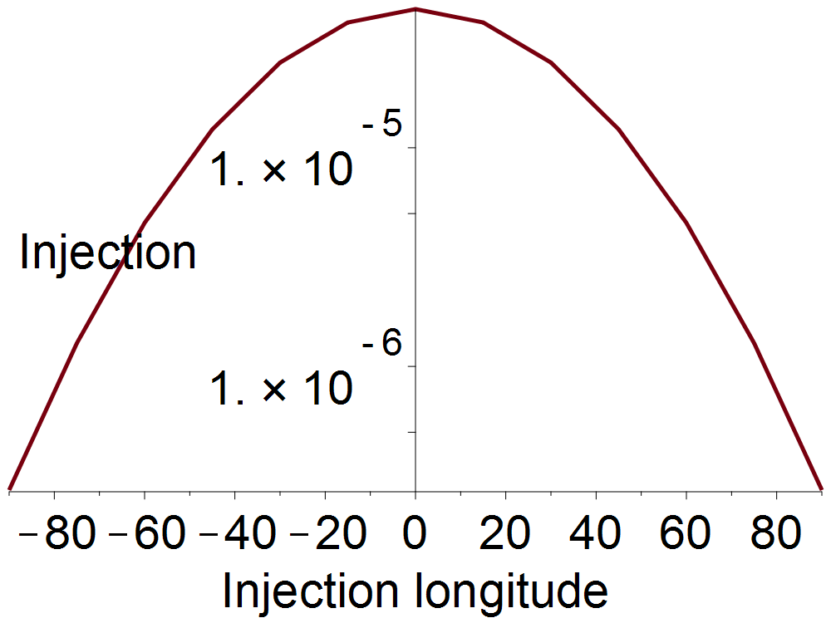
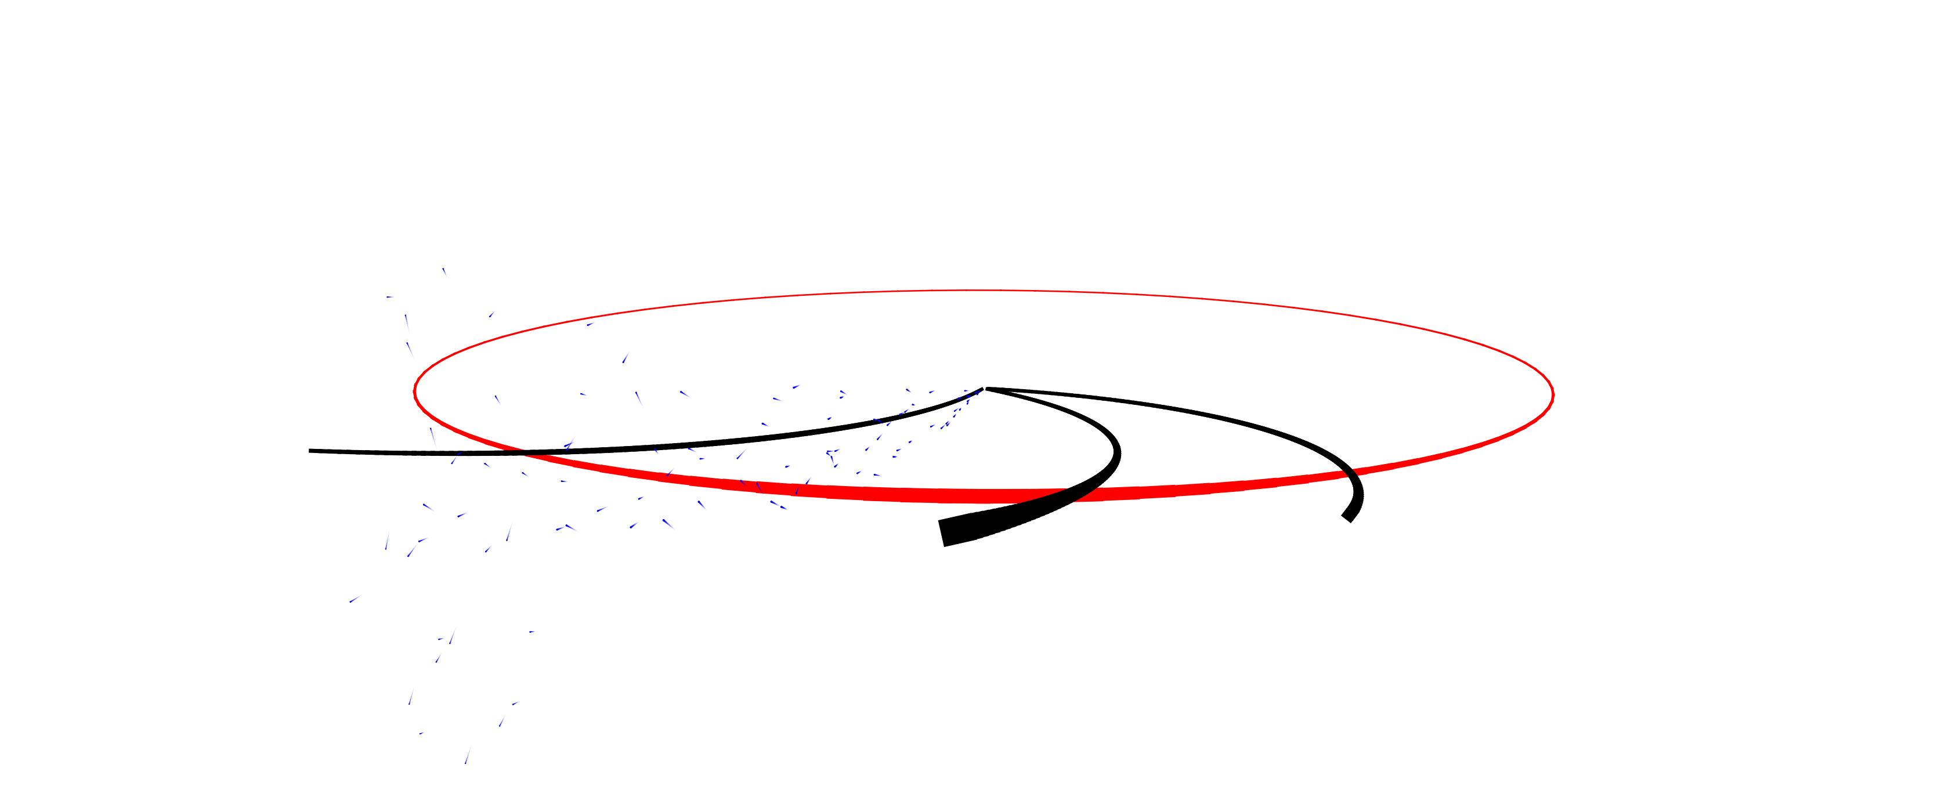
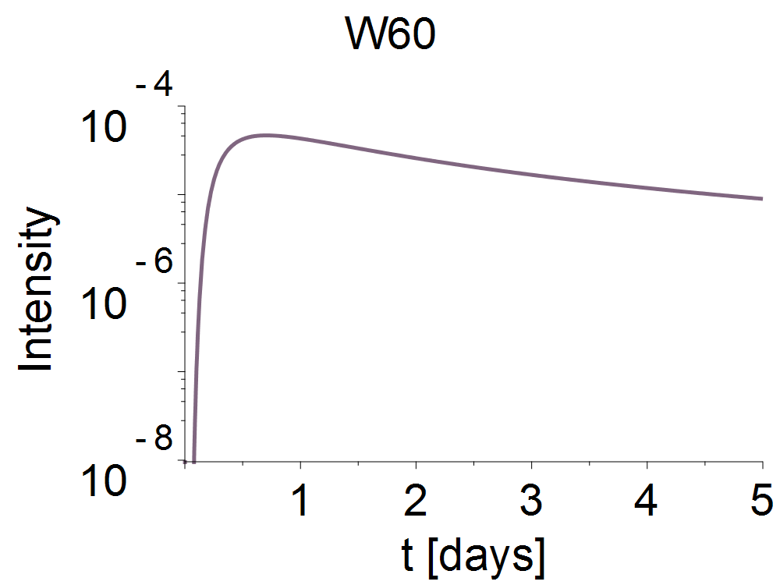
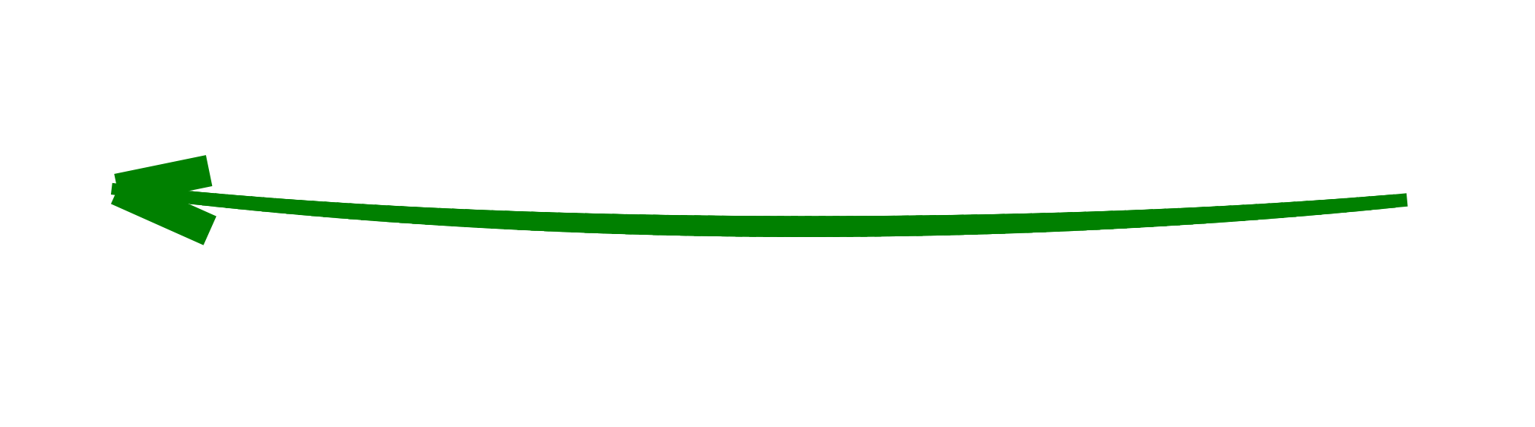
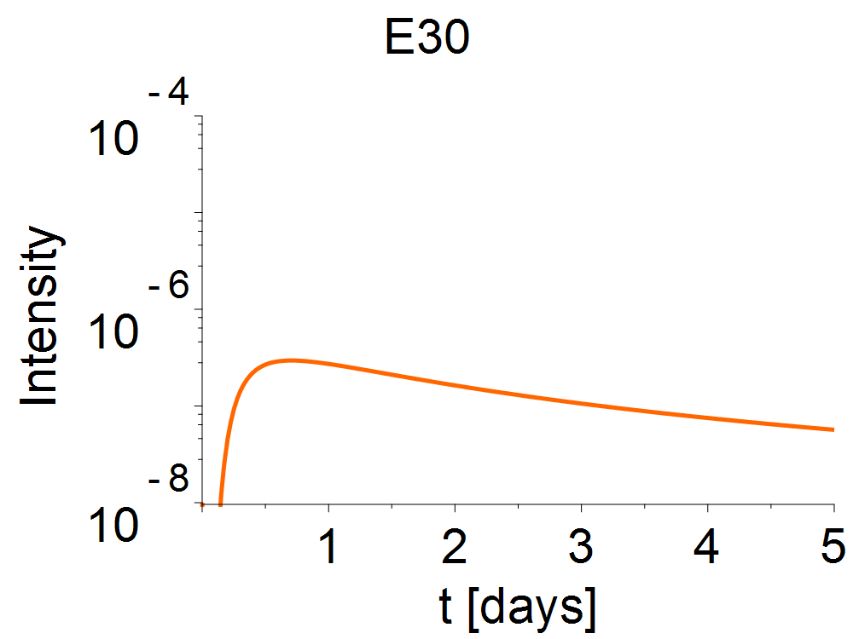
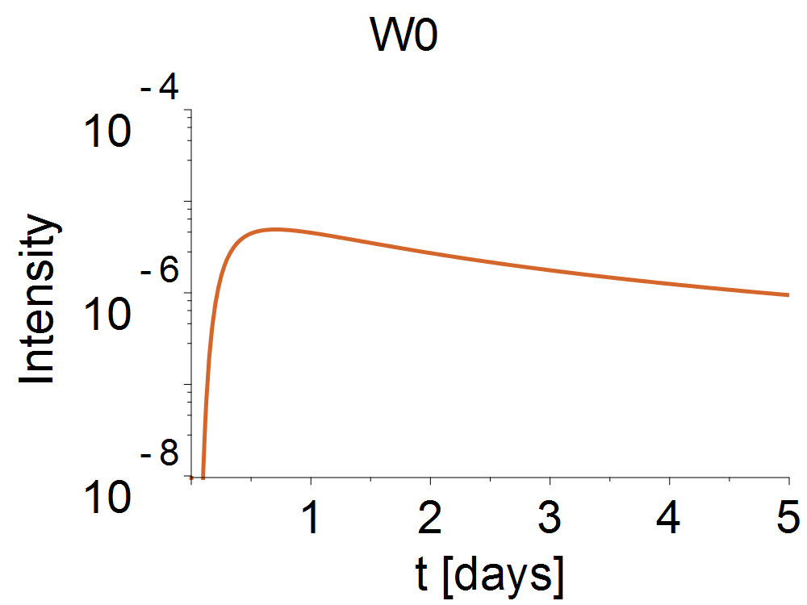
SEPs on fieldlines: A simple model
Simple injection model:
Impulsive injection at W0
σ_{longitude}=40º
Simple transport model:
Diffusive propagation along Parker spiral
10 MeV protons
L5
L1
Earth’s orbit

Slide 5
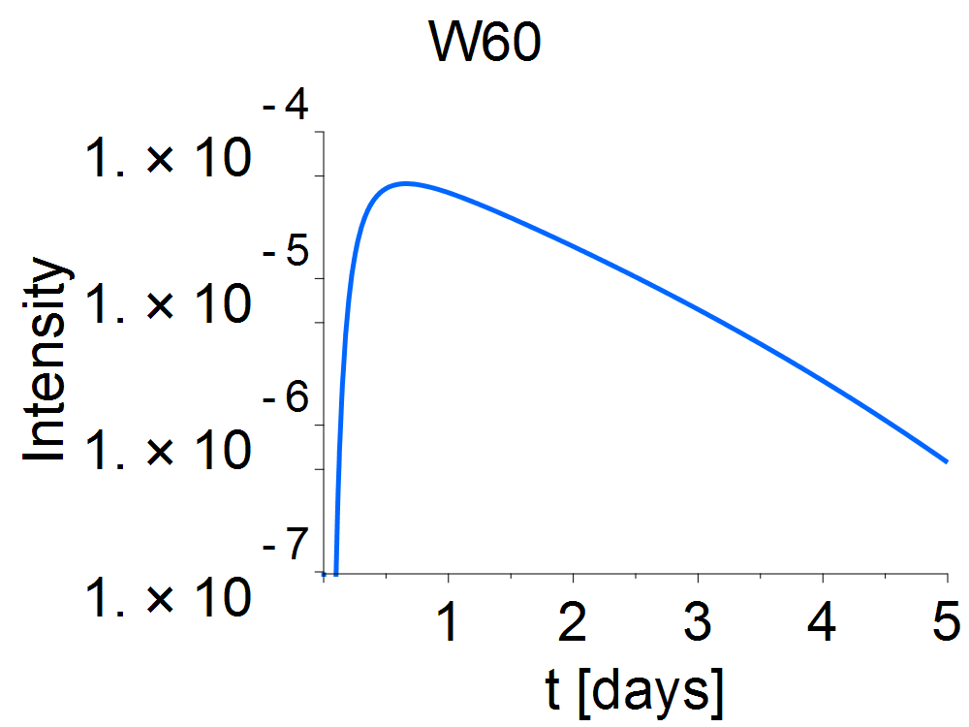
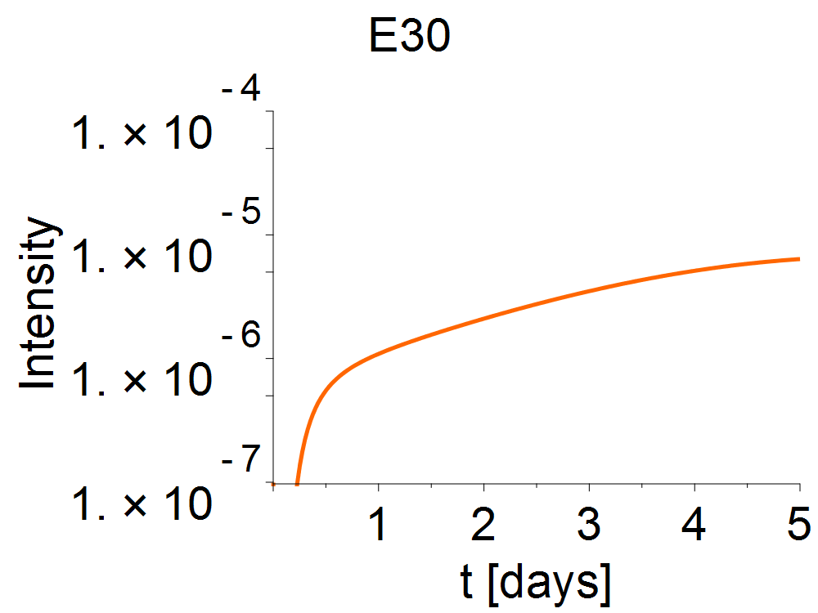
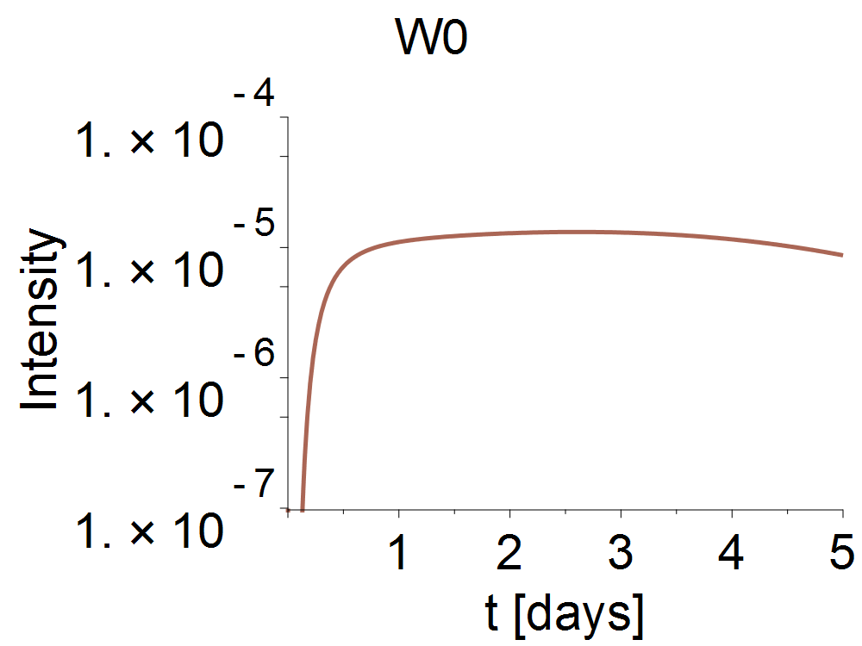
SEPs at L1and L5: Corotation effect
Simple injection model:
Impulsive injection at W0
σ_{longitude}=40º
Simple transport model:
Diffusive propagation along Parker spiral
10 MeV protons
L5
L1
Earth’s orbit
See also Giacalone+ 2012, Marsh+ 2015

Slide 6
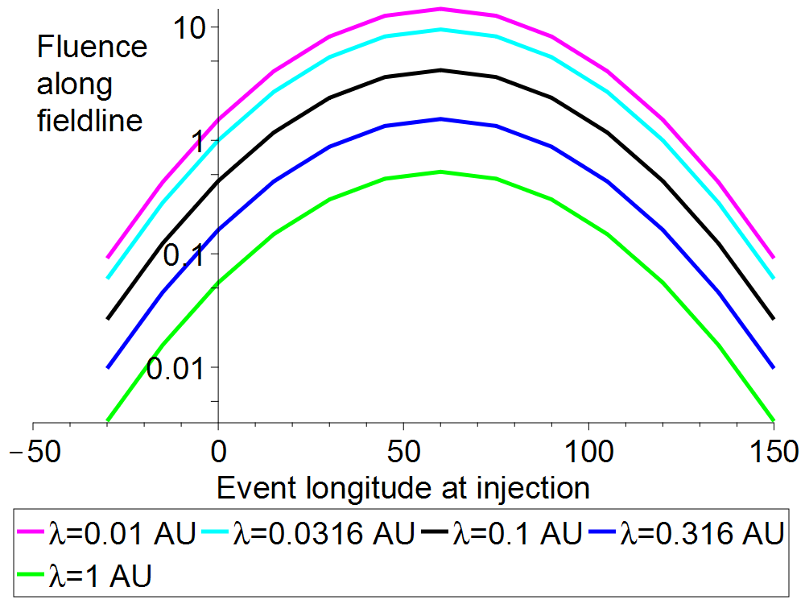
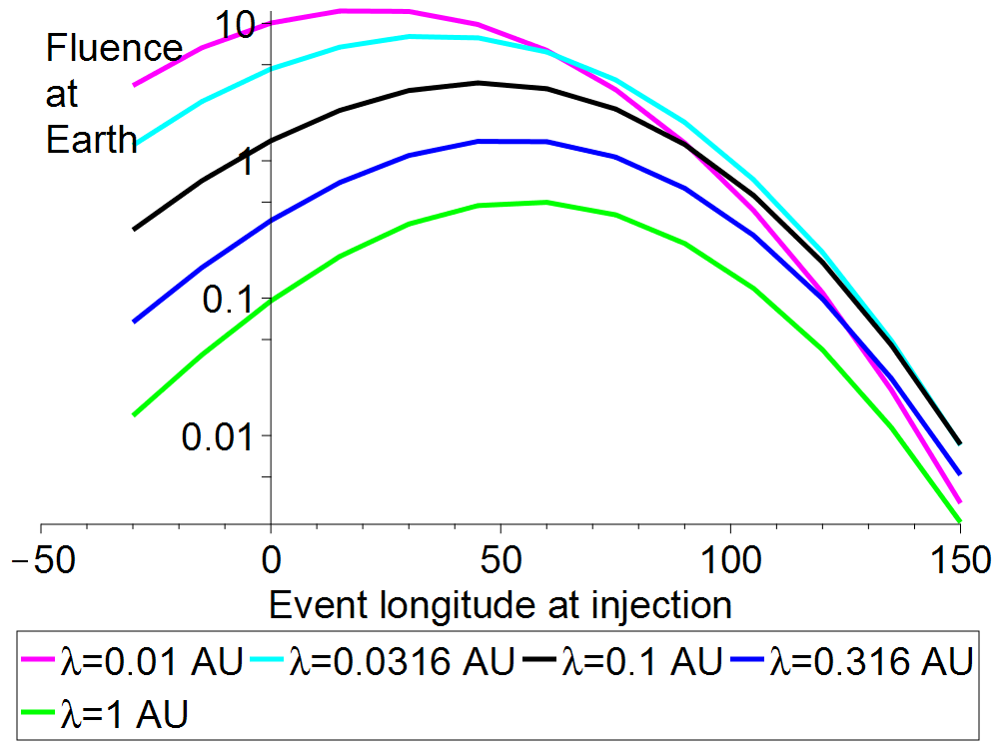
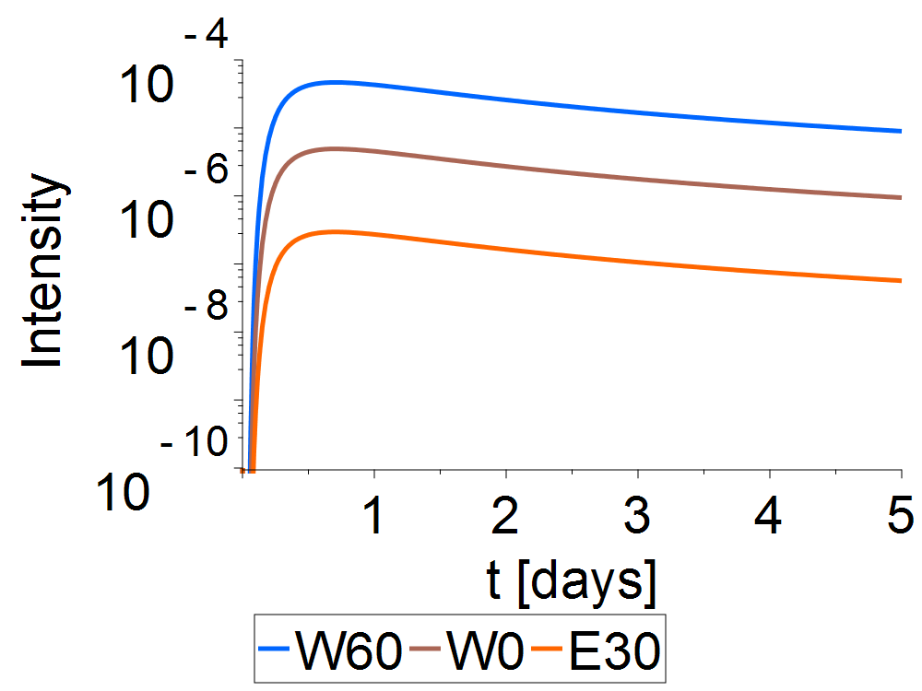
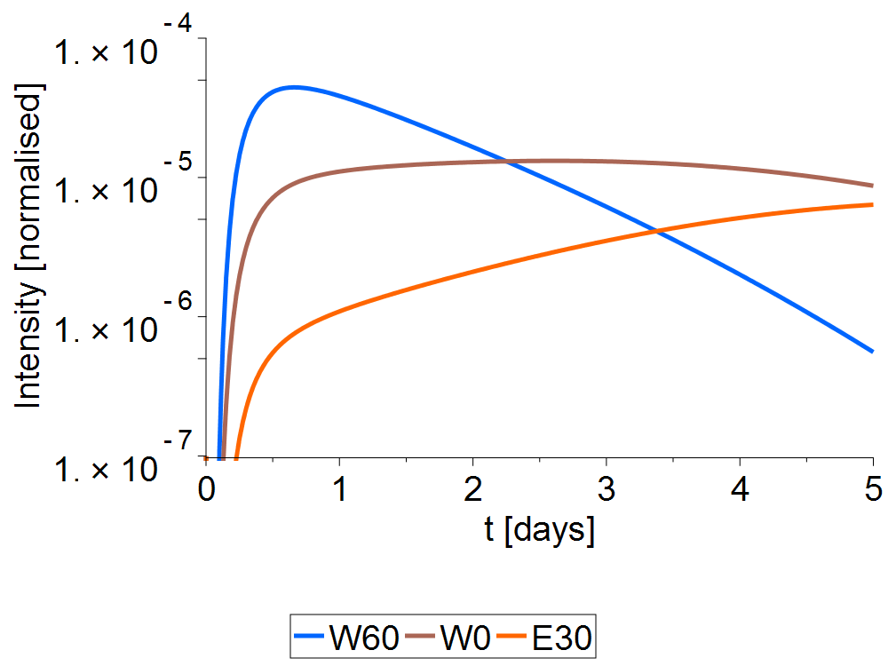
Corotation and SEP Fluence: Radiation dose
Corotation significant for event-integrated fluences
Locally-accelerated particles contribute at lower ion energies: Full modelling needed
Cross-field transport effects, deceleration at later stages significant: advanced modelling
See also Giacalone+ 2012

Slide 7
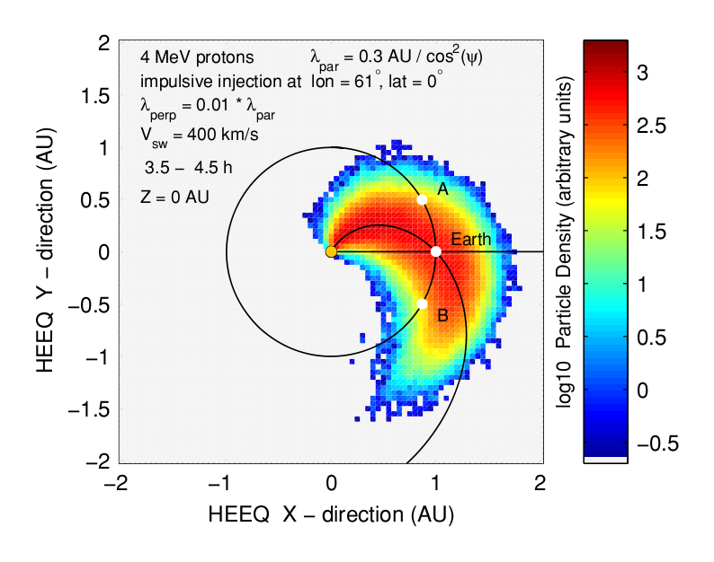
Advanced models
Cross-field diffusion (Zhang+ 2009, Droege+ 2010)
  Slow spreading across longitudes
Large-scale drifts (Dalla+ 2013, Marsh+ 2015, Battarbee+ 2017)
  Non-diffusive, asymmetric, energy changes
Turbulent meandering (Laitinen+ 2016)
  Fast initial SEP spreading across latitude and longitude
All require/desire for forecasting:
  Multi-point SEP observations
  Multi-point SEP anisotropy
  Turbulence for transport parameters
  Large-scale structure
Large-scale drifts (Marsh+ 2013)
Cross-field diffusion (Droge+ 2010)
Meandering (Laitinen+ 2016)

Slide 8
L5-L1 requirements for SEP forecasting
SEP observations, >10 MeV/n ions
  L5+L1 SEP observations for intensity and fluence estimates
  L5 SEP observations connected to Earth-bound source: CME diagnostics using acceleration modelling (e.g. Vainio+ 2014)
  L5 SEP anisotropy (desirable): Duration of acceleration as CME diagnostics; transport vs acceleration analysis (advanced transport models)
    Field often not Parkerian:
    Sun+Anti-Sun directions not sufficient
L5 In situ field observations (desirable)
  Magnetic turbulence at resonance scales (seconds to minutes) for SEP transport conditions
  Global heliosphere simulations for Parker geometry variations
SEPs at 1 AU following a impulsive injection with Gaussian longitudinal distribution

Slide 9
Spare slides

Slide 10
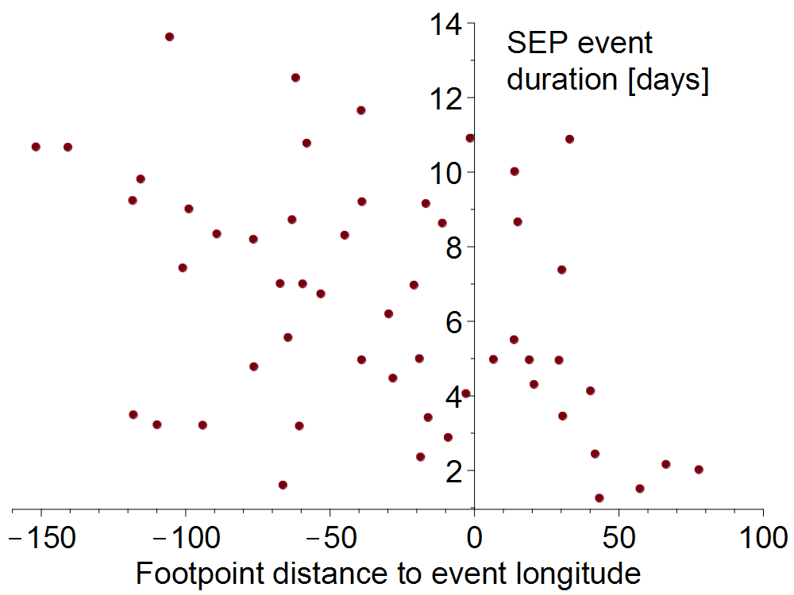
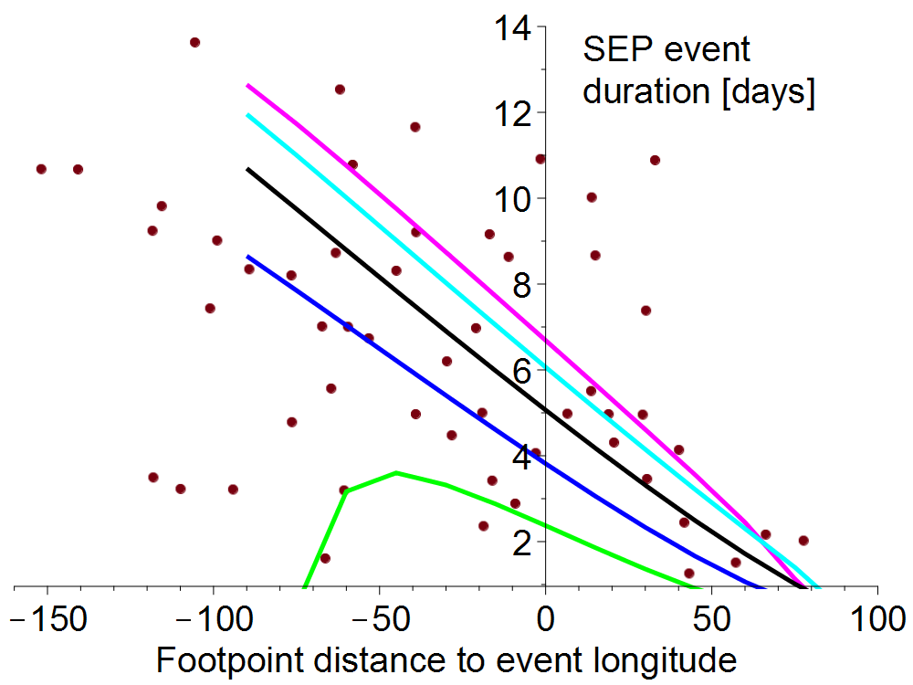
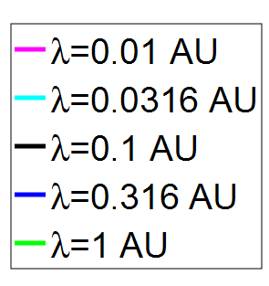
Event duration as function of longitude
SEP duration: non-symmetric dependence on the longitude difference between SC footpoint and flare (Dalla 2003)
Scatter due to different radial distances and event maximum intensities
Can be qualitatively explained with corotation
Further study with STEREO 2014-2015 observations needed (separation ~60º, both at 1 AU)
4-10 MeV proton event duration at IMP8, Helios 1 and Helios 2 (points), and model results (lines)

Slide 11
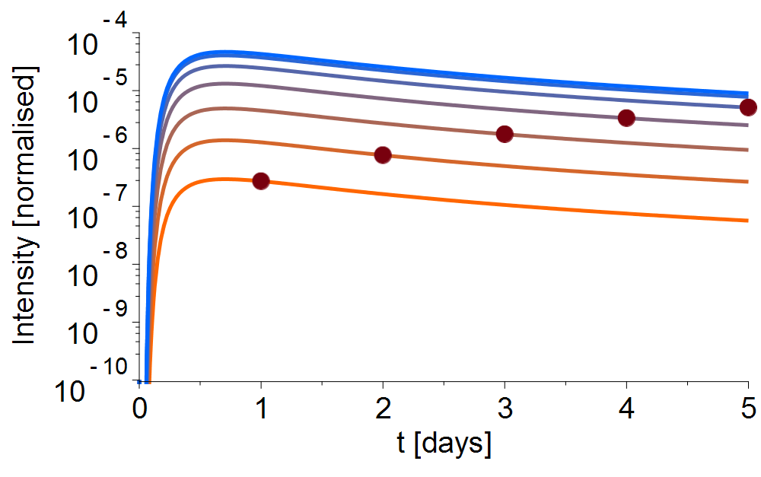
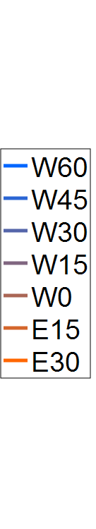
Effect of corotation (simple 1D model)
Particle-filled field lines corotate with the Sun
-> Earth moves about 15º per day towards L5
3-day timescale similar to σ_{longitude}
4-day timescale similar to L1-L5 longitude difference
Lines: intensity at different field lines. Dots: intensity for S/C seeing the event at E45

Slide 12
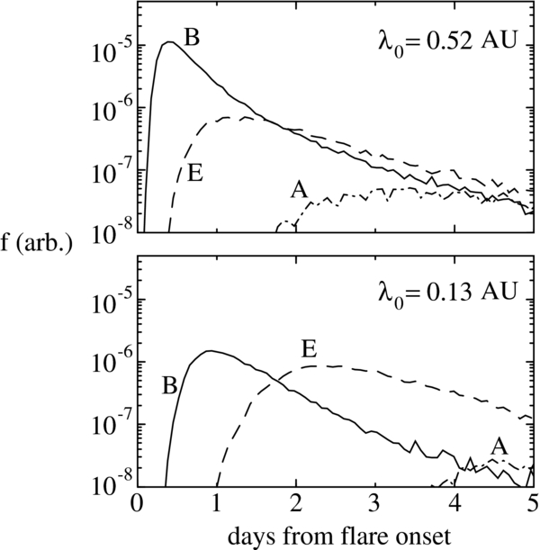
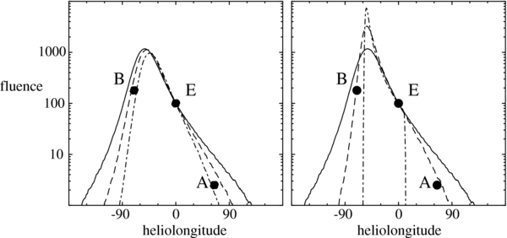
Corotation in other studies
Marsh+ 2015
Giacalone & Jokipii 2012

