Slide 1
WG5: EUV Imagers and XRS-type Instrumentation
R.D. Bentley
University College London, Mullard Space Science Laboratory
M. West, D. Berghmans, J Andries (OMA), T Woods, A. Jones (LASP),
S Petsov (NOAO), S. Bloomfield (TCD), D. Biesecker (NOAA), L.M. Green, S. Matthews (UCL)
L5 in Tandem with L1, London, 6-9 March 2017

Slide 2
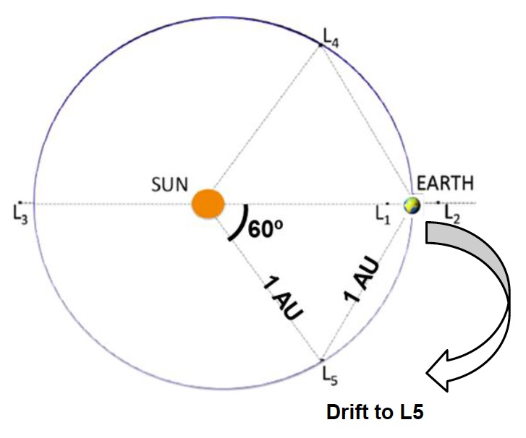
Outline Payload for L5
The various studies are in general agreement about which instruments should be included:
Remote Sensing:
  Coronagraph
  Heliospheric Imager (HI)
  EUV imager (full disk)
  Magnetograph (full disk)
  White light imager (full disk)
  X-ray sensor (GOES-type, whole sun)
  Radio monitor (possibly)
In-situ:
  Solar wind plasma analyser (velocity, temperature, density)
  Magnetometer
  Energetic particle monitor(s)
Still a lot of discussion of the exact design of each instrument and what capabilities are needed
Mass, volume and power are not driving factors (within reason)
Near continuous downlink of telemetry required; some limitation on quantity

Slide 3
Underlying purpose of the observations
Detection and tracking of structures in the heliosphere that could be geo-effective
  Coronagraph detects ejection; HI and Radio monitor propagation; L5 gives better view
Modelling the heliosphere to facilitate prediction of arrival times of propagating phenomena
  Structure based on extrapolation of the photospheric magnetic field
    Perspective from L5 extends region of solar surface that is accurately described
  Spot check of model using in-situ measurements of ambient solar wind and magnetic field
Monitoring structure in the solar wind that will sweep across the Earth in 4+ days
  In-situ measurements of ambient solar wind and magnetic field
  Changes could occur if morphology of the solar surface evolves
Observing structure and evolution of surface features to facilitate probabilistic forecasting
  Remote sensing of the solar disk by EUV imager, magnetograph and X-ray monitor from around the limb
  In-situ measurements of energetic particles provide additional information on active regions

Slide 4
Remote sensing of the solar disk
Build up an understanding of how features are evolving and what activity might be produced
  Location of various types of features and relation to underlying magnetic field
  Where active regions that will cross the east limb are in their life cycle
  How the field morphology associated with filaments, CHs, etc. is evolving
Need full disk imagery in EUV, white light and magnetograph
  All three needed if we are to truly understand what is happening
    None provide a complete picture on their own
  Structures and phenomena evolve on different time scales
    Affects required cadences of different types of imagery
Note that limitations on telemetry mean it is not practical to observe some feature
  Cadence may preclude detection of EUV waves and shock waves seen in magnetogram
Notes:
AR could produce biggest ever X-class flare

Slide 5
Remote sensing of the solar disk
EUV observations in at least two wavelengths are desirable
  Flare locations best identified in shorter wavelengths
    Show where energy released but not the overall structure (or how it is changing)
  Longer wavelength potentially more important for understanding long term evolution
    Features that could disrupt – e.g. filaments – are easier to identify
Nature of the features differ and they evolve on different time scales
  Opens up the possibility of ringing the changes
Notes:
AR could produce biggest ever X-class flare

Slide 6
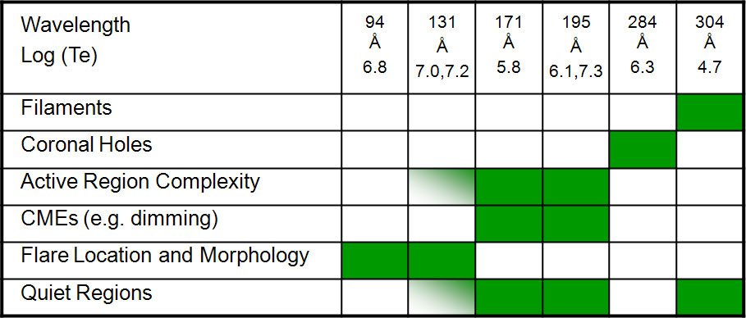

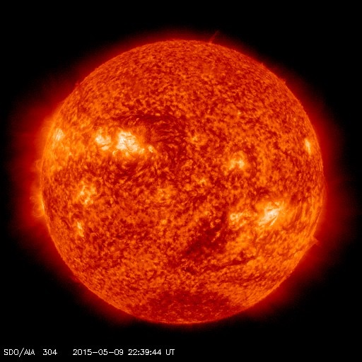
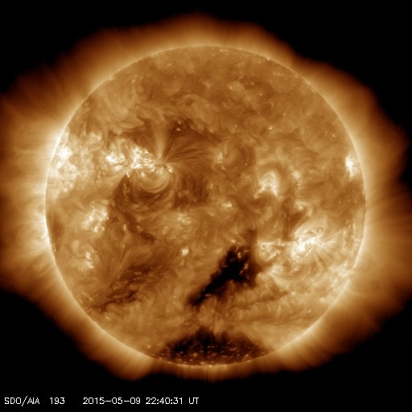
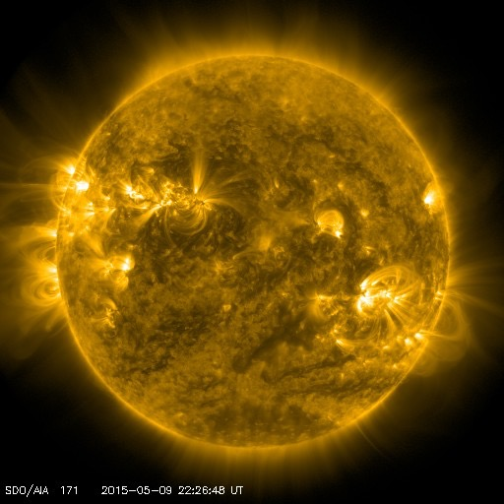
Remote sensing of the solar disk
Table from the GOES-R SUVI instrument page
Differences can be seen if examine the images in 195, 174 and 304 Å

Slide 7
Remote sensing of the solar disk
Many EUV imagers have flown before but what mix of wavelengths required for forecasting and what should the other instrument capabities be ?
  Mainly full disk images in a mid/long wavelength to observe general morphology
  Occasional context image in a longer wavelength for slowly evolving features
  Automatic flare detection and cut out of flaring region in shorter EUV wavelength with occasion context image
LOS Magnetograph provides contextual information for changes seen in the EUV
  Vector Magnetograph probably of more use in understanding evolution of active regions
Continuum images (by-product of the magnetograph) facilitate interpretation
GOES-style X-ray monitor allows description of flares consistent with Earth
  X-ray class of flares seen from L5 should have same meaning as those seen from Earth
  Same instrument as GOES would simplify some things but is not essential
  Location probably better derived from the imager…
Notes:
On-board processing of vector data risky; SOHO/MDI got it wrong

Slide 8
Cadence, Resolution, FOV and Latency
With large downlink capabilities some of the discussion may not be relevant.
Take conservative approach to match lower end of range under discussion
  Have defined extensions that could come down in “burst mode”…
Image resolutions should allow interpretation
  1024x1024 covering just over solar disk; extended FOV might be useful
Volume can be reduced by using different cadences for the different wavelengths
  Steady cadence of 15 minutes for the general overview
  Reduced cadence for the wavelengths showing slowly evolving features
  On demand for transiet event? (Flares OK, but problems with other things)
Magnetograms and continuum images needed to aid interprettaion
  Several discussion suggest similar FOV & resolution to EUV at 1 hour cadence
  Vector magnetograph might benefit from higher cadence; subfield of ROI?

Slide 9
Cadence, Resolution, FOV and Latency
With on-board processing, sub-field of image could be extracted
  AR sized sub image centred around flare site = both EUV and Vector magnetogram?
  Series could be returned within same envelope as a full image
Coronagraph observations require near real time downlink
  Need to maximize the warning for Earth-directed CMEs
Delays in downlink of other datasets can be tolerated
  Magnetograms and in-situ plasma data needed for modelling
  HI data support information derived from the coronagraph, further out
  EUV imagery and X-ray monitor used for prediction days ahead

Slide 10
Discussion
Need to consider downlink contents carefully
  Baseline set of observations that are minimum required for forecasting
  Bursts of extra data for more detailed look at issues and use of extra capabilities
    Campaigns for regions of interest – called by forecasters, others join in?
Packetized telemetry allows easy modification of data stream to Earth
Reasonable powerful on-board processing capabilities are required
  Techniques that could be used to reduce data volumes need careful consideration
  Compression many solve many of the telemetry constraints; better than alternatives?
Essential/extremely useful if the same instruments flown at L5 and L1
  Greatly simplifies merging of the datasets, particularly the magnetograms
Almost all existing instruments will need some modification for a service mission
Issue of redundancy of the instruments needs to be considered

Slide 11
Conclusions
Required core set of observations defined by operational forecasting needs
Science is evolving and ideas of what is important may change
  Observations at L5 still have large element of research – many things that are not clear
  Need to think what could be needed for modelling, etc. in the future when considering the instrument designs
Instrument should be capable as we can make them (but not cutting edge)
  Instrument designs should be flexible and not preclude ability to do science
  Capabilities beyond core needs that can be deployed if necessary
Good on-board processing capabilities and the ability to change data selection and priorities
Additional downlinks beyond real-time stream enhance capabilities very desirable
Idea is not to turn the mission into a science mission but rather to maximize the flexibility of a service mission
Clever researchers will still be able to do good science within the constraints so long as we do not hamstring them

