Slide 1
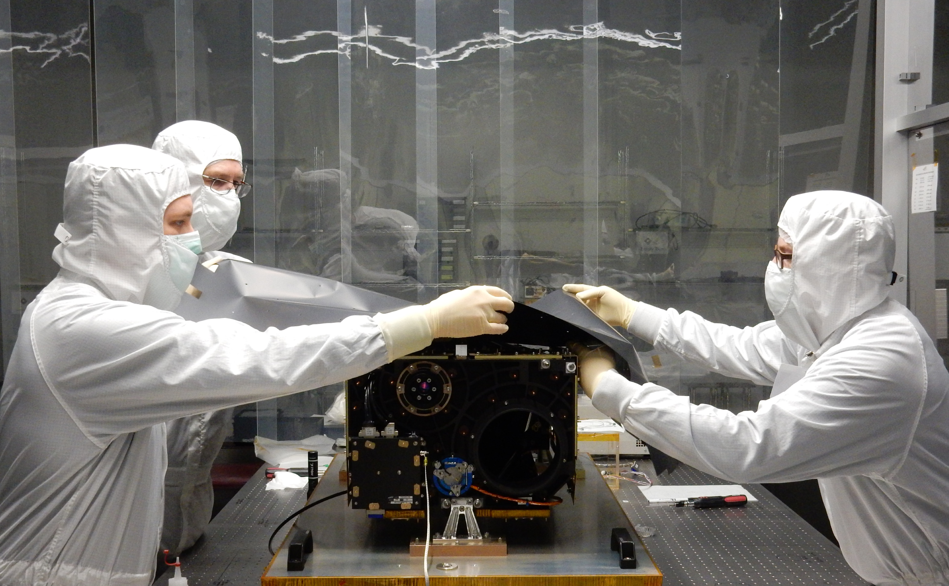
Solar Orbiter Polarimetric and Helioseismic Imager (SO/PHI)
Andreas Lagg and the PHI Team MPI for Solar System research, Göttingen

Slide 2
The Solar Orbiter Mission
last 2 days: magnetometer has high priority for L5 mission
2-viewpoint science: many parallels between SolO and L5
SolO launch: October 2018
3-year cruise phase
min. distance: 0.28 AU
max latitude: 34°

Slide 3
Solar Orbiter Science Cases

Slide 4
Polarimetric and Helioseismic Imager
PHI at a glance:
Scans over magnetic sensitive photospheric absorption line (FeI 617.3nm)
Narrow-band filtergrams at 6 spectral positions, 4 polarisation states
On-board data processing:
data reduction (dark, flat, calibration)
retrieval of physical parameters (ME inversions)
lossless / lossy compression
Intensity
LOS-velocity
B-strength
B-inclination
B-azimuth

Slide 5
Polarimetric and Helioseismic Imager
PHI stand-alone science:
What is the nature of magnetoconvection?
How do active regions and sunspots evolve?
What is the global structure of the solar magnetic field?
How strongly does the solar luminosity vary and what is the source of these variations?
Intensity
LOS-velocity
B-strength
B-inclination
B-azimuth

Slide 6
SO/PHI basic specs
Two Telescopes:
Full Disk Telescope:
FoV ~ 2°
Resolution ~3.5 arcsec/pix
Full disk at all orbit positions
17 mm aperture diameter
High Resolution Telescope:
FoV ~ 16 arcmin
Resolution: 0.5 arcsec per pixel (i.e., ~200 km at 0.28 AU)
140 mm aperture diameter

Slide 7
SO/PHI: new technologies
Heat rejection windows:
optical/polarimetric performance between 0.28 and 0.9 AU
Line scanning:
first ever LiNbO3 etalon in space
Science detector:
custom made APS sensor development
Polarization modulation:
space-qualification of LCVRs for SO
Data processing:
use of powerful reconfigurable FPGAs, autonomous onboard calibration and data processing
Telemetry issues:
6.4 GByte per orbit ≈ 100 GByte over entire mission lifetime 4Tbyte on-board storage

Slide 8
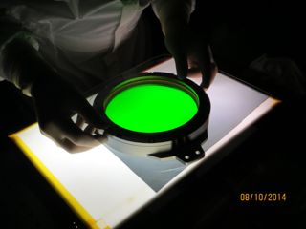
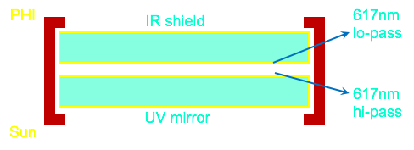
SO/PHI technical challenges

Slide 9
PHI@L5: simplification options
Telescope:
only 1 telescope
no feed selection mechanism
2” resolution (1”/pixel) —> 8cm aperture @6173 Å (optional: 4” —> 4cm)
Detector:
2k x 2k (optional: 1k x 1k)
Thermal environment:
lower heat input
stable conditions
Observation & operation:
constant orbital velocity & image scale (almost)
continous contact
Cadence:
several / day (reduces processing demands, on-board storage)
higher cadence for helioseismology (highly compressed)
No / less demanding correlation tracker required

Slide 10
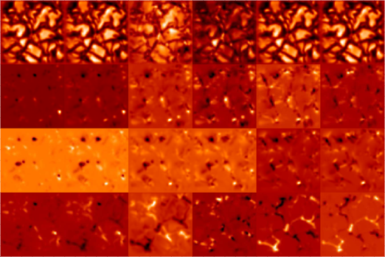
PHI@L5: Heritage (See also S. Kraft presentation Monday)
Hardware ready for launch (Oct. 2018)
On-board processing
most efficient data compression technique available
6x4 Stokes images, 14bit —> 1-5 par. maps, 10 bit
(comp ratio: 6 — 32)
Lossless comp: x2
Lossy comp: up to x3 —> total comp. 12 — 1000
I
Q
U
V
-400 mÅ
-160 mÅ
-80 mÅ
0 mÅ
80 mÅ
+160 mÅ

Slide 11
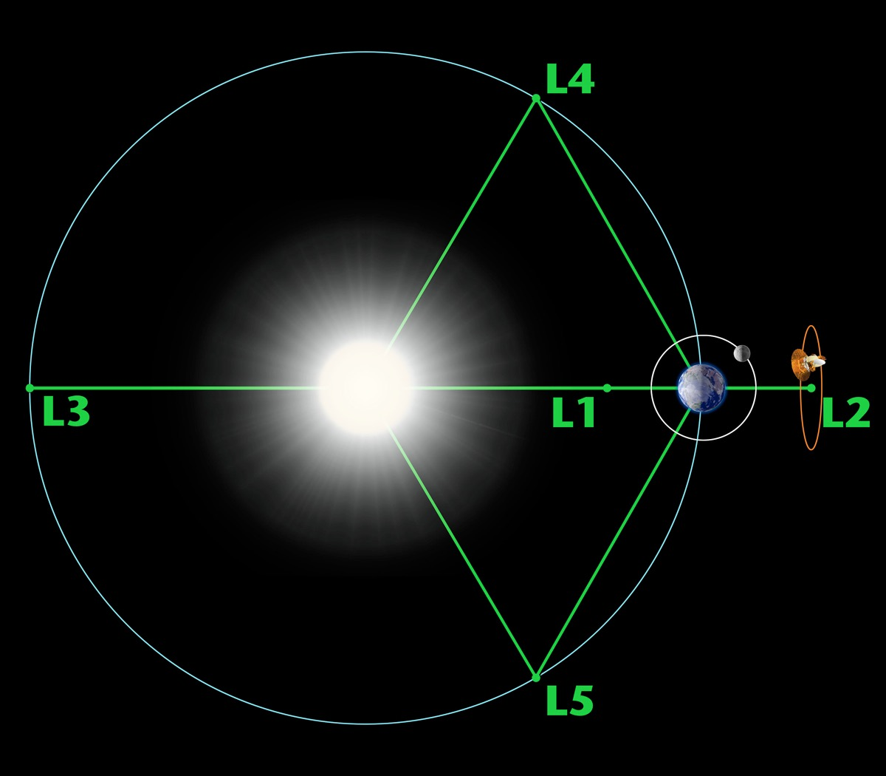
PHI@L5: space weather benefits
Advantages of L5 for space weather application:
easier & more reliable LOS-magnetic field measurements (advantageous viewing geometry)
larger disk coverage improves global field modelling
—> better prediction of flare probabilities

Slide 12
PHI@L5: Science benefits
Required are vector field measurements! (available for only 200g more than LOS magnetograph)
Continuous stereoscopic B-field measurements possible —>180° ambiguity removal
allows measurement of currents, build-up of magnetic energy in ARs
Essential to improve understanding of energy release mechanisms
Essential for reliable predictions

Slide 13
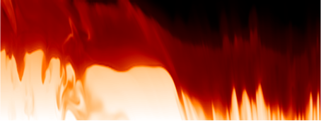
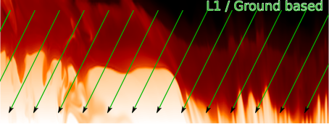
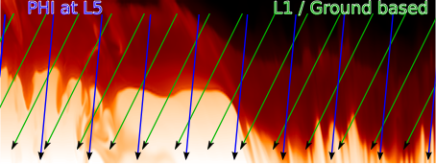
PHI@L5: Science Benefits
Magnetograms based on inversion of RTE are showing B on surfaces of equal optical depth.
Stereoscopic measurements will allow for inversions on a geometrical heigh scale
—> significant improvement/simplification for B-field extrapolation

Slide 14
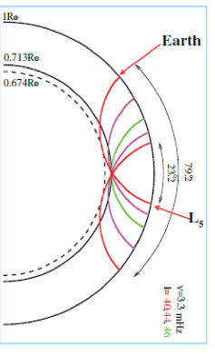
PHI@L5: Benefits for Helioseismology
PHI@L5 would improve
Better spatial coverage gives better statistics
Longer observations of each active region
Longer ray paths available for time-distance
Vector velocities
SDO+PHI+L5 offer three viewing angles and/or near complete coverage of the Sun.
Requirements:
low resolution Dopplergrams
Cadence: 1 map/minute

Slide 15
L5 Magnetograph Specification
for Global Solar Magnetic Field Maps
based on ADAPT WSA-Enlil and F10.7 & EUV irradiance modeling experience (Carl Henney, see presentation yesterday afternoon)
Parameter | Baseline | Optimal | Difference | SO/PHI
Observed Area | Active Regions | Full-disk | etalon size | FDT/HRT
Spatial Scale | 2”/pixel | 1”/pixel 1/3” res (*) | 4cm vs. 8cm 50cm (Hinode) (*) | 0.5”/pixel
Polarimetry | LOS (I,V) | I,Q,U,V | +200 g | I,Q,U,V
Dynamic Range | +/- 2500 G | +/- 3500 G | operation mode | +/-4 kG
Sensitivity | < 1 G/pixel | < 1 G/pixel | TBD | S/N 1000
Zero-point error | < 0.1 G | < 0.05 G | TBD
Cadence | 2 hours | 15 minutes | data volume | 1 minute
(*) L5 modeling matrix, talk by Pete Riley, Tuesday afternoon

Slide 16
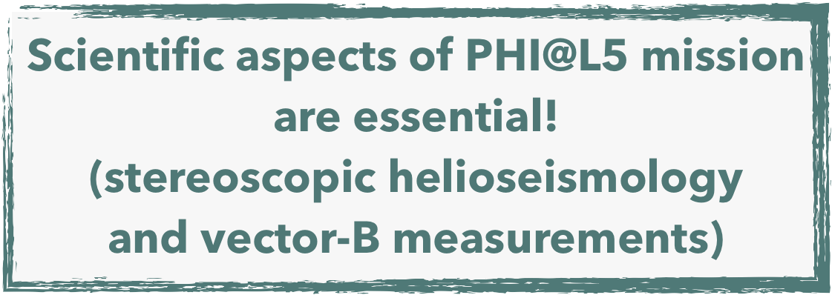
Summary

Slide 18
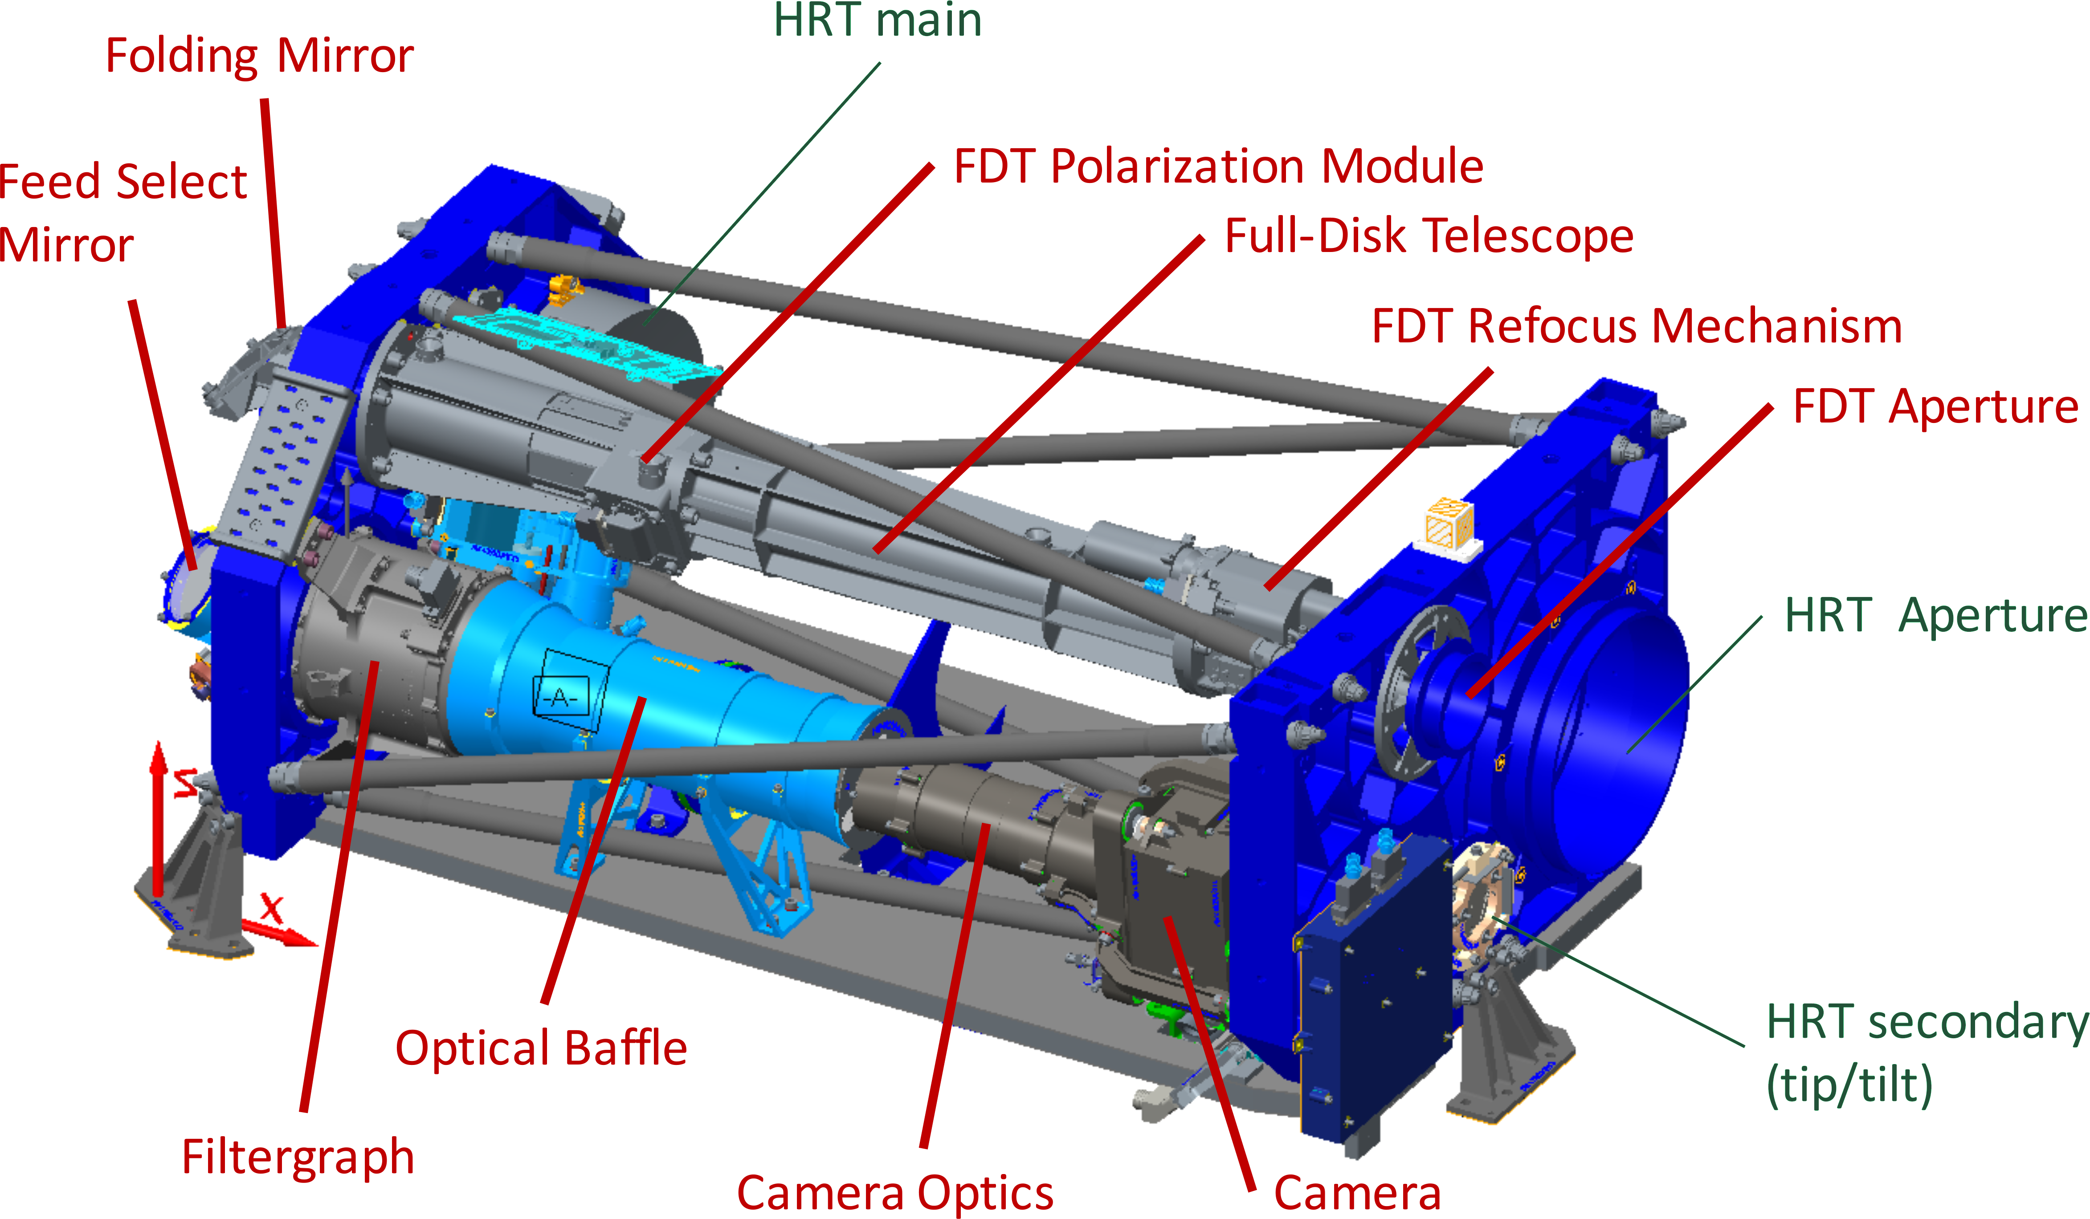
SO/PHI design
HRT: off-axis Ritchey-Chrétien telescope
FDT: off-axis refractor
Polarization Packages: based on Liquid-Crystal Variable Retarders (LCVRs)
Filtergraph: transfer-optics with solid state etalon and interference filters
Image stabilization: 30 Hz Correlation Tracker
Focal Plane: 2k / >10fps APS detector

Slide 19
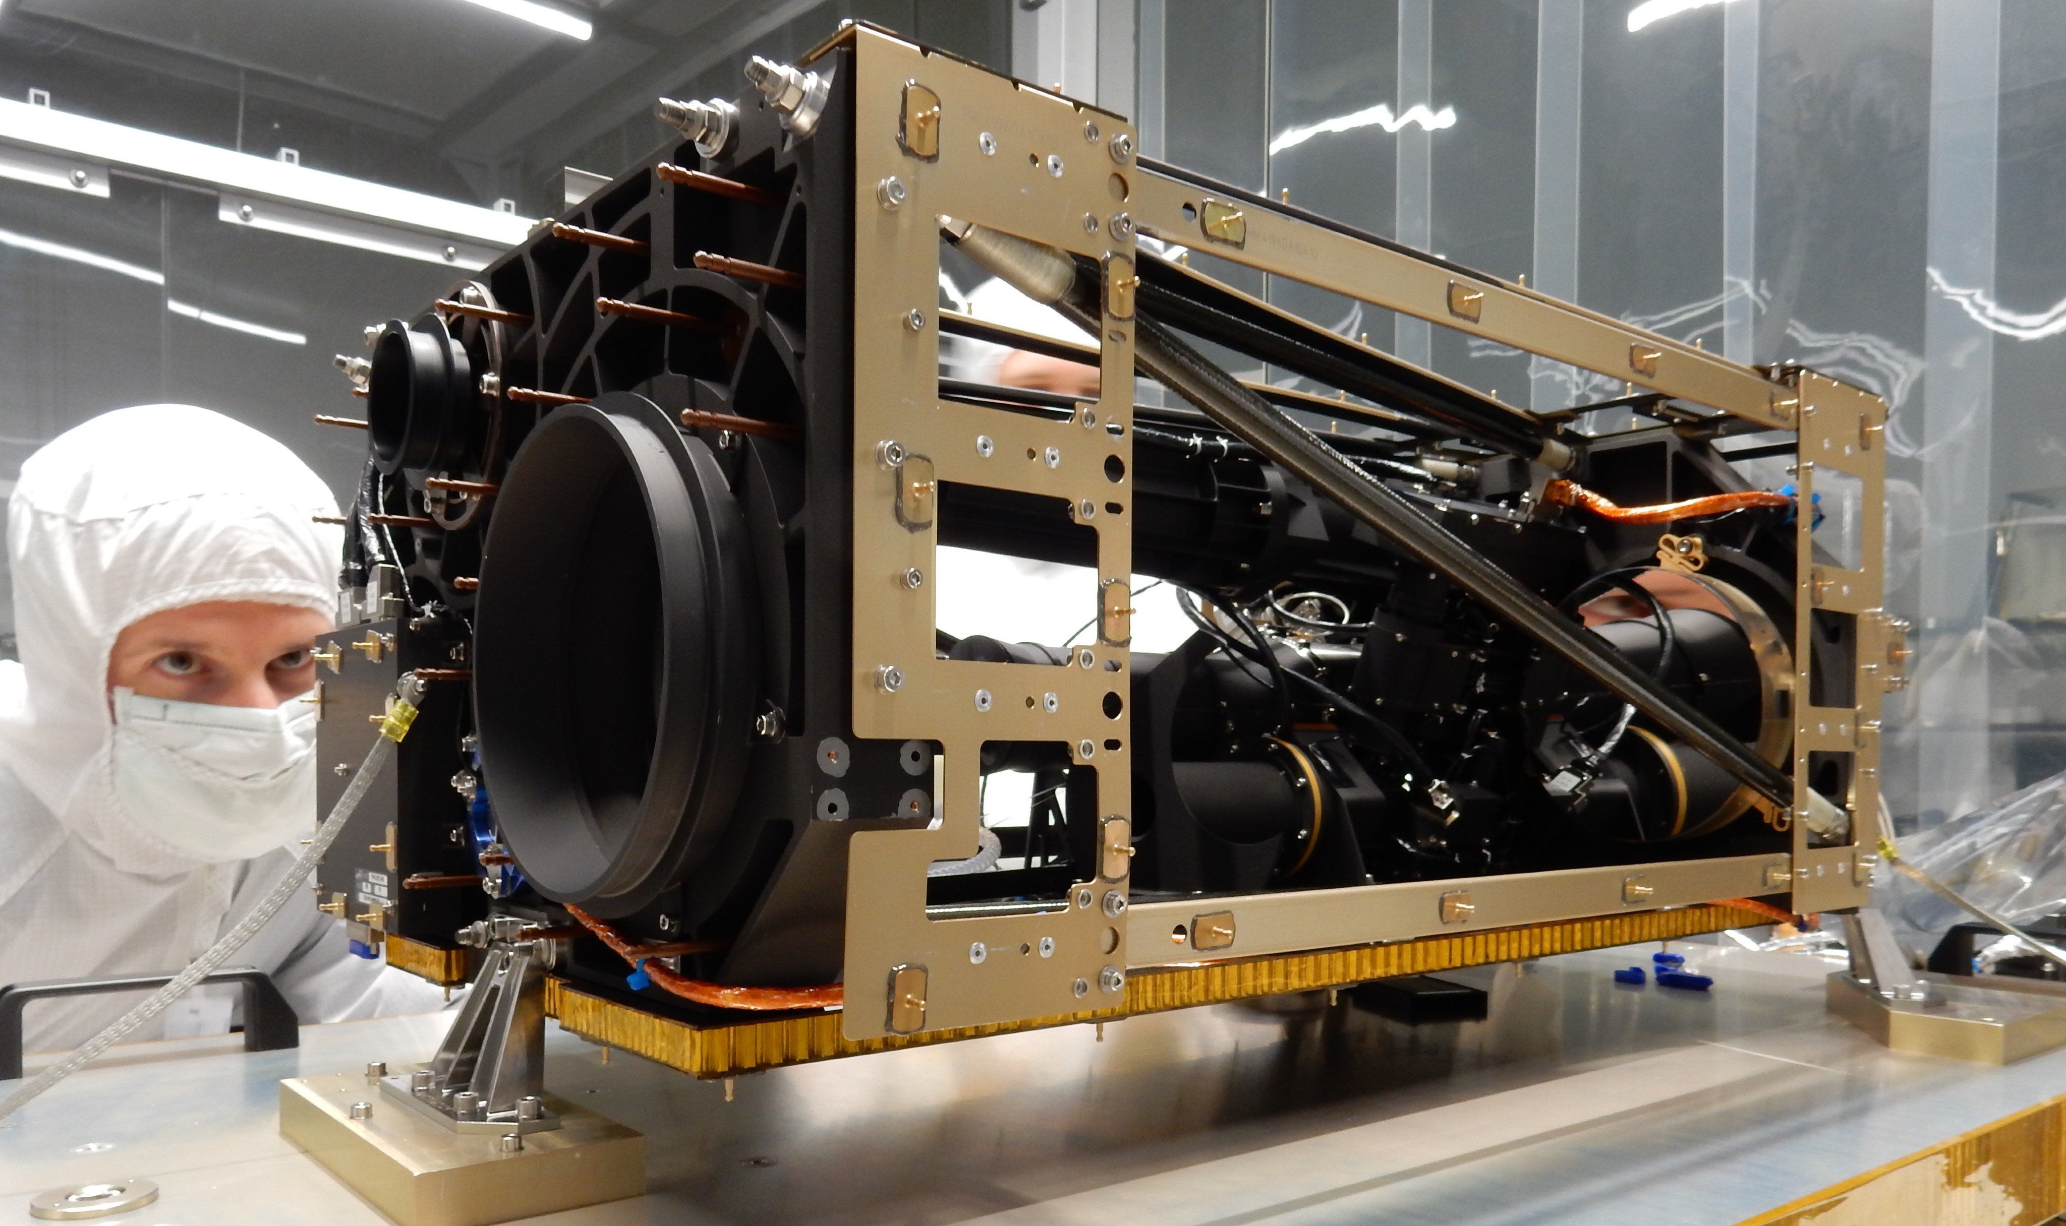
SO/PHI design
2 AlBeMet main blocks
6 low CTE CFRP struts
Al honeycomb baseplate
Total volume: 30 x 40 x 80 cm³
Total mass: 35 kg (c.f. HMI: 73kg, MDI: 56.5kg)
current status: FM polarimetric calibration
delivery to ESA in a couple of weeks
PHI FM, Jan 21 2017

Slide 20
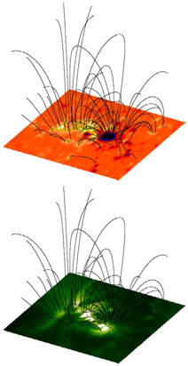
SO/PHI science: atmospheric coupling
SO is designed to probe all solar layers from its interior up to the heliosphere. The most prominent questions concern the magnetic coupling between the different atmospheric layers.
SO with both remote sensing and in-situ measurements aims to address the largely unsolved problems of chromospheric and coronal heating as well as the transport phenomena into the interplanetary space
SO/PHI will provide the photospheric magnetic field structure which represents essential boundary conditions to achieve these goals.
Marsch et. al (2004)

Slide 21
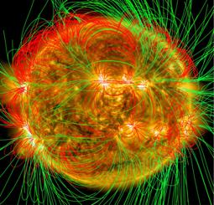
SO/PHI corona and global Sun science
SO’s close perihelion transits enables to follow surface structures for more than half of a rotation period, i.e. up to 23 days.
Vantage points far from Earth allow for instantaneous 4π magnetic maps

Slide 22
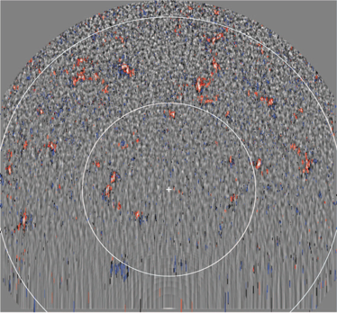
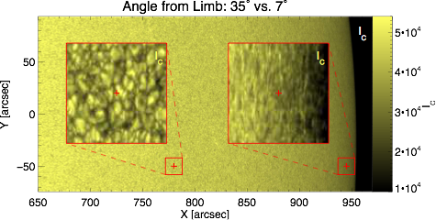
SO/PHI polar science
Polarimetric and dynamic studies of the solar polar regions from the ecliptic plane suffer from geometric foreshortening. SO/PHI will be the first polarimeter looking at the poles from an inclination <83 deg
Tsuneta et. al (2008)

Slide 23
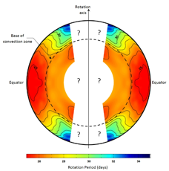
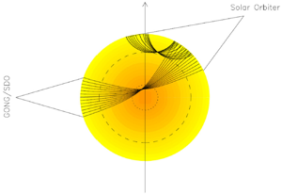
SO/PHI science: helioseismology
Observations from a vantage point in the ecliptic does not allow probing solar latitudes higher than ~70°.
SO/PHI observations from out of the ecliptic will help to address problems of, e.g., the solar dynamo.
Stereoscopic Helioseismology
Probing the Sun from different vantage points may allow for probing deeper layers than what is possible with only one instrument.

Slide 24
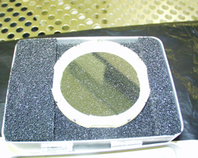
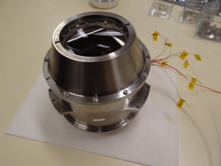
SO/PHI filtergraph
Line scanning device based on a solid state Fabry-Pérot etalon:
FWHM = 90mÅ, free spectral range = 3.0Å
~ 1nm surface roughness, ~10nm abs thickness tolerance
T-stability: <0.1K on etalon
66°C operating temperature
1.5 W heater power
250μm LiNbO3 etalon
2 optical windows (lenses, ITO coated)
2 interference filters (order sorter, IR blocker)
1 LiNbO3 etalon
Oven (active thermal control)
HV connection
filter graph

Slide 25
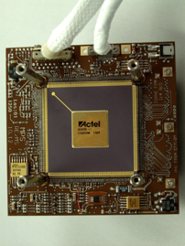
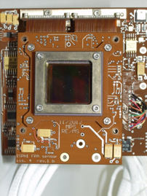
SO/PHI focal plane assembly
2k x 2k read-out at > 10fps
FWC: 100ke⁻ (<1% linearity)
Actively cooled sensor (cold element) => dark noise: ~100 e⁻/s per pixel
Automatic Single Event Upset (SEU) recovery
Automatic sensor Single Event Latch-up (SEL) detection and recovery (sensor power cycle)
FPA FPGA board
FPA sensor board (EFM)

Slide 26
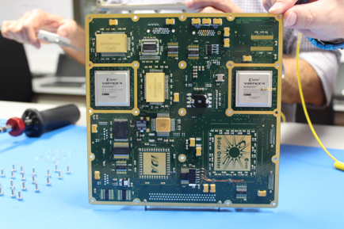
SO/PHI digital processing unit
Tasks:
Instrument control
Science data Acquisition with >10 fps
Correlation Tracker control
Onboard data calibration
Onboard data inversion
4 Tbits flash memory control
Commanding/Telemetry
Most critical items:
2 reconfigurable FPGAs for onboard data analysis, image acquisition and CT control

