Slide 1
L1? L5? Neither?
The Need for a Strategy for the Deployment of SpWx Space Infrastructure
(…remote sensing, mostly)
Angelos Vourlidas, JHU/APL
240-228-5073
angelos.vourlidas@jhuapl.edu

Slide 2
Lessons Learned: SpWx Sensor Investment is non-Optimal
SpWx sensors reflect ‘old’ research directions
Timeline | Research Payloads | Operational Payloads
To mid-1990s | SXRs: Yohkoh, SMM | No SXR imaging
To mid-2000s | EUV, CORs: SOHO | No EUV imaging: GOES/SXI
To mid-2010s | 3D, Cadence: STEREO, SDO | No CORs: GOES/SUVI
To mid-2020s | L5? Solar Polar Imager? | COR: SWFO
To mid-2030s | Research-2-Operations Optimized Payloads

Slide 3
Lessons Learned: The July 23, 2012 CME(s)
18.6 hour travel time to 1AU (STEREO-A)!
Lessons Learned:
A Carrington-level event can occur at any cycle, even the weakest cycle in 100 years.
An in-situ monitor at L1 provides insufficient warning time (10 mins for the July 23, ‘12 CME).
An off Sun-Earth line viewpoint could decipher the CME structure.
Extremely fast CME ~2400 km/s
Super strong flux rope: |B|~80 nT, with -40 nT Bz for several hours.
If it had hit Earth, Dst -1600 n -- -500 nT (Possibly the largest ever).

Slide 4
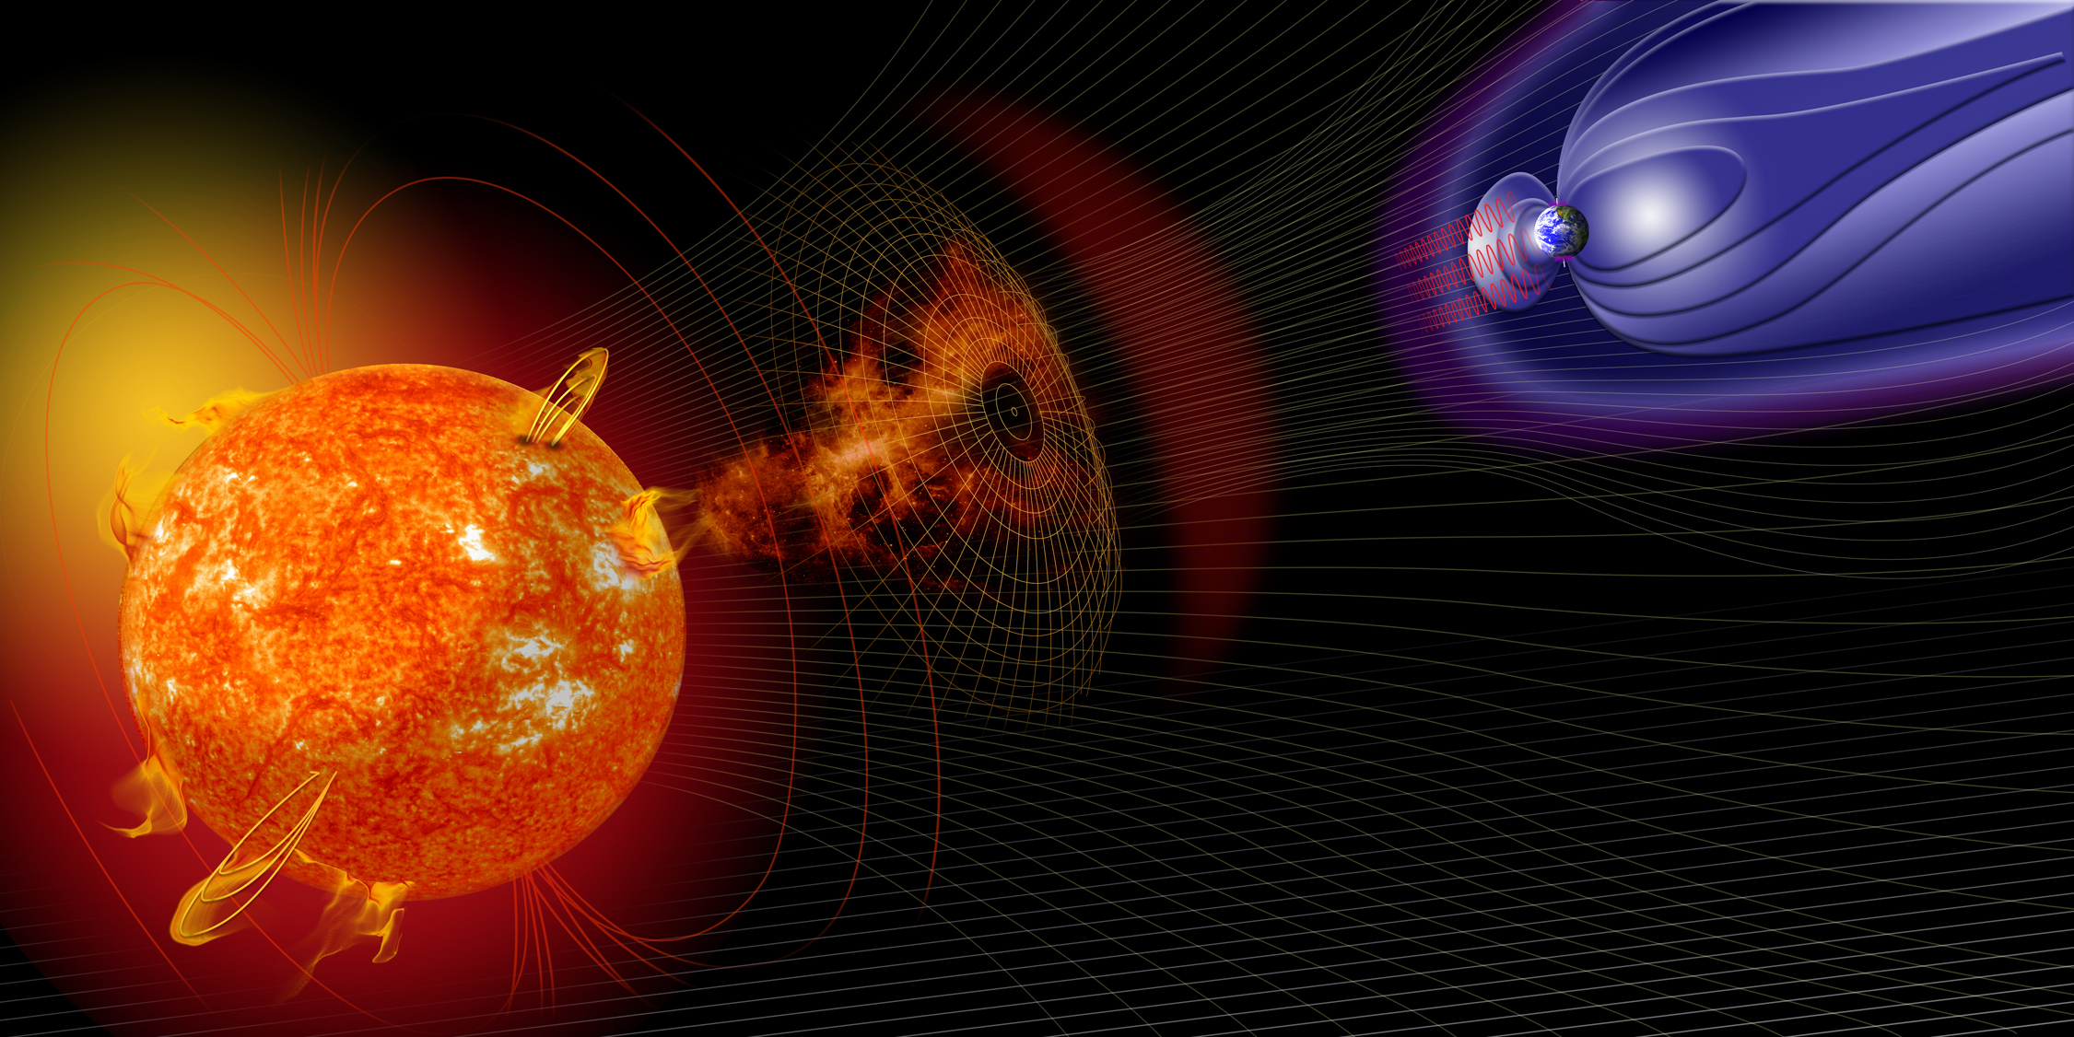

Basic SpWx Requirements are Straightforward Predict storm occurrence, intensity, and duration
When?
How Strong?
How Long?
Storm occurrence depends on CME Time-of-Arrival (ToA).
Storm intensity depends on speed, strength of B_{z}, and length of interaction.
  Rate of reconnection depends on electric field in CME (E = v x B = vBz).
  Flux injected in magnetosphere depends on duration of interaction (Φ = E Δt).
Empirical prediction (e.g. Wang et al. 2003).

Slide 5
Let’s Try TRACEABILITY
SpW Concern | Parameters | Research Issue | Required Inputs for OPS forecasting | Required Measurements | Sensor Deployment
Onset / Regional Effects | Arrival Time | Propagation: Interaction w/ solar wind (CMEs, CIRs) | Modeling of bgkd SW CME kinematics (fast <30 R_{s}; medium <70 R_{s}) B_{phot} over solar surface. | 2-view COR img. LOS B_{phot} >60º from S-E line. | COR (L₅, S-E) MAG (L₅, L₄) In-situ < 0.9 AU
Strength of interaction | Speed
 | B structure | Distortion | 3D CME structure. Modeling of bkgd SW. CME forces. | Multi-view COR img. High SNR imaging >50 R_{s} LOS B_{phot} >60º from S-E line. | HI (L₅) In-situ < 0.9 AU MAG (L₅, L₄)
 | B strength* | CME origin, initial evolution | Erupting volume. 3D CME structure <2 R_{s} | EUV img. (131Å, 171Å) off S-E line. 2-view COR img. | EUV/COR (L₅) In-situ < 0.9 AU
Duration of interaction | Size | Propagation: Interaction w/ solar wind (CMEs, CIRs) | CME direction. 3D CME structure. | HI img off S-E line. Multi-viewpoint img. High SNR imaging >50 R_{s} | COR (L₅, S-E) In-situ < 0.9 AU
*Not for OPS yet. Requires research.

Slide 6
Solar Driver Inputs (Path Forward)
SpW Concern | Parameters | Research Issue | Required Inputs for OPS forecasting | Required Measurements | Sensor Deployment
Onset / Regional Effects | Arrival Time | Propagation: Interaction w/ solar wind (CMEs, CIRs) | Modeling of bgkd SW CME kinematics (fast <30 R_{s}; medium <70 R_{s}) B_{phot} over solar surface. | 2-view COR img. LOS B_{phot} >60º from S-E line. | COR (L₅, S-E) MAG (L₅, L₄) In-situ < 0.9 AU

Slide 7
Novel Orbits:
Quasi-Satellite Orbits
Science Objectives
  Solar Imaging: EUV Stereoscopy, CME 3D recon, magnetograms??
  SEP: Longitudinal distr. at small-medium separations (0° - 44°).
  Fields+ Plasma: Multipoint ICME recon. – comparison w/ imaging.
  ITM: Imaging of: CME-Mag interaction (WL), plasmasphere. (EUV?),
45°
0.3 AU

Slide 8
Concrete Steps to Improve SpWx Predictive Accuracy
Lessons Learned:
A Carrington-level event can occur at any cycle, even the weakest cycle in 100 years.
An in-situ monitor at L1 provides insufficient warning time
(10 mins for the July 23, ‘12 CME).
An off Sun-Earth line viewpoint could decipher the CME structure.
What? | Why? | Where?
Increase Photospheric Magnetic Field Coverage | Better SW predictions, CME propagation | Line-of-Sight Magnetograph at L5
Obtain 3D CME Parameters | Better CME direction, speed, ToA | Coronagraph at L5
Measure CME Magnetic Field | Better Bz prediction accuracy | Upstream (~0.3AU) in-situ magnetometers (Quasi-Satellite Orbits)
Measure E_{magnetic} Build-up at CME Source | Predict Eruption and magnetic content | Vector Magnetograph + EUV imaging from L5
Improve Subsurface Imaging | Log-term activity prediction | Doppler/Magn. Imaging from L5+L1
Assumes availability of Earth or L1 assets: magnetograph, EUV imager, Coronagraph.

Slide 9
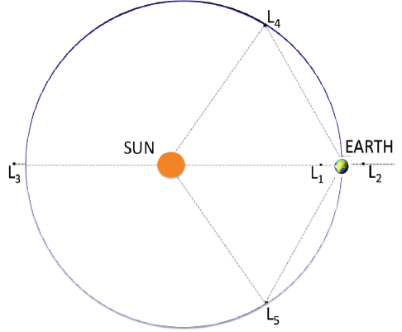
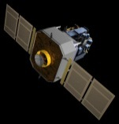
Path Forward: Increase (strategically) spatial coverage of inner heliosphere
Deploy a Space Weather Sentinel Network:
  DSCVR Follow-On (CCOR) or CCOR/COR2 in Earth orbit
  L5 Mission (endorsed in Decadal Report).
  L1 Upstream Monitor(s) at ~0.3 AU
  (SpWx Diamond Concept, Orbits endorsed
  in ILWS/COSPAR Roadmap).
  L4 Mission.
  …
COR, MAG, HI, EUV
DSCVR follow-on
Instrumentation Priority List
Coronagraph/Hel. Imgr at L₅ (2.5 Rs – 0.65 AU).
Coronagraph at L₁ (2.5 – 20 Rs).
Magnetograph at L₅.
EUV Imager/Coronagraph at L₅ (<2.5 Rs).
Heliospheric Imager at L₄ (2.5 Rs – 0.65 AU).
Magnetograph at L₄ .
Upstream Monitors (Quasi Satellite Orbits)
in-situ/COR
L5 Carrington
COR, MAG, HI, EUV

Slide 10
Suggestions
Assemble a detailed Traceability Matrix to identify
  ‘low-hanging’ fruit
  Sensors and their requirements
  Locations to deploy these sensors
  Mission concepts and timeline
Combination of operational and research payloads
Use of rides, small sats
LOCATION, LOCATION, LOCATION!
  Instruments do not need to be cutting-edge
  Instruments do not need to cost $$$$

Slide 11
Backup Slides

Slide 12
Methods for Estimating the Magnetic Field Entrained in the CME
Research
Technique | Requirements | Pros/Cons | Notes
Radio Imaging | Gyrosynch. emission, Spatially Resolved Modeling | Rare occurrence Complex emission Most direct estimate | Bastian et al. (2001), Tun & Vourlidas (2014), Sasikumar et al. (2014)
Faraday Rotation of radio polarization | Well-characterized polarized sources CME-source intersection Modeling | Rare occurrence Limited # of sources. LOS properties | Jensen & Russell (2008)
Kinematic Model of MFR | Force Description Modeling | 1D Many free parameters Promising | Kunkel & Chen (2010)
Geometric (empirical) | CME diameter Flux conservation | Statistical Self-similar | Vourlidas et al. (2000), Subramanian & Vourlidas (2009)
Geometric + B_{Phot} Measurements | 3D CME measurements B & Helicity measurements. | Statistical Uses CME and B data Promising | Lynch et al. (2010) Patsourakos et al. (2015)
‘Real-time’ Reconstruction | In-situ B measurements upstream of Earth | Short-term (<1hr) Assumes smoothness. Promising | Chen et al (2012). Riley et al. (LWS TRT)

Slide 13
Solar Driver Inputs (Status Summary)
SpW Concern | Parameters | Method | Prediction Status | Research Issue
Occurrence Onset Regional Effects | Arrival Time | Imaging* + analysis or modeling | +/- 6-8 hrs | CME IP propagation
Strength of interaction | Speed | Imaging* + analysis | +/- 200 km/s | CME IP propagation
 | B structure | Imaging* + modeling | Flux Rope | CME IP evolution
 | B strength | In-situ (at L1) | 40-60 min | CME Coronal origin / evolution
Duration of interaction | Size, Direction | Imaging* + model | ~few hrs (ongoing) | CME IP propagation / evolution
* Greatly improved by multi-viewpoint observations (SECCHI + LASCO)

