Slide 1
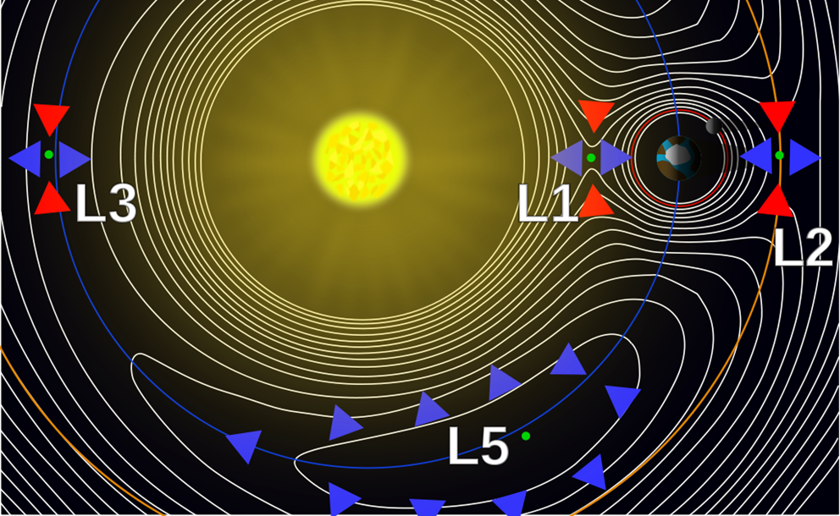
L5 in Tandem with L1: Future Space-Weather Missions Workshop – Introductions/Logistics/Welcome
Location: Department for Business, Energy & Industrial Strategy (BEIS), 1 Victoria Street, London, SW1H 0ET – 06-09 March 2017
Mario M. Bisi (1), Mark Gibbs (2), and Doug Biesecker (3)
(1) RAL Space, Science and Technology Facilities Council (STFC), Rutherford Appleton Laboratory (RAL), Harwell Campus, Oxfordshire, OX11 0QX, UK.
(2) Met Office Space Weather Operations Centre (MOSWOC), Met Office, FitzRoy Road, Exeter, Devon, EX1 3PB, UK.
(3) National Oceanic and Atmospheric Administration (NOAA ), Space Weather Prediction Center (SWPC), 325 Broadway, Boulder, CO, 80305, USA.

Slide 2
Goals of the Workshop?
To set the path for a dedicated L5 space-weather mission and how it might operate in tandem with a dedicated L1 DSCOVR follow-on mission.
To better define the requirements for these missions and explore how data from these missions can be effectively used to maximise their benefit in forecasting.

Slide 3
Social/Online Media etc…
The Workshop #tags are: #L1L5Together #SpaceWeather – please use them both on all social-media postings – there has been some good activity through the last 3 ½ days – thank you all!!!

Slide 4
Online…
Some time between now and mid-April, all the talks and write-ups of the sessions/discussions will be put online.
No-one has asked to redact anything thus far.
Please can all those with posters send me a PPT/PPTX/PDF of their poster so these can also go online.
Website remains to be:
https://www.ukssdc.ac.uk/meetings/L5InTandemWithL1/

Slide 5
Thanks!
Thanks to the whole of the WOC and all those that helped in putting the programme together and for organising the Media Coverage and Social Media aspects of the Workshop.
Thanks to all those that have helped out locally with the logistics and with putting up posters, arranging the extension leads, etc…
Most importantly – thanks to you all for being here and for wanting to take an active part in the workshop over the next 3½ days…

Slide 6
Safe Journey Home And Thank You All For Attending…
☺

