Slide 1
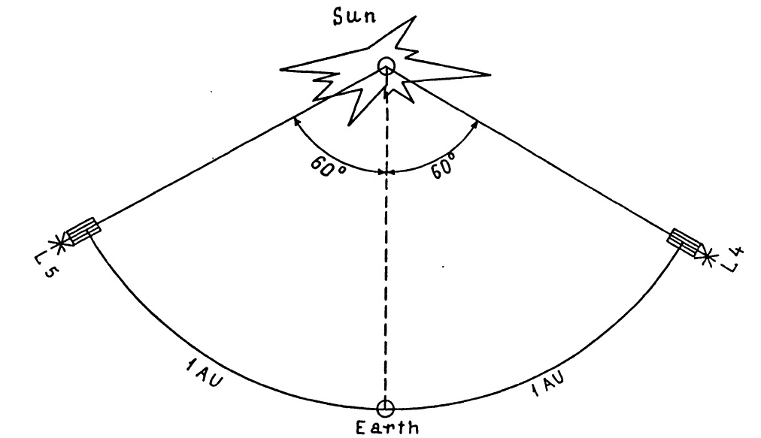
L4+L5 Mission as an Ideal Project for International Collaboration
Alexei Pevtsov^{1,2}, Mario Bisi³, Anatoli Petrukovich⁴, and Ying Liu⁵
    (1) U.S. National Solar Observatory, USA
    (2) University of Oulu, Finland
    (3) RAL Space, UK
    (4) Space Research Institute, Russia
    (5) National Space Science Center, China

Slide 2
What Do Some Other Spacefaring Nations Plan for L5?
China
  L5 mission was proposed to the Chinese Space Science Priority Program; could consider L4 as China’s contribution to the international project, and could also contribute to the ESA L5 mission in terms of instruments, launch and in particular Chinese DSN.
India
  Aditya - L1 mission (launch in 2019 – 2020)
  There is a considerable interest from Indian scientists for L5 mission and a white paper is under the review at ISRO (Indian Space Research Organisation).

Slide 3
Aditya –L1 Instruments
Visible Emission Line Coronagraph (VELC): (3 visible and 1 Infra-Red channels); magnetic field measurement of solar corona
Solar Ultraviolet Imaging Telescope (SUIT): near Ultraviolet (200-400 nm), solar irradiance
Aditya Solar wind Particle Experiment (ASPEX)
Plasma Analyser Package for Aditya (PAPA): solar wind composition
Solar Low Energy X-ray Spectrometer (SoLEXS)
High Energy L1 Orbiting X-ray Spectrometer (HEL1OS)
Magnetometer

Slide 4
What Do Some Other Spacefaring Nations Plan for L5?
Russia
  L4+L5 project originates from the Interplanetary Solar Stereoscopic Observatory (ISSO) → Orbital Stellar Stereoscopic Observatory (OStSO)
  Some interest from the Russian Academy of Sciences; the OStSO project is under evaluation at ROSCOSMOS (Russia's Space Agency).

Slide 5
Instead of having multiple L5 missions, should we aim at L1-L5 and L4?
L5 – early view of solar surface, which Earth will be facing 4-5 days later
L4 – a better view of source regions of eruptions responsible for SEPs affecting the near-Earth environment.
L4+L5 will cover about 83% of solar surface and significantly improve both short- and long-term forecasts.
L4+L1+L5+Flux transport (ADAPT) would provide very realistic representation of magnetic flux of entire solar surface.
Other benefits: better polar field, CME triangulation, SW throughout heliosphere, etc.

Slide 6
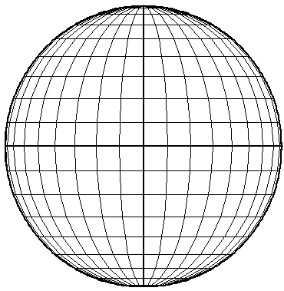
Example: L5-L1-L4 have different vantage to polar regions
June
March
L5
L1
L5
L4
L4
L1
(red) Plane of Earth orbit inclined to about 7 degrees to solar equator

Slide 7
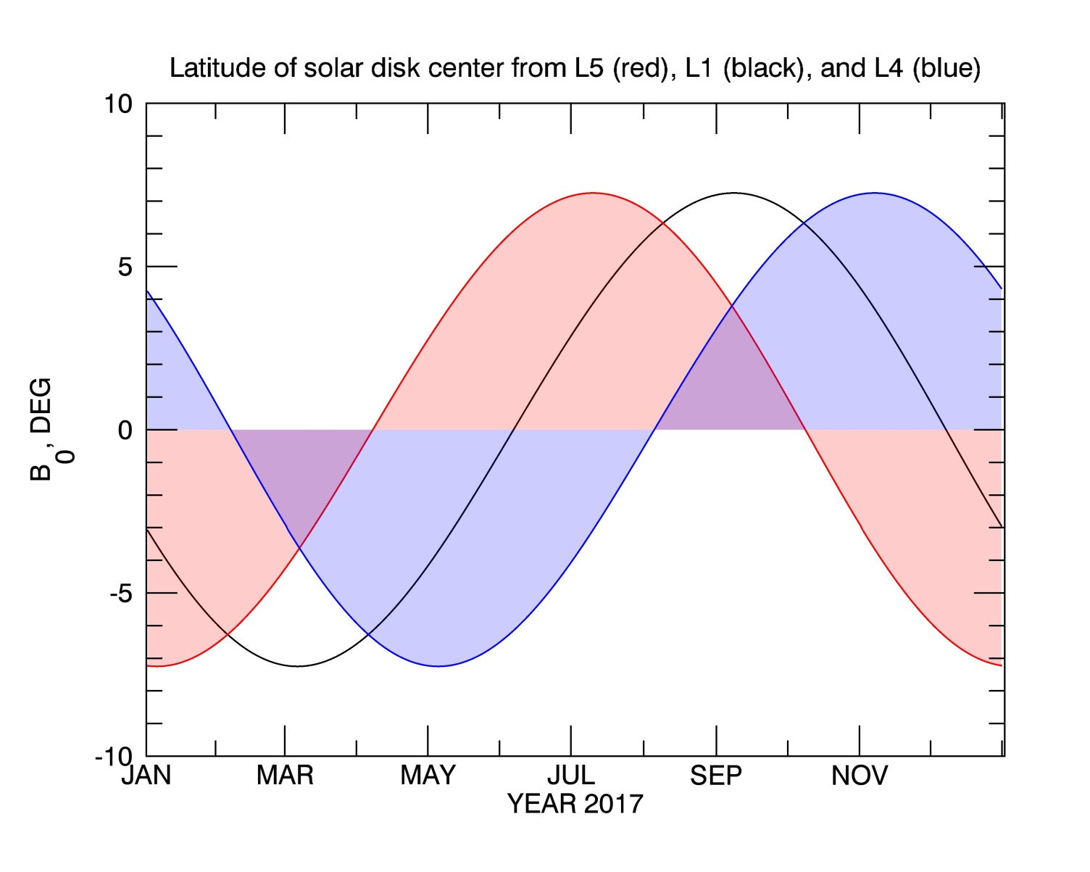
Polar Field from L1-L5-L4
Knowledge of polar fields is critical for many SW models (e.g., PFSS, WSA-Enlil).
Combination of L1, L5 and L4 will improve polar field representation.

Slide 8
Role of L4-L5 for Mars Expedition
30 April 2018
Depart Earth
+260 days
15 Jan 2019
Arrive Mars
L5
L5
L4
Mars
L4
Earth

Slide 9
It is unlikely that ESA-(NASA-NOAA) will fund L4 (in addition to L1 and L5)
Possible solution: to encourage other spacefaring nations such as China, India, Russia to launch their own spacecraft to L4 in close coordination with the L5 mission.
Advantages:
  Having L5-L1-L4 would have a huge mutual benefit
  Costs are more-fully shared; minimal inter-dependency
  Avoids “usual” restrictions on transfer of technology (EAR, ITAR)
  Strong international collaboration in critical area
  Will provide very positive public and political visibility to the field
Requires political will to initiate such collaboration: willingness to share/coordinate requirements for key instruments, establishing clear rules about sharing the data, etc. – this needs to happen soon.

