Slide 1

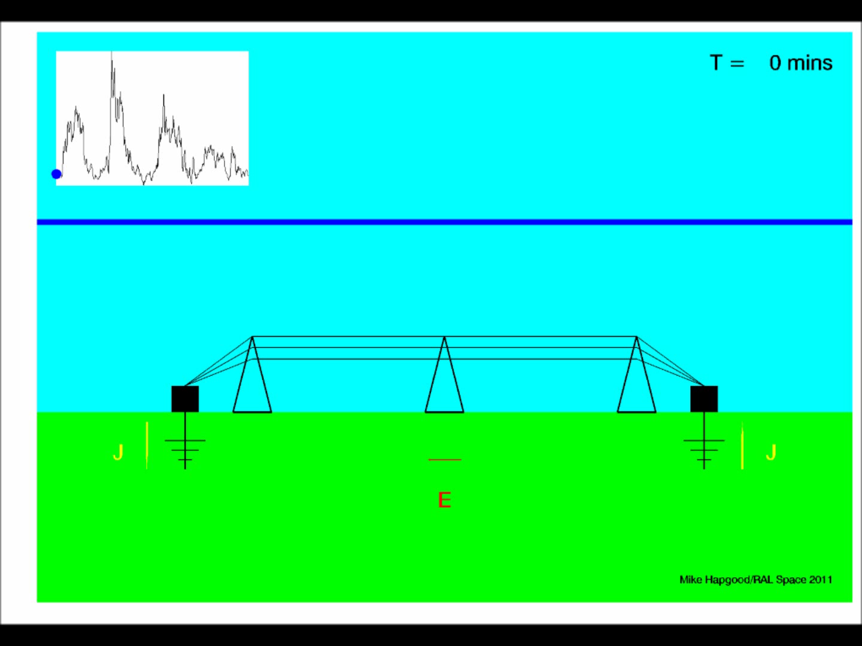

Mario M. Bisi (1), Mike A. Hapgood (1), Richard A. Harrison (1), Mark Gibbs (2),
Catherine Burnett (2), and Mike Willis (3).
(1) RAL Space, UK Research and Innovation – Science & Technology Facilities Council – Rutherford Appleton Laboratory, Harwell Campus, Oxfordshire, OX11 0QX, UK. (2) Met Office Space Weather Operations Centre, Met Office, FitzRoy Road, Exeter, Devon, EX1 3PB, UK. (3) UK Space Agency, Electron Building, Fermi Avenue, Harwell Campus, Oxfordshire, OX11 0QR, UK.
Space Weather in the UK: National Priorities and Contributions to the International Space-Weather Capability and Strategies

Slide 2



















Acknowledgements
An overview (Venn diagram) of the UK Government’s Governance of Space Weather…
Government
Entities
Academics, Research, and Development
SEIEG
Impacts and Mitigations
Improving Capability
Technology, Data, and Forecasting
Scenarios
International Engagement
Acknowledgements: Mark Prouse, Laura Cooke, and Thomas Madden (Department for Business, Energy, & Industrial Strategy – BEIS, UK)
2

Slide 3
Work of SEIEG
SEIEG = Space Environment Impacts Expert Group.
Independent advice to government on space weather environments with adverse effects on infrastructure:
  Experts from research, industry and government; and
  Guided by appreciation of impacts (RAEng report).
Key outputs:
  Reasonable worst case scenarios (RWCS) for range of technologies (power, aviation, satellites, …); also
  RWCS for human radiation dose, public behaviour/anxiety;
  Support for national (e.g. COBR) and international exercises;
  Supports work at GO Science, BEIS, and Met Office;
  RWCS available as tech report on STFC Epubs; and
  Narrative summary in-prep. for peer-reviewed publication.
© 2019 RAL Space
2

Slide 4
SWx as a Hazard?
Space Weather is a Natural Hazard… …because:
Flooding | People, homes, and infrastructure on flood plains and coasts.
Tsunami | People, homes, and infrastructure near coast.
Volcanoes | People, homes, and infrastructure on pyroclastic and lava flow lines.
Space weather | People, homes and infrastructure near a star!
Natural hazards occur in places that are good to live and occasionally dangerous. Scale and frequency of extreme risks is a key concern.
© 2019 RAL Space

Slide 5

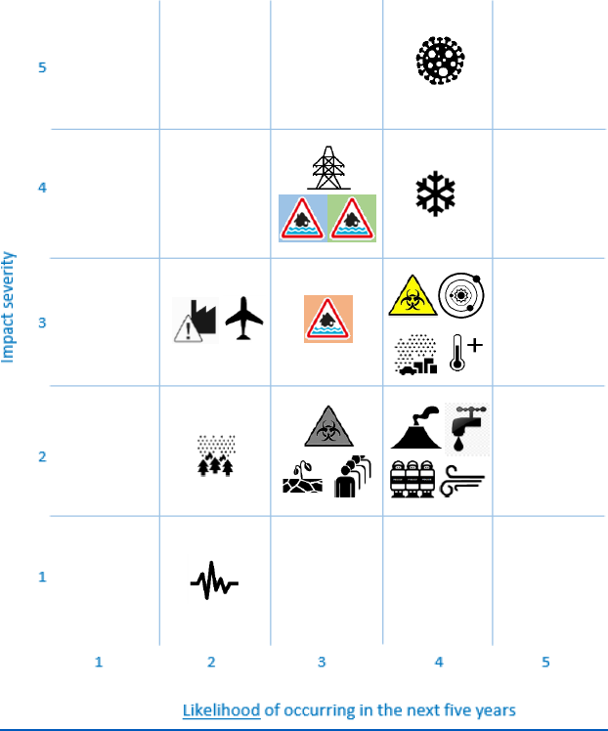
Assessing the Risk
UK’s National Risk Register (NRR – 2015 edition) – other risks.
Severe space weather has been on the UK’s NRR since 2011.
This, along with other additional risks, were brought to the Government’s attention following the problems caused by the Iceland ‘Eyjafjallajökull’ volcanic ash clouds in 2010.
Not just the UK government is concerned here though – other governments are also taking account of the risks of space-weather!
UK Space Agency have funded a socio-economic study on space-weather impacts and others have followed…
© 2019 RAL Space

Slide 6
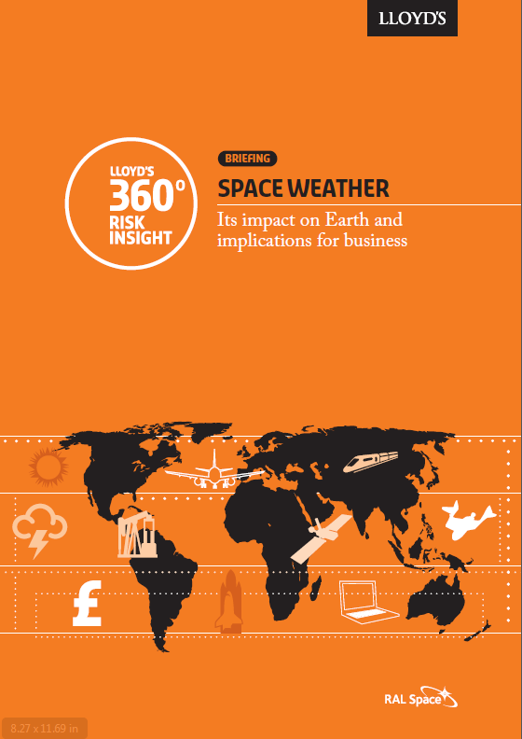
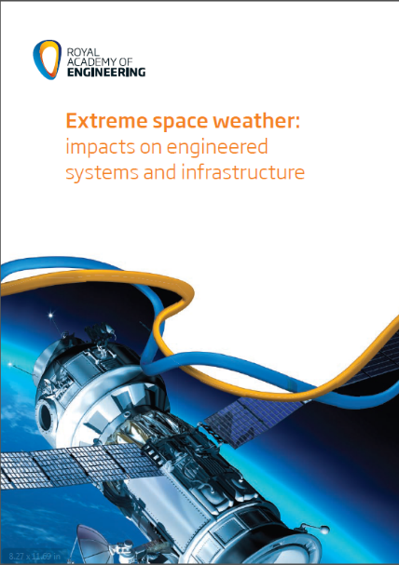
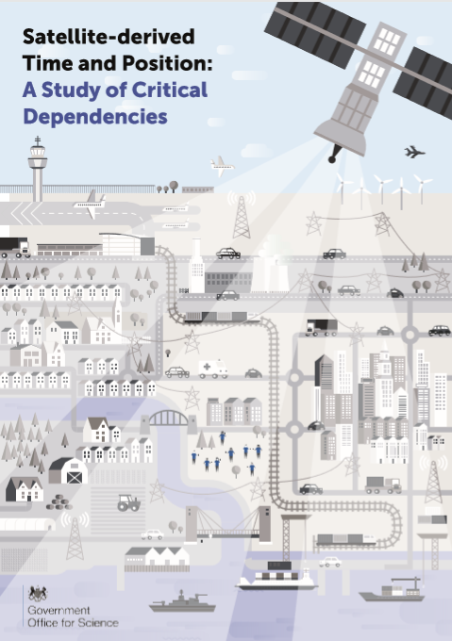
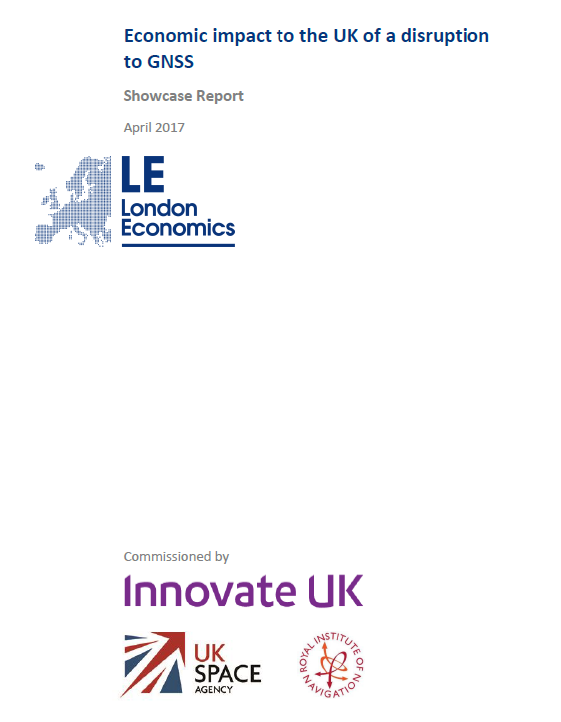
Our Understanding
Reasonable worst-case scenario and understanding:
These reports have collectively provided valuable information for UK Government Departments trying to understand what their vulnerabilities to space weather might be and are used to inform
the development of proportionate risk
mitigation strategies…
Take the scale of the Carrington Storm (1859) lasting 1-2 weeks.
Mix of phenomena – coronal mass ejections (CMEs), solar flares, solar radiation storms, and solar radio bursts…
Each phenomena may occur multiple times and vary in magnitude, timing and time scales as well as in spatial size.
High degree of overlap or synchronicity between individual phenomena.
Commissioning of several reports and studies including economic studies…
Don’t panic, do prepare!
£3B inferred for the loss GNSS for three days…

Slide 7
What about Risks?
Optimising the Risk Equation…
The “Triangle of Pain”…
Who Bears the Risk?
Who Benefits from Resilience?
Government and Regulators
Do not own
Responsibility for safety
Private Sector Critical Infrastructure Companies
Society: Corporate and Private Consumers
Provision of service
Courtesy of Edward J. Oughton

Slide 8
Economic Impacts
Reasonable worst-case scenario and understanding:
The risk and scenarios have to be regularly monitored and updated (guided in the UK case by the Space Environment Impacts Expert Group – SEIEG).
All aspects of society are interconnected making this a difficult task!
A clear financial benefit is derived from space weather forecasting.
  Lessons learned from completed socio-economic studies (e.g. UKSA IPSP, University of Cambridge, etc…), and these are and will be applied to future pertinent studies.
  Wider UK impact (with current forecasting) from the IPSP moderately-severe event case was ~€5B, but across Europe (including Scandinavia) suggested impacts of up to €82B.
  Loss of power costs far outweigh the civil aviation – but other sectors need greater study.
  Similar such impact costs were derived by an ESA socio-economic study.
© 2019 RAL Space

Slide 9
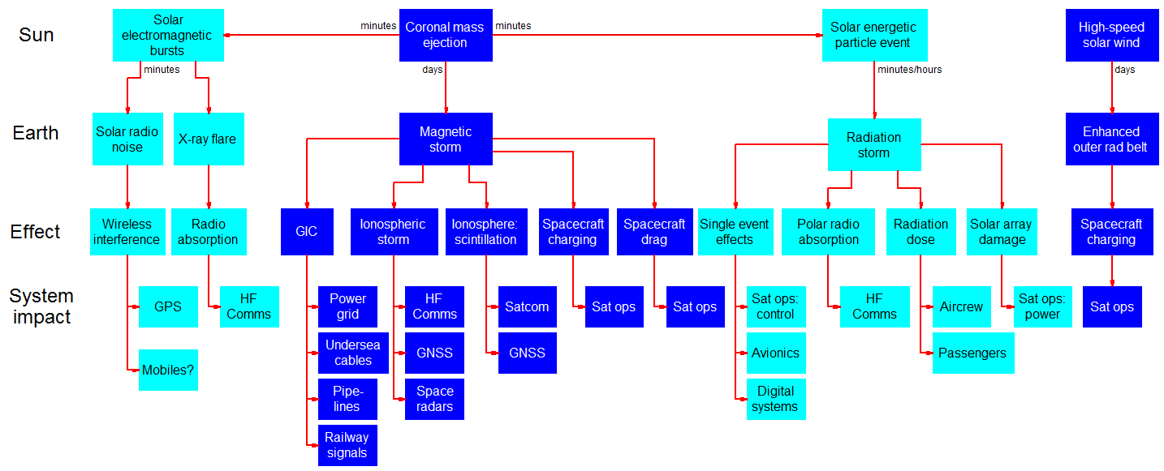
Understand Impact
SEIEG Sun-to-Earth Impact tree (above) developed in response to government request.
Government work now building on this to deepen sector-specific understanding on the scale of the impacts, the level of understanding about the impact, and the level of sector preparedness.
© 2019 RAL Space

Slide 10
Understand Impact
Electricity Sector
_{Coronal Mass Ejection}
_{Solar Flare}
_{High speed stream}
Solar phenomena
Sun to Earth travel time
15 hours to 3 days
‘Event’ at Earth
_{Geomagnetic storm}
_{Radiation storm}
_{Radio burst}
_{X-ray flare}
_{Enhanced outer radiation belt}
Typical event duration
8½ minutes
2 to 3 days
1 to 3 days
1 to 3 days
1 to 10s mins
1 to 10s mins
Days - weeks
Effect
_{GICs}
_{Ionospheric storm}
_{Ionospheric scintillation}
_{Spacecraft charging}
_{Atmospheric density}
_{Single event effects}
_{Polar radio absorption}
_{Radiation dose}
_{Solar array damage}
_{Interference}
_{Increased ionisation}
_{Spacecraft charging}
_{Power grid}
_{GNSS}
_{Satellite anomalies}
_{Satellite anomalies}
_{GNSS}
Degraded VLF, (VHF, UHF) SATCOM
_{Satellite anomalies}
System impacts
_{SATCOM}
_{[mobiles]}
_{Digital systems}
_{GNSS}
1-in-1000yr to 1-in-10,000yr +
Nuclear power stations
Control systems upset
1-in-50yr to 1-in-100yr +
Impact?
Synchronisation issues
1-in-50yr to 1-in-100yr +
Loss of SCADA control
Synchronisation issues
Good understanding
1-in-50yr to 1-in-100yr +
Short-term localised blackouts
Voltage instability
Longer-term blackouts in rural areas
Transformer damage
Limited understanding
Preliminary: direct GIC power-grid impacts with secondary GNSS-degradation impact and single event upsets to a variety of control systems.
In commissioning Sector Specific Trees it is allowing the UK to develop a more-common understanding of space-weather impacts and to coordinate our understanding of those impacts in a simple and informative way.

Slide 11
Ongoing Work…
Ongoing UK Developments and Priorities
National Risk Assessment (and hence NRR) updated:
  Loss of GNSS and economic impacts improved; and
  Adjustments for increases in knowledge, understanding, and current capabilities.
Table top exercises continue to improve knowledge and understanding.
UK Space Weather Strategy being developed:
  Includes close working with the USA on the Benchmarks activities.
UK continues to see UK-led ESA L5 mission a priority.
UK has an interest in other avenues for space-weather data, forecasting, modelling, and potential backup/fall-back options; e.g.:
  Increased number of radiation monitors on satellites; and
  Use of IPS as part of the Worldwide IPS Stations (WIPSS) Network and investigating potential use of heliospheric Faraday rotation (FR).
© 2019 RAL Space
Notes:
Table top exercises:
- Two aviation sector exercises in 2018: July and September;
- Electronic communications; and
- Others planned.
L5 Mission: Expected improvements to space-weather forecasting and resilience.

Slide 12
UK SWx Strategy
A Key component of UK preparedness…
The UK Space-Weather Mission Statement:
  “We will ensure the UK is resilient, and able to respond to a Severe Space Weather Event, on the basis of proportionate risk mitigation”.
The UK SWx strategy will be established around five key strands/pillars:
A five-year period detailing outcomes and challenges in order to achieve our strategic objectives above, with each strand/pillar underpinning the next.
  BEIS should look to reach out to response teams across governments.
  Funding/collaboration streams will be explored as part of our strategy development work across industry, academia, international partners, and internal UK funding mechanisms…
PREDICT
UNDER-STAND
PREPARE
RESPOND
RECOVERY
© 2019 RAL Space
Notes:
Predict – to build the technology and forecasting capability to accurately predict Severe Space Weather Events;
Understand – to develop a common national understanding of space weather impacts, and to share that understanding internationally;
Prepare – to ensure UK’s preparedness to Severe Space Weather event through a proportionate risk mitigation programme, underpinned by a common understanding of impacts; and
Respond – to develop and maintain appropriate response capabilities.
Recovery – to develop recovery methods for different scenarios to get things moving again.

Slide 13
Summary
Space weather is very complex with real-world impacts, it comes in multiple strands with local, regional, and global impacts requiring national and international working/funding!
Economic studies have shown the large-scale impacts even moderately-severe space weather can have.
Severe and everyday space weather are internationally-recognised risks which require adequate forecasting/warnings and need dedicated space-weather missions, new data streams, and improvements to Sun-to-Earth modelling.
The UK is keen to build future space-weather capabilities.
The UK will ensure it is resilient and able to respond to a Severe Space Weather Event on the basis of Proportionate Risk Mitigation.
Development of the UK SWx Strategy is in progress; there will be further engagements with the key stakeholders throughout the process.
© 2019 RAL Space

