Slide 1

Coronal Spectrographic Imager in the EUV (COSIE) for the International Space Station
PI: Leon Golub (lgolub@cfa.harvard.edu)
Smithsonian Astrophysical Observatory
I-PI: Sabrina Savage (sabrina.savage@nasa.gov)
Marshall Space Flight Center
RAS Discussion Meeting – 8 March 2019
Smithsonian Astrophysical Observatory (PI Institution)
Marshall Space Flight Center
Laboratory for Atmospheric and Space Physics

Slide 2
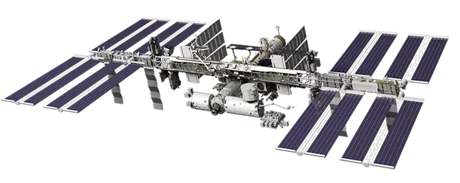
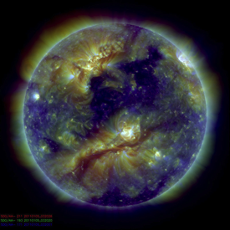
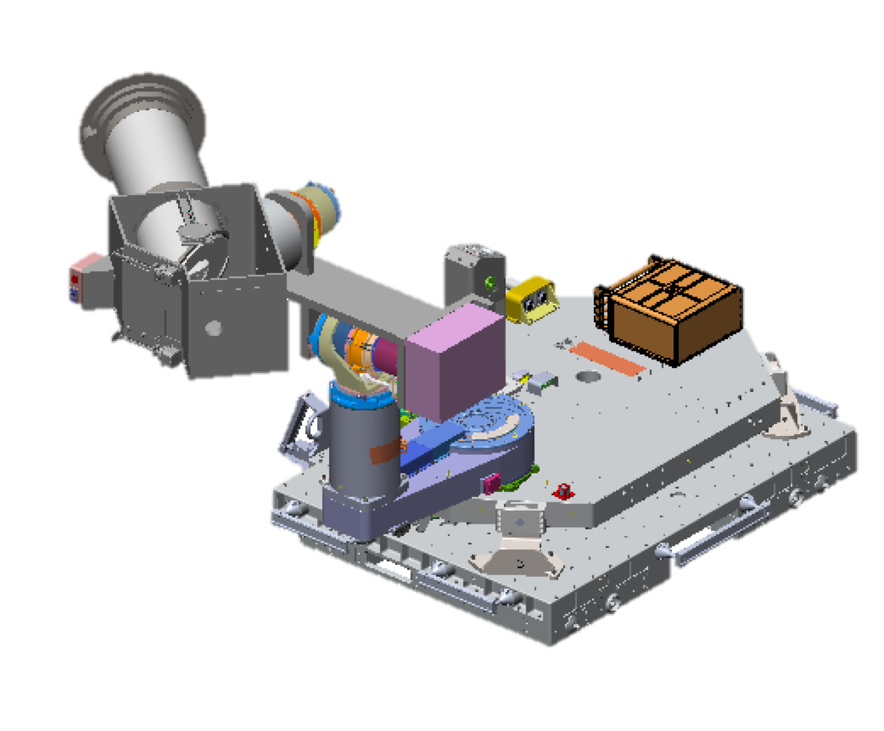
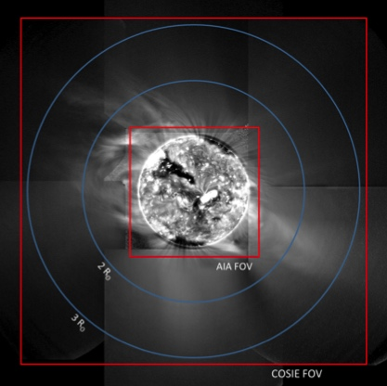
COSIE Investigation Overview
SDO/AIA 171+193+211
-- COSIE is a wide-field extreme ultraviolet (EUV) Coronagraph (COSIE-C) and an EUV Spectrograph (COSIE-S), on the ISS.
-- The non-occulting design provides diagnostics of space weather-related activity in the low corona, from source regions on the disk out to beyond 2.5R.
-- COSIE observations address how the coronal fields open and reclose, how ARs interact with the global field, and how CMEs evolve as they accelerate through the solar atmosphere.
COSIE’s goal is to understand the dynamics and eruptions of the hot, magnetized solar coronal plasma:
The transition between closed and open magnetic structures in the outer corona.
The evolution of CMEs in the low corona.
GOES-R SUVI EUV mosaic of the mid-corona. COSIE captures this entire region within a few seconds as a single image. (GOES image courtesy D. Seaton.)

Slide 3
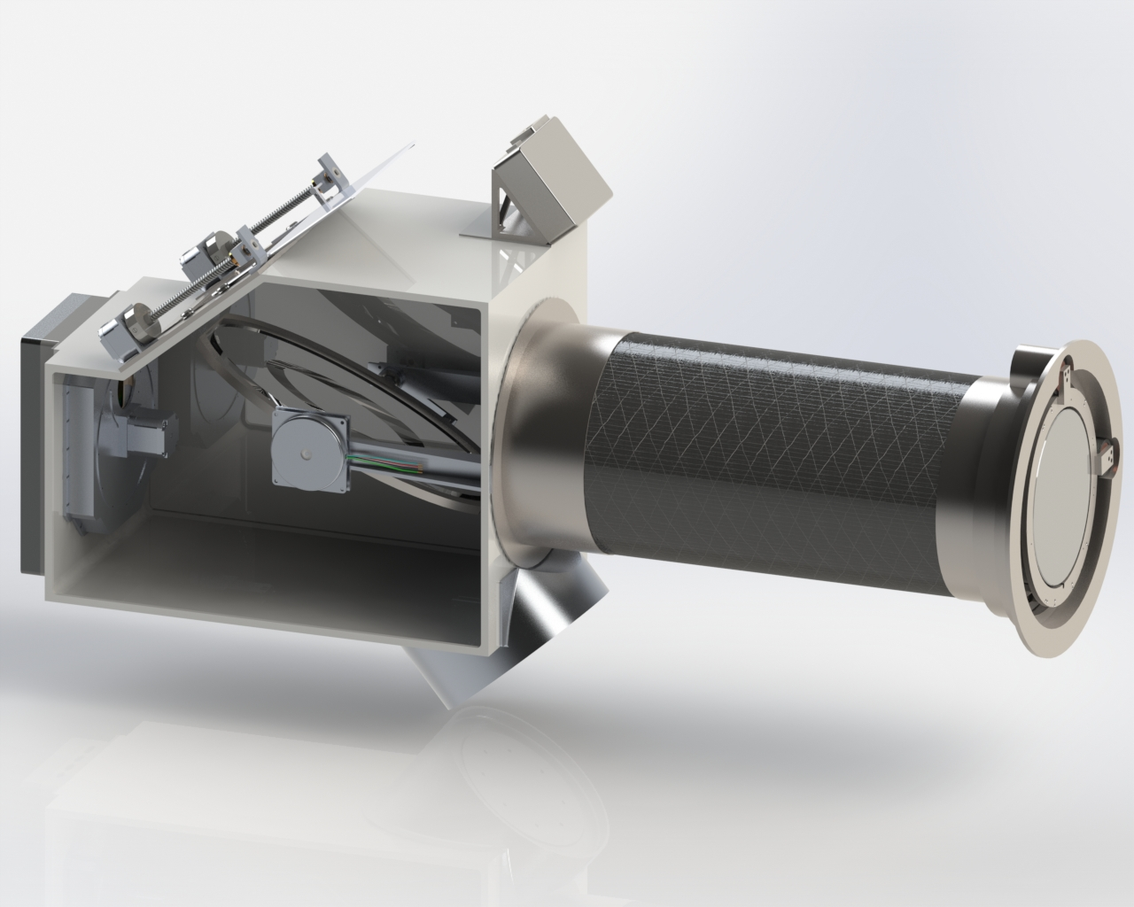
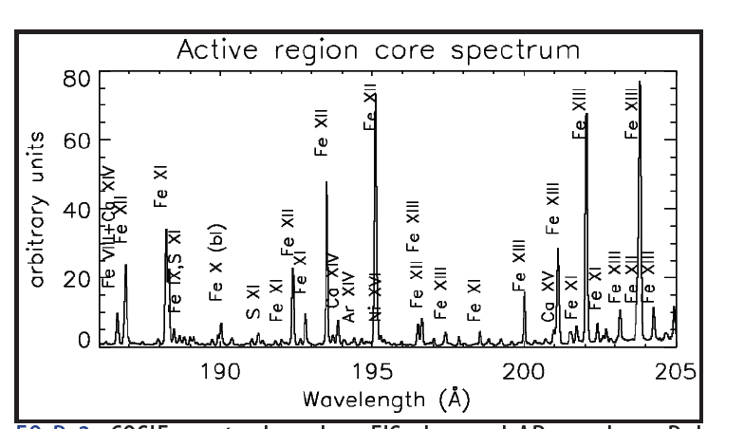
COSIE Investigation Overview
Comparing to SDO/AIA: COSIE’s telescope feeds larger pixels resulting in 27x more sensitivity; has 3.2x larger effective area, higher filter throughput (1.5x), and broad EUV response that includes additional emission lines (3-4x).
COSIE has ~500x higher sensitivity than an AIA EUV image.
COSIE Instrument
COSIE passband / spectra based on AR core loop observations made by the Hinode EIS (Del Zanna 2013).

Slide 4
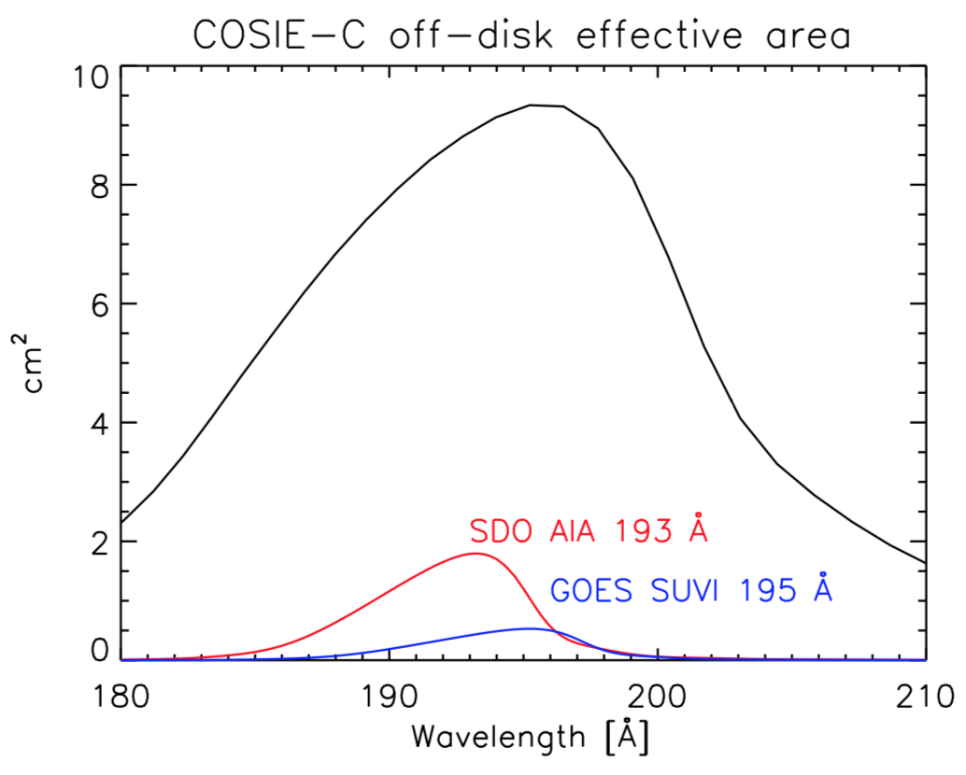
COSIE Investigation Overview
COSIE achieves high sensitivity by combining a prime focus telescope, high reflectance coatings, a passband with multiple bright lines, and improved entrance and focal plane filters.
COSIE has ~500x higher sensitivity than a typical AIA EUV image.
COSIE Instrument
COSIE passband / spectra based on AR core loop observations made by the Hinode EIS (Del Zanna 2013).

Slide 5
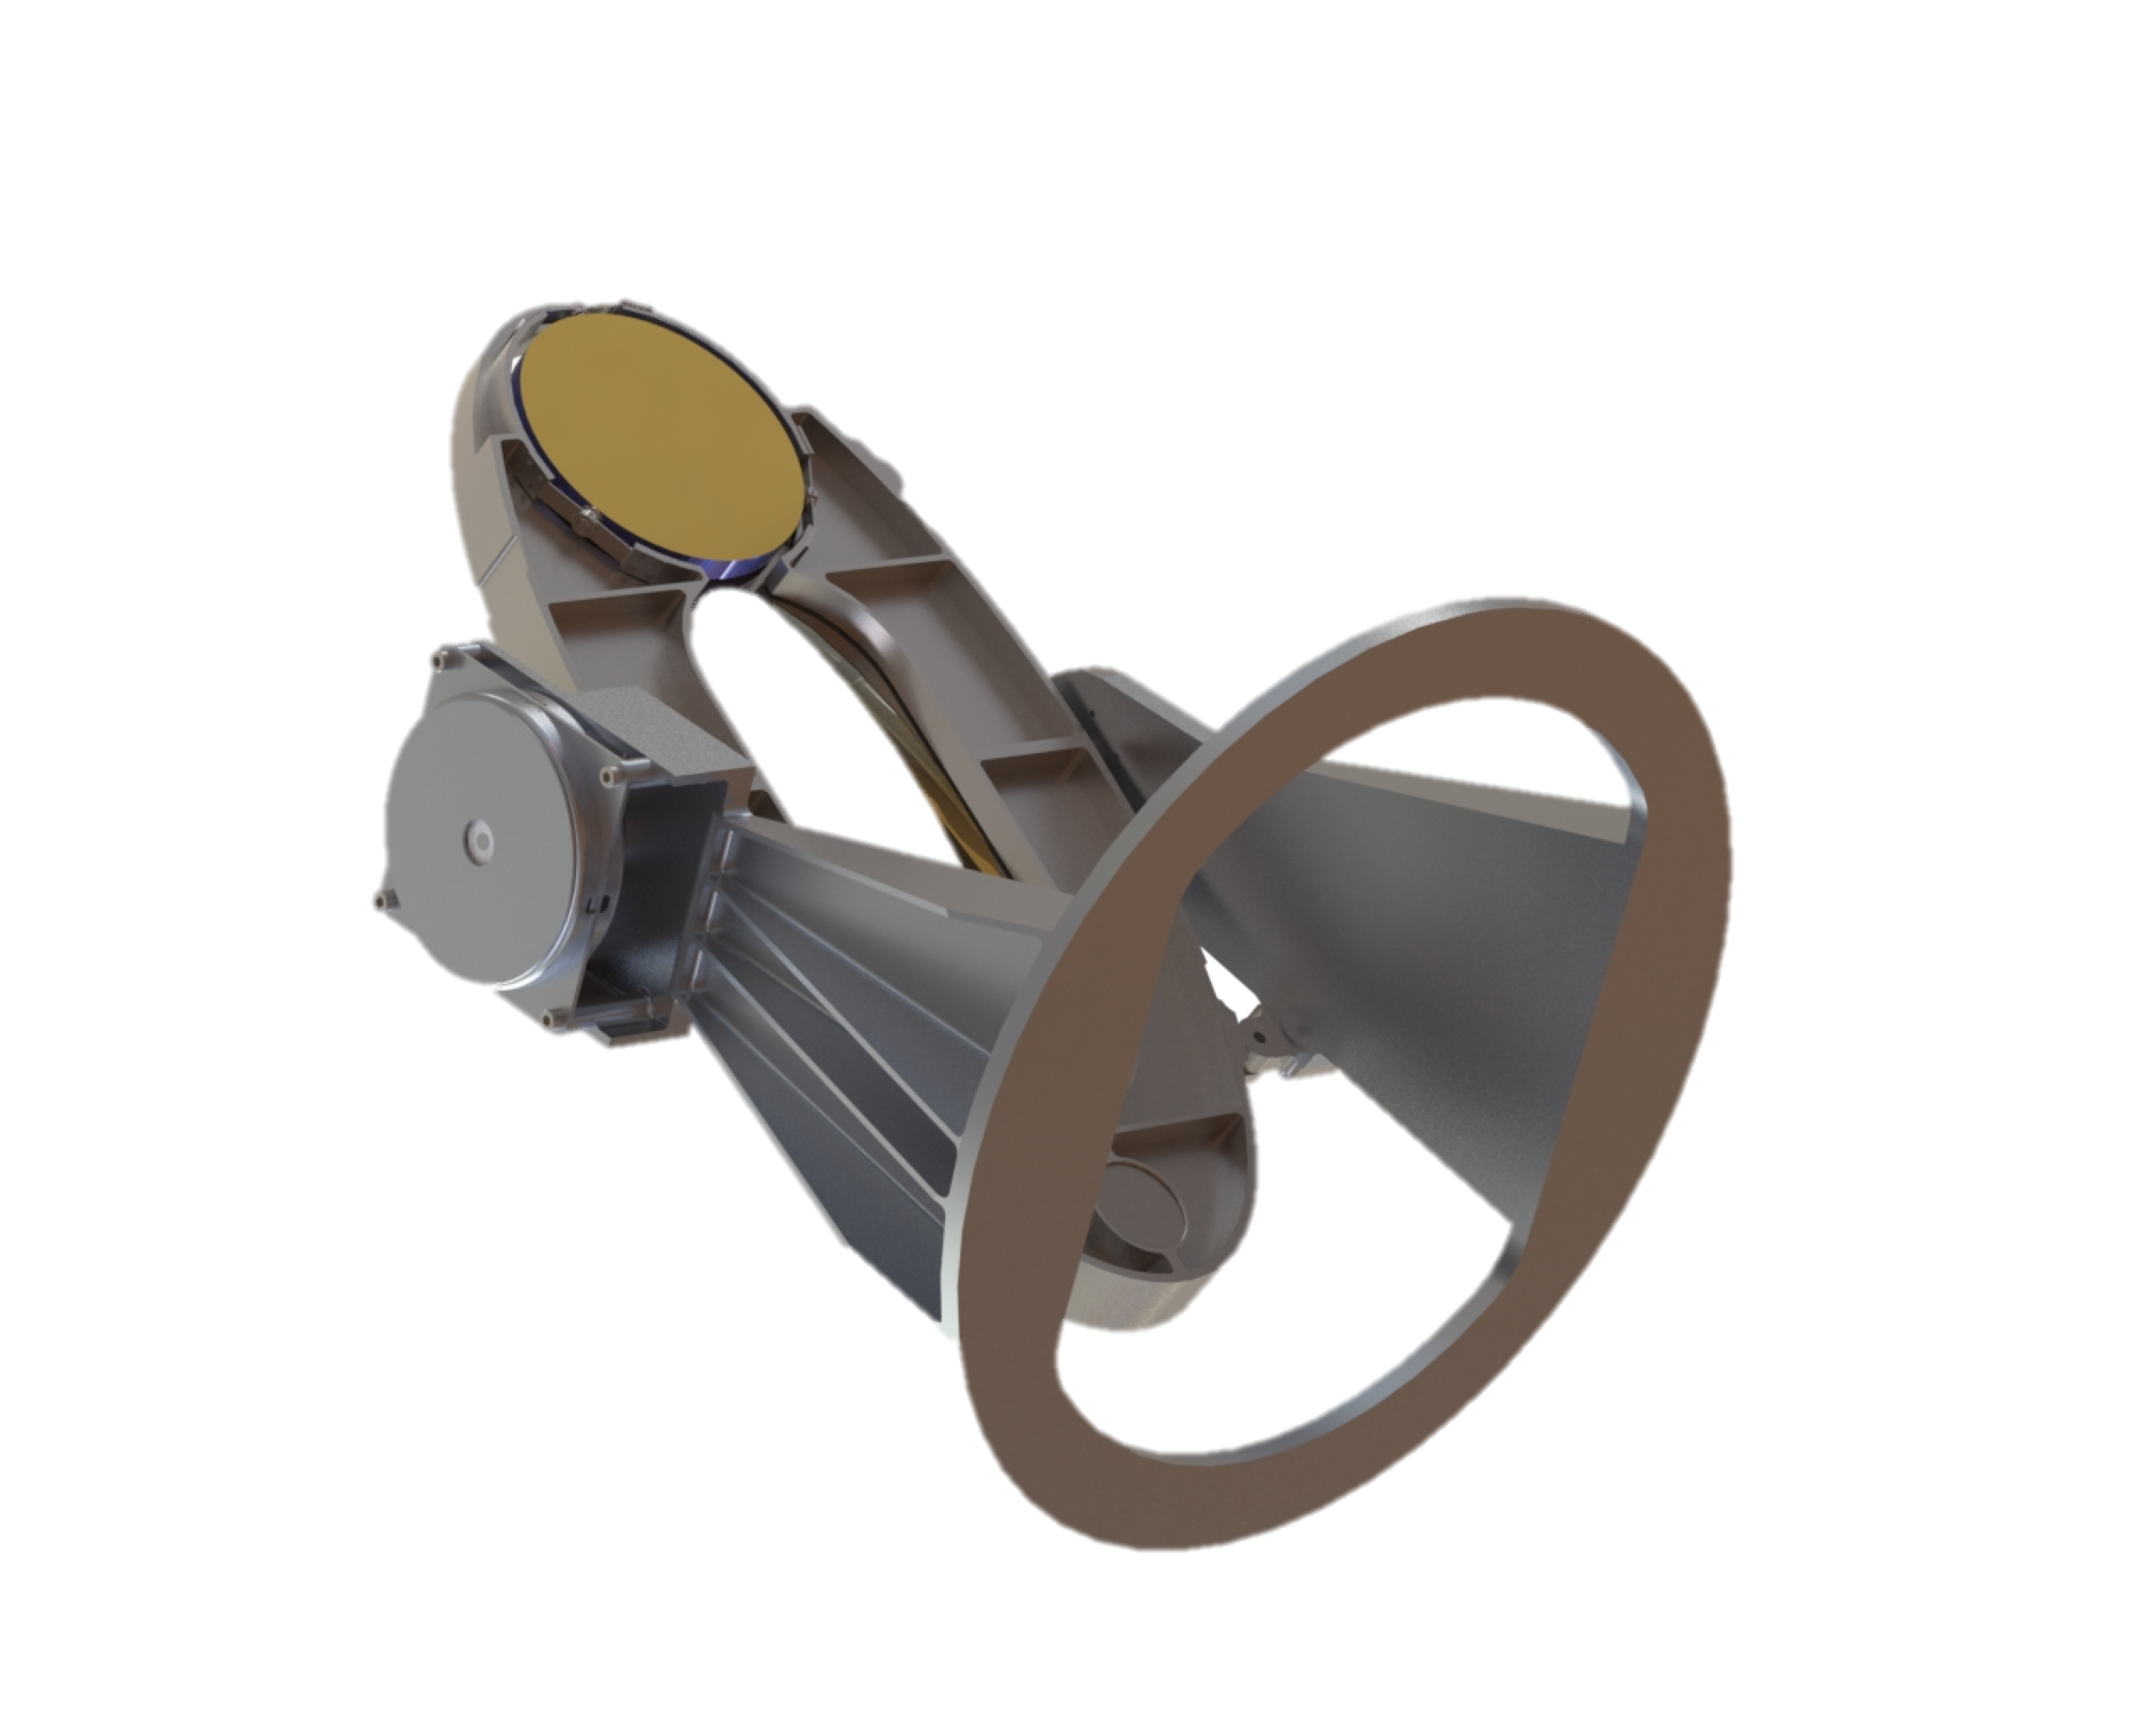
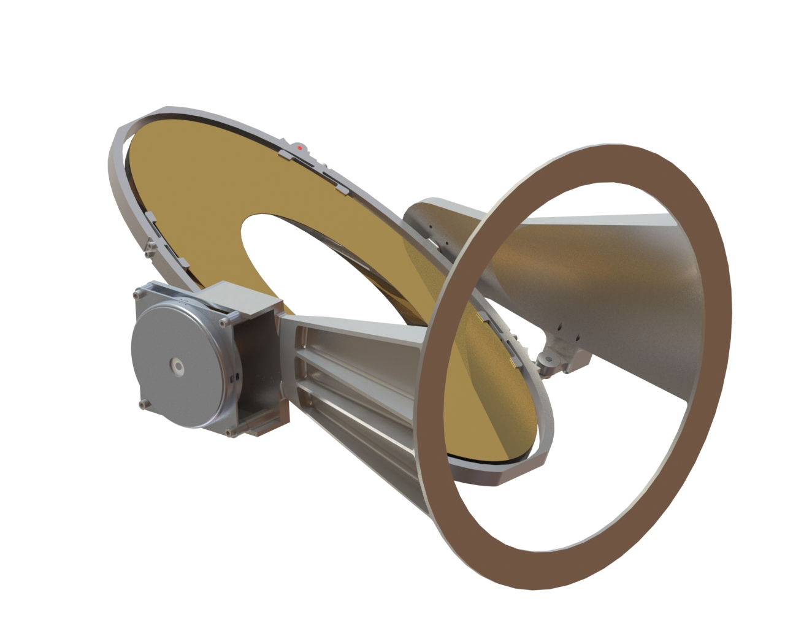
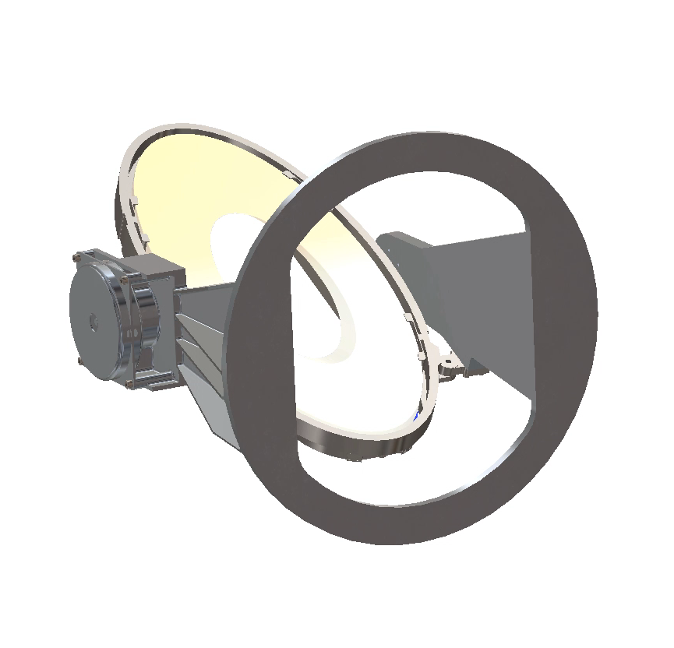
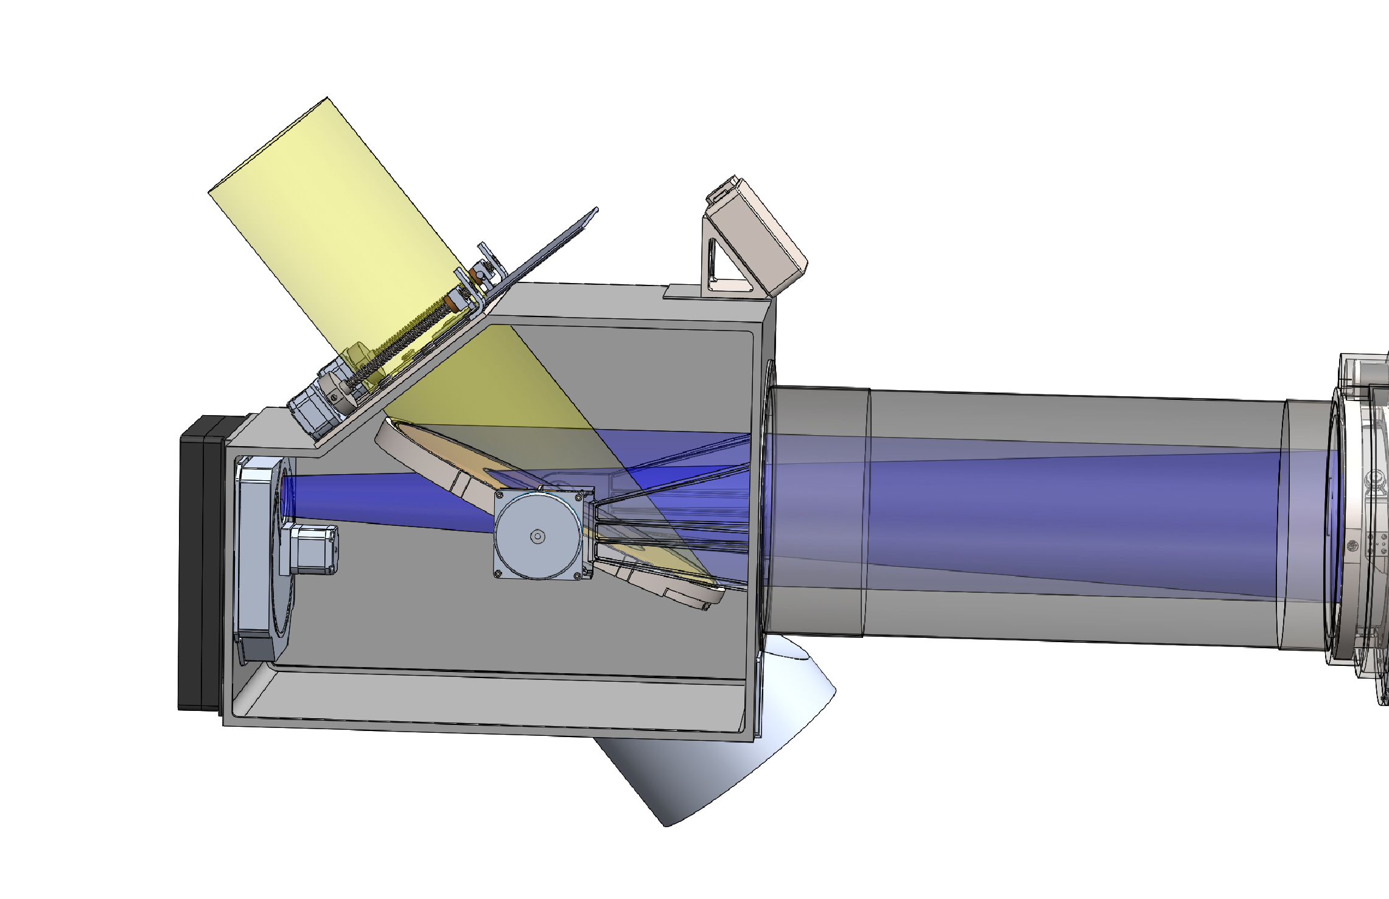
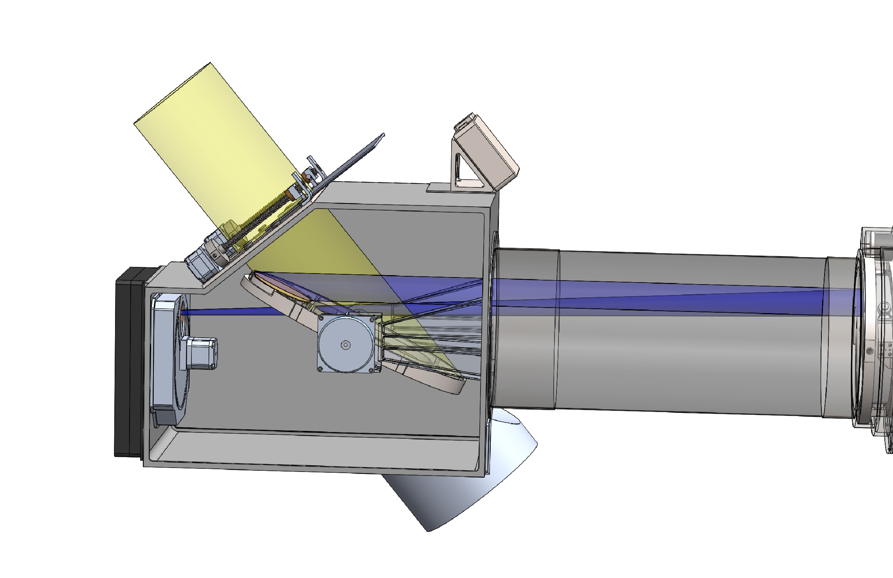
COSIE Channel Selector
ANIMATION
(sped up)
COSIE-C
COSIE-S

Slide 6
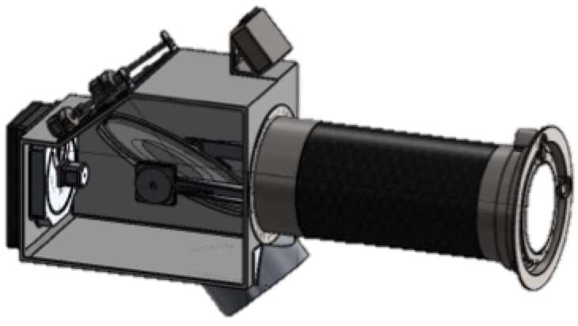
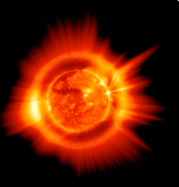
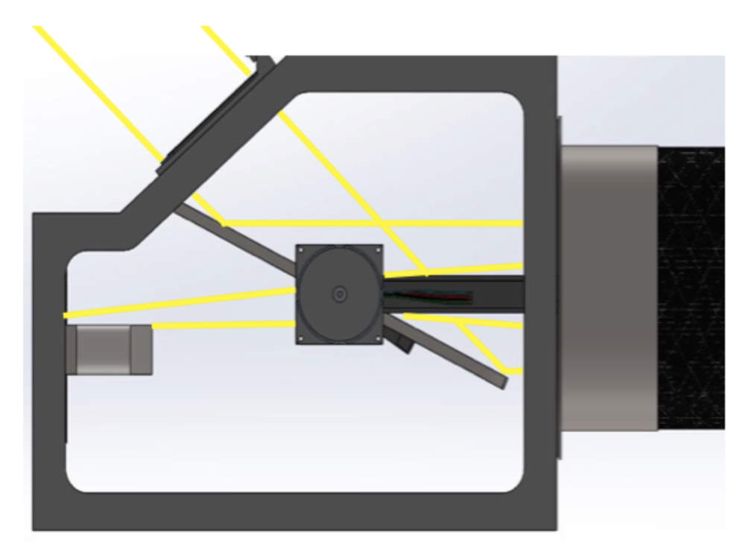
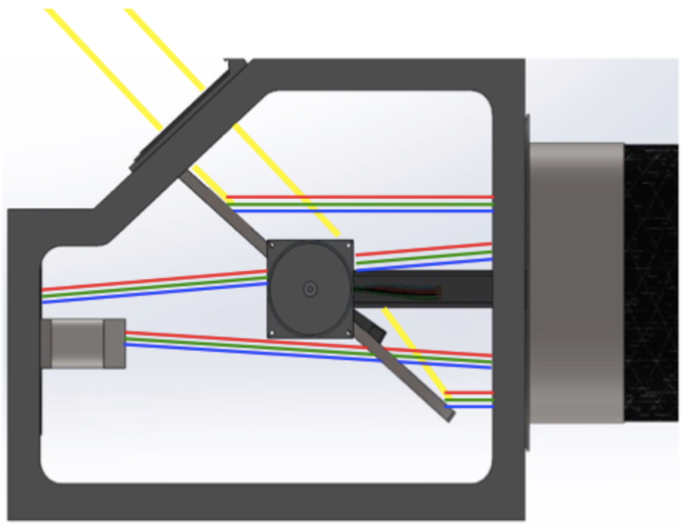
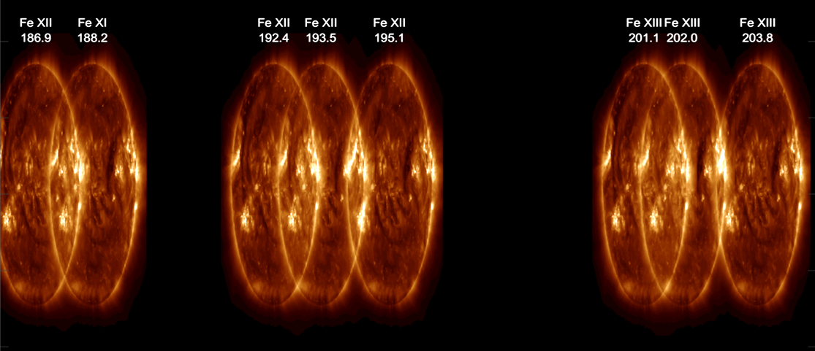
COSIE Data Products
The COSIE-C (coronagraph) and COSIE-S (spectrograph) channels are selected by flipping the feed mirror.
The instrument operates such that image sets of each channel are taken in succession on each orbital pass.
Incoming Light
Feed Mirror
Channel Selector
COSIE-C
Rather than occulting the solar disk, the disk emission is reduced via an apodized filter.
The result is simultaneous wide-field imaging of the solar disk and the corona out to beyond 2.5 R .
COSIE-S
The COSIE-S channel disperses the incoming light across the passband, providing full-Sun images at the EUV wavelengths.

Slide 7
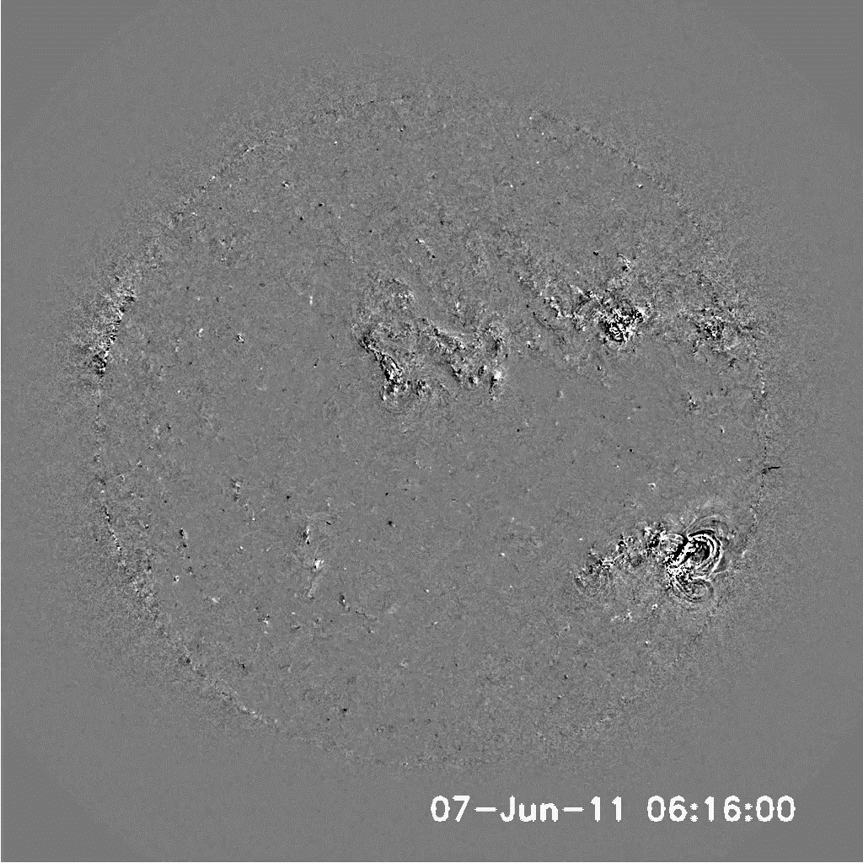
CME Detection in the EUV

Slide 8
Importance of Early Detection and Tracking of CMEs
(AN 337:10, 1016, 2016)
In general, the peak acceleration of a CME occurs within a solar radius of the surface, and near-maximum velocity is also attained there.
Large changes in direction due to pre-existing structures will occur within the first solar radius as well.
  Also magnetic rotation occurs early in the eruption process.
(Gallagher et al 2003; Zhang & Dere 2006; Bein et al 2011)

Slide 9
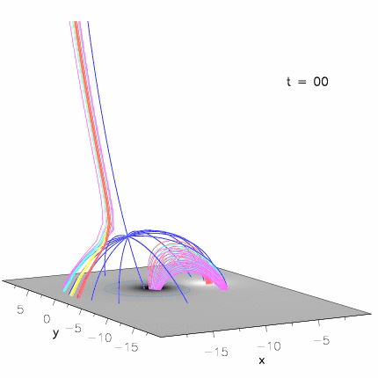
Understand the processes that govern the transition from closed to open and open to closed coronal structure.
Opening of extended structure due to evolution of surface B.
(Masson et al. 2014)

Slide 10
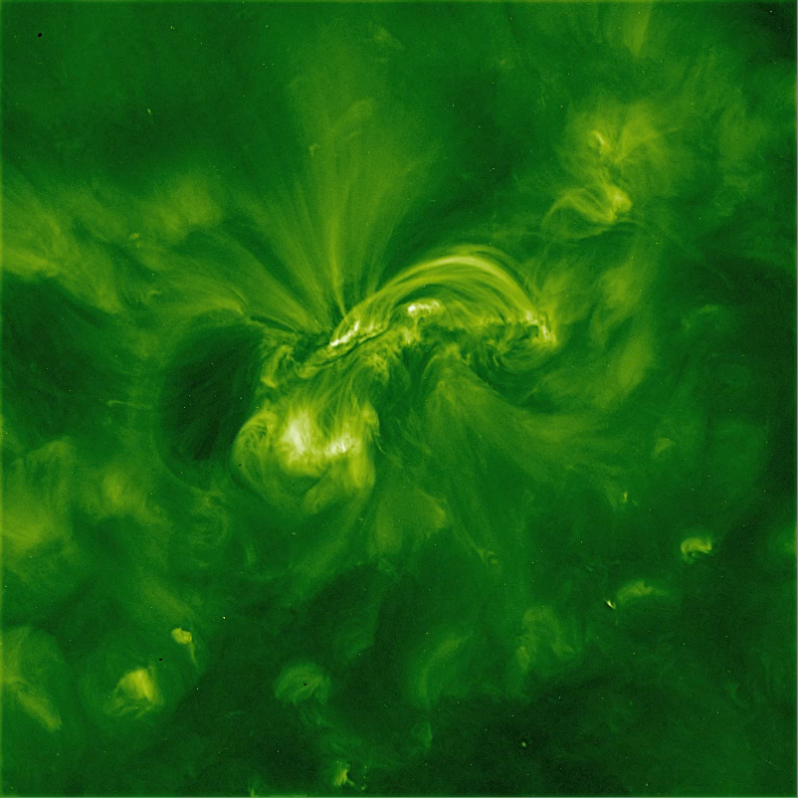
On-disk signatures of CMEs.
Coronal dimming
Well-observed in 195A channel.

Slide 11
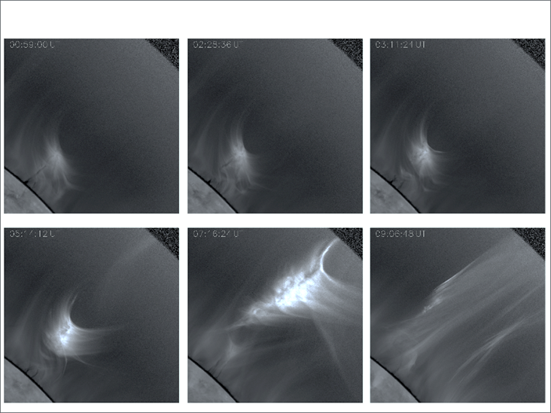
Stealth CMEs, little or no on-disk signature.

Slide 12
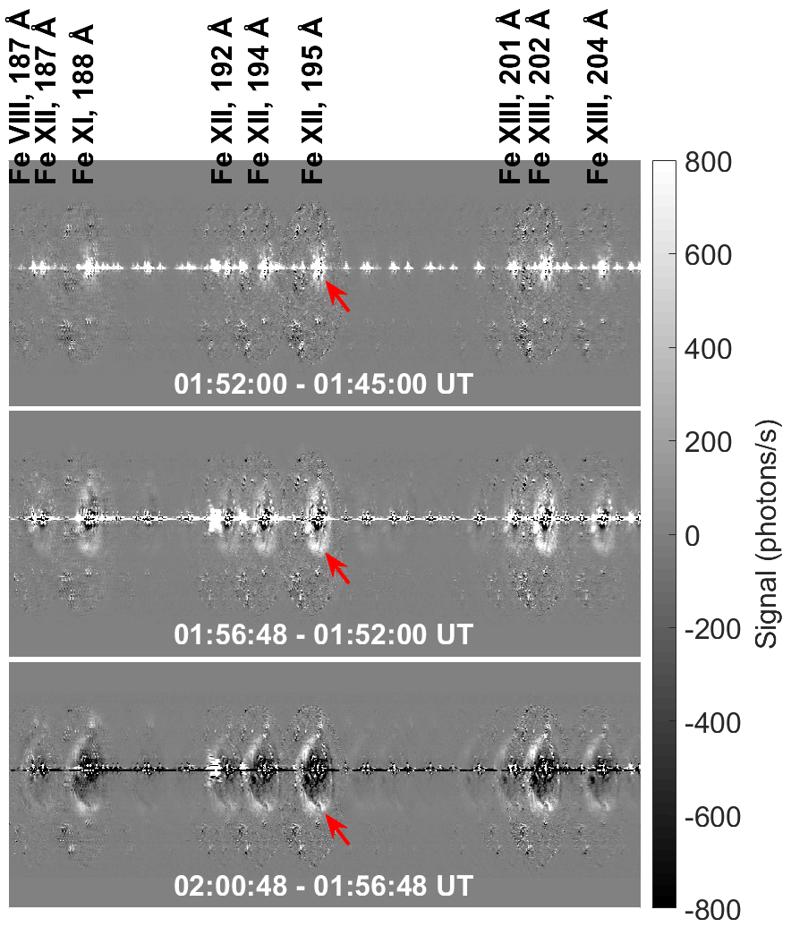
Understand the physical processes that control the early evolution of coronal mass ejections.
Measure T and n_{e} of ARs
  Measure energy buildup in ARs.
Determine temperature structure of expanding EUV wave.
Measure shock front strength n_{e}(in) / n_{e}(out)
Modeled COSIE‑S observation of an EUV wave from the 2011-Feb-15 X-class flare and CME (Vanninathan et al. 2105). The flare is seen as a bright or dark line across the middle of each image.

Slide 13
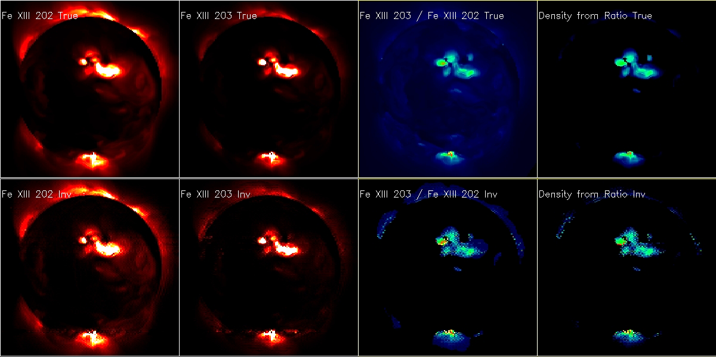
Unfolding “overlappogram” images
Uses a sparse inversion method, described in Winebarger et al (2019) and Cheung et al (2019).
Uses the LASSSOLARS routine in Python, a Least Angle Regression (Efron et al. 2004) implementation of the Lasso selection method (Tibshirani 1996).
Full Sun EM maps for Fe XII 203 A and Fe XIII 202 A, and density maps calculated from the ratio of these lines, based on AIA data (top) and from the inversion code (bottom).

Slide 14
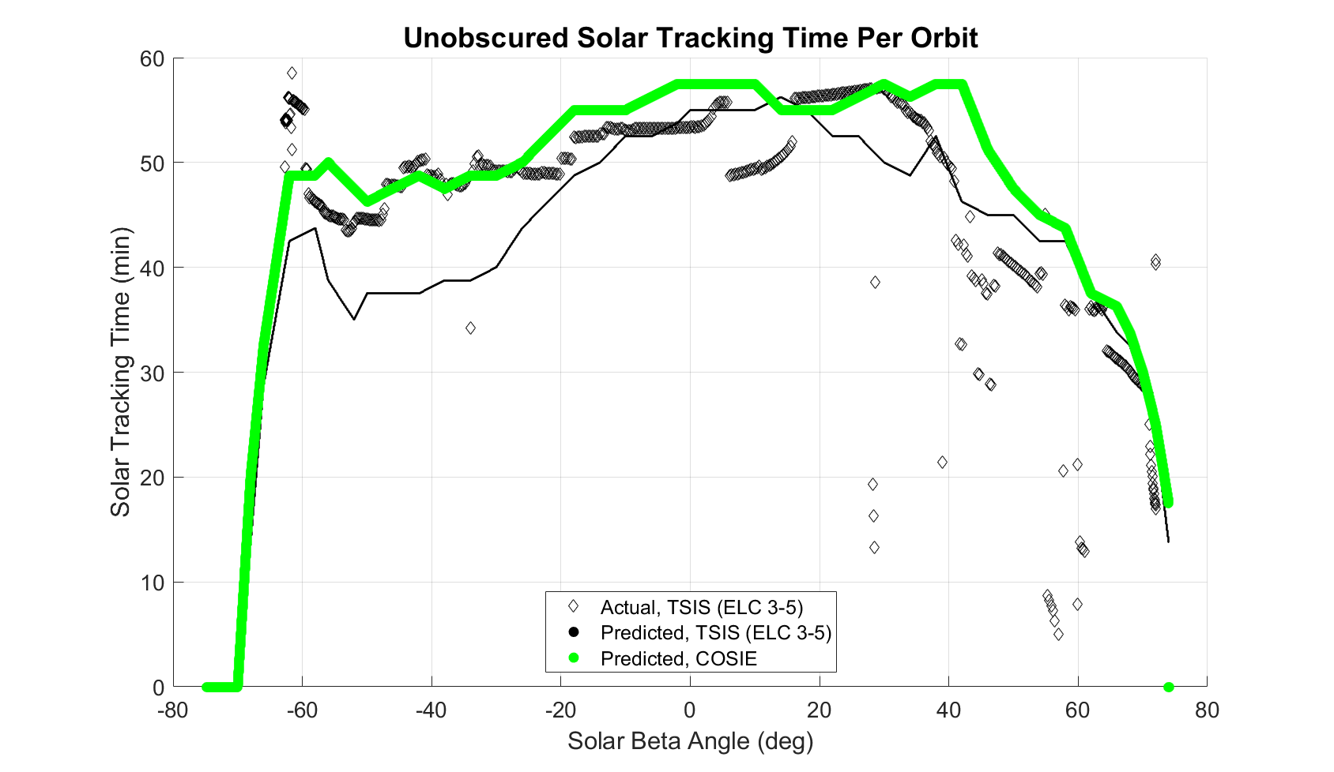
COSIE Solar Viewing
TSIS, located on ELC 3-5, is achieving 44-57 minutes of precision solar tracking per orbit even with ISS obscuration challenges. View factors from ELC 2 site 7, ELC 3 site 3, and from the Columbus SZP are comparable and provide more unobstructed solar viewing time.
Notes:
No comment
Outliers in TSIS actuals around 20-60 beta are due to EVA activities, visiting vehicle docking events, payload MDM bounces, etc. artificially affecting the data. Note that the TSIS actuals was derived from data selected randomly, and is not a comprehensive dataset.

Slide 15
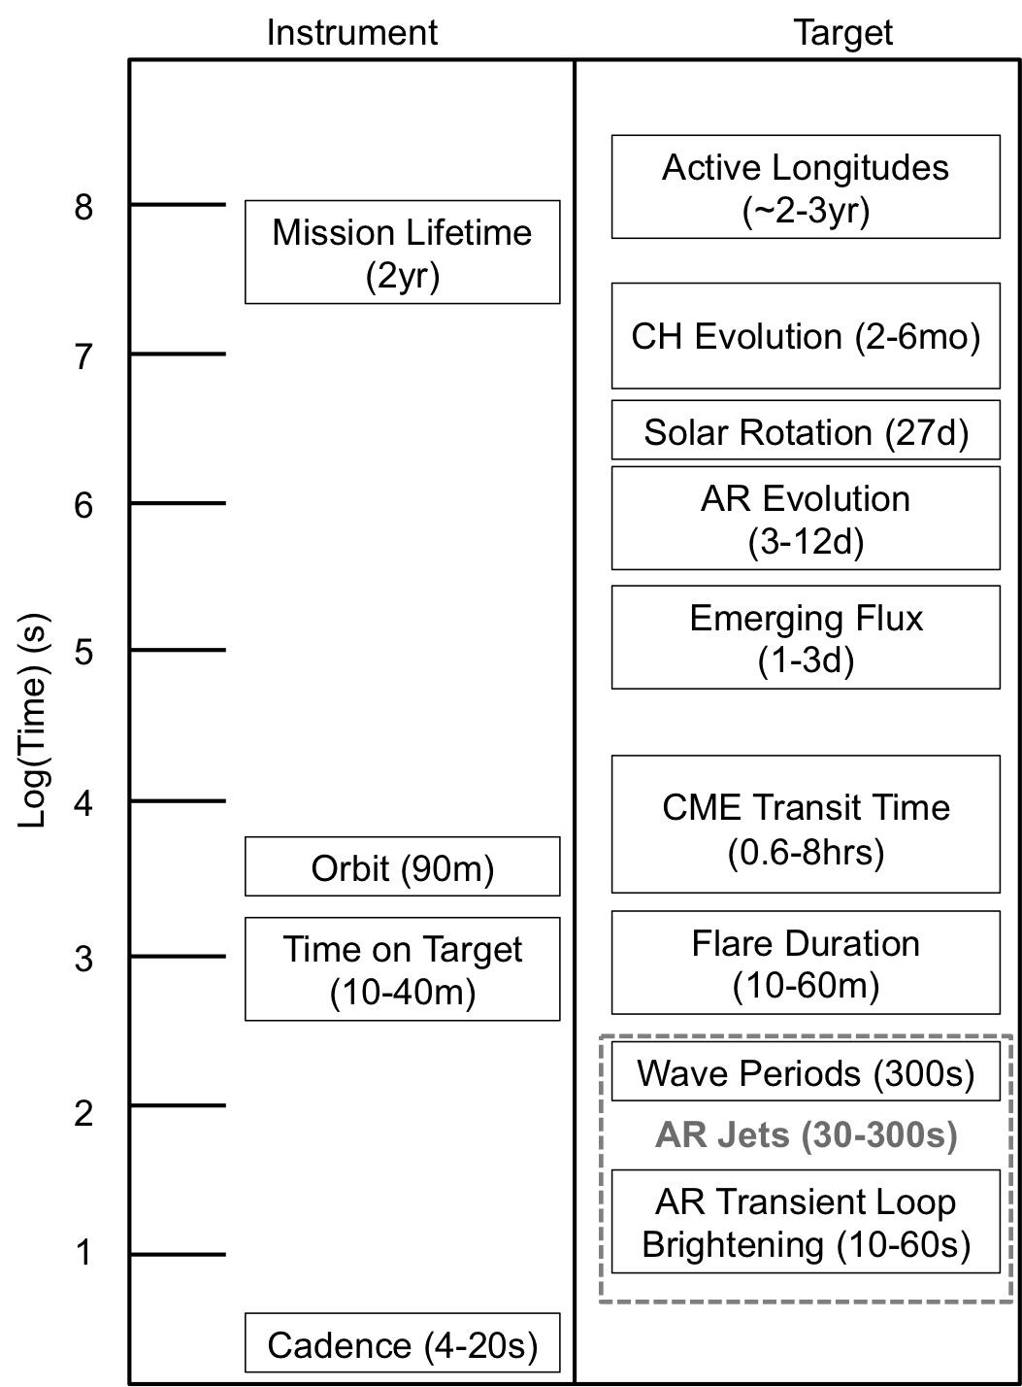
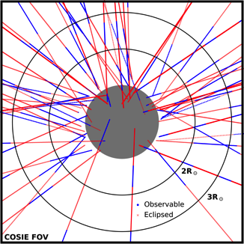
COSIE Mission Requirements
Mission Requirement | Instrument/Platform Requirement | Ground System Requirement | Operations Requirement
Orbit: ISS orbit; inclined day/night orbit Mission Duration: 6 months minimum; 2 years nominal Launch: Commercial Resupply Vehicle Launch Date: July 2023 | Attitude Control: 3-axis gimbal system (Azimuth, Elevation, Roll) Pointing Stability: 3.1” 3-σ per exposure Pointing Knowledge: 10” Pointing Repeatability: 50” Tracking Rate: 4 deg/min Data Storage (onboard): At least 80GB System Power: 187-525W | Data Volume: 59 GB/day (peak) 4 GB/pass (peak) Data Transfer Time (nominal): Full day 3.5 hrs Columbus 14 hrs ELC Pass 14 min Columbus 55 min ELC Near Real Time Data.. | Timeline Uploads: Up to 1 command upload per day; (3 per week nominal) Data Processing: Daily data validation and verification. Daily health and safety monitoring. Coordinated Observing: Parker Solar Probe, Solar Orbiter, SDO, Hinode, STEREO, CoMP, DKIST EOVSA
Conservative analysis of CME detection statistics, based on CACTus detections and ISS orbital data from 2011. Detection is >40s of observation. CME crossing times and COSIE total observing times vs. CME speed. We detect nearly all slow (<1000km/s) CMEs and ~50% of fast (>1000km/s) CMEs. In a 4 month period, we expect to detect ~10 fast CMEs.
ISS Orbital Properties, Observational Timescales, and Characteristics of Solar Targets. Vertical axis is in Log₁₀ seconds.
The capability of observing these targets drives the Mission Requirements.

Slide 16
COSIE Mission Requirements
Mission Requirement | Instrument/Platform Requirement | Ground System Requirement | Operations Requirement
Orbit: ISS orbit; inclined day/night orbit Mission Duration: 6 months minimum; 2 years nominal Launch: Commercial Resupply Vehicle Launch Date: July 2023 | Attitude Control: 3-axis gimbal system (Azimuth, Elevation, Roll) Pointing Stability: 3.1” 3-σ per exposure Pointing Knowledge: 10” Pointing Repeatability: 50” Tracking Rate: 4 deg/min Data Storage (onboard): At least 80GB System Power: 187-525W | Data Volume: 59 GB/day (peak) 4 GB/pass (peak) Data Transfer Time (nominal): Full day 3.5 hrs Columbus 14 hrs ELC Pass 14 min Columbus 55 min ELC Near Real Time Data.. | Timeline Uploads: Up to 1 command upload per day; (3 per week nominal) Data Processing: Daily data validation and verification. Daily health and safety monitoring. Coordinated Observing: Parker Solar Probe, Solar Orbiter, SDO, Hinode, STEREO, CoMP, DKIST EOVSA
Conservative analysis of CME detection statistics, based on CACTus detections and ISS orbital data from 2011. Detection is >40s of observation. CME crossing times and COSIE total observing times vs. CME speed. We detect nearly all slow (<1000km/s) CMEs and ~50% of fast (>1000km/s) CMEs. In a 4 month period, we expect to detect ~10 fast CMEs.
ISS Orbital Properties, Observational Timescales, and Characteristics of Solar Targets. Vertical axis is in Log₁₀ seconds.
The capability of observing these targets drives the Mission Requirements.

Slide 17
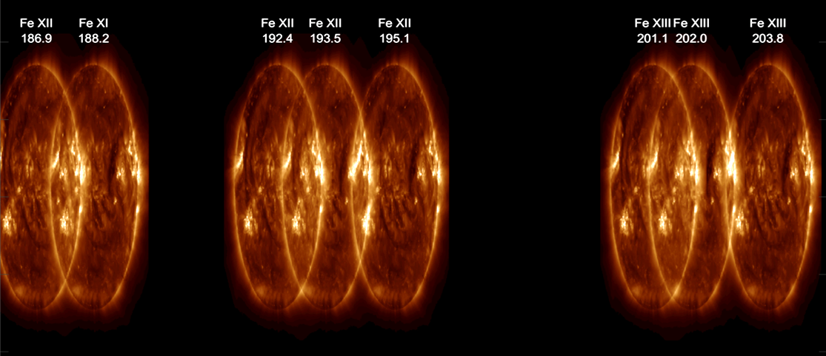
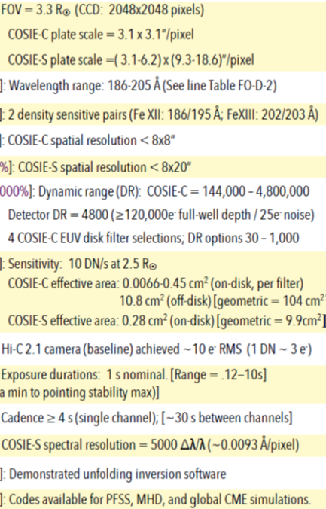
COSIE Observables
xxxxxxxxxxxxxxxxxxxxxxxxxx

Slide 18
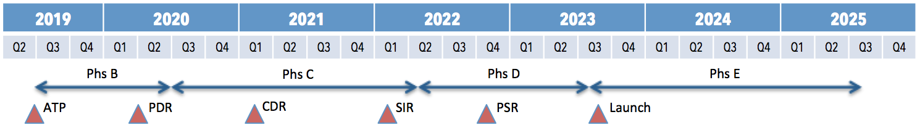
COSIE Mission Schedule
MISSION DEVELOPMENT TIMELINE (ASSUMING PHASE B START):
Proposals Selections for Phase A studies July 10, 2019 (TBD)
Phase B Start August 2019
PDR (TRL 6) April 2020
Deliver to KSC Jan 2023
Launch Vehicle Integration April – May 2023
Launch July 2023*
*For ISS payloads, the MoO requires that the prime mission be complete prior to the end of ISS funding (Oct. 2024). COSIE will meet prime mission science goals within ~6 months with nominal mission operations extending to 2 years pending ISS availability.
Launch readiness in July 2023 allows for 14 months prior to the end of ISS funding.
Phs F: 07/2025 – 01/2026

Slide 19
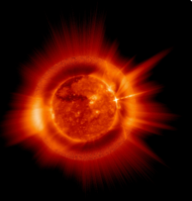
COSIE Data Products
The COSIE-C (coronagraph) and COSIE-S (spectrograph) channels are selected by flipping the feed mirror (see also the “COSIE Instrument Diagram” chart), which has a hole in the center and a grating on one side.
The instrument will be operated such that image sets of each channel are taken in succession per each orbital pass, with rapid COSIE-C channel cadence. The cadence between COSIE-C images will peak at ~6 seconds, depending on solar conditions.
COSIE-C
COSIE-C is not a typical “coronagraph”. Rather than occulting the solar disk, the disk emission is reduced via an apodized filter, increasing the sensitivity by ~500x over operating EUV imagers. The result is unique wide-field imaging of the solar disk combined with the corona out to beyond 2.5 R .
COSIE-S
The COSIE-S channel disperses the incoming light across the passband, providing full-Sun images at many different wavelengths. Full disk density, temperature, and velocity maps can then be reduced from this data via novel deconvolution analysis software.

Slide 20
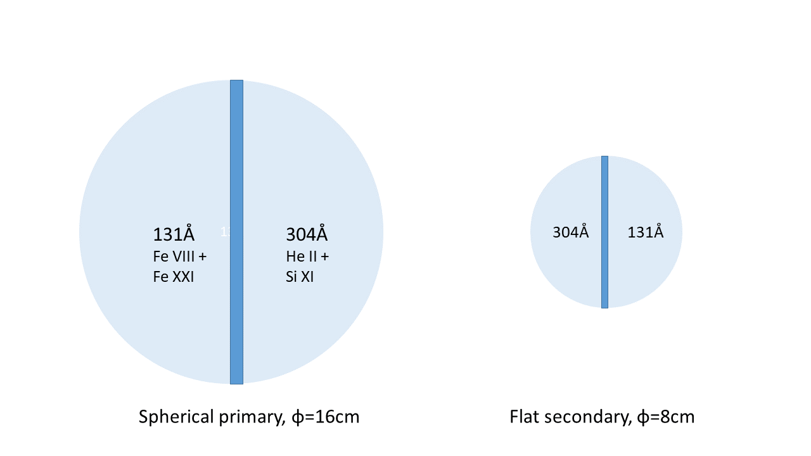
Suggested design for LGR RS EUVI Supplement: I
Supplemental 131/304Å telescope, designed to work together with EUVI 195A channel.
→ Zr and Al filters
→ Zr and Al filters

Slide 21
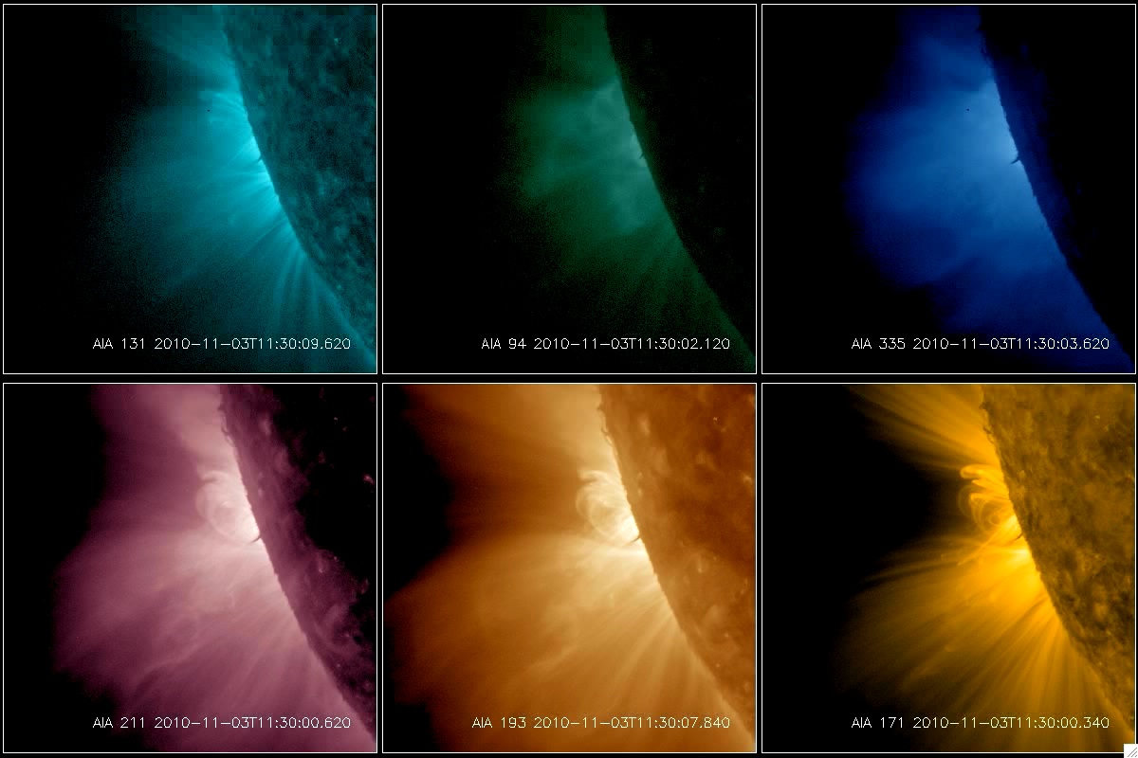
Hot material seen in 131A channel

Slide 22
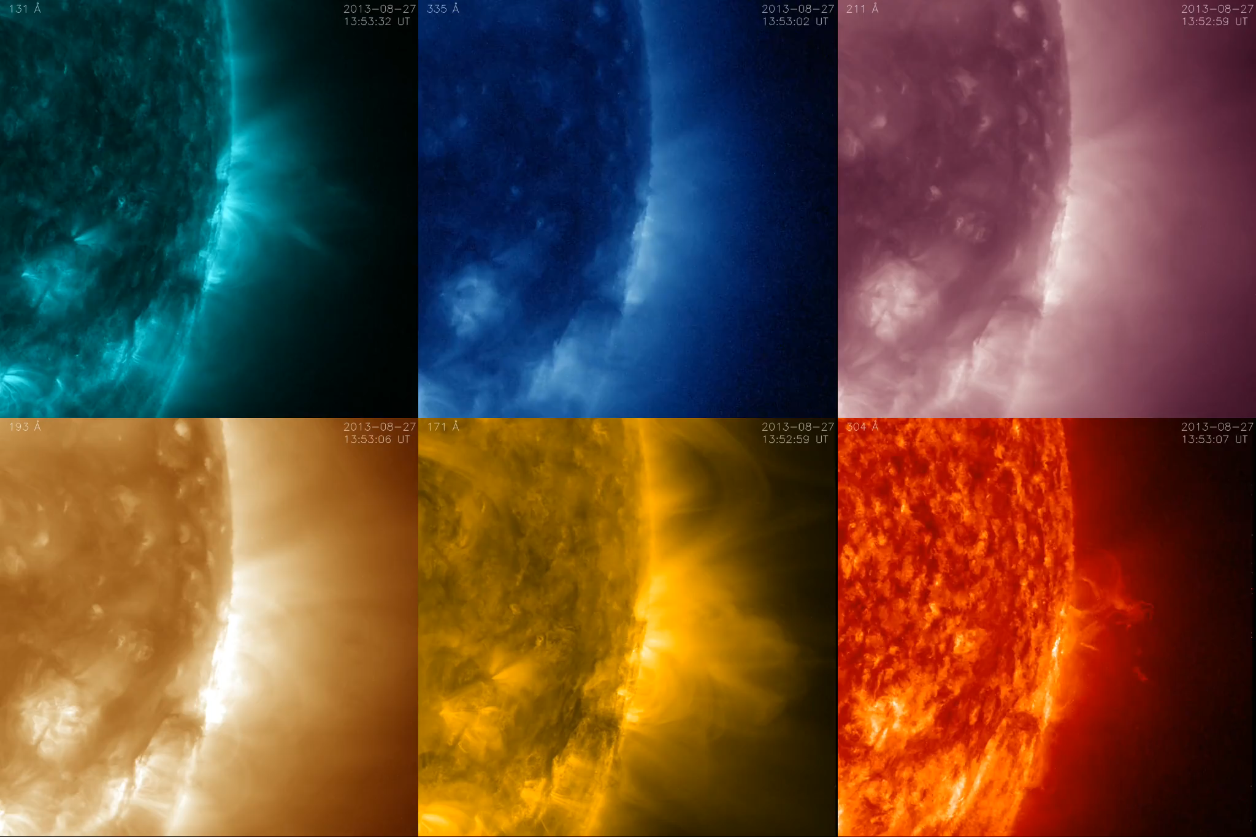
Limb event comparison

Slide 23
Suggested design for LGR RS EUVI Supplement: II
Simplified COSIE-S channel, designed to work together with EUVI 195A channel.

Slide 24
COSIE System Mass
The contingency values below 25% are based on high TRL components and/or previously as-built final system values that have not undergone any design change.
Subsystem/Component | Mass (kg) | Contingency % | Total (kg)
Tip/Tilt Assembly | 2.1 | 25 | 2.6
Mirror Support Assembly | 1.5 | 25 | 1.9
Aperture Door Assembly | 1.5 | 25 | 1.9
Channel Selector | 3.1 | 25 | 3.9
Filter Wheel | 0.3 | 10 | 0.4
Shutter | 0.3 | 10 | 0.3
Instrument Housing | 6.5 | 25 | 8.1
Tracker/Pointing System | 187.5 | 8** | 202.6
Thermal Components | 8.9 | 14 | 11.6
Power & Avionics | 18.5 | 57 | 29
Pointing Control | 0.6 | 20 | 0.7
Camera | 3.8 | 38 | 5.3
Totals | 234.4 | 14 | 268.1
**Low contingency due to high TRL and as-built design measurements.

Slide 25
EUVI-S System Mass
Subsystem/Component | Mass (kg) | Contingency % | Total (kg)
Tip/Tilt Assembly | 2.1 | 25 | 2.6
Mirror Support Assembly | 1.5 | 25 | 1.9
Aperture Door Assembly | 1.5 | 25 | 1.9
Channel Selector | 3.1 | 25 | 3.9
Filter Wheel | 0.3 | 10 | 0.4
Shutter | 0.3 | 10 | 0.3
Instrument Housing | 6.5 | 25 | 8.1
Tracker/Pointing System | 187.5 | 8** | 202.6
Thermal Components | 8.9 | 14 | 11.6
Power & Avionics | 18.5 | 57 | 29
Pointing Control | 0.6 | 20 | 0.7
Camera | 3.8 | 38 | 5.3
Totals | 234.4 | 14 | 268.1
The contingency values below 25% are based on high TRL components and/or previously as-built final system values that have not undergone any design change.
→ est. ~3 kg
→ Control computer/FPGA, est. ~4 kg
→ Total: ~16 kg
**Low contingency due to high TRL and as-built design measurements.
= smaller, exact value TBD

Slide 26
Thank you

Slide 27
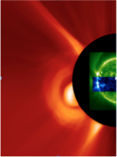

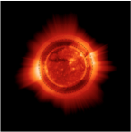
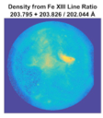
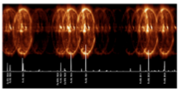
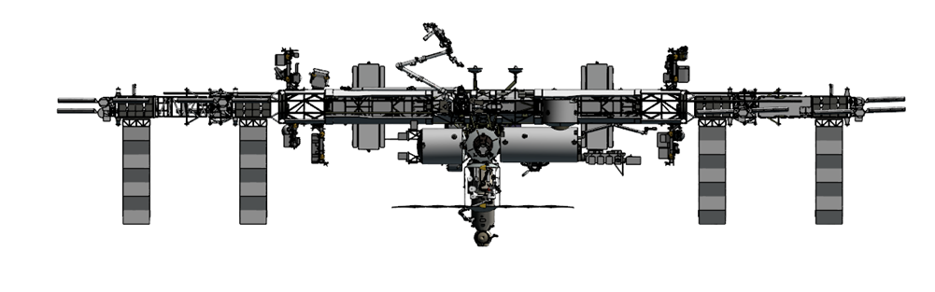
COSIE: Summary of Reasons for Pursuing
Why COSIE? COSIE’s 500x increase in EUV sensitivity and improved spatio-temporal coverage compared to available coronal EUV instrumentation will answer major outstanding questions of solar wind origin, and lead to improved forecasting of geo-effective CMEs.
Why now? Space weather forecasting is a high-priority national issue, and developing the next generation of forecasting models requires observations that fill the gap between the disk and the outer corona.
Why ISS? The ISS provides a low cost unique observing platform that offers an excellent option for testing cutting edge instrumentation prior to investing into a free flying spacecraft. It offers high data rates and ample power at an altitude compatible with high energy observations. The orbital day/night cycles do not compromise COSIE science, as nearly all departing CMEs will be detected.
COSIE fills this gap with a consistent wavelength
SDO/AIA
Wavelength /
Phenomena Ranges
COSIE-C FOV
COSIE-S Overlapogram

Slide 28
COSIE Mission Requirements

Slide 29
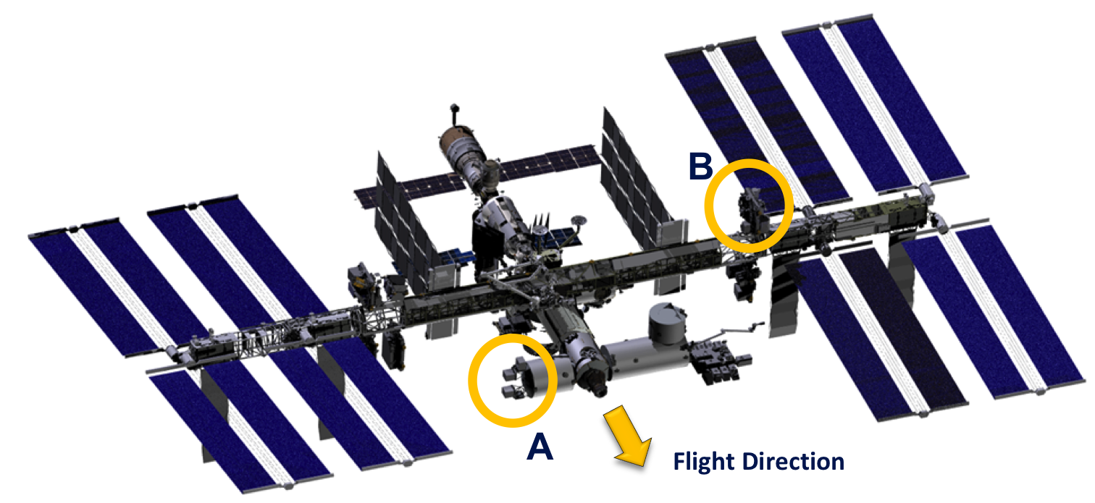
ISS Locations Being Pursued for COSIE
ISS locations under consideration:
  A. Columbus SOZ
  B. ELC 3-3 (Preferred)
  C. ELC 2-7
Preferred location
ELC 3-3
C
Three potential mounting locations have been considered on ISS by the COSIE team (Col. SOZ [A], ELC 3-3 [B], and ELC 2-7 [C]).
These locations were chosen based on solar viewing compatibility and availability. The ELC locations are more suitably oriented for the alt-az coarse pointing system in its base configuration. The Columbus SOZ is more advantageous for data rates; however, there are likely to be more interruptions at the Columbus site due to visiting vehicles.
The COSIE design can be adapted for any of these locations; however, ELC 3-3 is preferred due to platform design, FRAM placement, and solar viewing. While COSIE can be operated successfully from ELC 2-7, it is currently the least vetted location with respect to CME-detection rate analysis and requires further evaluation prior to final site selection.

Slide 30
COSIE Pointing Platform
Overview

Slide 31
Teaming up with LASP for COSIE Pointing Platform
The 2016 MoO proposal included an MSFC-built pointing platform based on the NICER design. In order to accommodate a Phase B start at ATP, a Pointing System RFI was released by MSFC.
The LASP pointing platform developed for the Total and Spectral Solar Irradiance Sensor (TSIS) was selected for use as the COSIE Coarse Pointing System (CPS) due to the following reasons:
Successful TSIS design that meets COSIE coarse pointing requirements;
On-orbit operations since December 2017 (high heritage);
Designed for solar pointing (except for roll);
Can accommodate the COSIE instrument with minimal redesign;
Most compatible with Phase B start (accelerated schedule);
High TRL, Lowered risk.

Slide 32
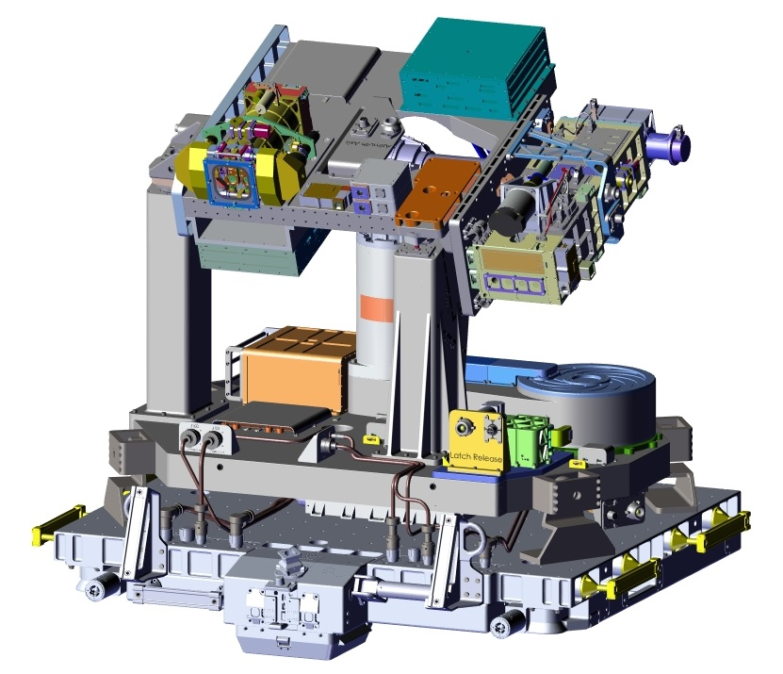
COSIE TSIS-based Design
The COSIE system consists of a nearly identical pointing platform to the TSIS pointing platform with the COSIE instrument replacing the TSIS instrument.
The only change to the pointing platform design is the location of the launch towers in order to accommodate the COSIE instrument in the stowed position (i.e., reduce launch volume exceedance).
Advantages:
Flight-proven design that meets COSIE pointing requirements
High TRL
Meets Phase B start schedule
TSIS Instrument + Pointing Platform

Slide 33
COSIE Pointing Platform
Life Cycle, Launch, Deploy, Stow

Slide 34
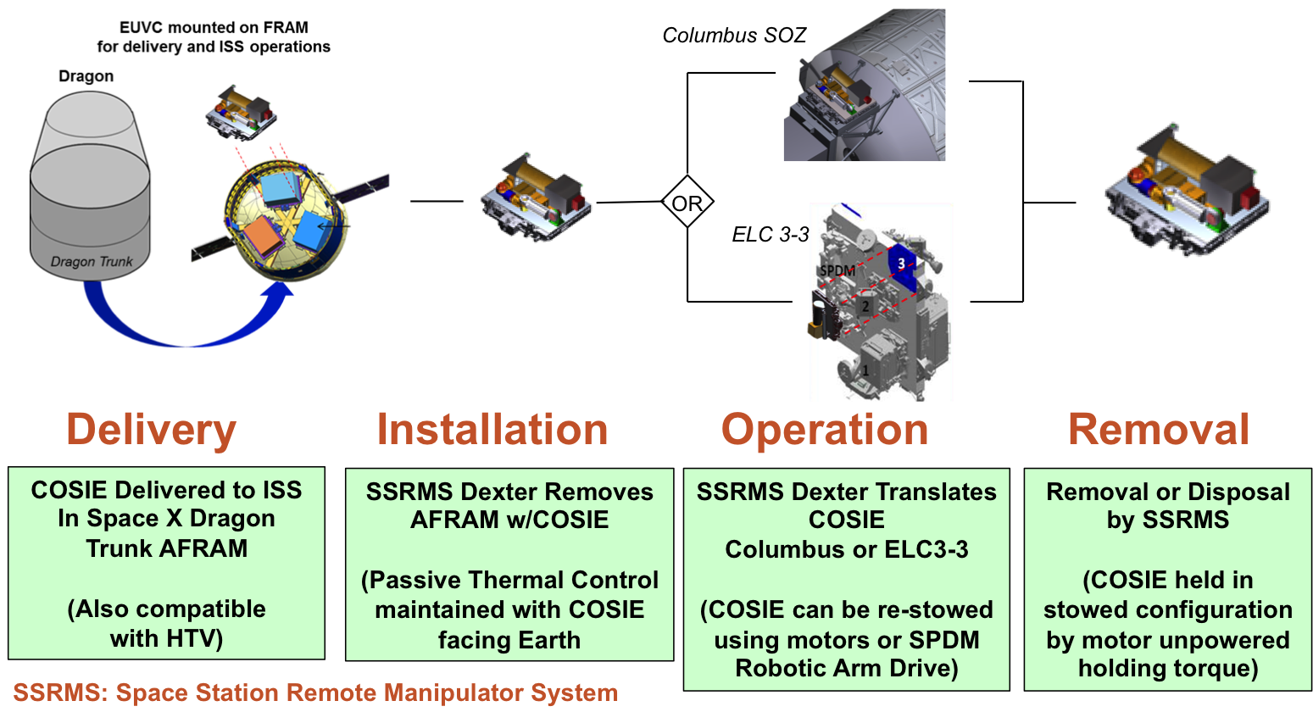
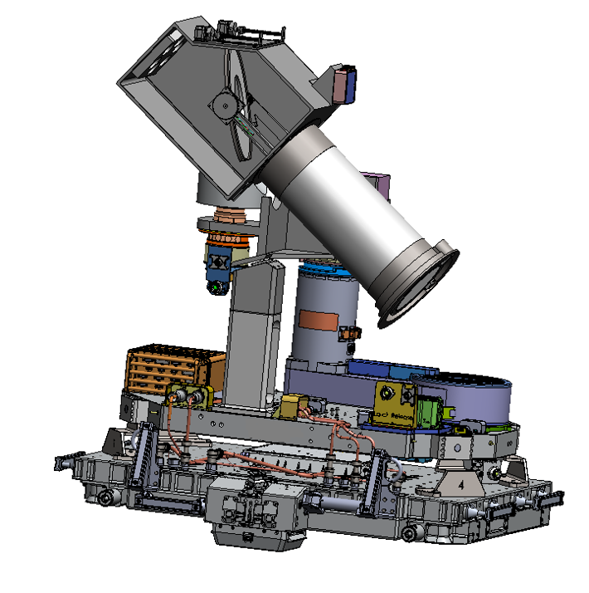
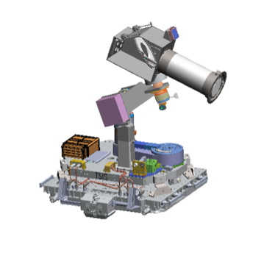
COSIE Concept of Operations
COSIE mounted on FRAM for delivery and ISS operations
JSC collaboration required to assess SSRMS operations.
Note: The SpaceX Dragon Trunk is used here as an example of a suitable Commercial Resupply Services 2 (CRS 2) vehicle.
Notes:
Moved up to be near deployment sequence

Slide 35
COSIE Pointing Platform
Deployed, Operational

Slide 36
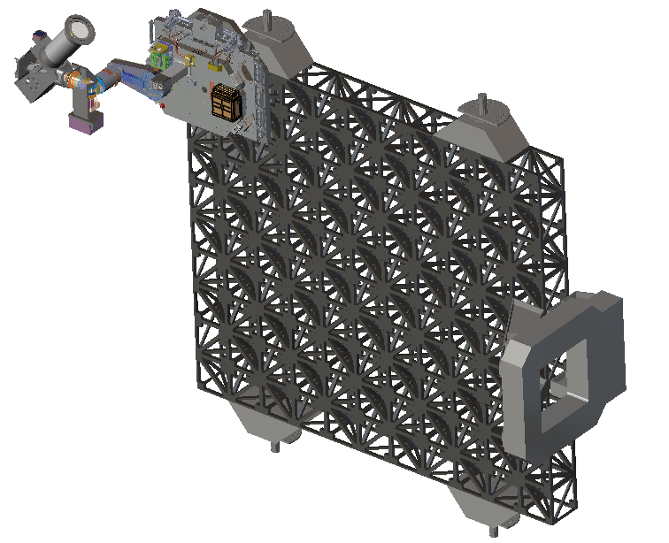
COSIE Configuration - ELC 3-3
COSIE on ELC will extend into the astronaut translation corridor, like TSIS. The instrument is shown in zenith viewing (eclipse park) position, with a zero degree roll angle.
Notes:
No comment

Slide 37
COSIE Pointing Platform
Stability & Visibilities

Slide 38
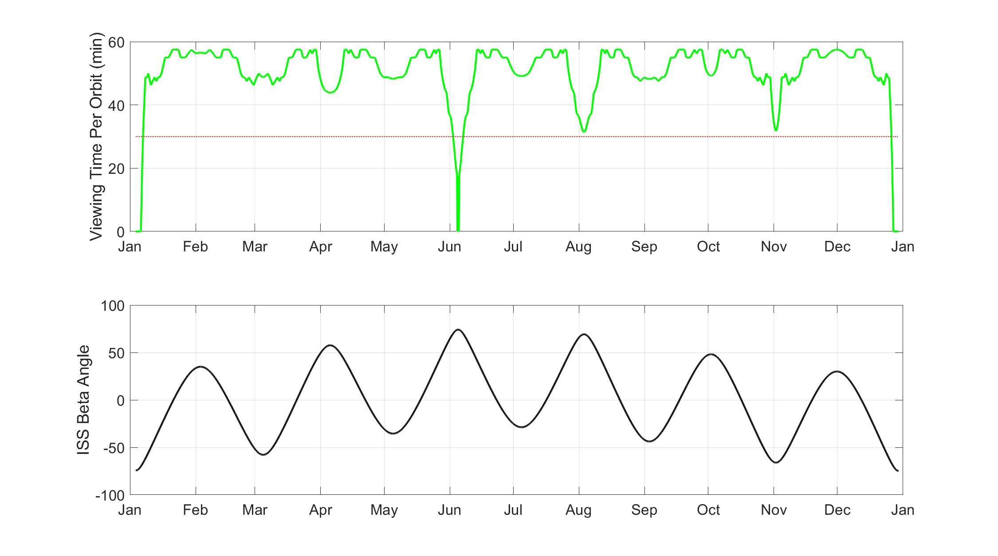
COSIE Solar Viewing
On >96% of ISS orbits, COSIE will have at least 30 minutes of solar viewing time.
Notes:
No comment

Slide 39
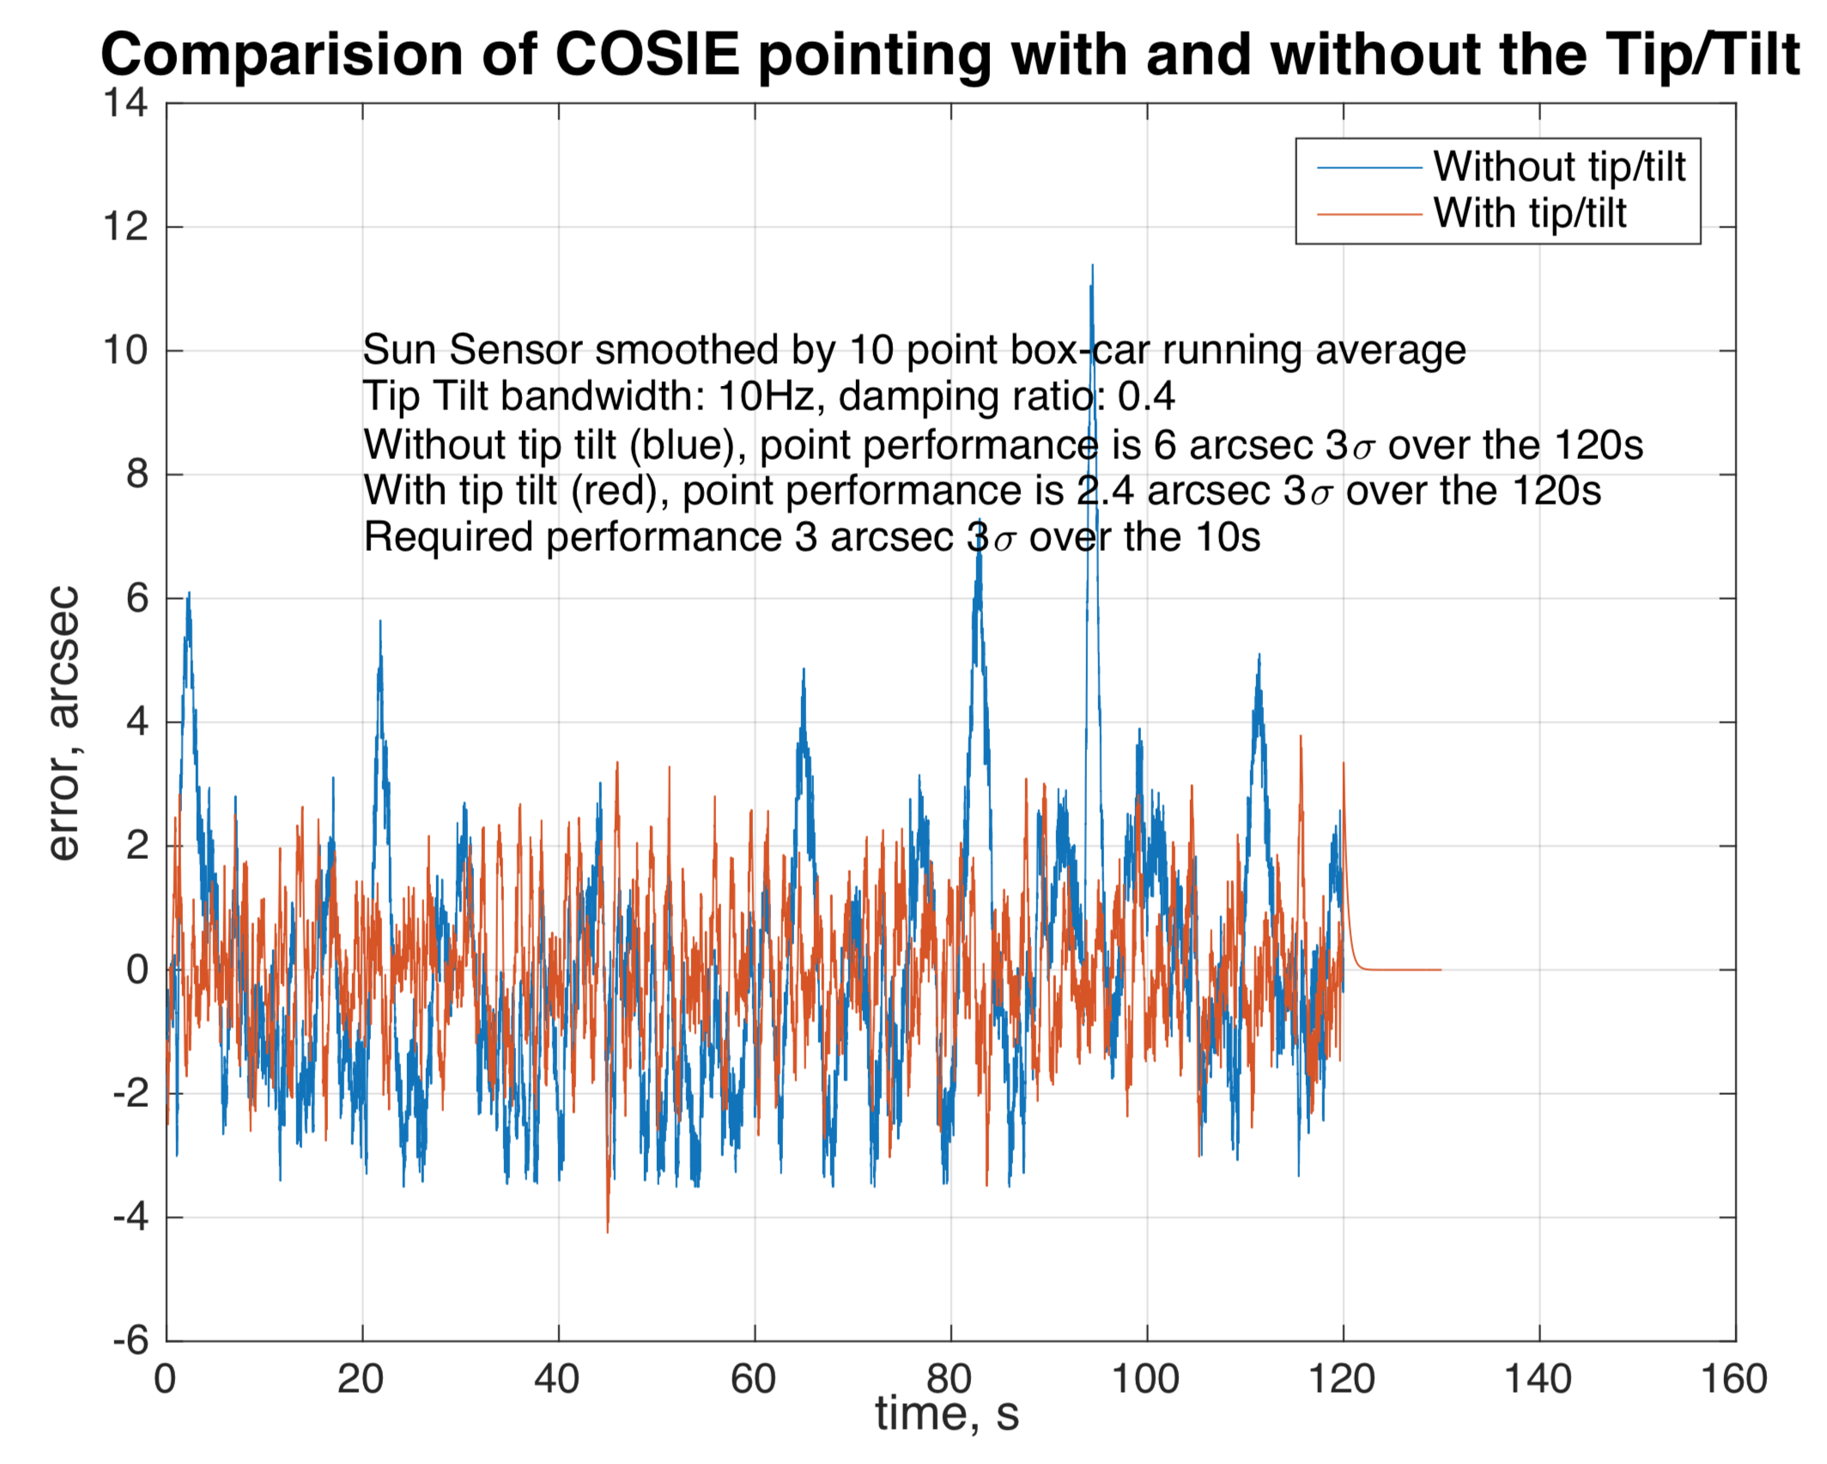
COSIE Pointing Performance
Pointing performance requirements met by combination of the LASP coarse pointing system (pointing arm assembly on platform) together with the SAO fine pointing system (tip/tilt mechanism within the instrument).
Notes:
No comment

