Slide 1
L1/L5 observations and Solar Energetic Particle event
T. Laitinen, S. Dalla
Jeremiah Horrocks Institute, UCLan, UK

Slide 2
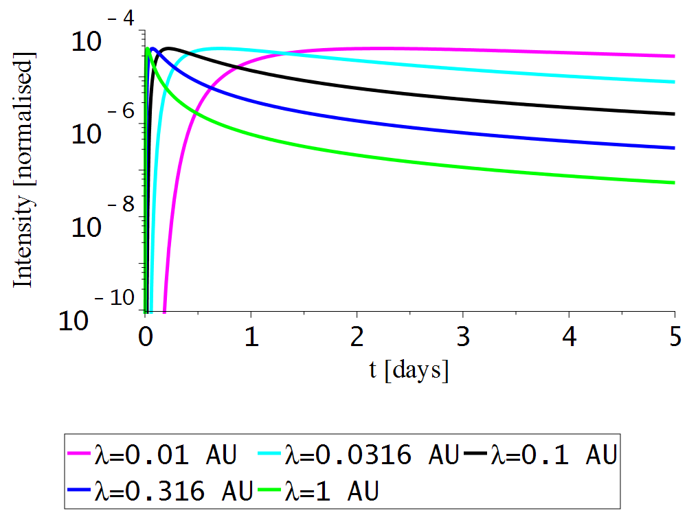
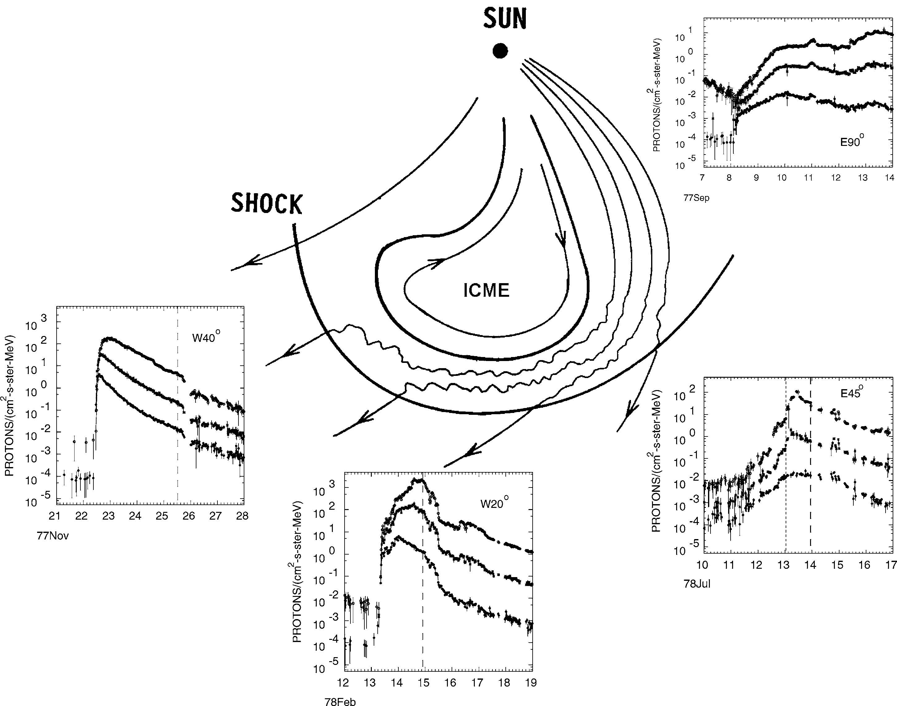
SEP events: 1D view in 3D
1D view: SEPs along field lines
SEPs at 1 AU: Diffusive transport convolves the injection
Profiles result from acceleration?
Single-point measurements:
  No global view of the SEP event
Cane+ 1988

Slide 3
Multi-Spacecraft observations: 3D view of the whole event
SEP event width: Multi-spacecraft observations give σ_{longitude}=30-50º
  Advanced modelling needed to explain the width
Width similar to L5/L1 separation, 60º
  Implies 10-fold difference in L1/L5 flux
Similar to corotation timescale, 60º in 4 days
  -> Spacecraft motion important for fluxes
Corotation effect significant (e.g. Giacalone+ 2012, Marsh+ 2015)
Statistical studies possible with latest STEREO observations
Dresing+ 2012
Richardson+ 2014

Slide 4
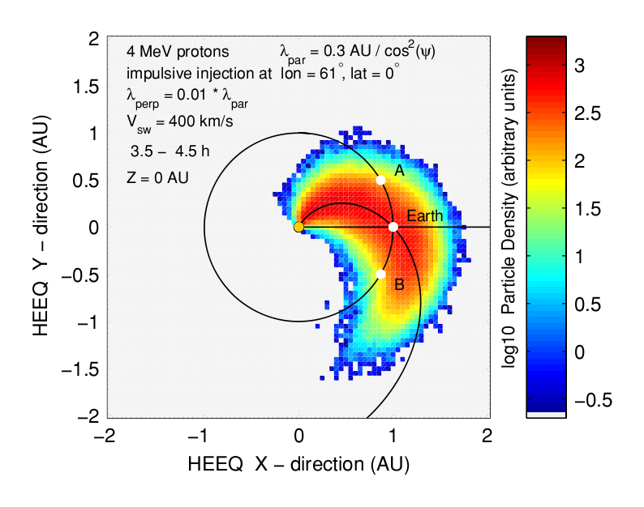
Advanced models
Large-scale drifts (Dalla+ 2013, Marsh+ 2015, Battarbee+ 2017)
  Non-diffusive, asymmetric, energy changes
Cross-field diffusion (Zhang+ 2009, Droege+ 2010)
  Slow spreading across longitudes
Turbulent meandering (Laitinen+ 2016)
  Fast initial SEP spreading across latitude and longitude
All require/desire for forecasting:
  Multi-point SEP observations
  Multi-point SEP anisotropy
  Turbulence for transport parameters
  Large-scale structure
Large-scale drifts (Marsh+ 2013)
Cross-field diffusion (Droge+ 2010)
Meandering (Laitinen+ 2016)

Slide 5
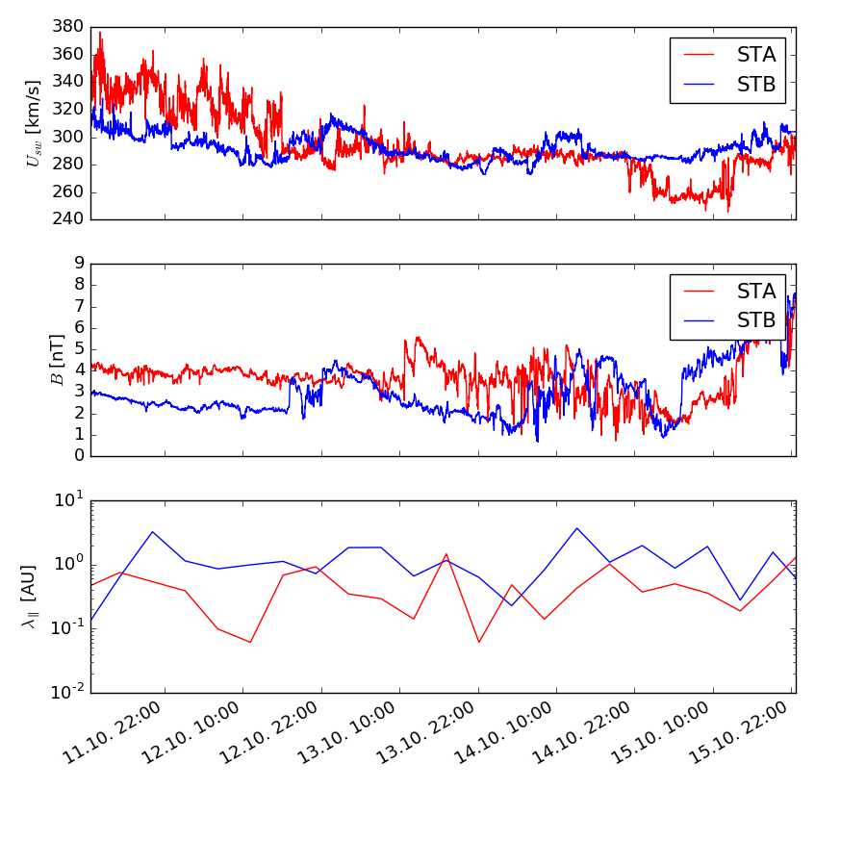
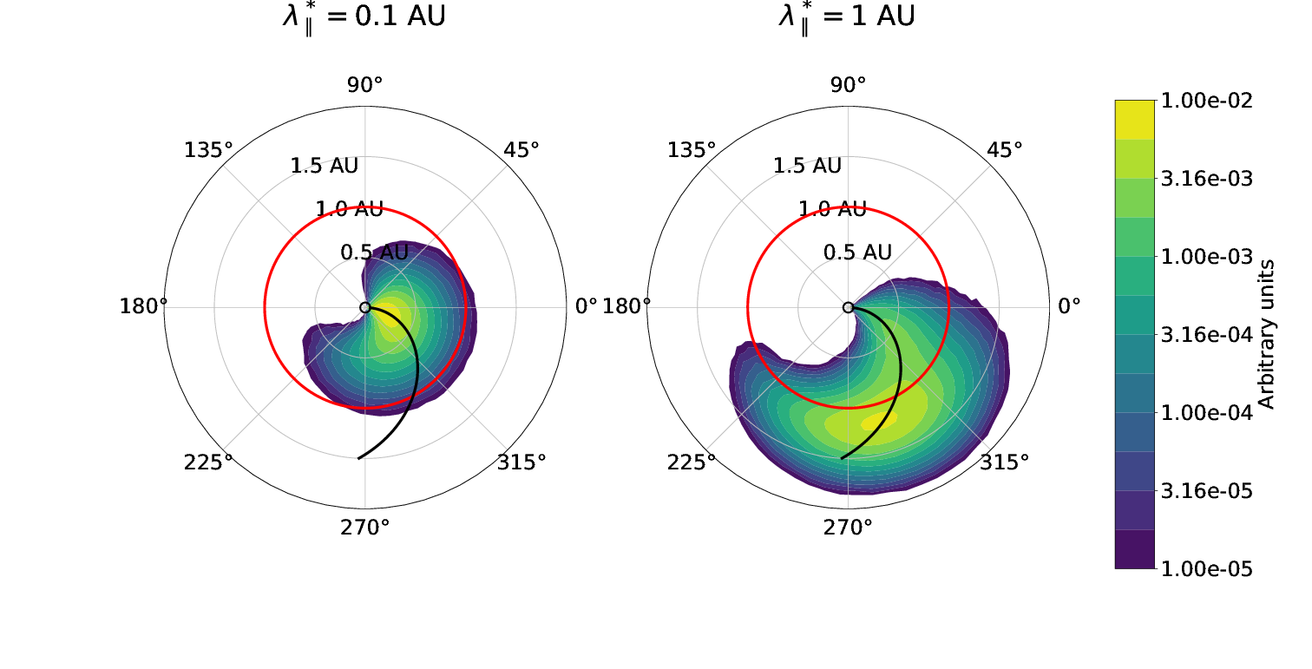

Solar wind turbulence
Solar wind varies in longitude, latitude and time: Different at STA and STB (or L1 and L4/L5)
Longitudinal effects also on particle transport?
  Implied by SEP observations (Droge et al 2016, Gomez-Herrero et al 2016)
  Persistence? Thomas et al (2018)
  Conversely: If there are none, why not?
Laitinen+ (2018)
Solar wind and turbulence during an event. Note: $λ$ values preliminary!

Slide 6
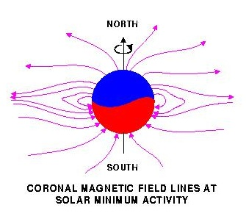
Large-scale drifts for SEPs
Traditionally SEPs thought to follow large-scale field lines
Recent work shows significant drift of SEPs, and resulting SEP deceleration (Marsh+ 2013, Dalla+ 2013)
Drift depends on element, charge state and energy: Important for SEP observation analysis (e.g. Mason+ 2012, Zelina 2017)
Initial monopole field extended to dipole with wavy current sheet (Battarbee+2018)
A⁺
Top panel: particles drift towards current sheet in A+ solar magnetic polarity (conversely away in A-)
Meyer-Vernet 2007

Slide 7
Drift in Parker field, A+ vs A- polarity
10-800 MeV protons injected at/near current sheet (corotation effect removed) (Battarbee+ 2018)

Slide 8
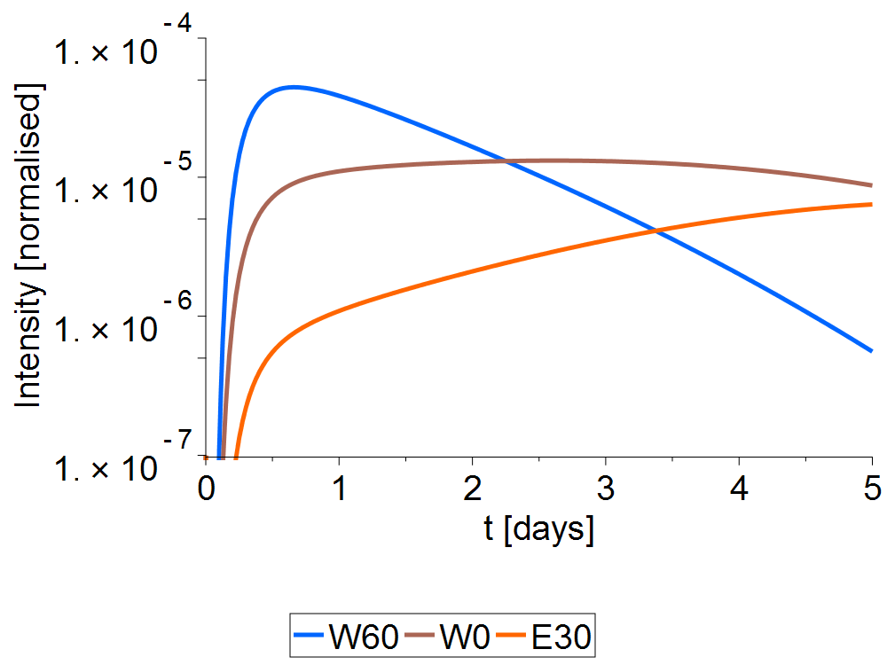
L5/L1 observations and SEP forecasting
SEP observations, >10 MeV/n ions
  L5+L1 SEP observations important: longitude-dependent temporal evolution
  L5 observations connected to Earth-bound source:
    SEP source characterisation from CME observations and modelling
    CME diagnostics from SEP observations using acceleration modelling (e.g. Vainio+ 2014)
  L5 SEP anisotropy: Duration of SEP acceleration as CME diagnostics; transport vs acceleration analysis (advanced transport models)
    Duration of acceleration as measure of CME characteristics
L5 In situ solar wind and magn field observations
  Longitudinal variation of magnetic turbulence for SEP transport conditions
  Observations and global heliosphere simulations for Parker geometry variations
  Current sheet location between L1 and L5 significant for SEP propagation, interpretation
10 MeV protons at 1 AU following an time-impulsive, 40-degree-wide injection at W0 at Sun, as seen at L5 (W60), L1 (W0) and half-way to L4 (E30) (simple 1D transport model)

Slide 9
Conclusions
SEP event longitudinal width is similar to L1/L5 separation and corotation scale
Significant implications on SEP event temporal evolution, duration and total fluence
Implies potential for SEP Space Weather with L1/L5 SEP observations
Solar wind turbulence key for event modelling
  Longitudinal dependence, persistence L5->L1?
Large-scale field: effect of heliospheric current sheet on particle propagation, drifts, access to 1 AU

Slide 10
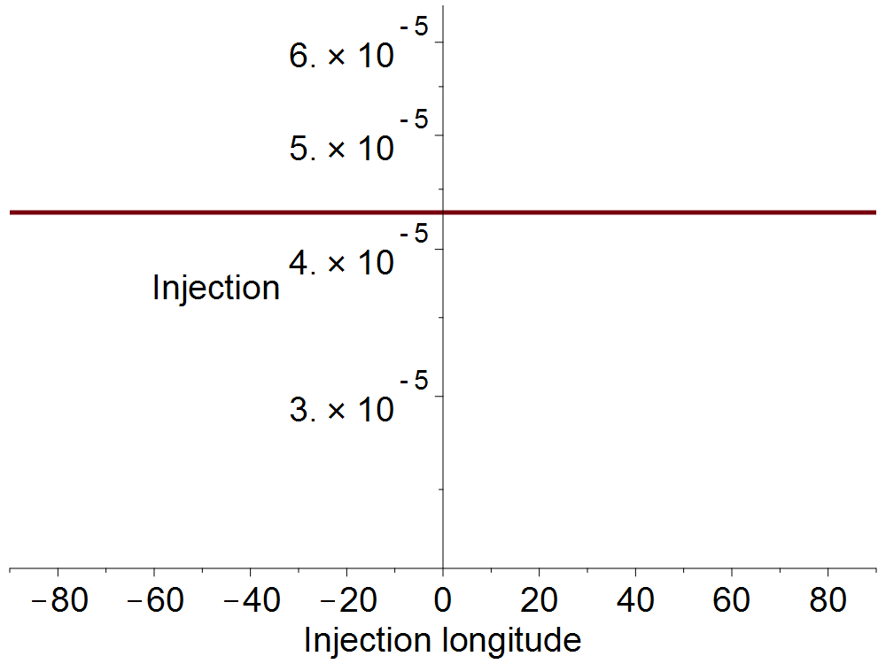
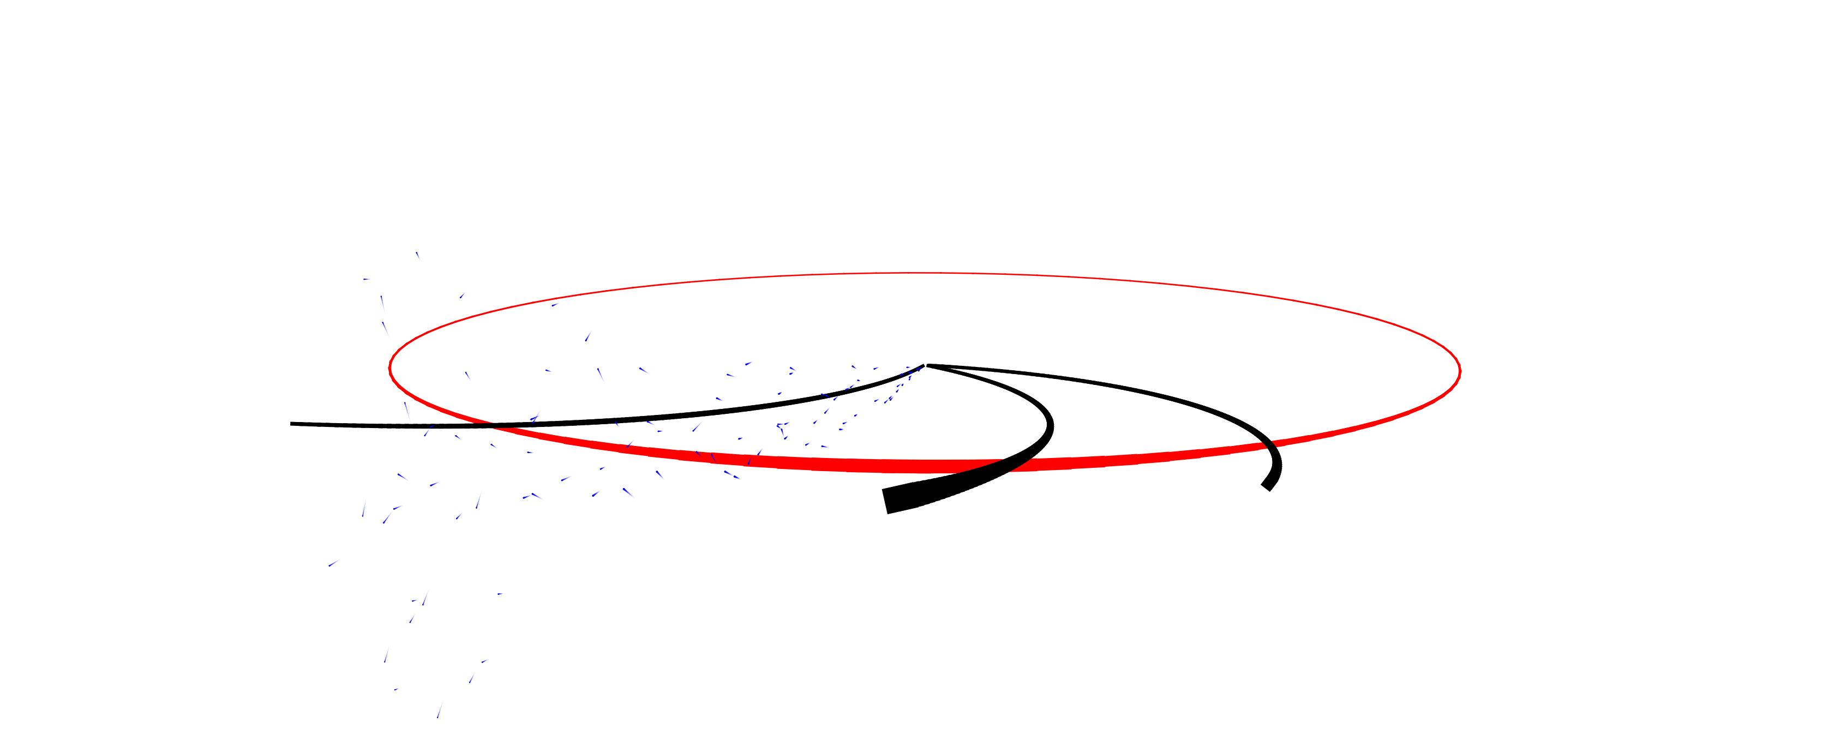
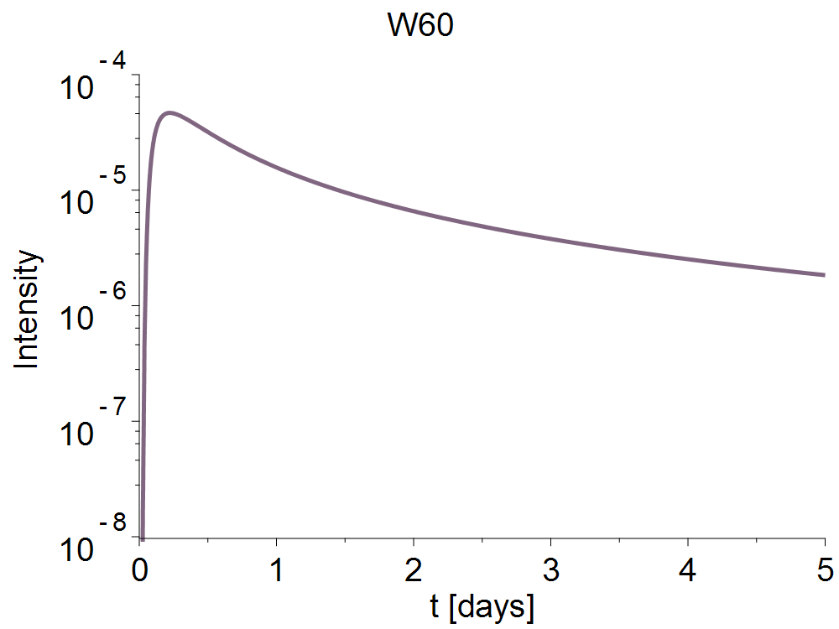
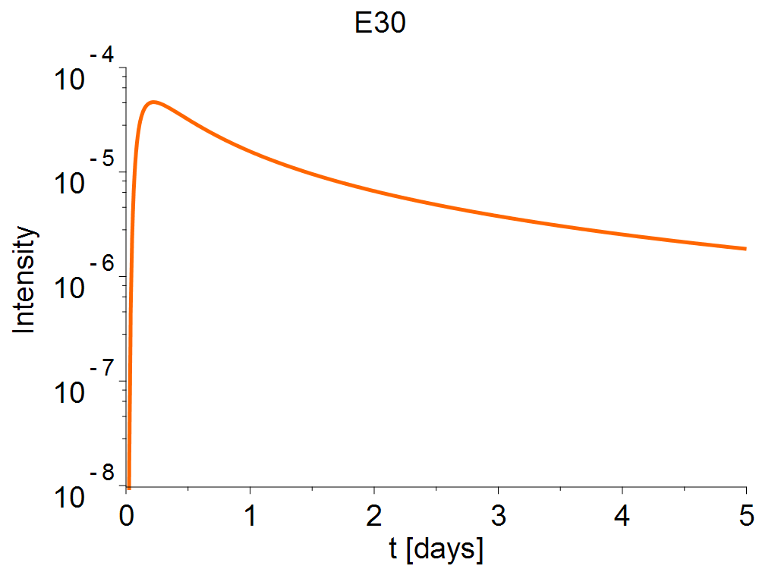
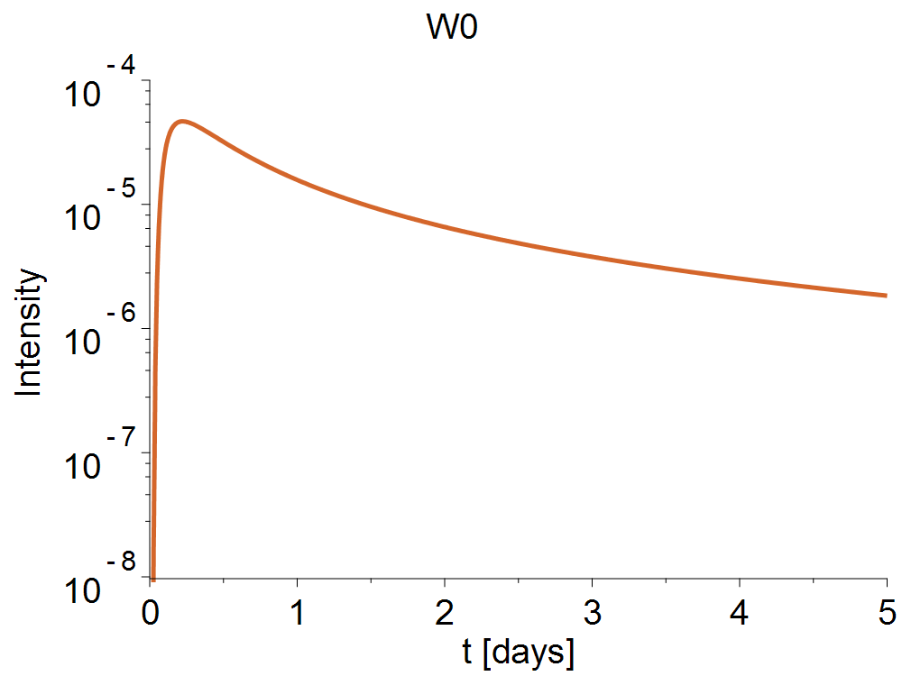

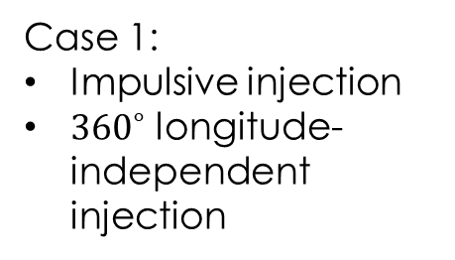
Simple transport model: flat injection
Simple transport model:
Diffusive propagation along Parker spiral
10 MeV protons
$λ_{∥}=0.1$ AU
Case 1:
Impulsive injection
${360}^{∘}$ longitude-independent injection
L5
L1
Earth’s orbit

Slide 11
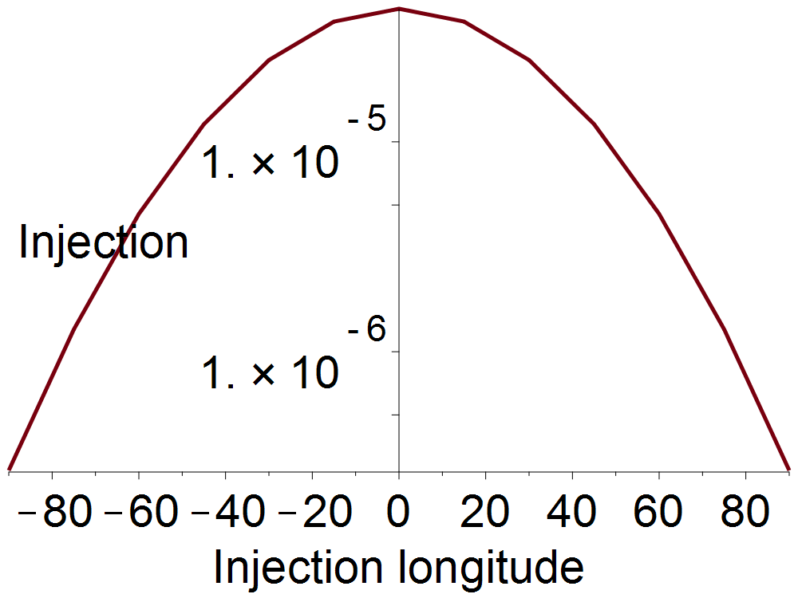
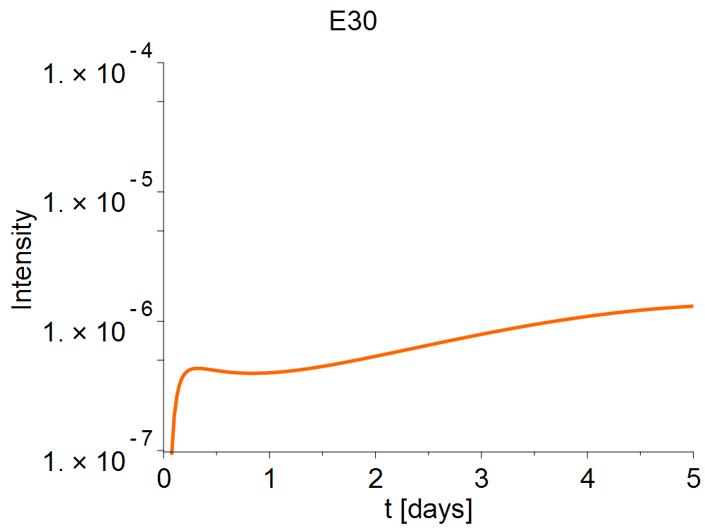
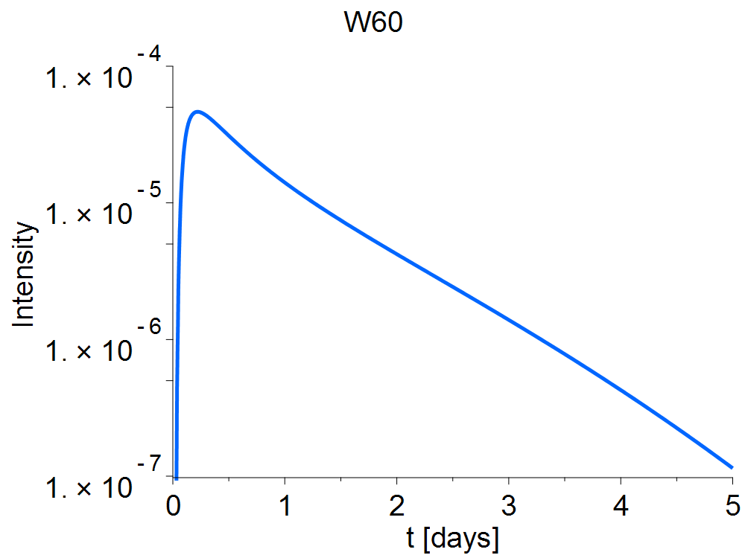
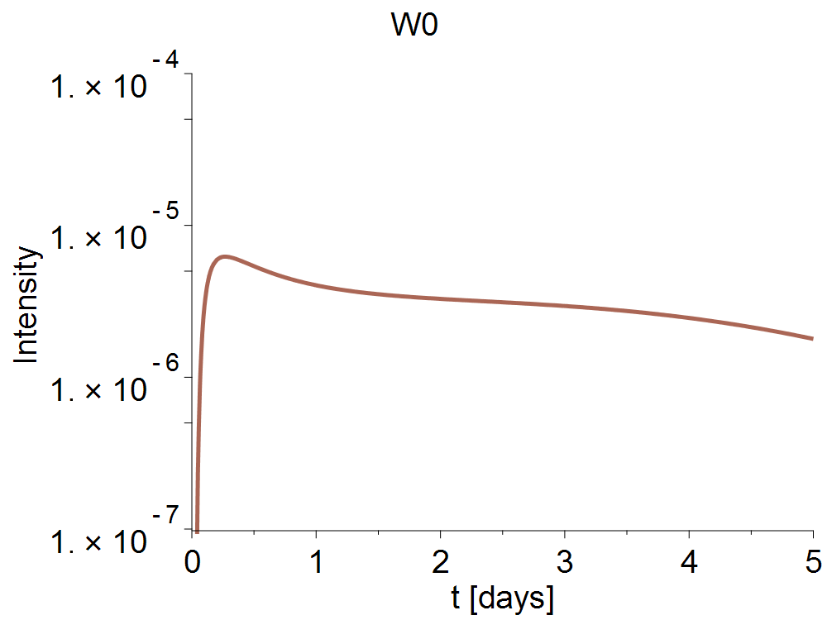

Simple transport model: Gaussian injection
Simple transport model:
Diffusive propagation along Parker spiral
10 MeV protons
$λ_{∥}=0.1$ AU
Case 2:
Impulsive injection
Longitudinal Gaussian at W0, with σ_{longitude}=40º
L5
L1
Earth’s orbit
See also Giacalone+ 2012, Marsh+ 2015

