Slide 1
Solar wind Data assimilation from L5
Space and Atmospheric Electricity group
Department of Meteorology
Mathew Owens & Matt Lang

Slide 2
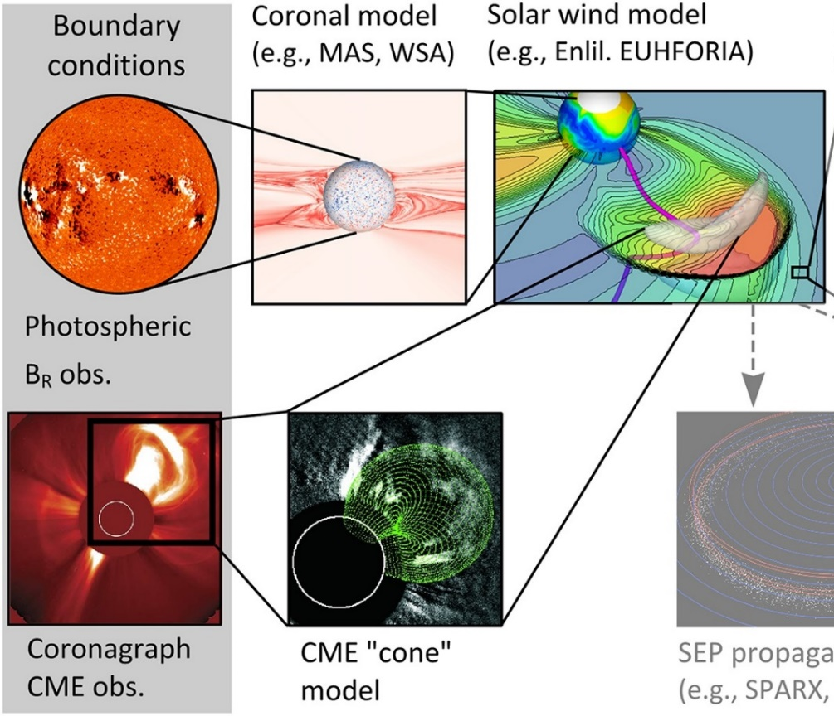
solar wind forecasting
Strengths:
Remote observations: Global reconstructions
Dynamic/transient structures
Weaknesses:
Relation of coronal field to solar wind speed is poor
No means of generating Bz (aside from ICME sheath)
No observational constraint past photosphere/corona
Lang et al., Space Weather, 2017

Slide 3
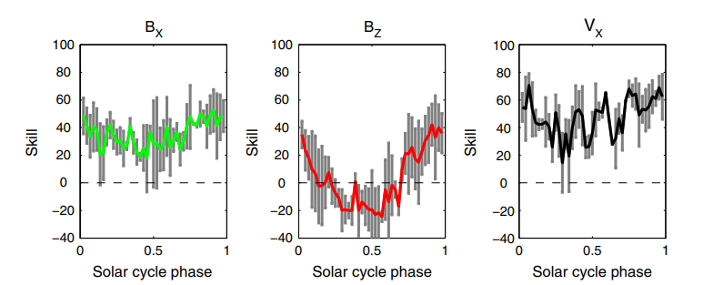
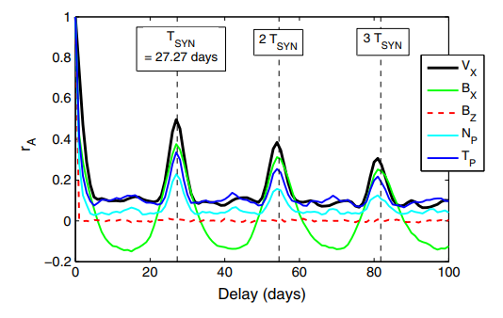
27-day Recurrence
Strengths:
In situ observations: Direct, accurate measure of solar wind properties
Weaknesses:
Steady state (over 27-days)
Extremely localised
Owens et al., Space Weather, 2013

Slide 4
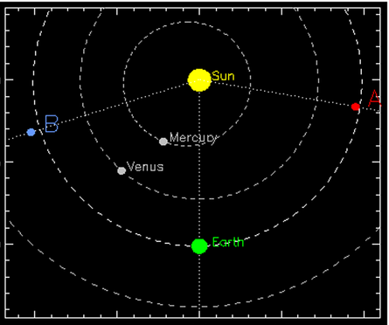
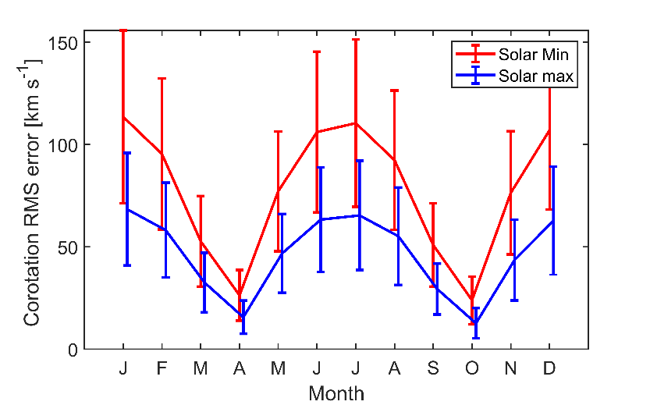
Corotation from l5
Kohutova et al., Space Weather, 2016
[see also
Thomas et al., 2018]
B_{X} B_{Y} B_{Z} |B| n_{P} V_{P} T_{P}
Owens & Riley, Space Weather, 2019. (Hopefully)

Slide 5
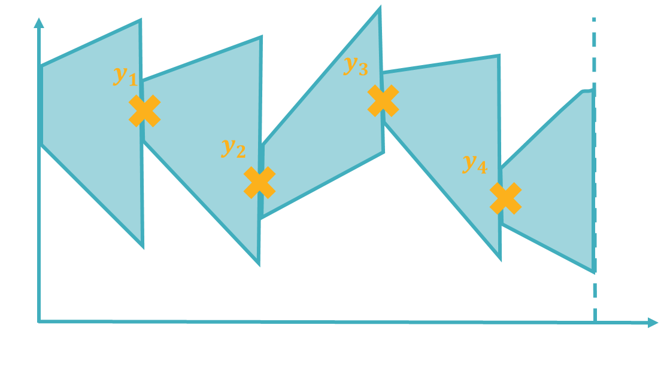
Data assimilation
Can we rigorously combine info from corona/photosphere with L5 (and L1) in situ measurements?
Would I be posing this question if we couldn’t?
Data assimilation (DA):
Find optimal combination of model and obs, within uncertainties of both.

Slide 6
Boundary-driven system
Lang & Owens, Space Weather, 2018
Variational approach: map information back in time using model fields
Requires “adjoint” model, which does not exist for Enlil, HelioMAS, EUHFORIA, etc.
(Permanently) change inner boundary conditions, propagate out

Slide 7
Simple solar wind model
Solar wind speed propagation model
$$v_{i+1,j}=v_{i,j}+\frac{ΔrΩ}{v_{i,j}}\left(\frac{v_{i,j+1}−v_{i,j}}{Δφ}\right)$$
$$v_{i,j}^{acc}=αv_{0,j}\left(1−exp\left(\frac{r_{i}}{r_{H}}\right)\right)$$
$v_{i,j}$ is the solar wind speed at radius $r_{i}$ and Carrington longitude, $φ_{j}$
$v_{i,j}^{acc}$ is a term added to the speeds to account for solar wind acceleration
$Δr$ and $Δφ$ are the radius and Carr. Lon. grid-size
$Ω$ is the Sun’s rotational speed, $α$ and $r_{H}$ are constants
Assumes the Sun doesn’t change over one Solar rotation (steady-state)
Earth
Riley & Lionello, Sol Phys, 2013; Owens & Riley, Space Weather, 2017

Slide 8
Example DA results
STEREO A and B in quadrature with Earth
Prior state is from magnetogram and MHD simulation
Assimilate STEREO A and B obs, forecast L1
Huge improvement in L1 conditions
Not a forecast: reconstruction
 | Prior RMSE (km/s) | Posterior RMSE (km/s) | RMSE Red. (%)
STEREO A | 177.94 | 81.23 | 54.35
STEREO B | 122.44 | 68.35 | 44.18
ACE | 125.05 | 79.23 | 36.64
Lang & Owens, Space Weather, 2018

Slide 9
Conclusions
Data assimilation allows us to combine info from magnetogram-driven models and in-situ observations
Benefits from global info from model and accurate-but-local info from in situ observations
Can accommodate latitudinal offsets in observations
Still need to full quantify forecast skill gain from L5
Same principles could be applied to Heliospheric Imager data
Converting HI into localised model state estimates is difficult

Slide 10
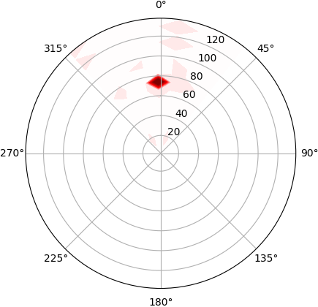
Supersonic solar wind
Synthetic obs:
Make change to model state at 0.5 AU on Earth Sun line
State update is swept out of system
If updated L5, no change to state at L1.
Localisation issue
Lang et al., Space Weather, 2017

Slide 11
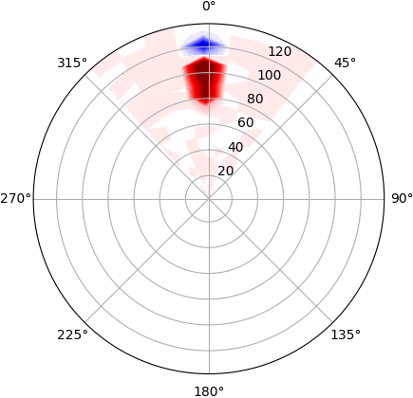
Supersonic solar wind
Synthetic obs:
Make change to model state at 0.5 AU on Earth Sun line
State update is swept out of system
If updated L5, no change to state at L1.
Localisation issue
Lang et al., Space Weather, 2017

Slide 12
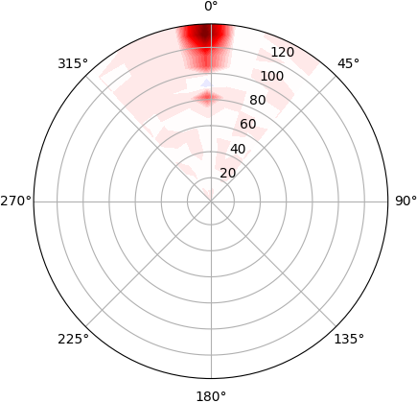
Supersonic solar wind
Synthetic obs:
Make change to model state at 0.5 AU on Earth Sun line
State update is swept out of system
If updated L5, no change to state at L1.
Localisation issue
Lang et al., Space Weather, 2017

Slide 13
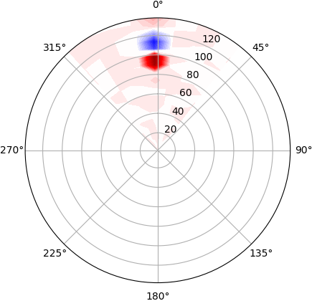
Supersonic solar wind
Synthetic obs:
Make change to model state at 0.5 AU on Earth Sun line
State update is swept out of system
If updated L5, no change to state at L1.
Localisation issue
Lang et al., Space Weather, 2017

Slide 14
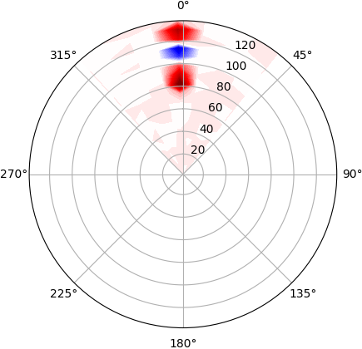
Supersonic solar wind
Synthetic obs:
Make change to model state at 0.5 AU on Earth Sun line
State update is swept out of system
If updated L5, no change to state at L1.
Localisation issue
Lang et al., Space Weather, 2017

