Slide 1
Impact of geomagnetic disturbances on Ionospheric structures

Slide 2
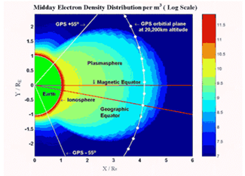
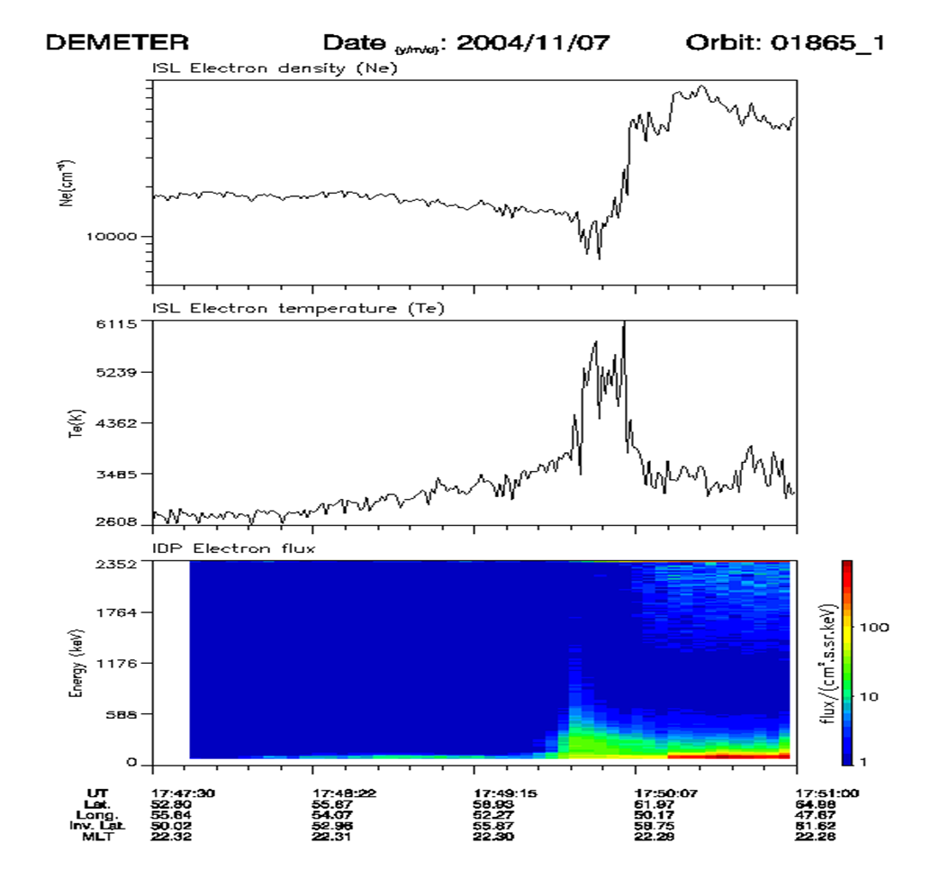
DEMETER: altitude: 660-700 km sunsynchronous orbit (about 10.30 and 22.30 LT: night observations used) observation range in magnetic latitudes: [-65º:65º] time coverage: 2005-2010
sudden electron density drop at 60º-70º dip latitudes, both hemispheres
narrow in latitudes but extended in longitudes
polar wall usually steeper than equatorial wall
night-time phenomenon

Slide 3
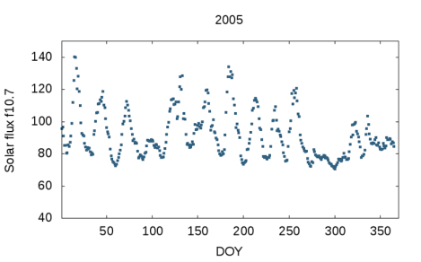
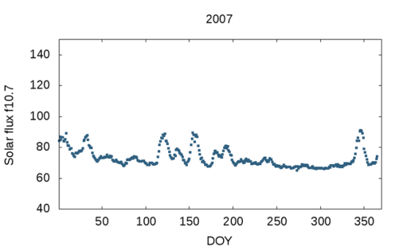
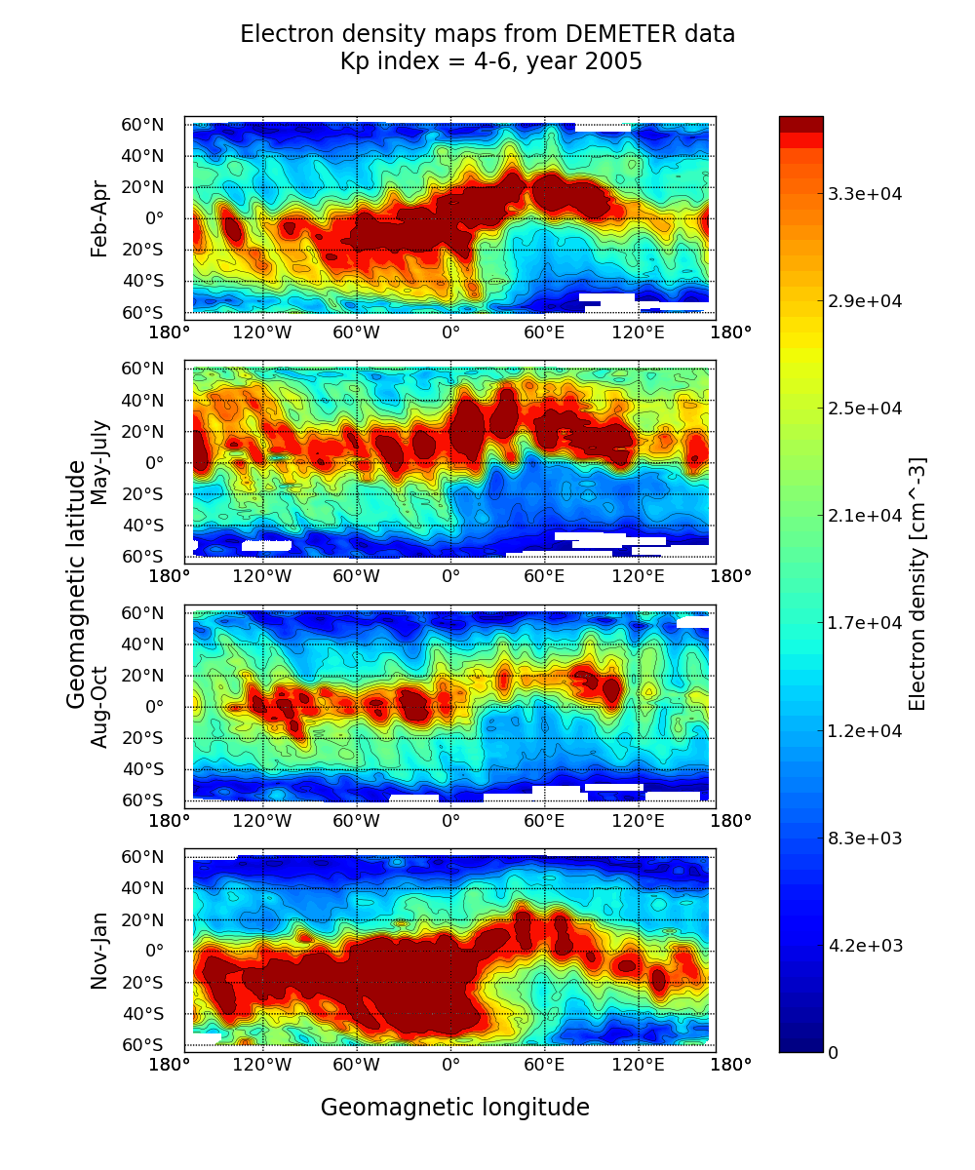
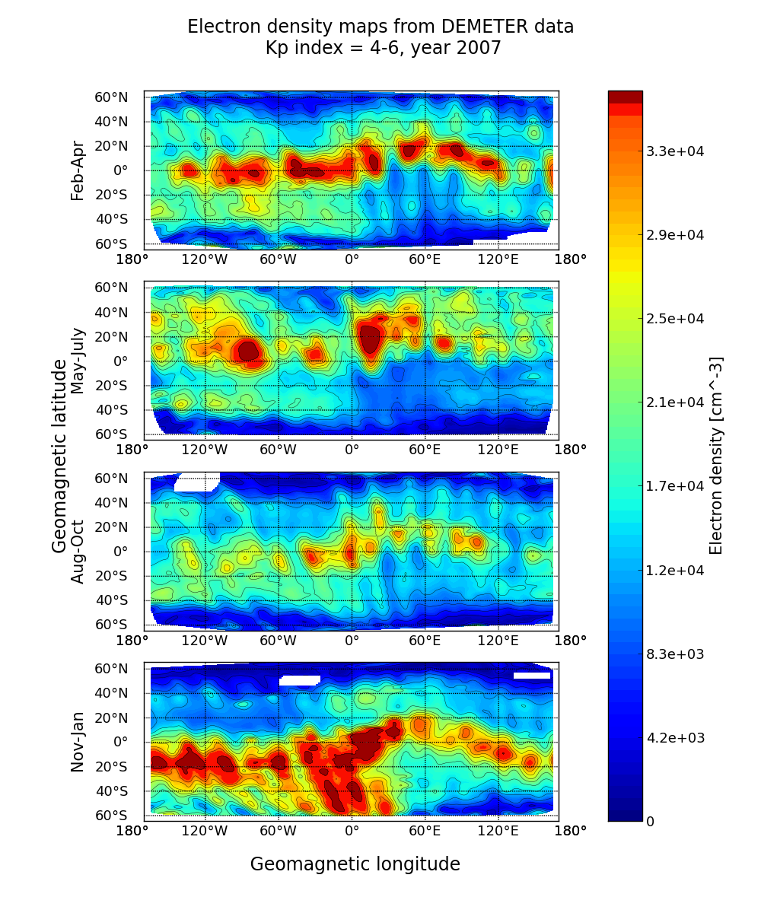
SOLAR CONDITIONS

Slide 4
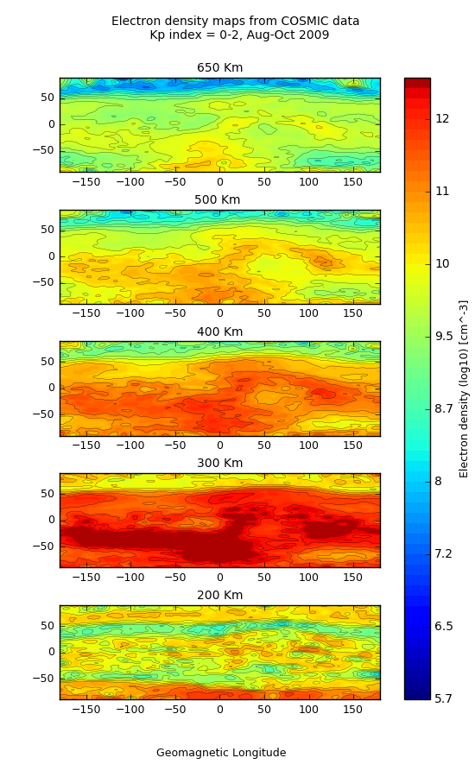
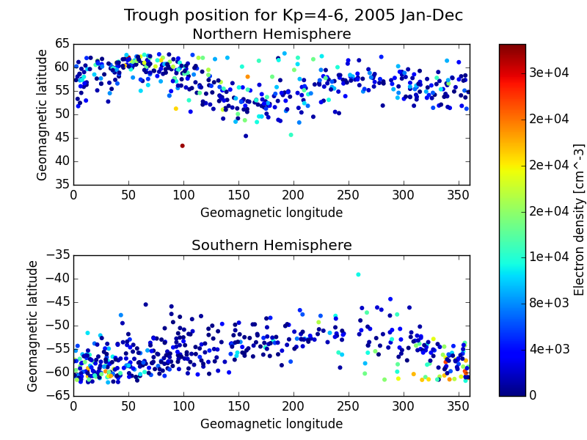
3D and longitudinal effect

Slide 5
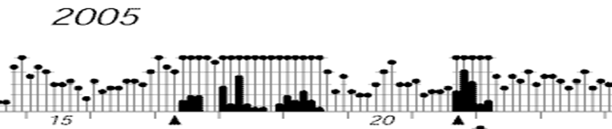
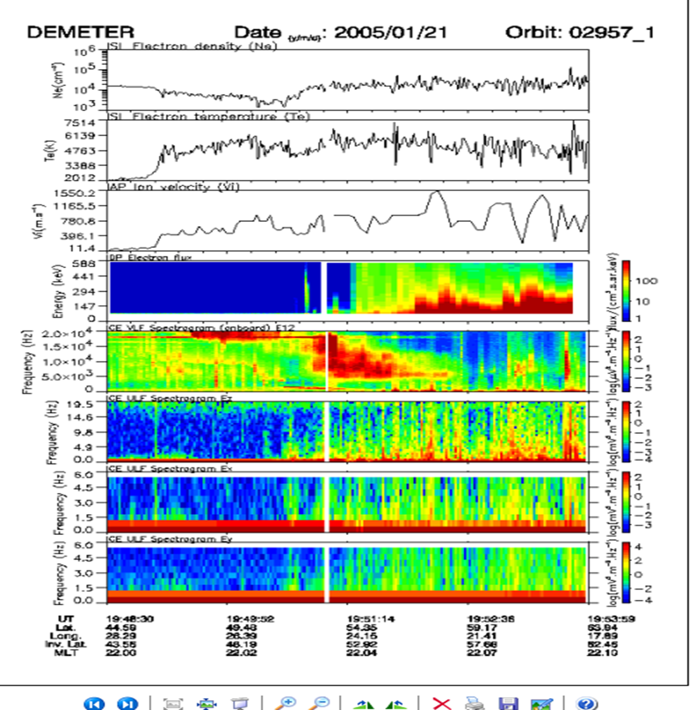
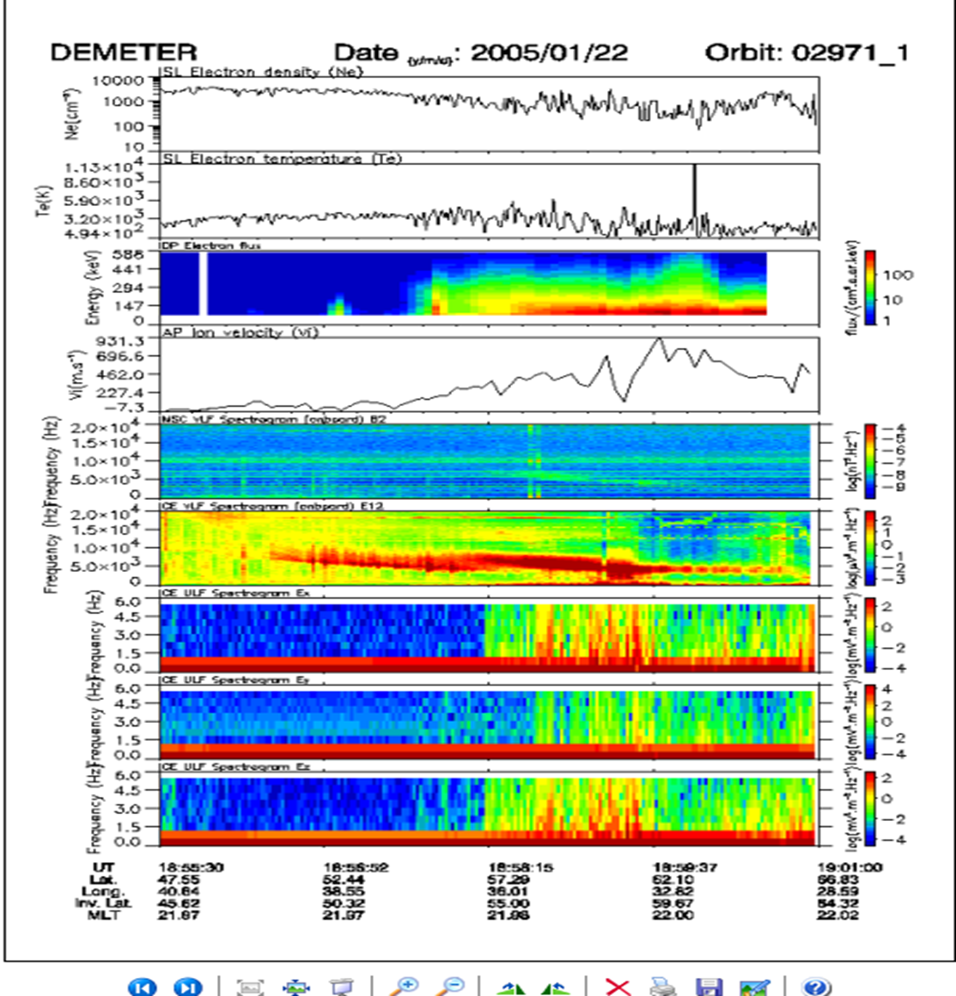
Alfven waves, EMIC, LHR, UHR
Frozen emissions,
turbulent regions

Slide 6
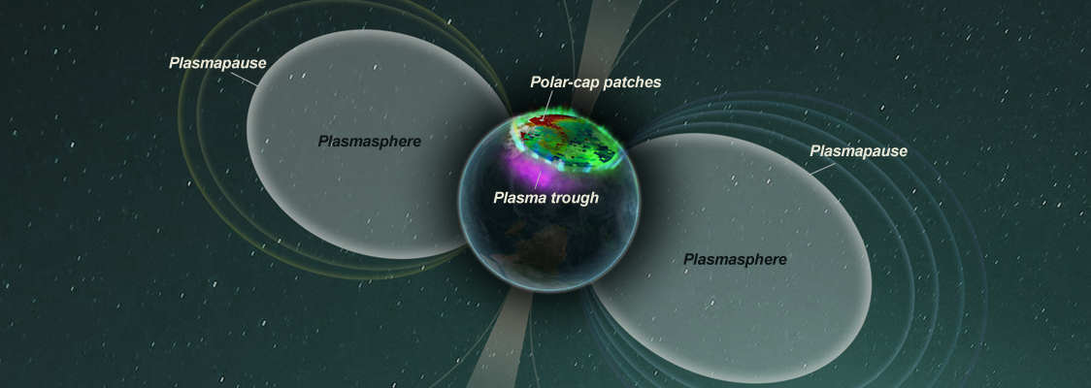
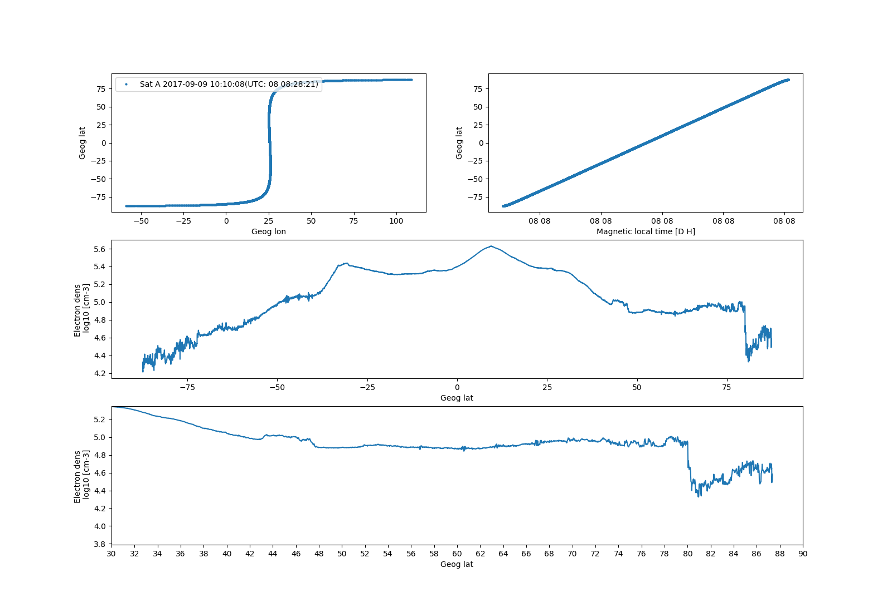
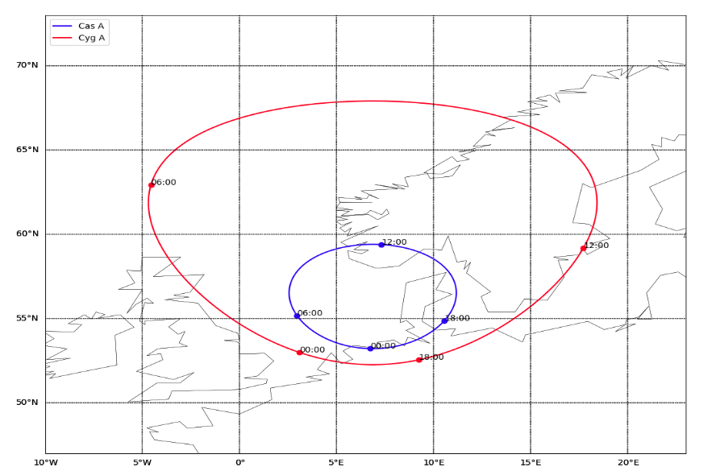
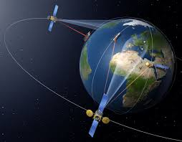
Top- side insitu diagnostics
SWARM
FAC
09 08 row 48
Lukianova 2019

Slide 7
Radars and riometr
PL610
Yamauchi 2018
2019

Slide 8
structures iN TEC representation
LOFAR
Wan et al..

Slide 9
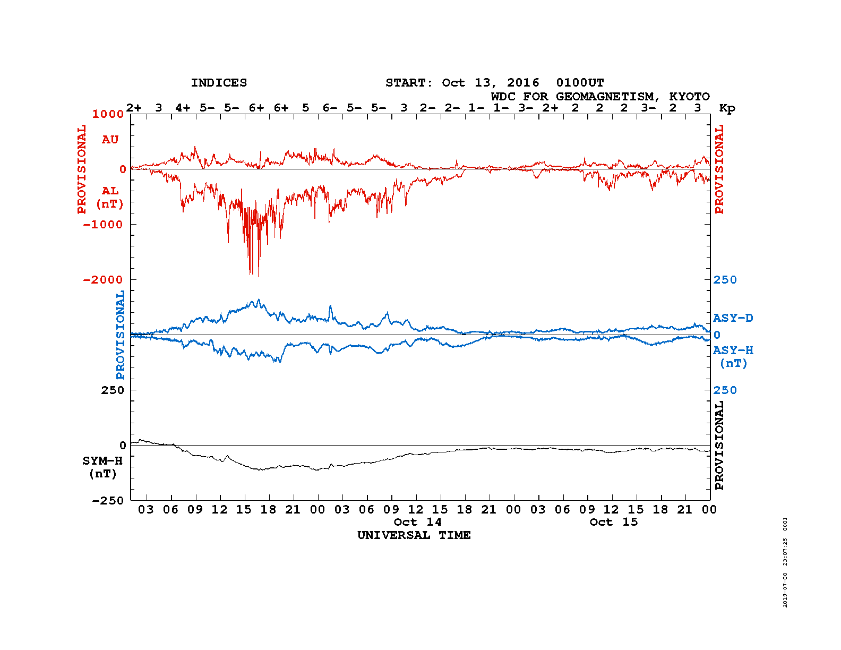
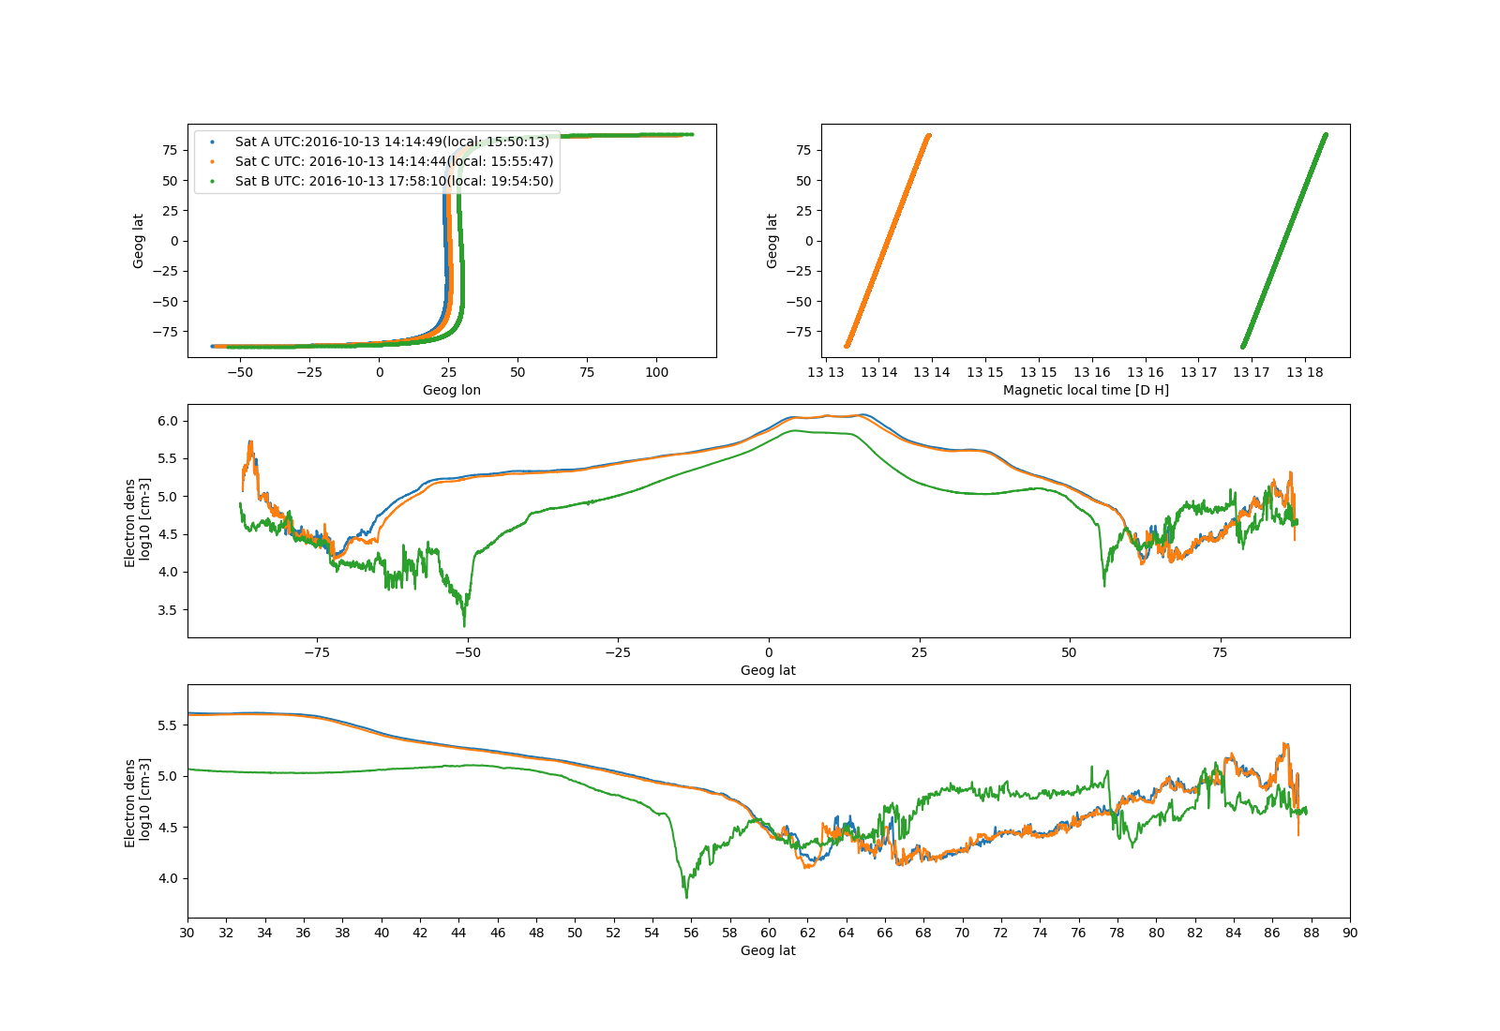
SWARM TOP side ionosphere 13 10 2016

Slide 10
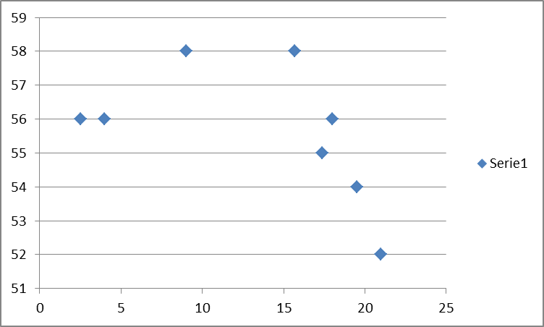
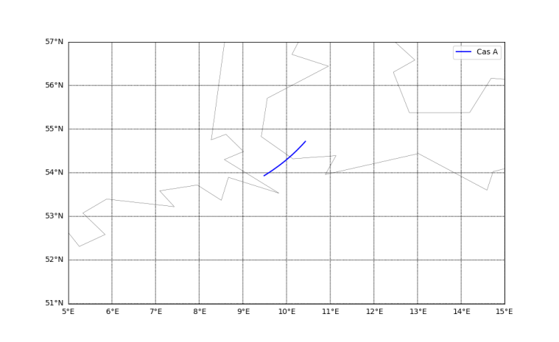
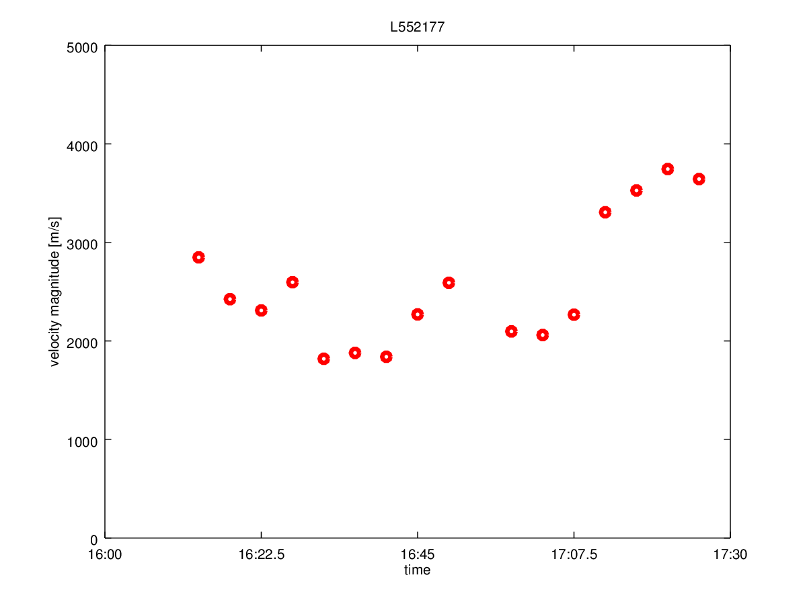
Geomagnetic storm 13 10 2016
Combination of different scales dynamic
Lat
SWARM
Time
LOFAR

