Slide 1


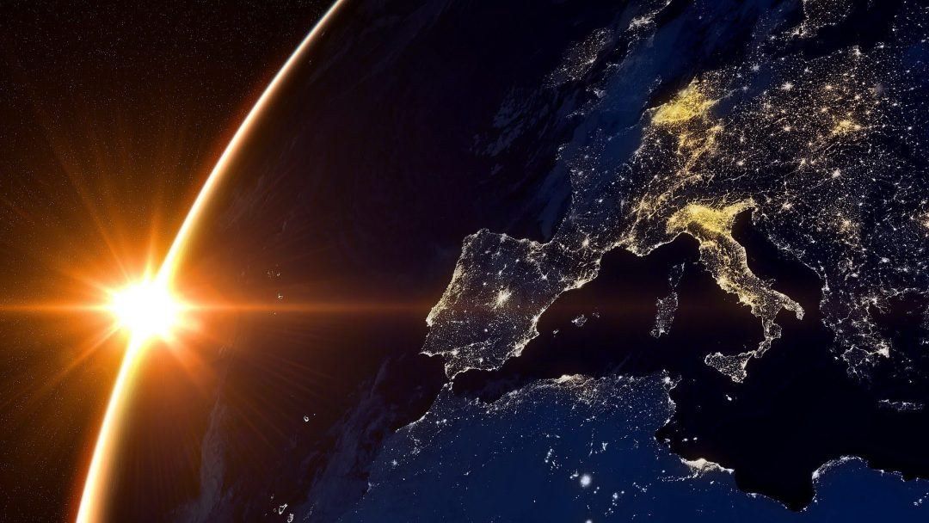
Investigation of the ionospheric irregularities on global and regional scale
Vincenzo Romano, Lucilla Alfonsi, Claudio Cesaroni, Giorgiana De Franceschi, Ingrid Hunstad, Luca Spogli
Istituto Nazionale di Geofisica e Vulcanologia (INGV)
Notes:
Besides the traditional observation by the ionosondes started in the ‘30s, INGV performs measurement of the ionosphere through GNSS ground-based receivers since 2003. The stations are located in the Mediterranean area, at high and low latitudes all over the world, allowing a global description of the ionospheric plasma reconstructed through a regional assessment. Furthermore, thanks to its international collaborations with academic entities from European and extra-European Countries, such as Brazil, South Africa, USA, Canada and South-East Asia, INGV has access to additional ground-based and satellite data.
The measurements are analysed by means of different approaches to derive information on the effects of the solar wind-magnetosphere-ionosphere interplay in terms of formation and evolution of ionospheric irregularities. The ionosphere is considered irregular when its electron density is unevenly distributed, presenting regions of depleted or enhanced density, termed irregularities. The study of the irregularities is necessarily based on a multi-instruments and multi-disciplinary approach, leveraging on in-situ (from satellites and rockets) and ground-based data providing information on the Sun, the solar wind, the magnetosphere, the ionosphere. Where the data are scarce, or completely missing, the use of theoretical and semi-empirical models can support the investigation. INGV developed good skills in this framework, contributing to advance the understanding of physical mechanisms triggering the electron density gradients, the scintillations, the ionospheric absorption, the positive/negative ionospheric storms, the travelling ionospheric disturbances.
This presentation will give an overview of the capabilities recently reached in probing, modelling and investigating the ionospheric irregularities, causing scintillation, at global and regional scale as a matter of discussion and further collaboration with the audience.

Slide 2

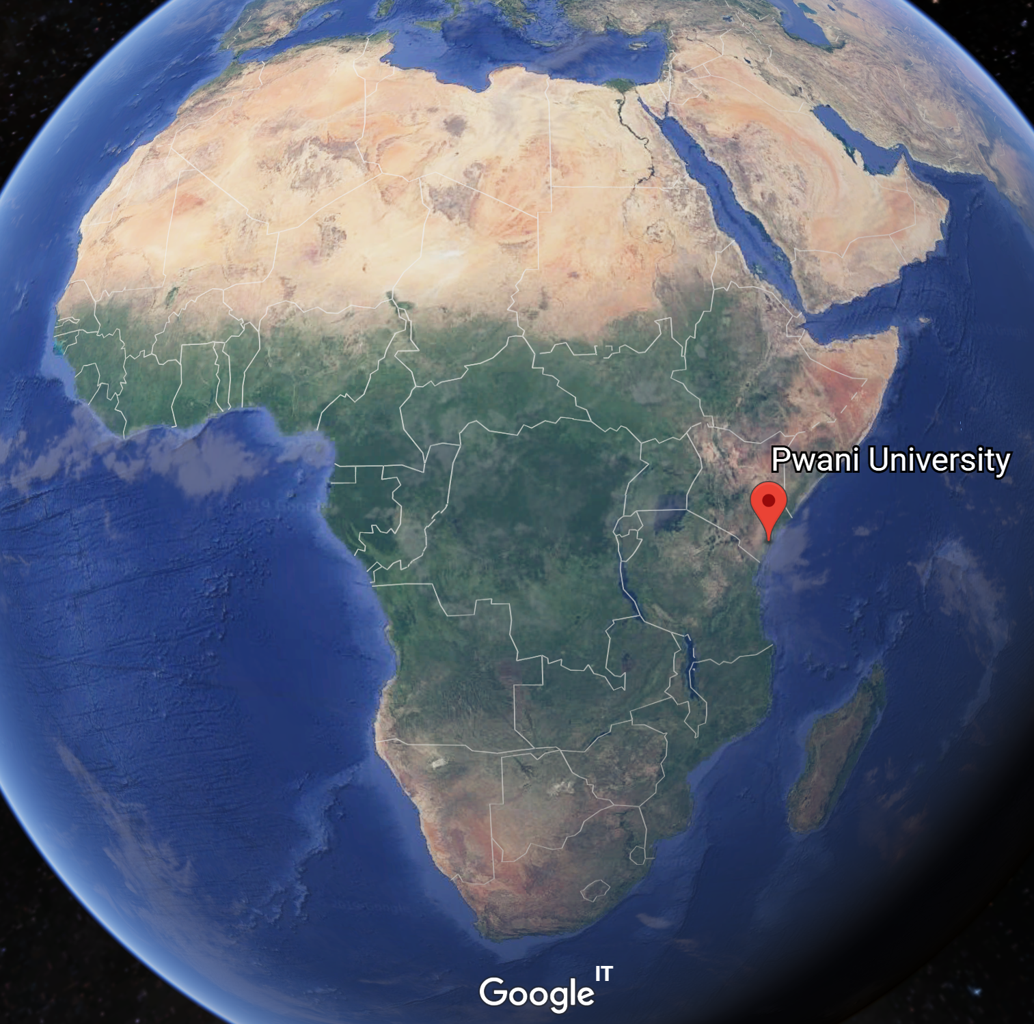
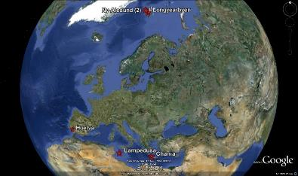
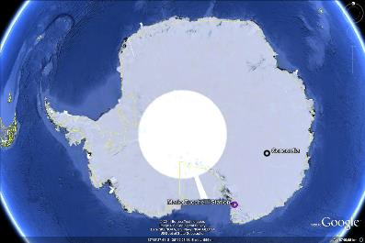
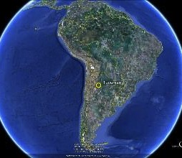



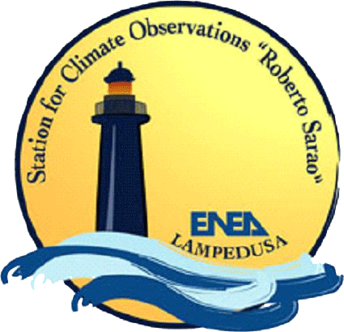





Ionospheric Scintillation GNSS Network
First receiver installed at Ny-Alesund (Svalbard) in 2003
Polar ionosphere
  Svalbard islands (3|NyAlesund, Longyearbyen)
  Antarctica (5|MZS, Concordia, SANAE)
Mid latitude ionosphere
  Chania (Crete)
  Lampedusa (Sicily, Italy)
Equatorial Ionosphere
  Tucumán (Argentina)
  Sao Paulo (Brazil)
  New station has been installed in Kenya in May 2019
  In collaboration with Embry-Riddle Aeronautical University (USA) and Pwani University (KEN)

Slide 3








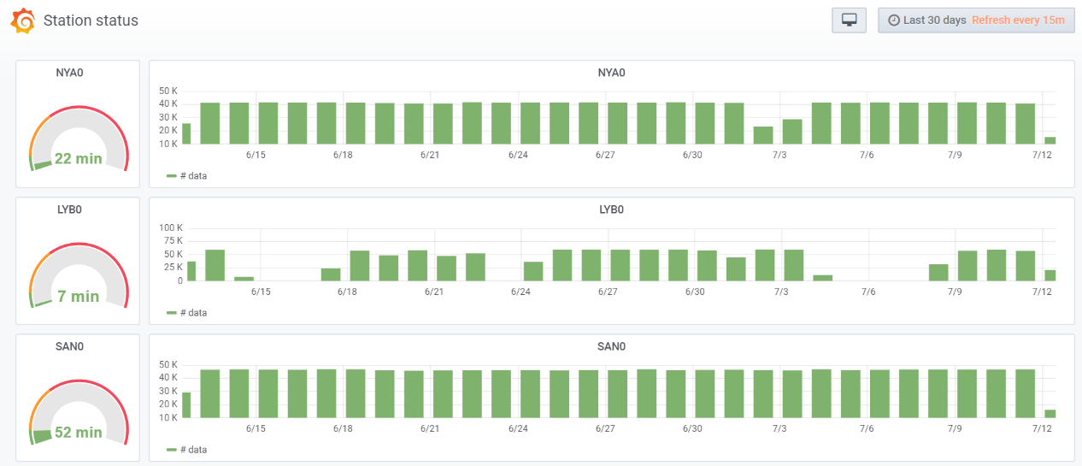
Ionospheric Scintillation
Data Management System
Server
Clients
Database
Remote stations
Backup
World Wide Web
Data are accessible at the electronic Space Weather upper atmosphere website
http://eswuax.rm.ingv.it

Slide 4
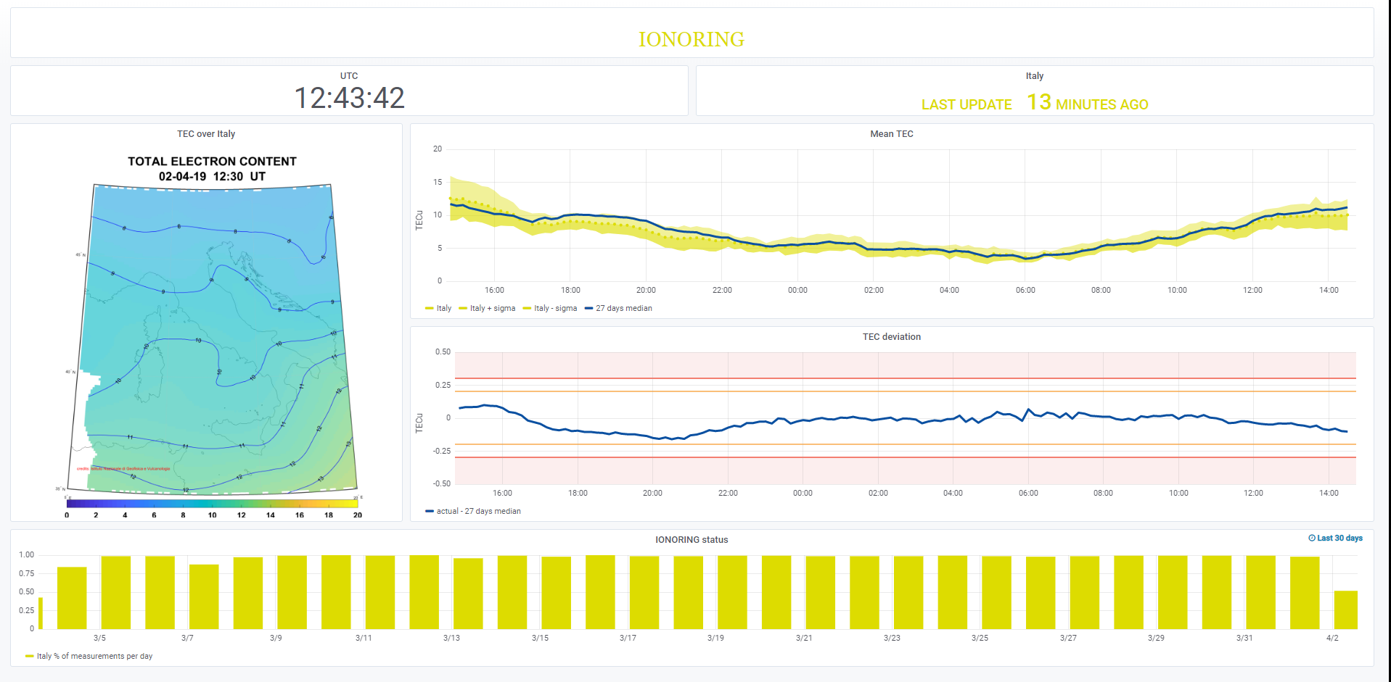
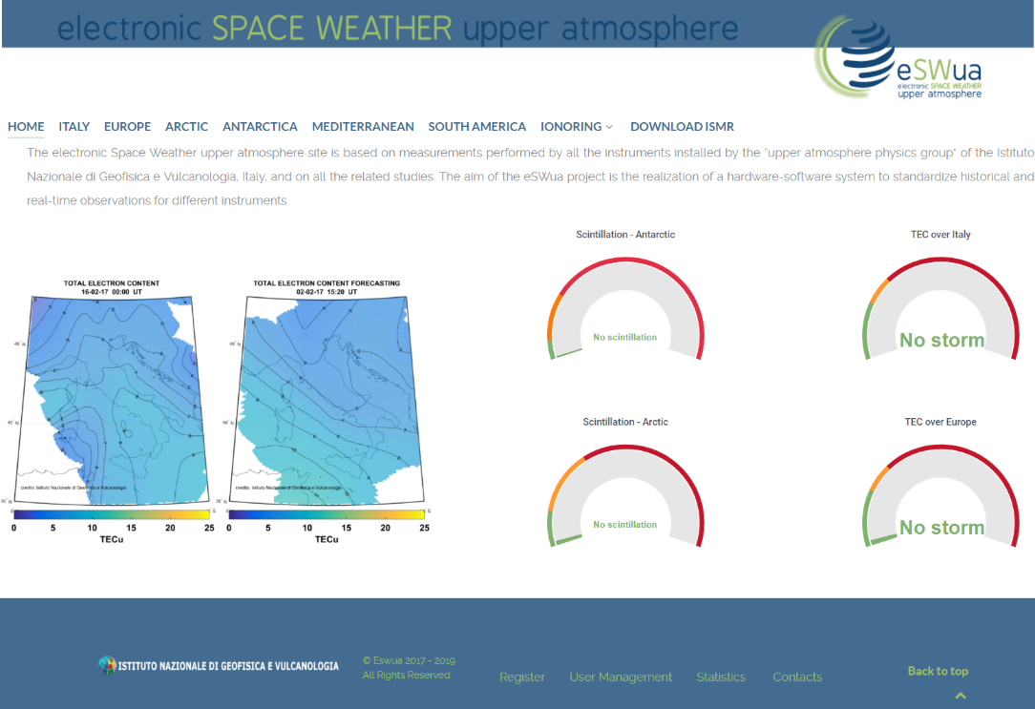
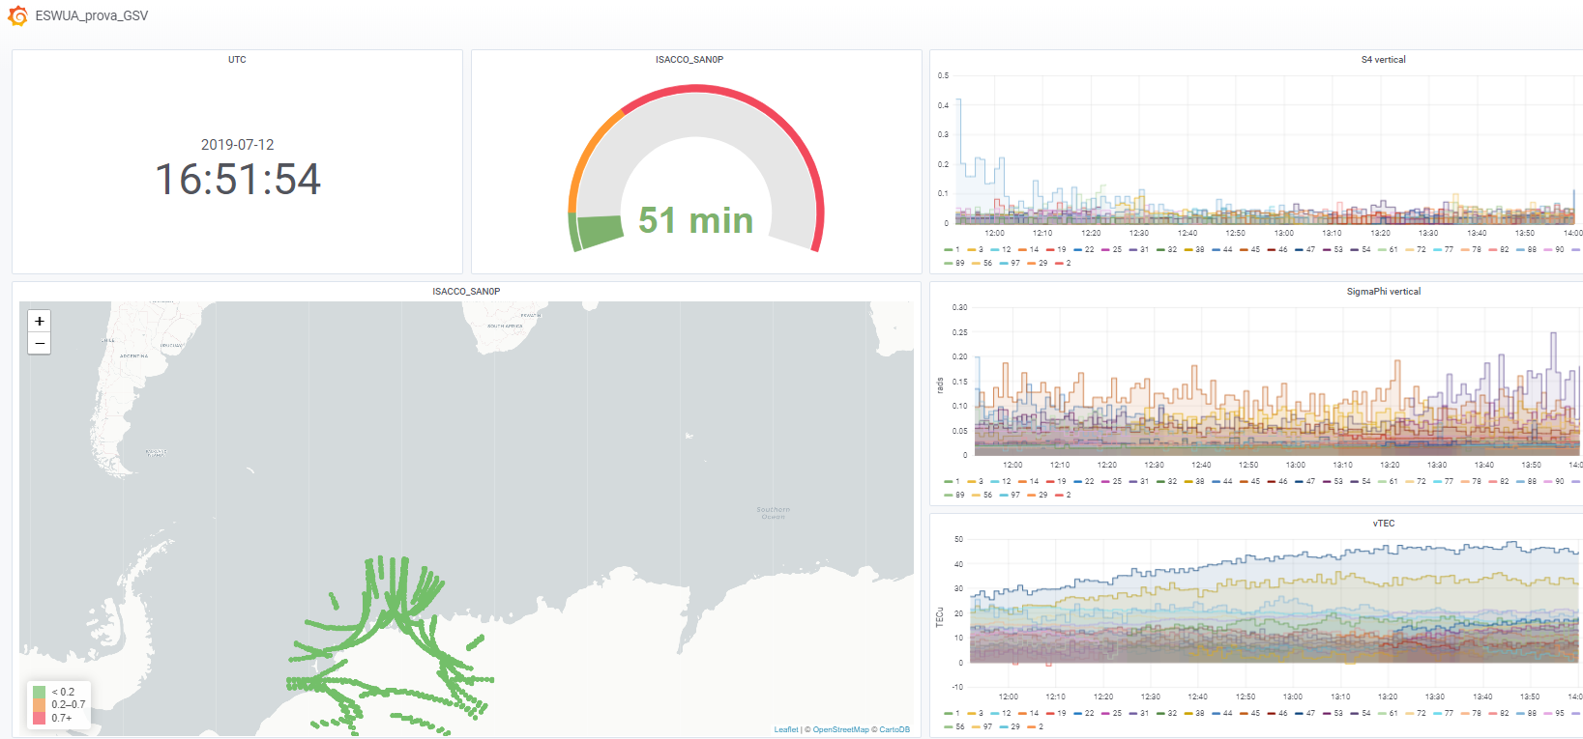
Ionospheric Scintillation
Data Management System
eSWua Homepage
TEC data
Scintillation data
Notes:
-quarta immagine bianca con 3 stazioni?
-TEC data ci vuole?
-

Slide 5
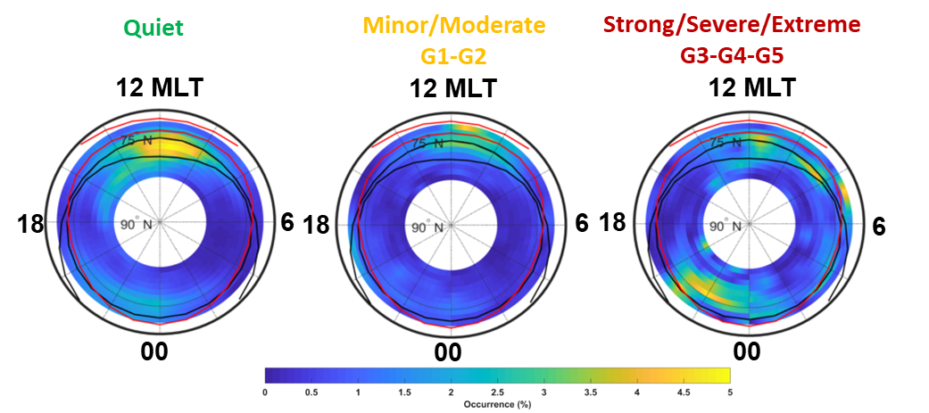
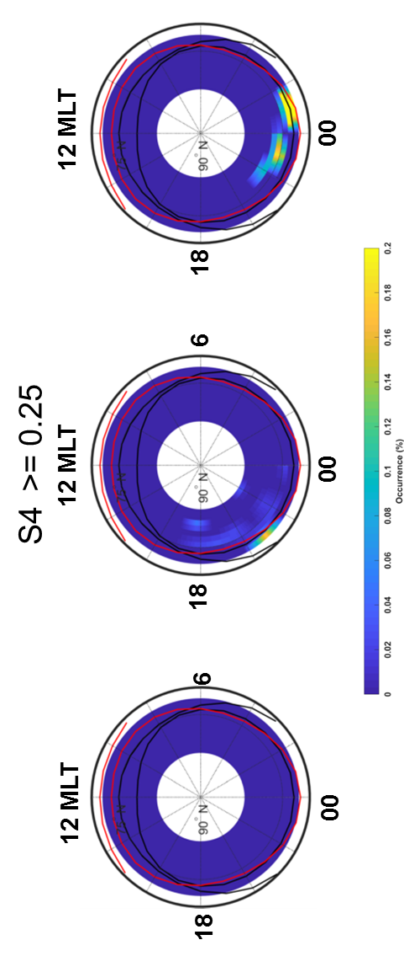
The ionospheric irregularities climatology over Svalbard from solar cycle 23
Scintillations and refractive effects derived from the longest data series ever collected to study the ionospheric response to the geospace conditions. The data are acquired by a GNSS receiver operating at Ny Ålesund (Svalbard, Norway) and show the presence of ionospheric irregularities from the auroral oval boundaries to the polar cap sorted according to different levels of geomagnetic activity. Such assessment can significantly help the development of forecasting models supporting the GNSS-based operations.
Scintillation occurrence of σ_{Φ} and S4 climatology maps sorted according different level of Kp: quiet (left plots), minor/moderate G1-G2 (middle plots) and strong/severe/extreme G3-G4-G5 (right plots).
De Franceschi G. et al., Scientific Report., 2019

Slide 6
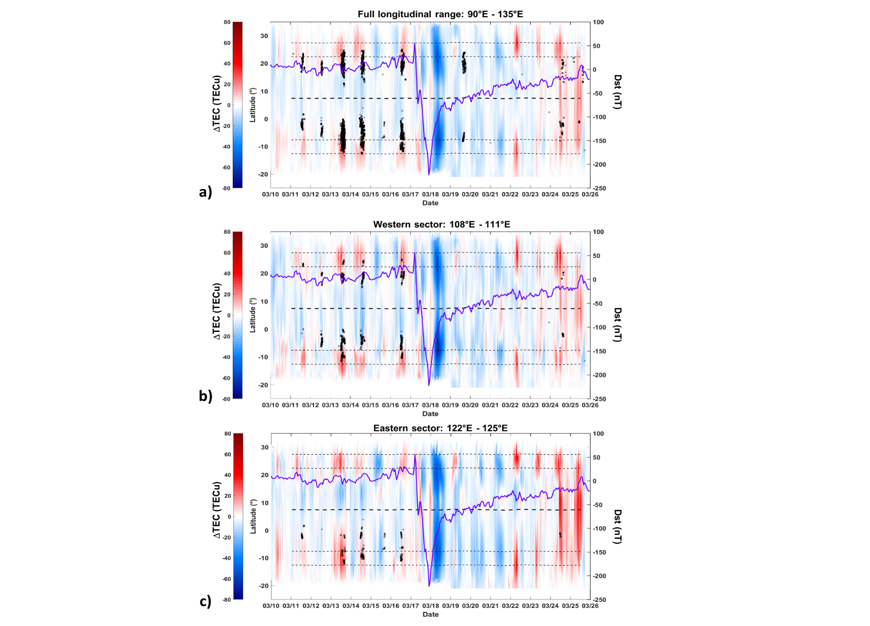
Formation of ionospheric irregularities over Southeast Asia during the 2015 St. Patrick's Day storm
Study of TEC and ionospheric scintillation during the St. Patrick storm 2015 over South-East Asia. The longitudinal mean of ΔTEC values is compared with S4 values greater than 0.1 (black dots). To relate ΔTEC and scintillation to the different phases of the storm evolution, the Dst index has been also superimposed in the figure (violet line). Black tick dashed and isoclinic lines represent the magnetic equator an the average position of the EIA crests. This study provided new insights on enhancement and inhibition of low latitude scintillations
Mean value of ΔTEC for the longitudinal sectors 90°E – 135°E as a function of latitude from 15 to 26 March 2016. Dimension of the black dots is proportional to S4 and is shown only if S4 > 0.1. The purple line is the Dst index. The black dashed lines represent the position of the dip equator as measured by the Swarm constellation of satellites and the isoclinic lines at ±15° and ±20°.
Spogli et al., JGR, 2016

Slide 7
L-band scintillations and calibrated total electron content gradients
This work presents a contribution to the understanding of the ionospheric triggering of L-band scintillation in the region over São Paulo state in Brazil, under high solar activity. In particular, a climatological analysis of Global Navigation Satellite Systems (GNSS) data acquired in 2012 is presented to highlight the relationship between intensity and variability of the total electron content (TEC) gradients and the occurrence of ionospheric scintillation.
Climatological maps of different ionospheric parameters from GBSC for summer days. S4 occurrence (left), standard deviation of calibrated TEC gradients along N-S direction (in TECU km⁻¹, right). Black lines represent 15th southern magnetic parallel.
Cesaroni C. et al., J. Space Weather Space Clim., 2015

Slide 8
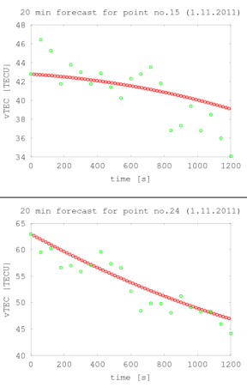


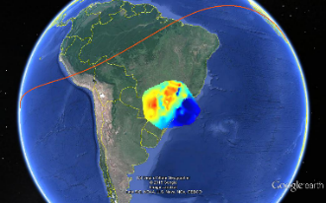

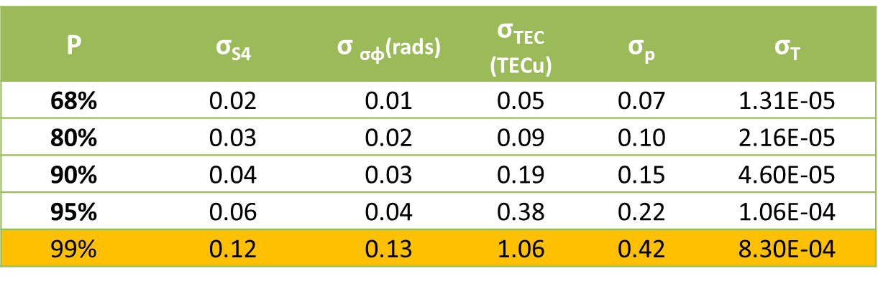
Short-term forecasting of TEC and scintillation
A novel empirical technique for the regional, short-term (from seconds to minutes) forecasting of both TEC (total electron content) and scintillation indices on Global Navigation Satellite System signals.
Forcasted TEC map
International patent n. PCT/IT/2016/000126 “Forecasting model for Scintillation and TEC”
Model forecasting resolution
0 to 20 min forecasting horizon
Grzesiak M. et al., Radio Science, 2018

Slide 9
Final Remarks
Ionospheric irregularities can be studied by means of GNSS receivers especially configured to record ionospheric scintillations and TEC gradients.
INGV matured a solid experience in studies based on GNSS data analysis integrated with auxiliary data acquired by ground and space-based instruments
Thanks to skills achieved analysing long data series, INGV developed tools for TEC and scintillations forecasting
INGV manages directly several GNSS stations for ionospheric monitoring, among the others also the station in Ny Ålesund with the longest data series ever collected for scientific purposes; INGV adopts an open access data policy
New collaborations on experimental and scientific activities are welcome
Notes:
Testo eliminato:
INGV has a long experience in installing and managing GNSS scintillation network, often in collaboration with international academic entities.
A large data repository is well organised in a data management system to make data accesible and preserved.
Investigation of scintillation and TEC climatology is performed at high, low and mid latitudes thanks to the well established GBSC method.
Multi-instrument approach is carried out to investigate scintillation events.
Short-term forecasting of both TEC and scintillation indices can support the mitigation of scintillation effects of GNSS.
New collaboration on experimental and scientific activities is welcome.

Slide 11
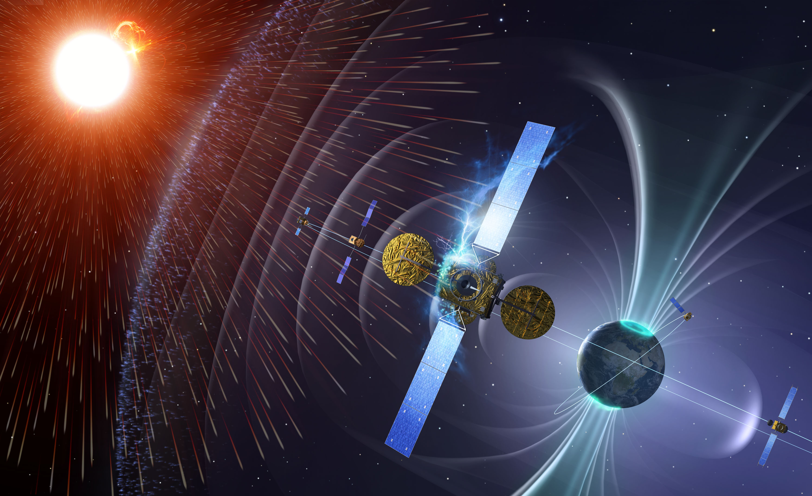
Thank you for your attention! vincenzo.romano@ingv.it

Slide 12
Back-up

Slide 13

Mitigation on high accuracy positioning
In collaboration with University of Nottingham and Space Research Centre Polish Academy of Science
Precise Point Positioning results
São José dos Campos: 07 February 2012
 | RMS of height error (m)
 | Mitigated | Conventional | Improvements
During convergence | 0.21 | 0.51 | 60%
After convergence | 0.16 | 0.54 | 69%
www.spacearth.net

Slide 14

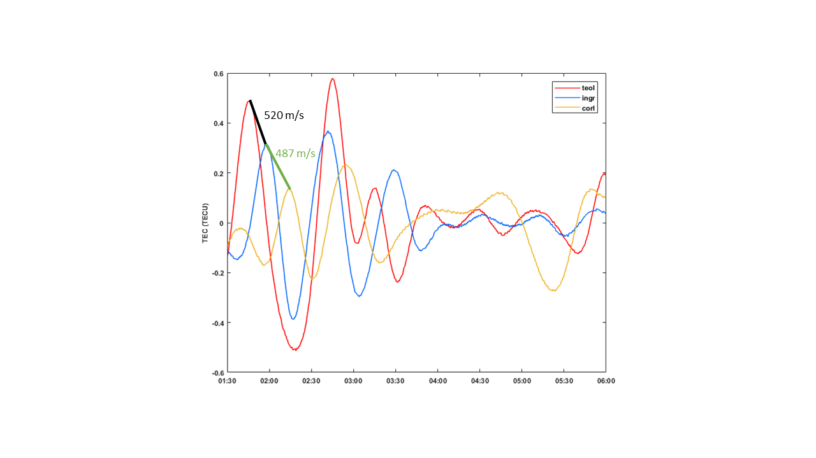
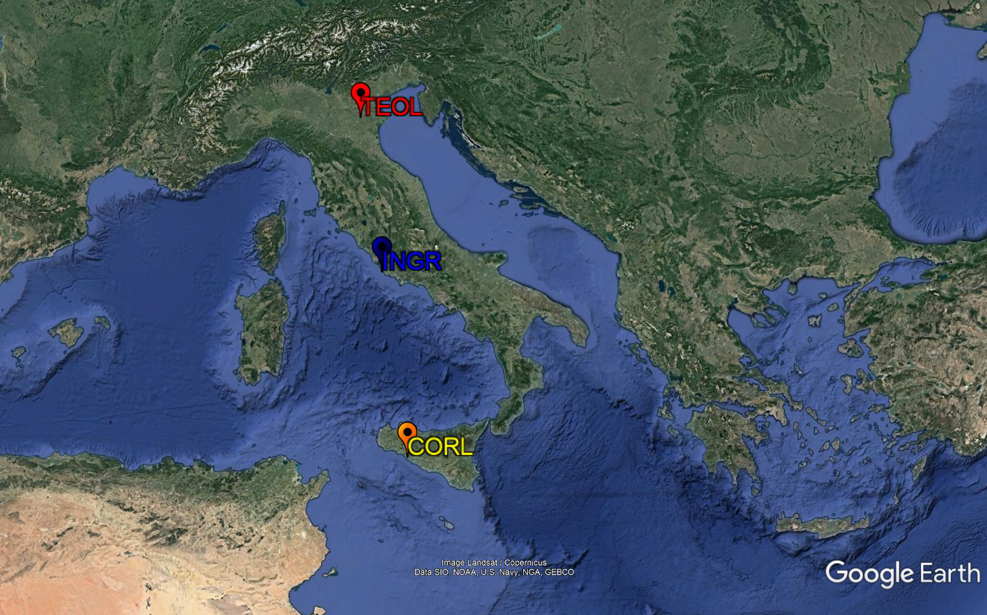
Coordinated Ionospheric Radio and Optical
Observations Over Italy
Study of auroral activity from all-sky imager in Asiago and TEC response from INGV RING network in Italy. Auroral activity was responsible for the presence of small amplitude TEC waves propagating at about 500 m/s and wavelength of ~1350 km typical of LSTIDs, revealed by the application of the EEMD method to TEC measurements from ground-based GPS stations.
TEC oscillating components from TEOL (45.20°N, 11.40°E, red line), INGR (41.83°N, 12.51°E, blue line), and CORL (37.89°N, 13.30°E, yellow line) stations on 15 November between 01:30 and 6:00 UT. Oblique lines connect the peaks of the vTEC oscillatory components that are used to evaluate the velocity of the wavy perturbation along the path TEOL-INGR (black thick line) and INGR-CORL (green thick line).
Cesaroni et al., JGR, 2017

