Slide 1
The impact of ionospheric scintillation on satellite positioning and timing
B. Forte (1)
Astin (1), I. and Allbrook, T. and Arnold, A. and Vani (2), B. C. and Monico (3), J. G. and Shimabukuro (3), M. H. and Smith, N. and Koulouri (4), A. and John (1), H. J.
Affiliations:
(1) University of Bath, UK, (2) Instituto Federal de Educação, Ciência e Tecnologia de São Paulo – IFSP, Brazil, (3) Sao Paulo State University - UNESP, Brazil, (4) Tampere University, Finland
This work was supported by the Natural Environment Research Council
[grant number NE/R009082/1]
(b.forte@bath.ac.uk)

Slide 2
The impact of Ionospheric Scintillation on
Satellite Navigation and Positioning
Scintillation is rapid changes in satellite radio signals caused when travelling through the Earth’s ionosphere.
In the presence of scintillation radio receivers (such as those used in satellite navigation applications) can lose the ability to follow such satellite radio signals. Positioning accuracy and reliability are reduced.

Slide 3
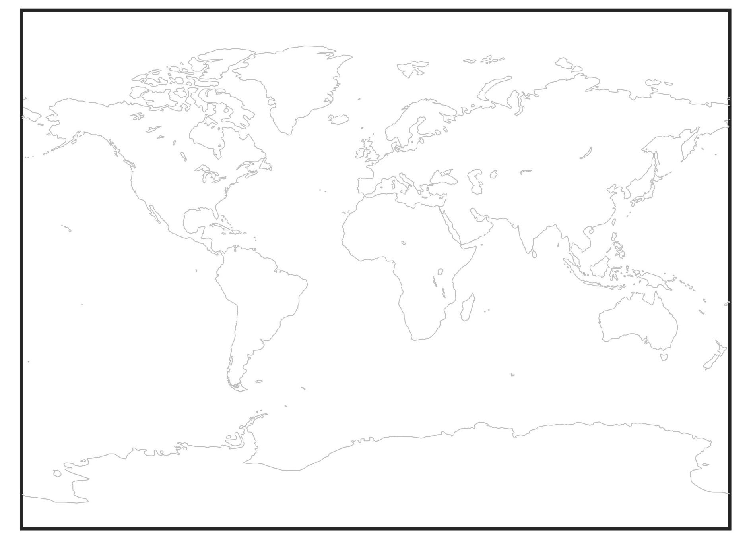
Ionospheric Scintillation – Average map of occurrence
Areas subject to L-band ionospheric Scintillation –

Slide 4
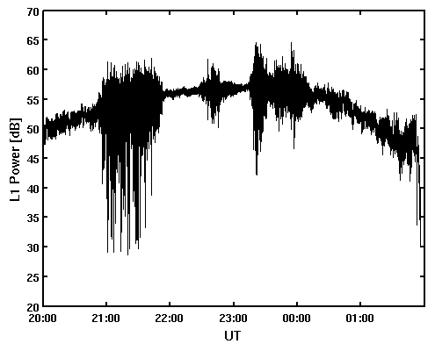
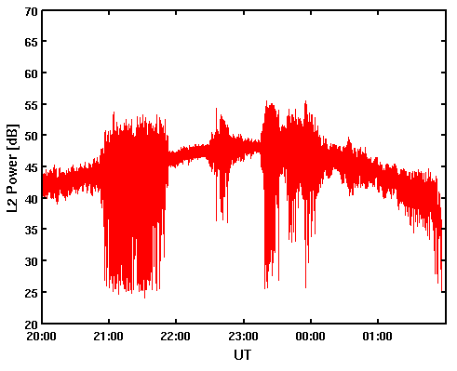
Ionospheric Scintillation: An example on GPS frequencies (L1 and L2)
L1
L2
Cape Verde – 29 March 2011 PRN05

Slide 5
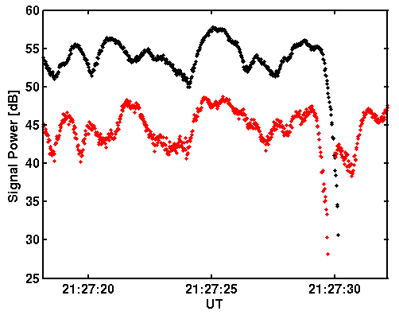
Ionospheric Scintillation: An example on GPS frequencies (L1 and L2)
Cape Verde – 29 March 2011 PRN05

Slide 6
Average duration of scintillation event (avg_d)
S4 > 0.3

Slide 7
Maximum duration of a scintillation event (d_max)
S4 > 0.3

Slide 8
Probability that a random data point belongs to an event of duration above or equal to the duration threshold (p_join=p_all*p_ts_tmin)
S4 > 0.3
Duration > 7 min

Slide 9
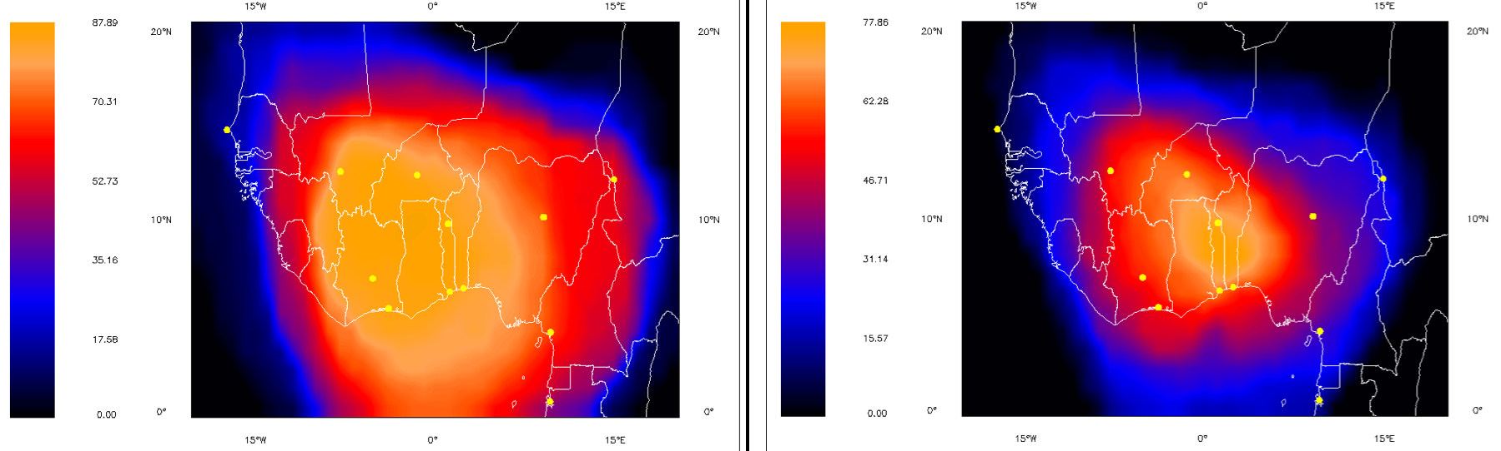
EGNOS availability over the chosen area
16 – 20 LT
20 – 24 LT
Credit: EC FP7 MISW Consortium

Slide 10
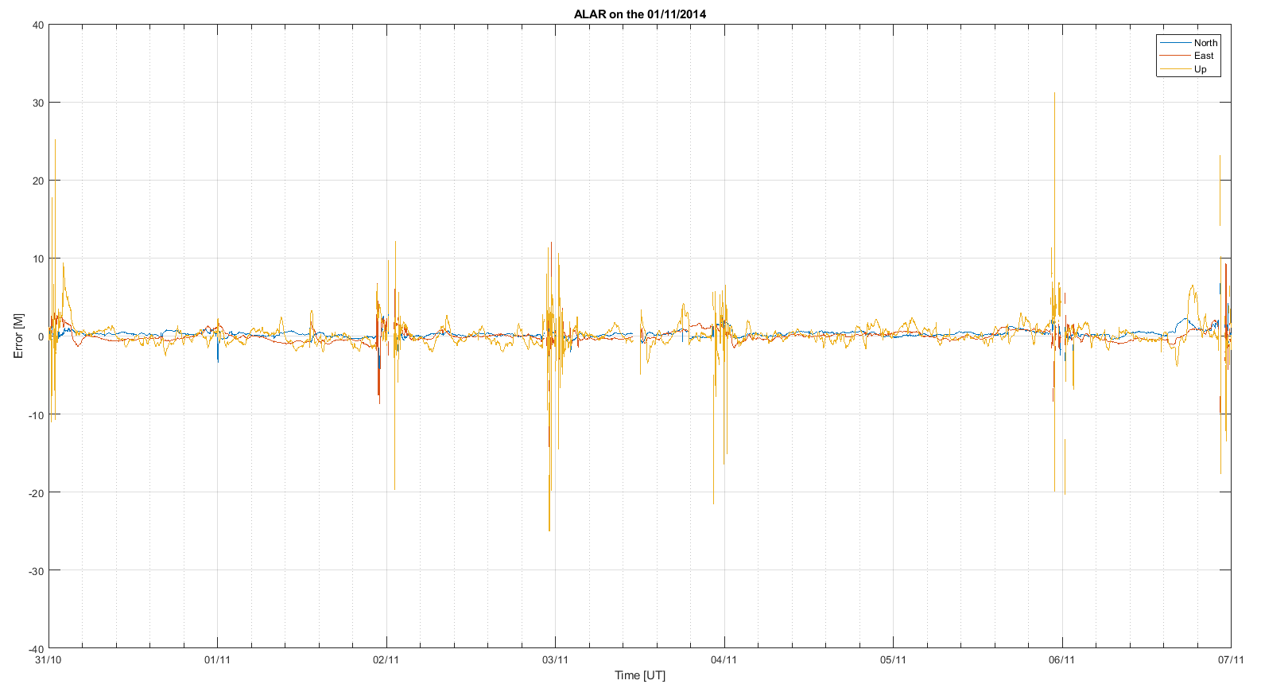
RTK for ground station in Brazil - positioning

Slide 11
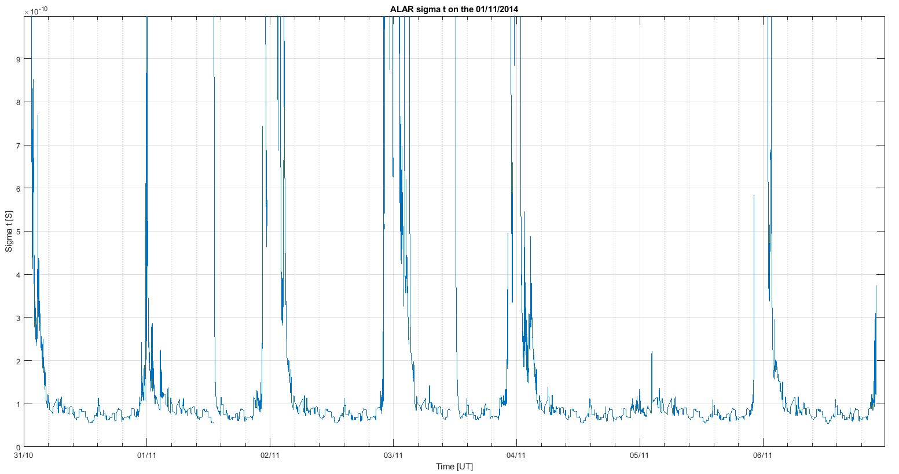
RTK for ground station in Brazil - timing

Slide 12
Conclusions
The results obtained indicate that:
The positioning accuracy increases from cm-level (typical of dual-frequency precise positioning) to metre-level at all latitudes under the presence of scintillation (and enhanced TEC fluctuations).
The problem is characterised by the severity and duration of scintillation.

Slide 13
Thank you for your attention!

