Slide 1
M.M. Bisi (1), R.A. Fallows (2), O. Chang (1), and D. Barnes (1).
(1) RAL Space, UK Research and Innovation – Science & Technology Facilities Council – Rutherford Appleton Laboratory, Harwell Campus, Oxfordshire, OX11 0QX, UK
(2) ASTRON – the Netherlands Institute for Radio Astronomy, Postbus 2, 7990 AA Dwingeloo, The Netherlands
Exploiting LOw Frequency ARray (LOFAR) Observing Capabilities to Better Understand Interplanetary Scintillation (IPS).

Slide 2
Key Acknowledgements
Alessandra A. Pacini (Arecibo Observatory)
Bernard V. Jackson and Hsiu-Shan Yu (CASS-UCSD – USA)
Munetoshi Tokumaru et al. (ISEE, Nagoya University – Japan)
J. Americo Gonzalez-Esparza et al. (UNAM-SCiESMEX – Mexico)
Igor Chashey and Sergei Tyul’Bashev (Lebedev Physical Institute – Russia)
Elizabeth A. Jensen (PSI – USA)
Dusan Odstrcil (NASA/GMU – USA)
P. K. Manoharan (Ooty-TIFR – India)
Caterina Tiburzi (Bielefeld University – Germany)
John Morgan and Charlotte S. Sobey (Curtin University – Australia)
© 2019 RAL Space

Slide 3
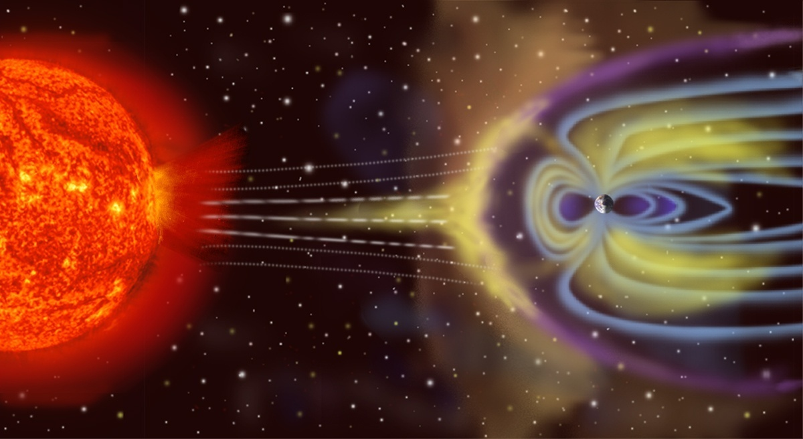
Outline
Part 1: The LOw Frequency ARray (LOFAR).
Part 2: LOFAR Data Analyses.
Part 3: Summary.
© 2019 RAL Space

Slide 4
Part 1
The LOw Frequency ARray (LOFAR).
© 2019 RAL Space

Slide 5
The LOw Frequency ARray
(LOFAR) (1)
Pathfinder to the Square Kilometre Array (SKA).
Frequency agile system over two primary observing bands of ~10 MHz to ~250 MHz split into ~10 MHz to 90 MHz (LBA) and 110 MHz to ~250 MHz (HBA) using two antenna types.
Ample collecting area with plenty of combinations of multi-site observations with the International Stations over multiple and varying long baselines.
Experimentation with beam modes to enable band widths encompassing 80 MHz to ~the entire observing frequency range with a trade off on sensitivity!
Kilpisjärvi Atmospheric Imaging Receiver Array (KAIRA) based on LOFAR technology located just inside Finland.
© 2019 RAL Space

Slide 6
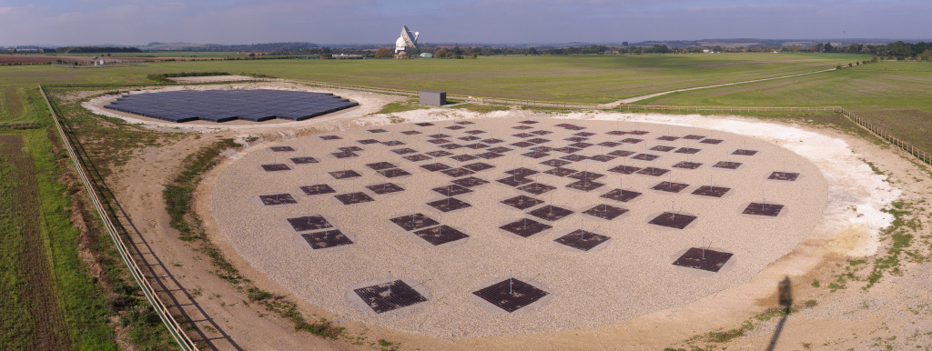
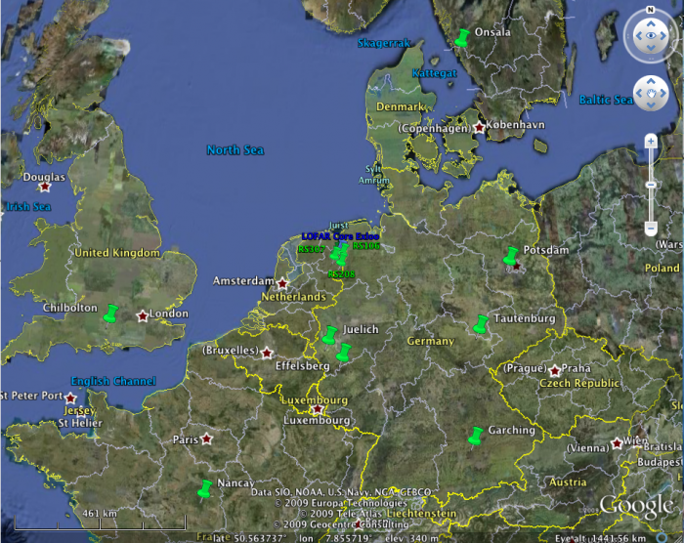
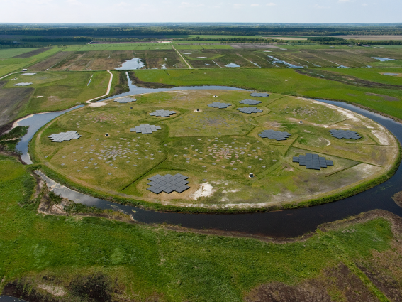
LOFAR (2)
High-Band Tiles
110 to ~250 MHz.
Low-Band Dipoles
~10 to 90 MHz.

Slide 7
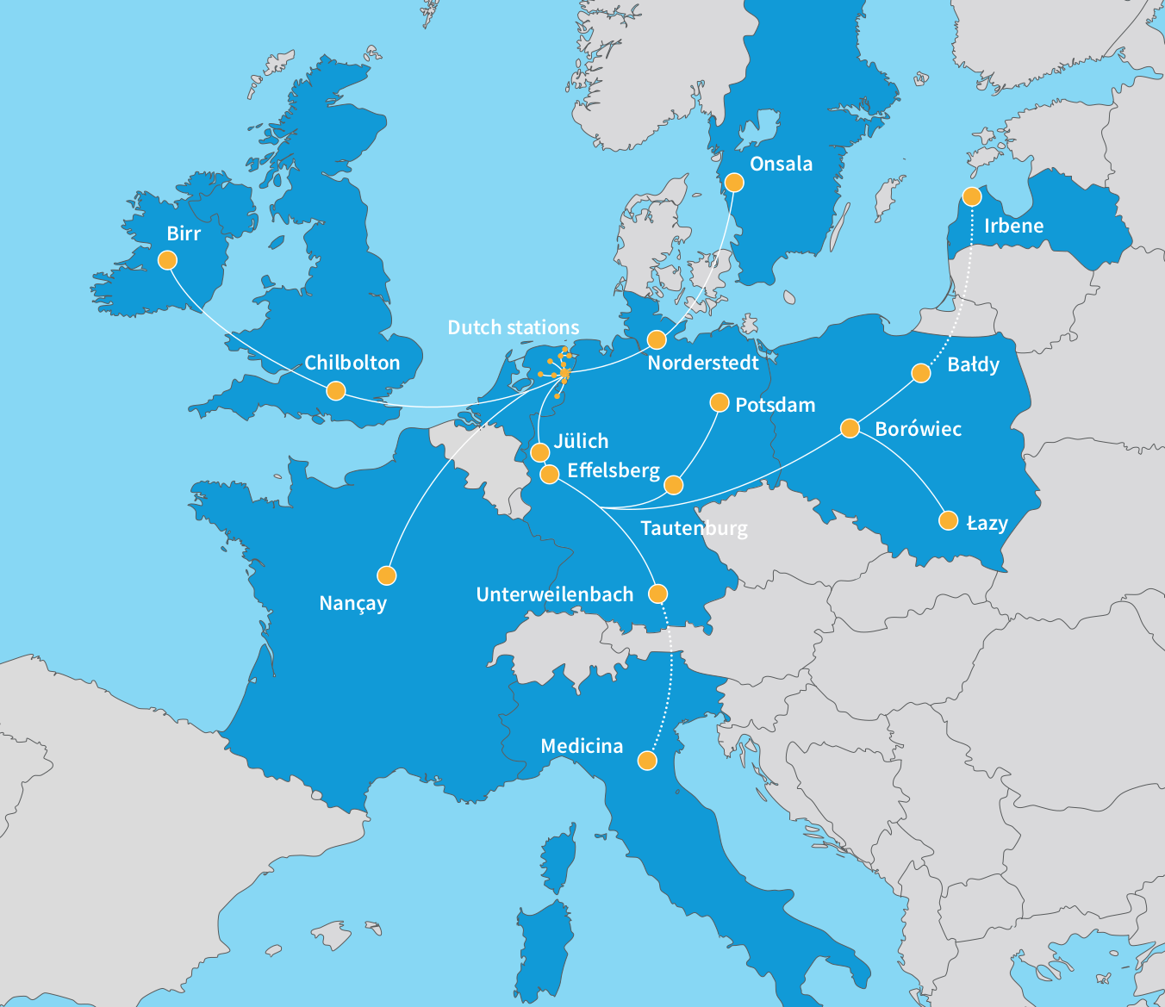

Expanding LOFAR:
Many baseline combinations…
LOFAR:
Central core of 24 stations in area with 4km diameter with 14 remote stations scattered across the NE of the Netherlands.
Thirteen operational stations across Europe:
- 6 in Germany;
- 3 in Poland;
- 1 each in France, Ireland, Sweden, and the UK.
Two new stations to come:
- Latvia in 2019; and
- Italy in 2021.

Slide 8
Part 2
LOFAR Data Analyses.
© 2019 RAL Space

Slide 9

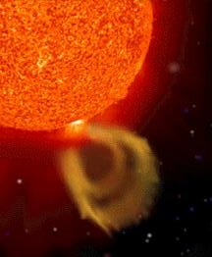
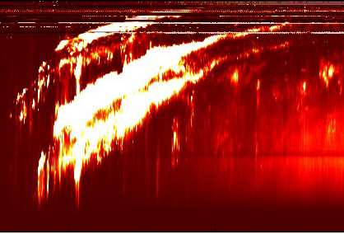
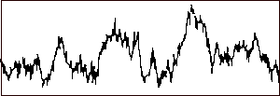
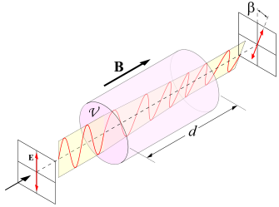

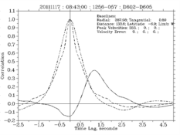
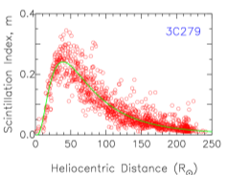
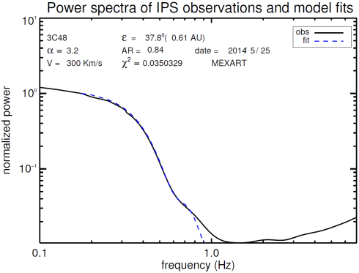
Radio Techniques
Sun and solar radio-burst dynamic spectra providing key information on solar activity
Interplanetary
magnetic field
Faraday rotation (FR) from
polarised radio source
Ionospheric scintillation
Solar wind velocity, density/turbulence, and signatures of field rotation and SIRs
Interplanetary scintillation (IPS)
from compact radio source
Cross-correlation of power spectra → velocity
Variation in amount of scintillation → density proxy
Fit to individual power spectra → velocity etc…

Slide 10
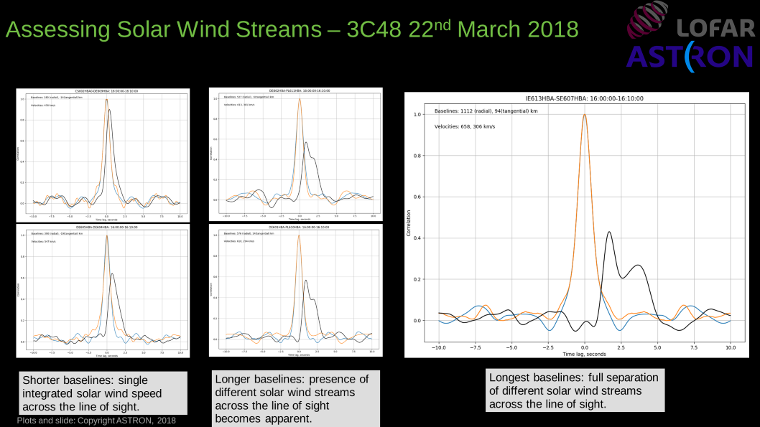
LOFAR Analyses (1)
LOFAR Example CCFs demonstrating the effect/benefits of the longer baseline availabilities…
© 2019 RAL Space

Slide 11
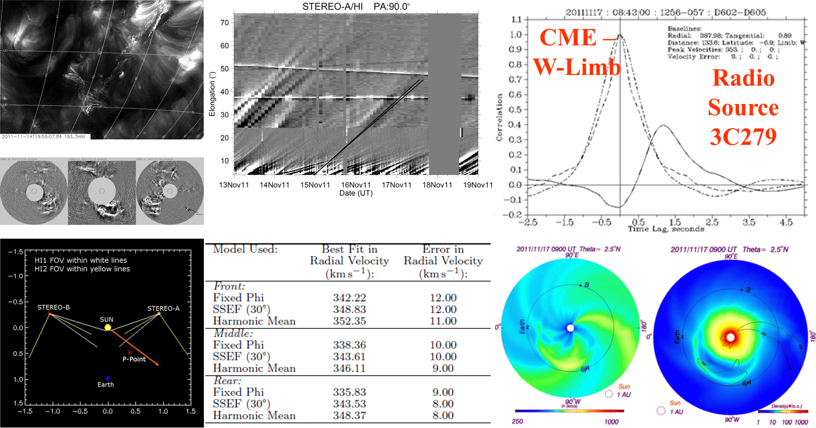
LOFAR Analyses (2)
© 2019 RAL Space
Our First CME with LOFAR…
Observations of J1256-057 (3C279) detecting a CME with LOFAR on
17 November 2011 and (briefly) its comparison with other remote-sensing observations and 3-D MHD modelling.

Slide 12
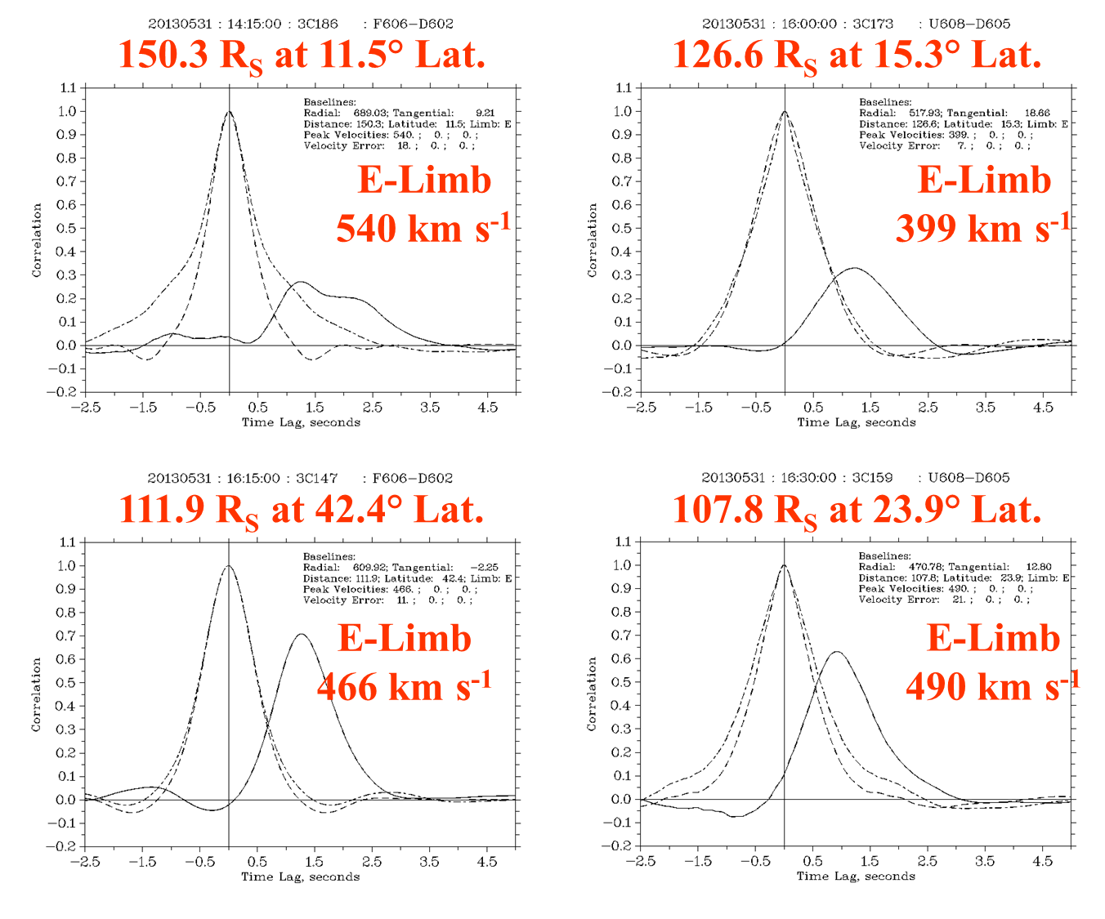
LOFAR Analyses (3)
© 2019 RAL Space
LOFAR Observations of IPS 31 May 2013 (1)

Slide 13
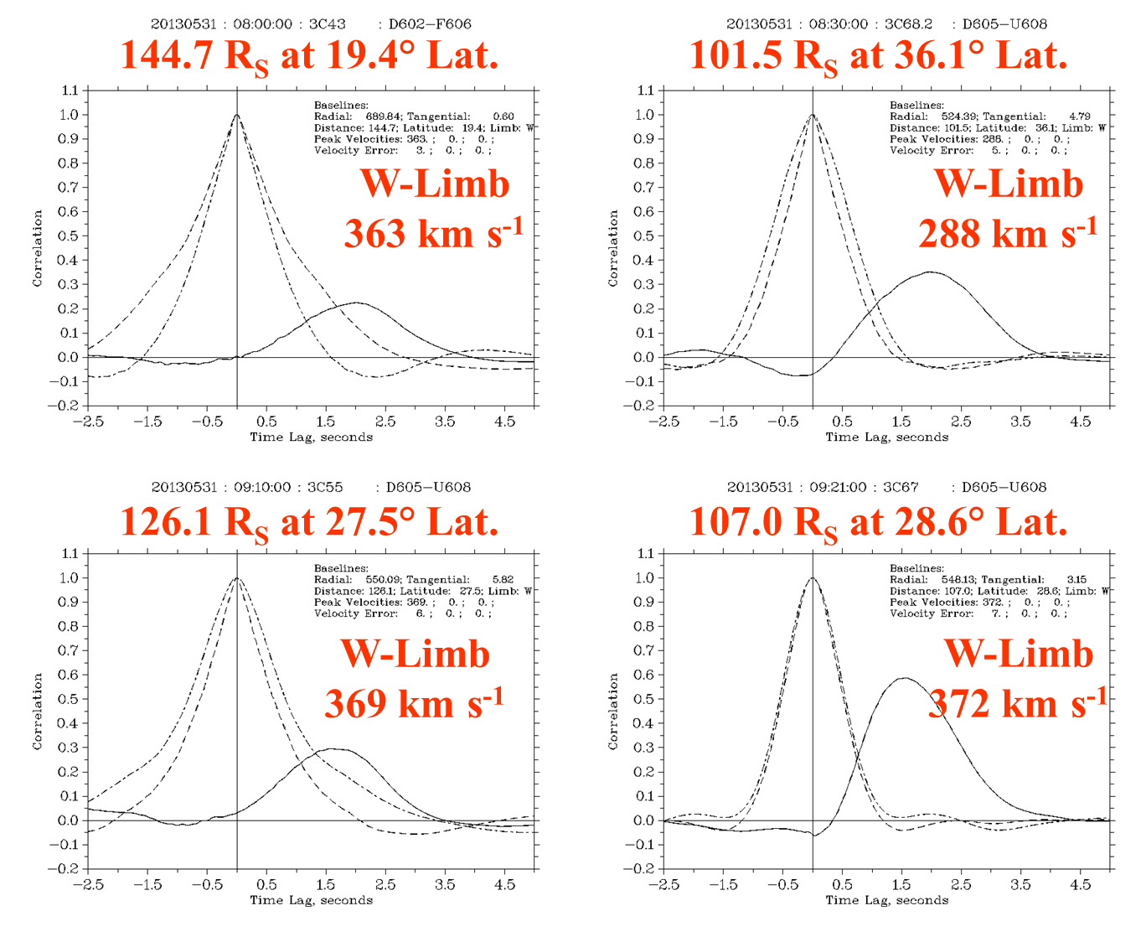
LOFAR Analyses (4)
© 2019 RAL Space
LOFAR Observations of IPS 31 May 2013 (2)

Slide 14
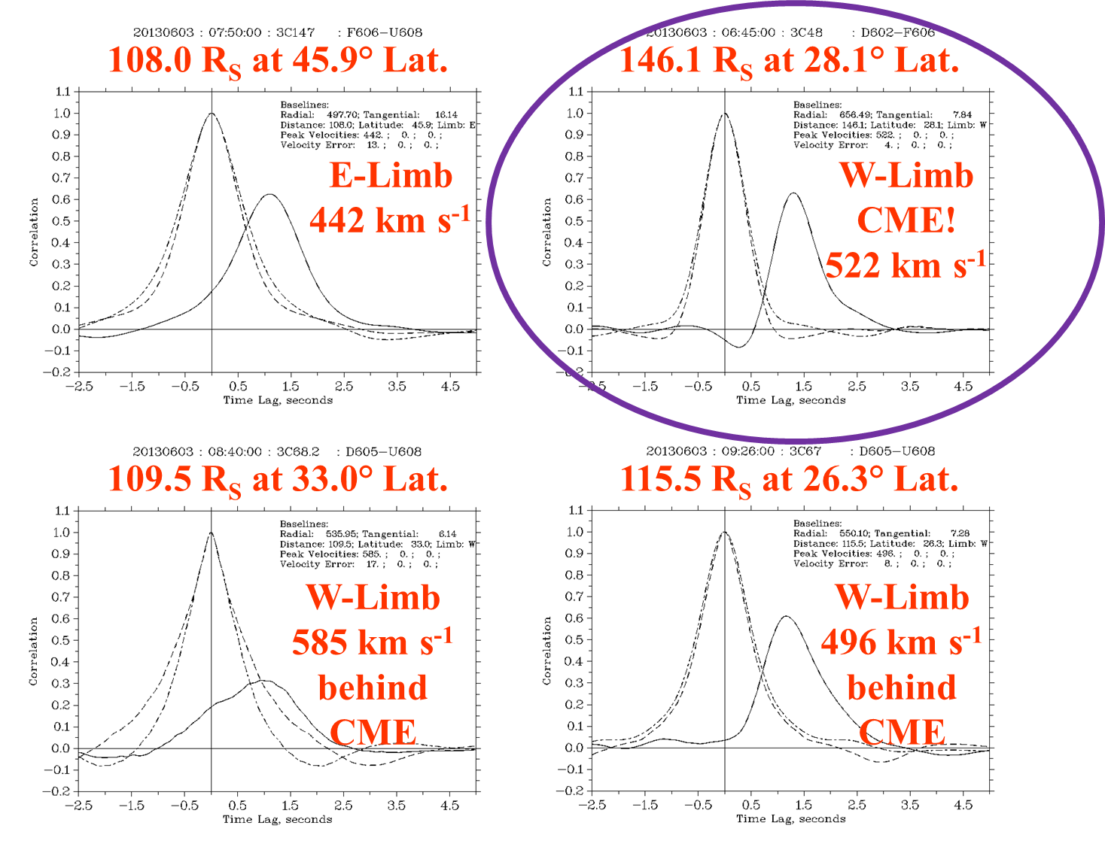
LOFAR Analyses (5)
© 2019 RAL Space
LOFAR Observations of IPS on 03 June 2013

Slide 15
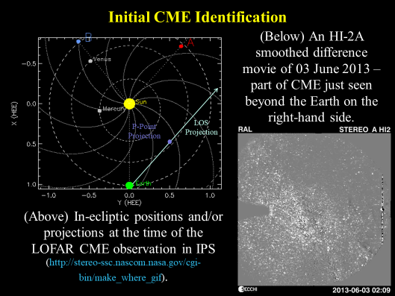
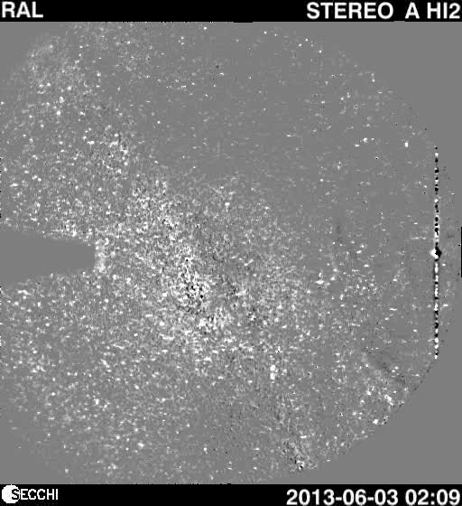
LOFAR Analyses (6)
© 2019 RAL Space
Initial CME Identification…

Slide 16
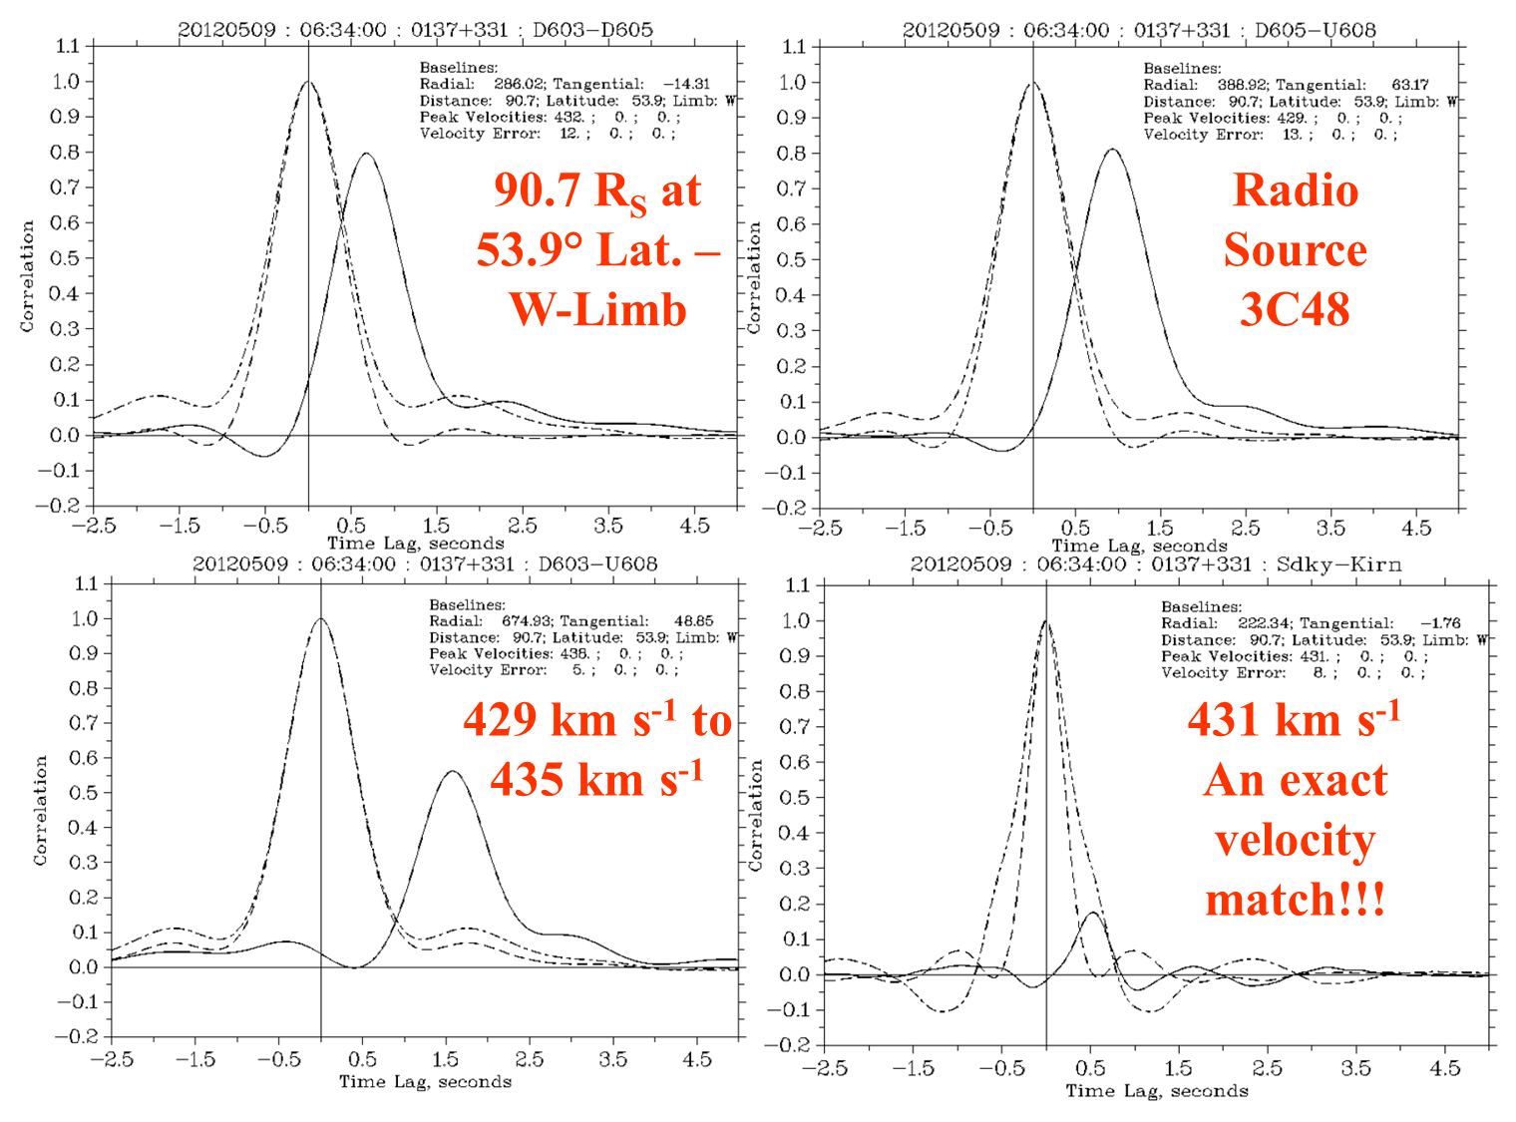
LOFAR Analyses (7)
© 2019 RAL Space
Comparison with EISCAT UHF…

Slide 17
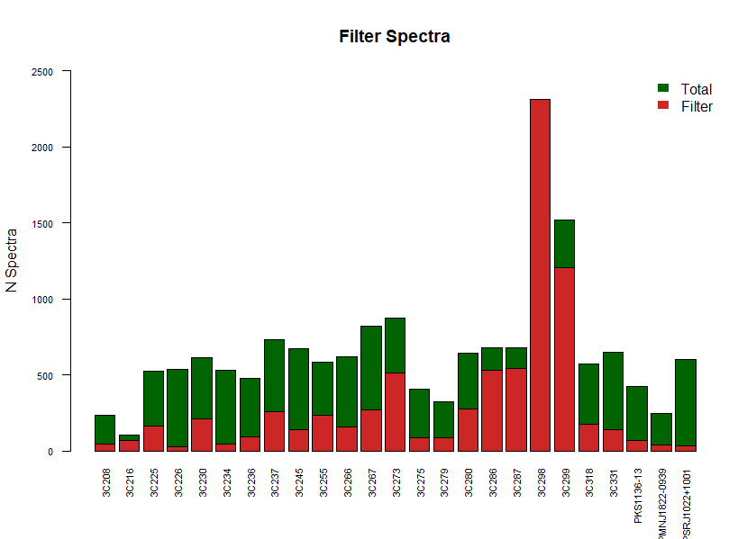
LOFAR Analyses (8)
LOFAR WIPSS Campaign October 2016 (1)
During October 2016 we had a unique opportunity to observe IPS for an ~entire month with LOFAR making this a very-rich data set where we have only started to scratch the surface with the analyses…
© 2019 RAL Space

Slide 18
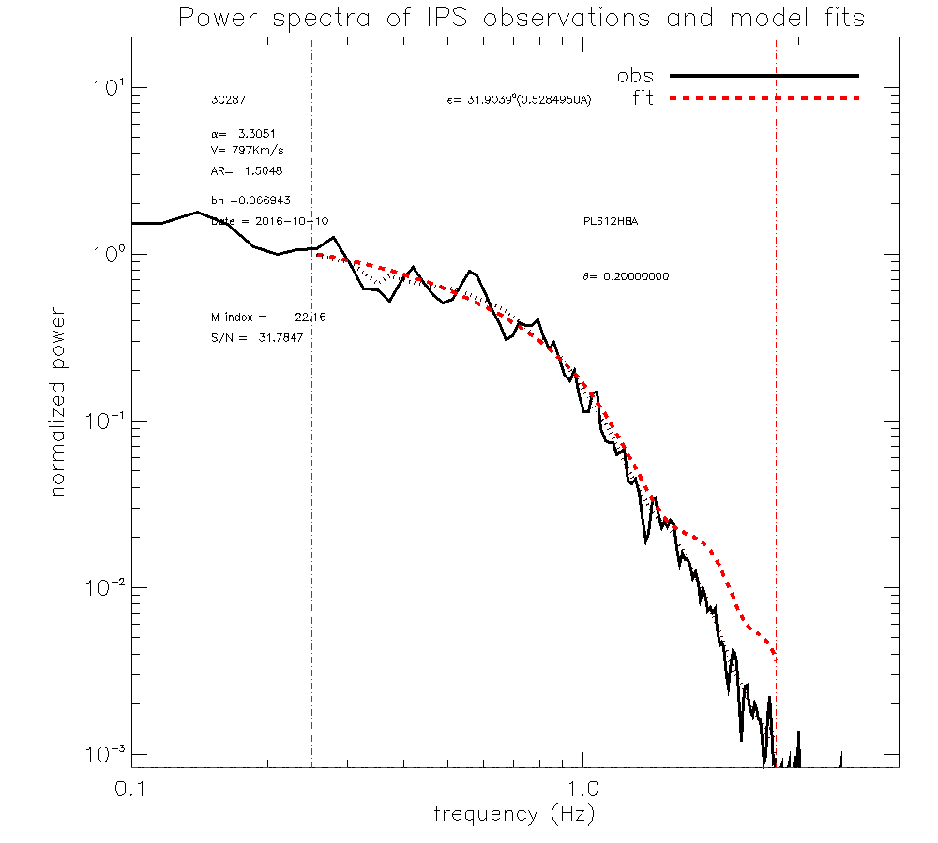
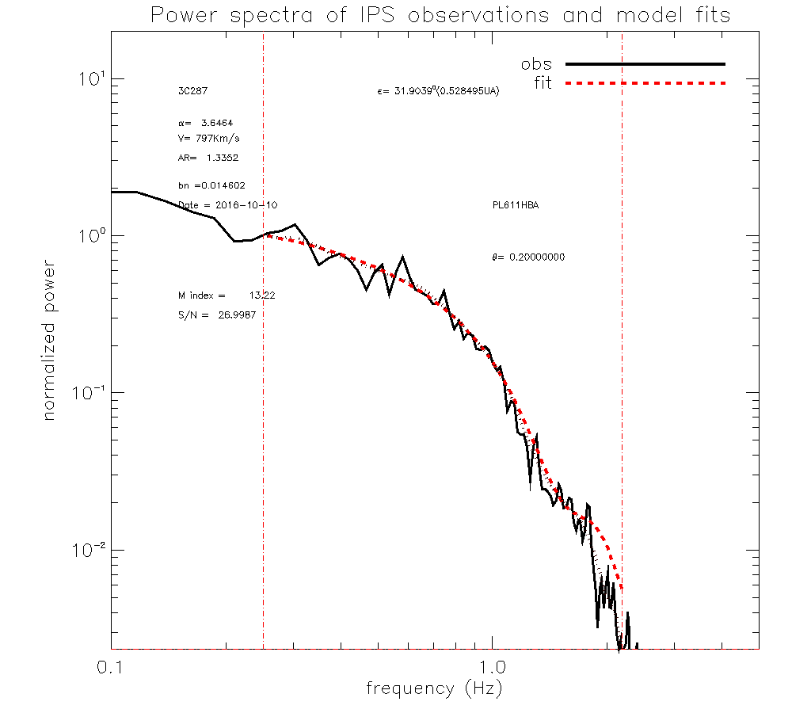
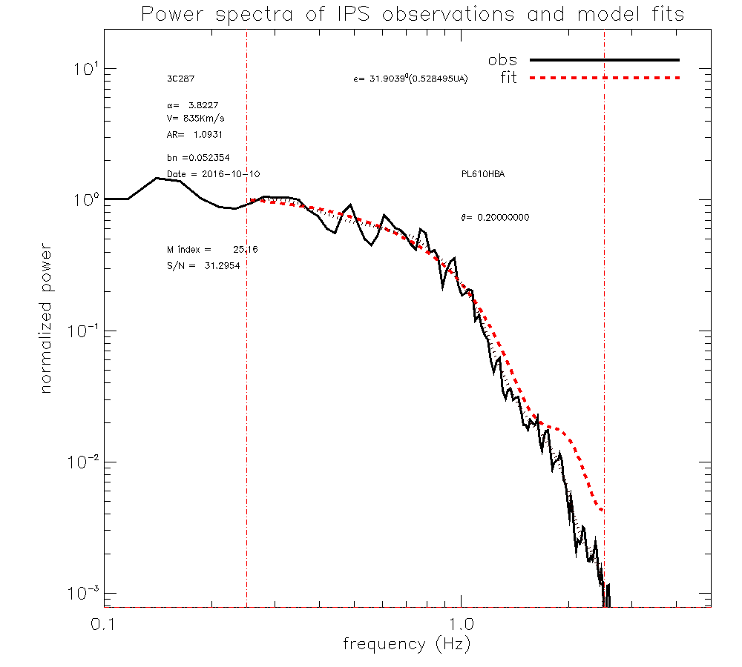
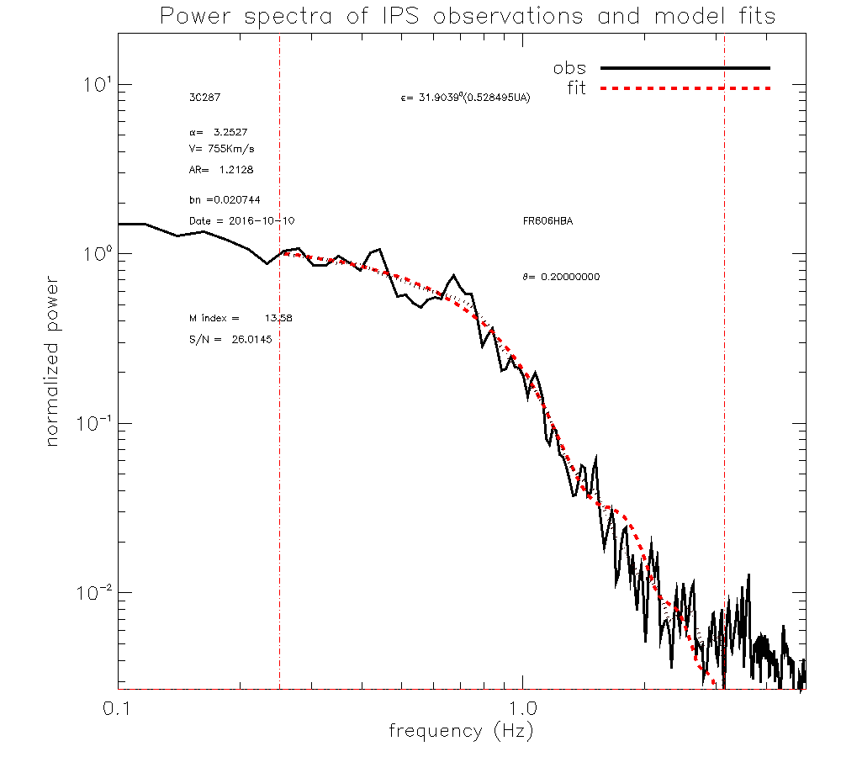
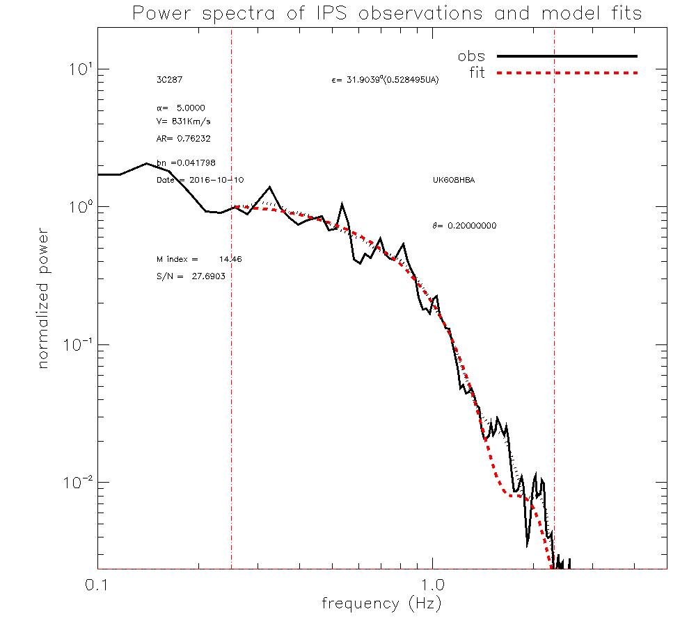
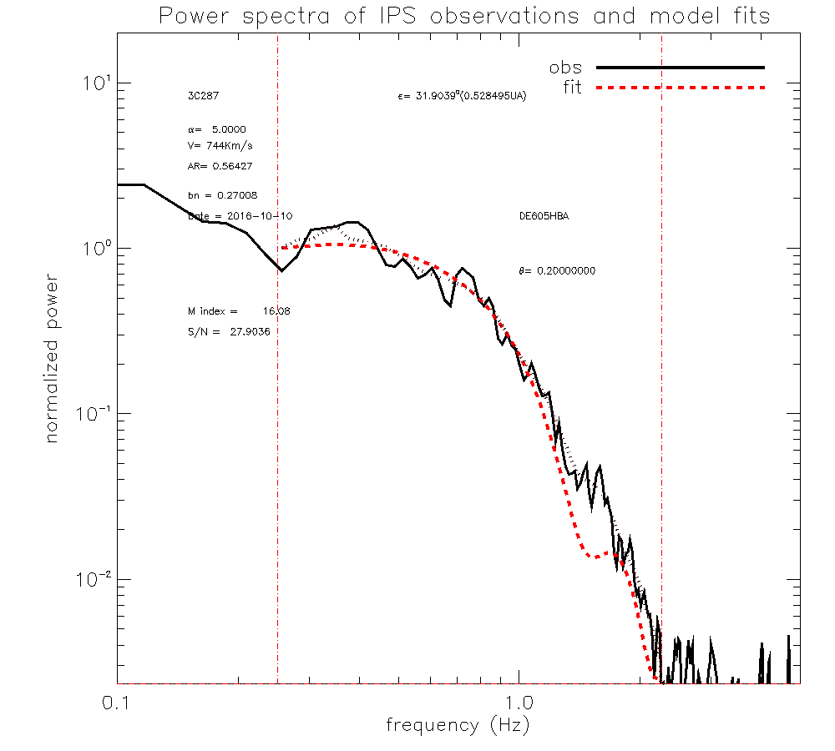
LOFAR Analyses (9)
© 2019 RAL Space
LOFAR WIPSS Campaign October 2016 (2)
10th October 2016
3C287

Slide 19
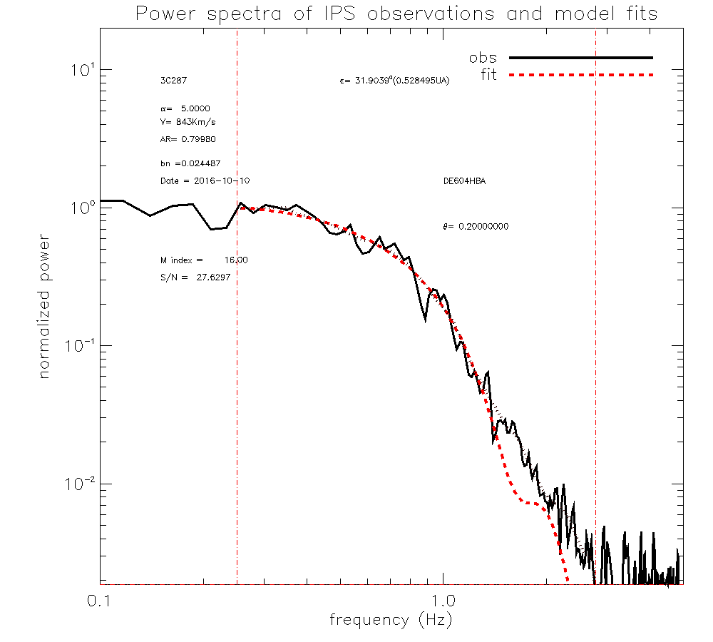
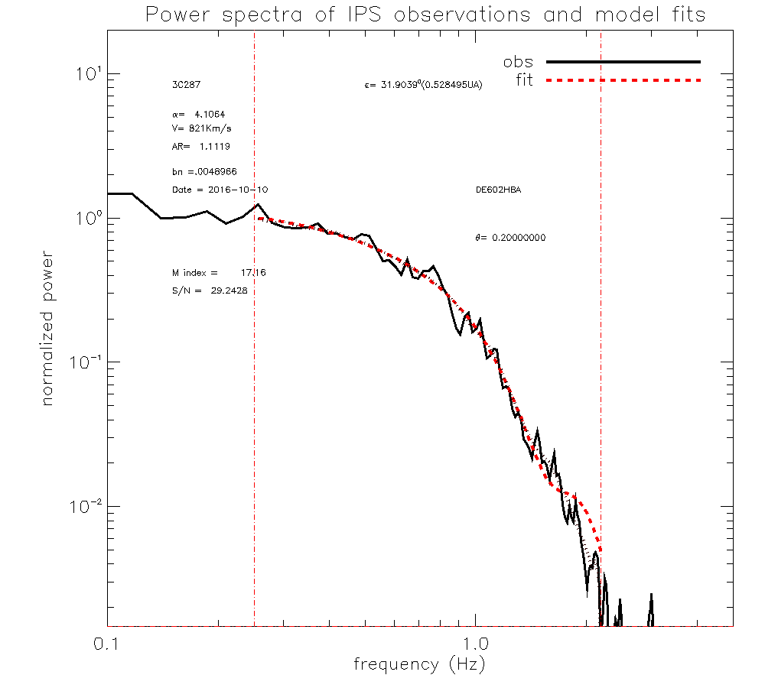
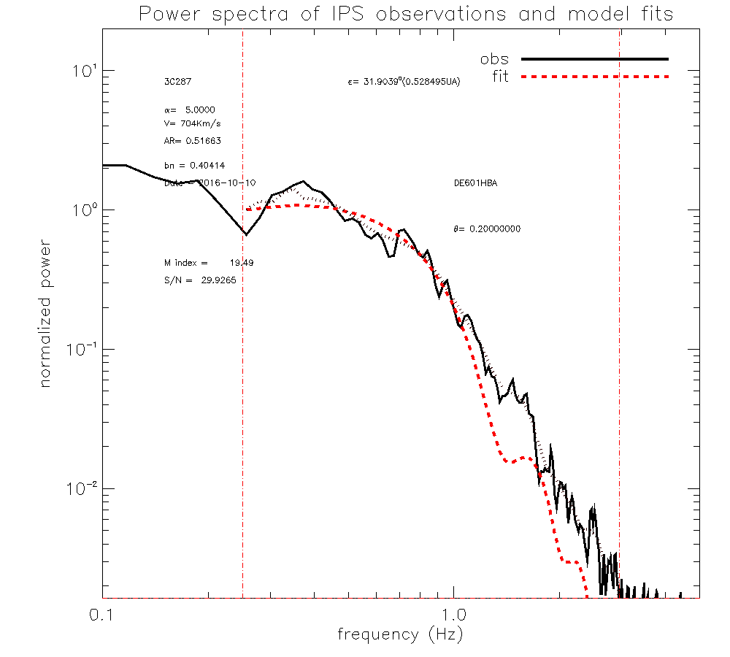
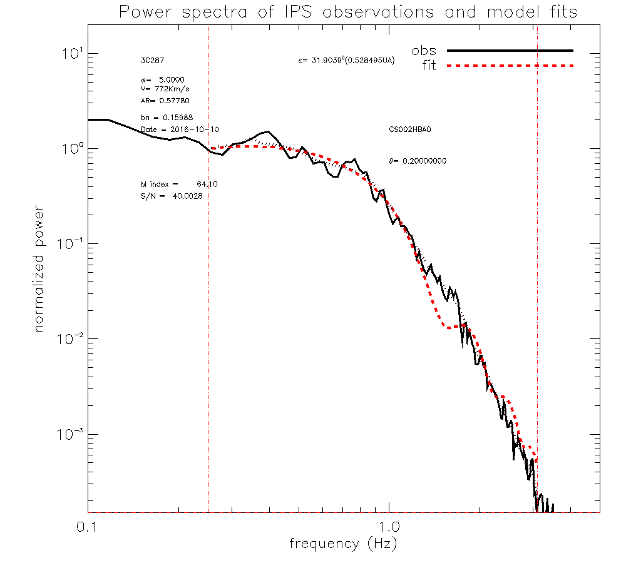
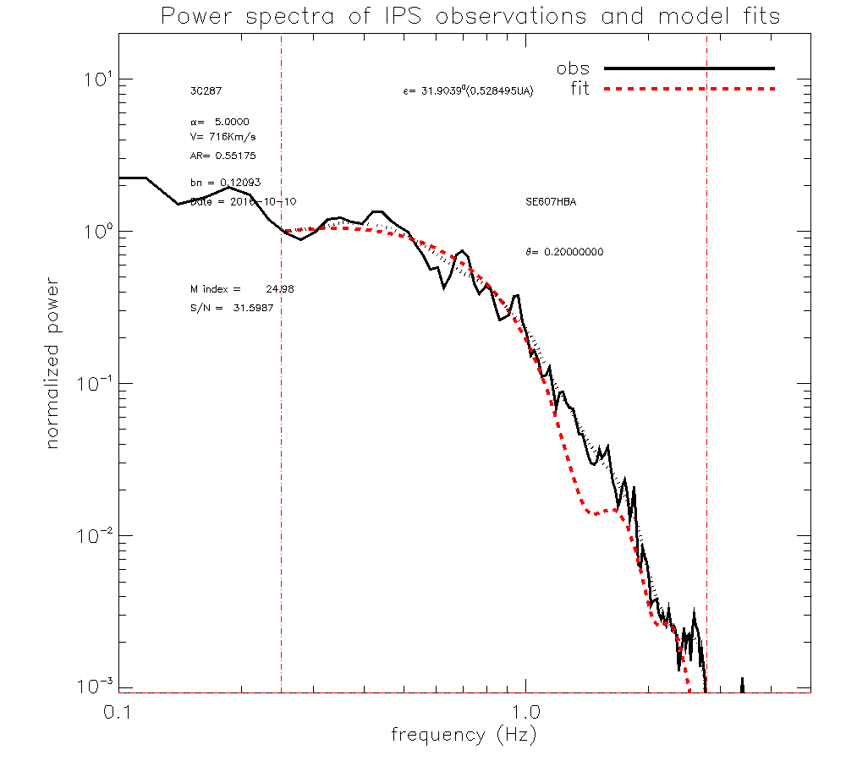
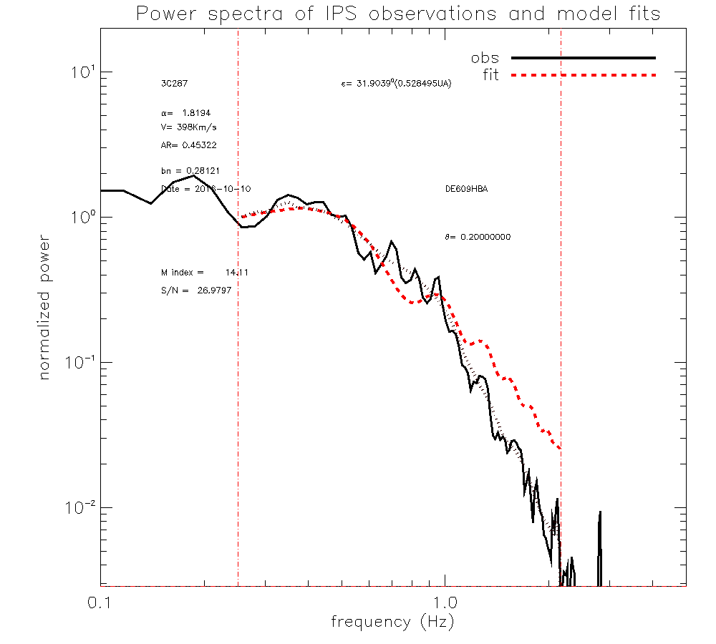
LOFAR Analyses (10)
© 2019 RAL Space
LOFAR WIPSS Campaign October 2016 (3)
10th October 2016
3C287

Slide 20
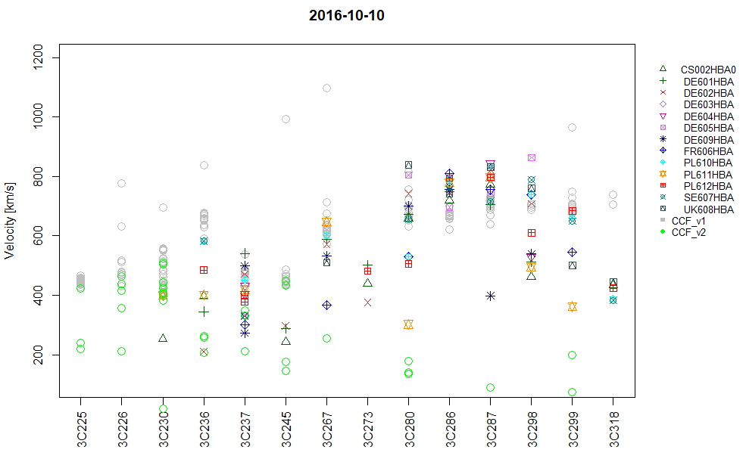
LOFAR Analyses (11)
© 2019 RAL Space
LOFAR WIPSS Campaign October 2016 (4)

Slide 21
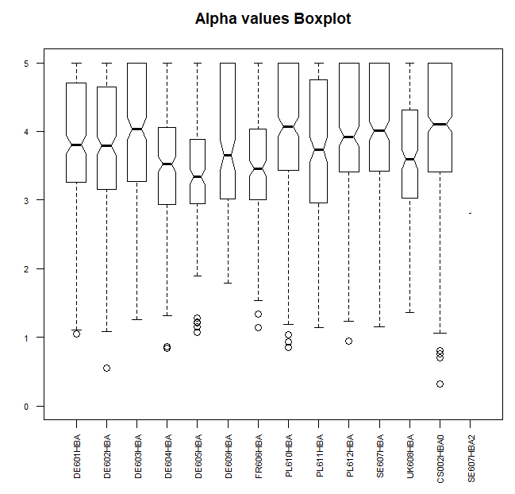
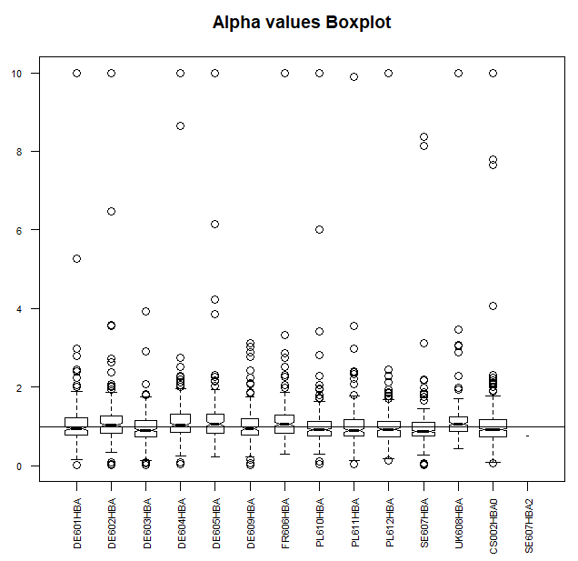
LOFAR Analyses (12)
© 2019 RAL Space
LOFAR WIPSS Campaign October 2016 (5)
On the left is a box plot of all the Alpha-Value fits for October 2016…
On the right is a box plot of all the Axial-Ratio fits for October 2016…

Slide 22
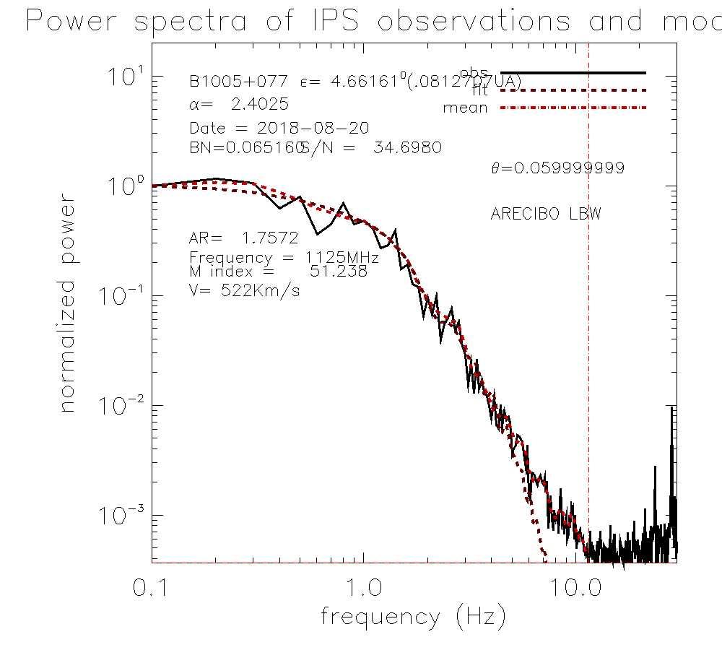
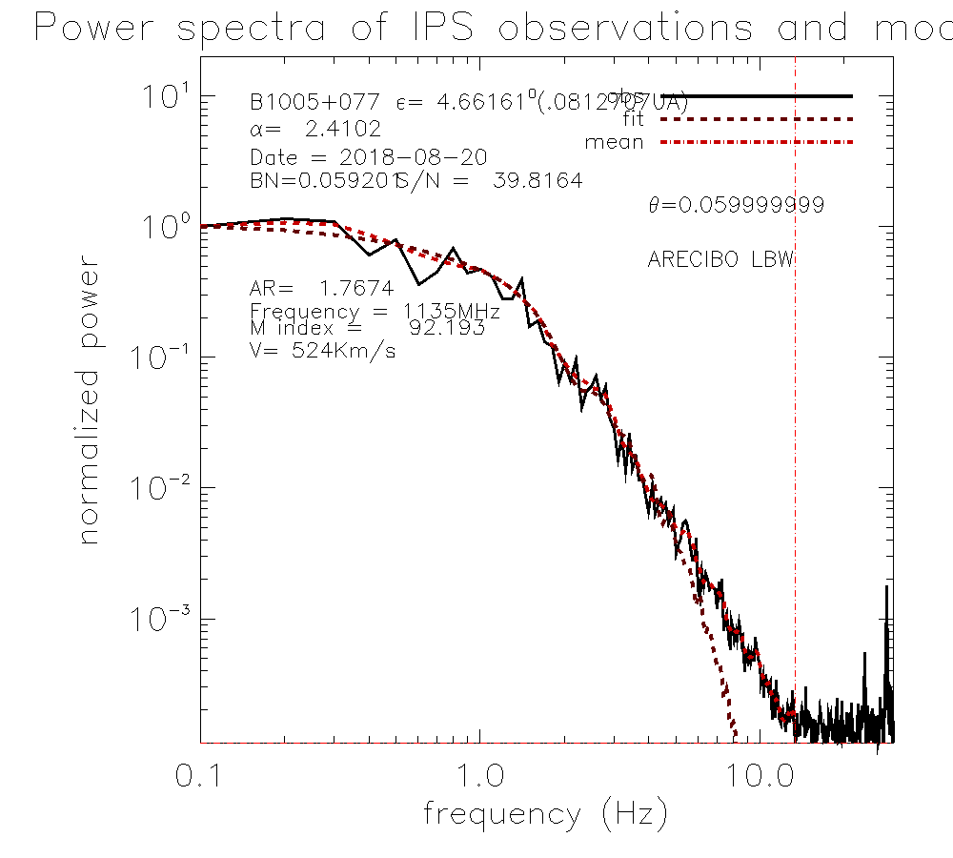
Arecibo Analyses (1)
Spectra and model fits to observations of source B1005+077 in polarisation A (left) and polarisation B (right) providing near-identical fit parameters.
Initial single-site fits to spectra from Arecibo observations of IPS – the first in recent years…
© 2019 RAL Space
Data Courtesy of A.A. Pacini et al.

Slide 23
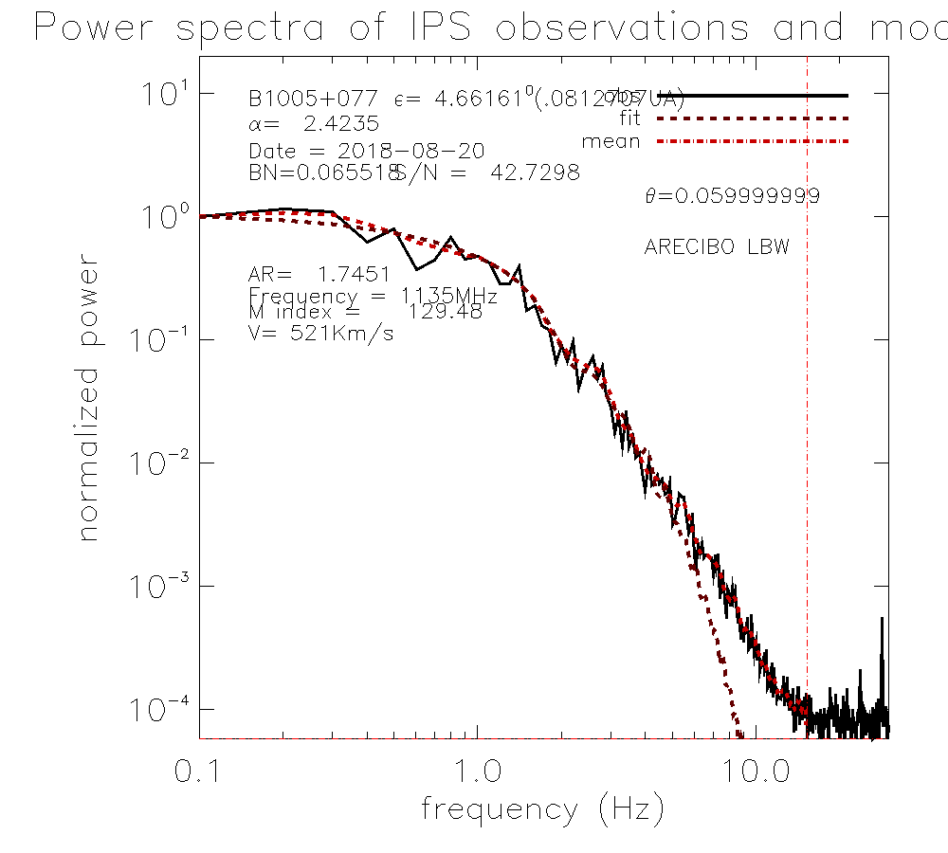
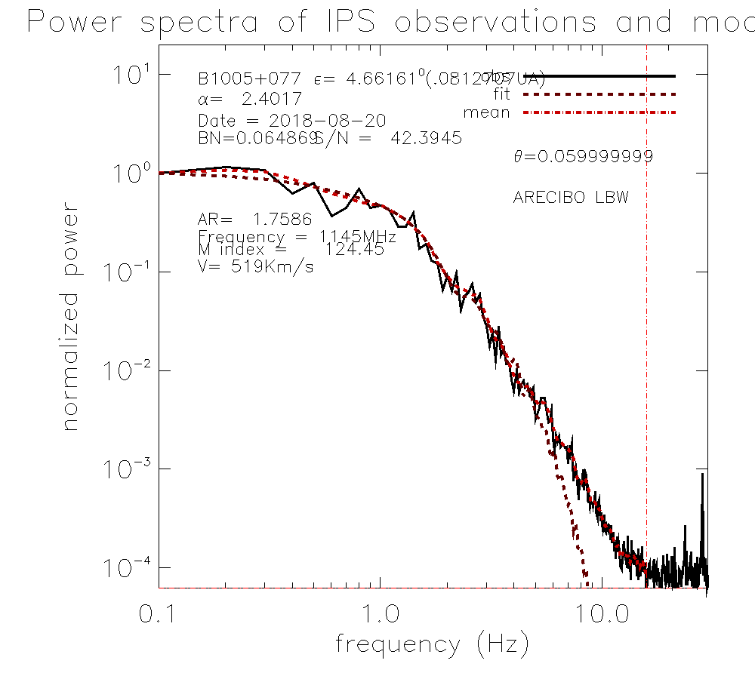
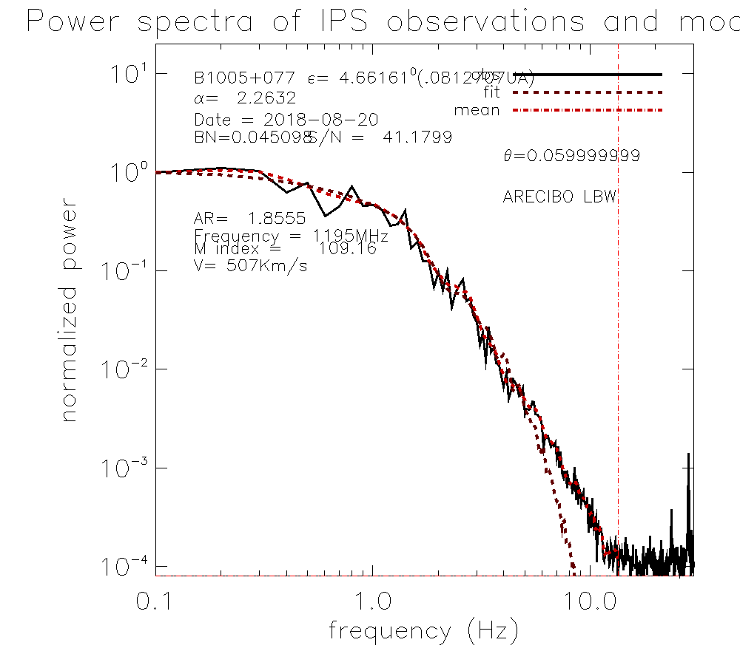
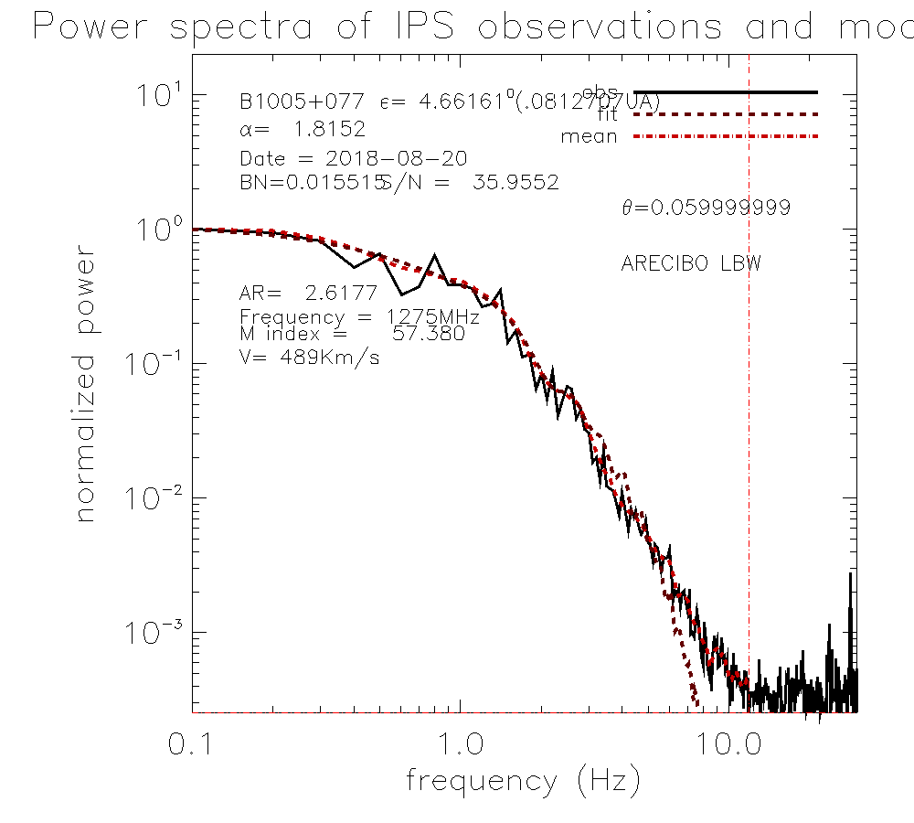
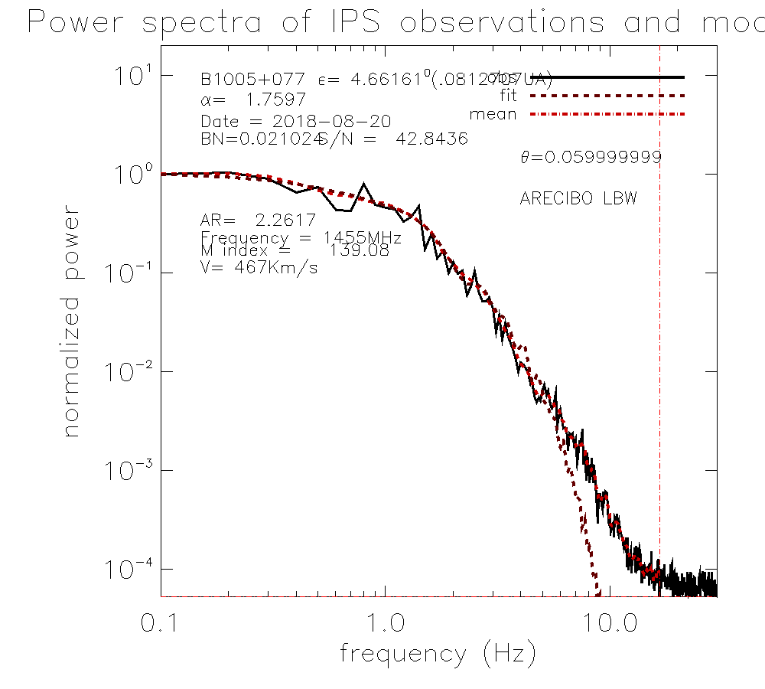
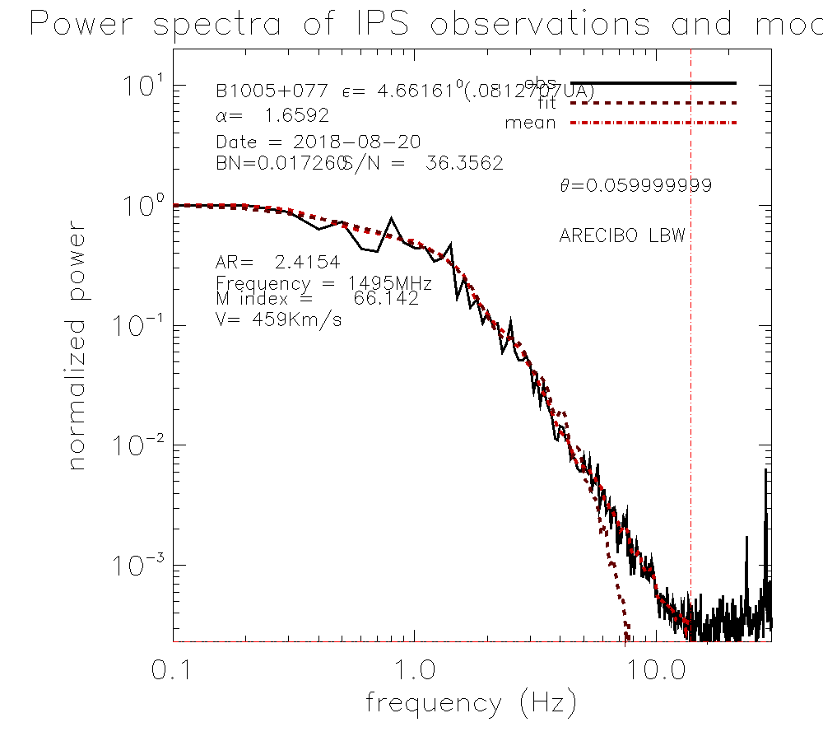
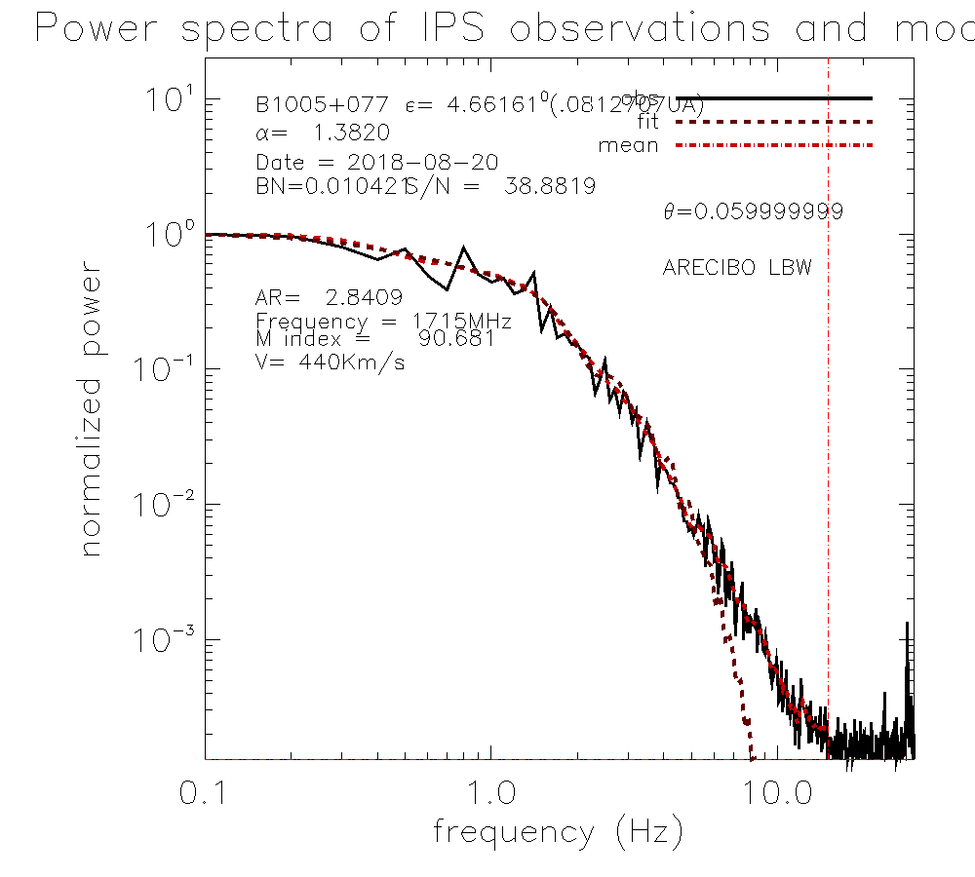
Arecibo Analyses (2)
Spectra and model fits to observations of source B1005+077 in polarisation A with increasing observing frequency from 1,125MHz (top left) to 1,715MHz (bottom right).
Spectra all look very similar, but the parameters derived vary with observing frequency for a fixed source size…
© 2019 RAL Space

Slide 24
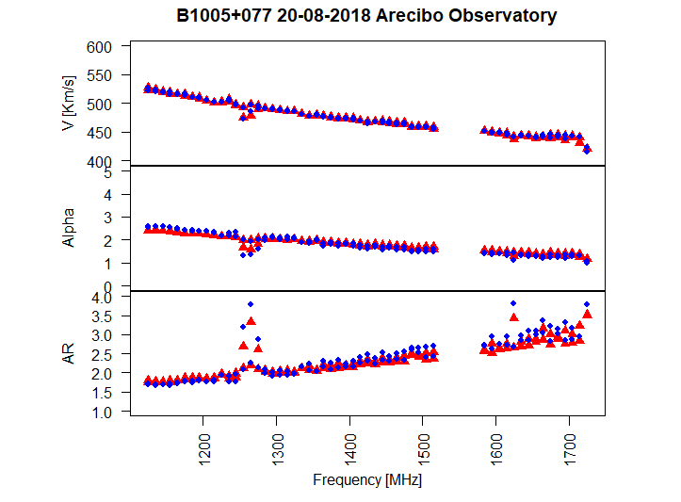
Arecibo Analyses (3)
© 2019 RAL Space

Slide 25
Part 3
Summary
© 2019 RAL Space

Slide 26
Summary
© 2019 RAL Space
We are learning more about the fundamental parameters and how they vary across the inner heliosphere from observations of IPS.
Single-Site analyses of both LOFAR and Arecibo data sets are yielding parameters from those data not previously obtained until now.
We look forward to working more on this WIPSS Campaign period for individual event cases, whole-rotation studies, and integrating further WIPSS data sets into the reconstructions and ascertaining how and where improvements are made with the use of the additional data sets.
We also have lots of data pertaining to the Parker Solar Probe close passes which are yet to be looked at…

Slide 27
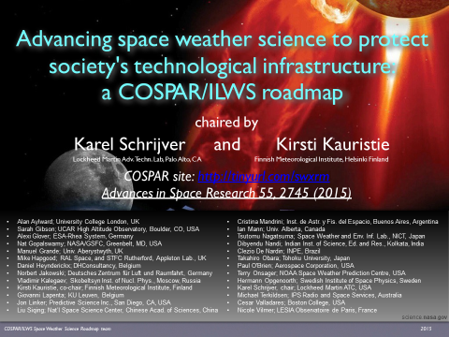
COSPAR/ILWS…

Slide 28
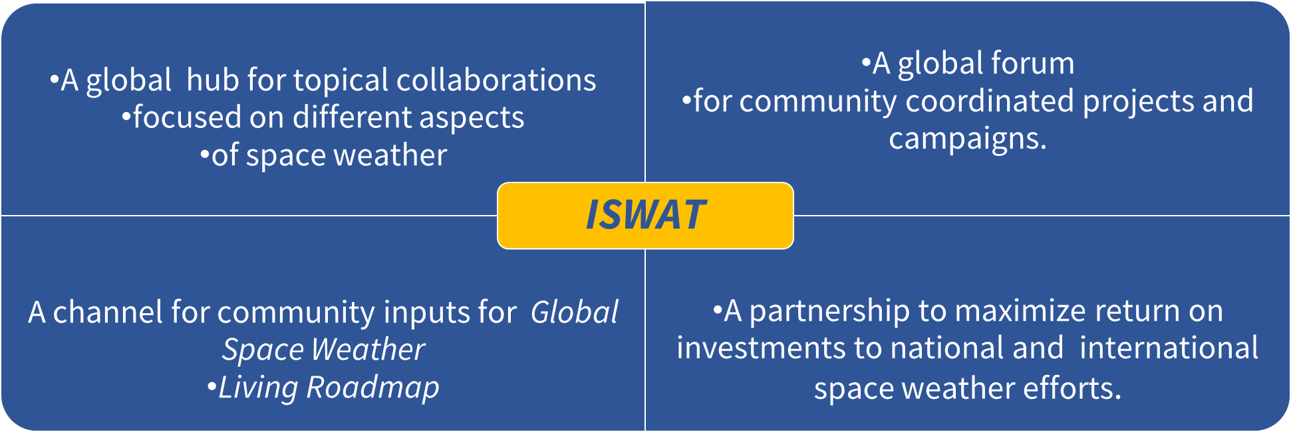
COSPAR PSW (1)
International Space Weather Action Teams (ISWATs)
Joining forces to advance space-weather understanding and capabilities to alert and shield society.

Slide 29
COSPAR PSW (2)
ISWAT Structure…
A topical action team provides a building block of the ISWAT initiative.
Action teams are organised into ISWAT clusters grouped by domain, phenomena, or impact.
An action team choses to focus on a specific task relevant to ISWAT cluster objectives.
Teams are working in coordinated effort across boarders and are not limited by funding agencies – only by scientists’ willingness to collaborate.
They are intended to advance our understanding of space-weather processes linked to major impacts.
ISWATs feed validated improvements in understanding, modelling and forecasting into the R2O transition process.
And the ISWATs within PSW will also help us to maintain a Global Space Weather Living Roadmap.

Slide 30
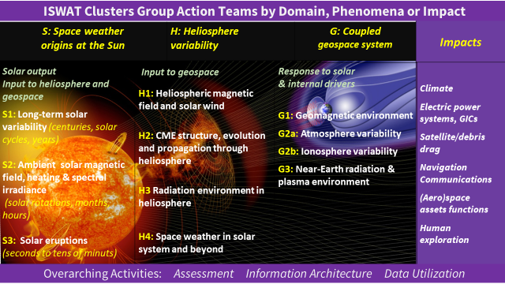
COSPAR PSW (3)

