Slide 1
Preliminary Design for a New Interplanetary Scintillation (IPS) Telescope
Linjie Chen, Yihua Yan*, Wei Wang, Fei Liu, Lihong Geng, Zhijun Chen
National Astronomical Observatories, Chinese Academy of Science, Beijing, China
* School of Astronomy and Space Science, University of Chinese Academy of Science, Beijing, China

Slide 2
Outline
Introduction of a new IPS Telescope
System Specifications
Preliminary Receiver Design
Summary

Slide 3
Introduction
A new IPS telescope is proposed, it consists 3 stations, one main station and 2 sub-stations.
Main station: 3 cylinder antennas placed side
by side, and each antenna is 140m (N-S) ×
40m (E-W), and a Ø20m steerable parabolic
antenna.
Sub-station: a ~20m steerable parabolic antenna

Slide 4
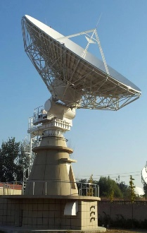
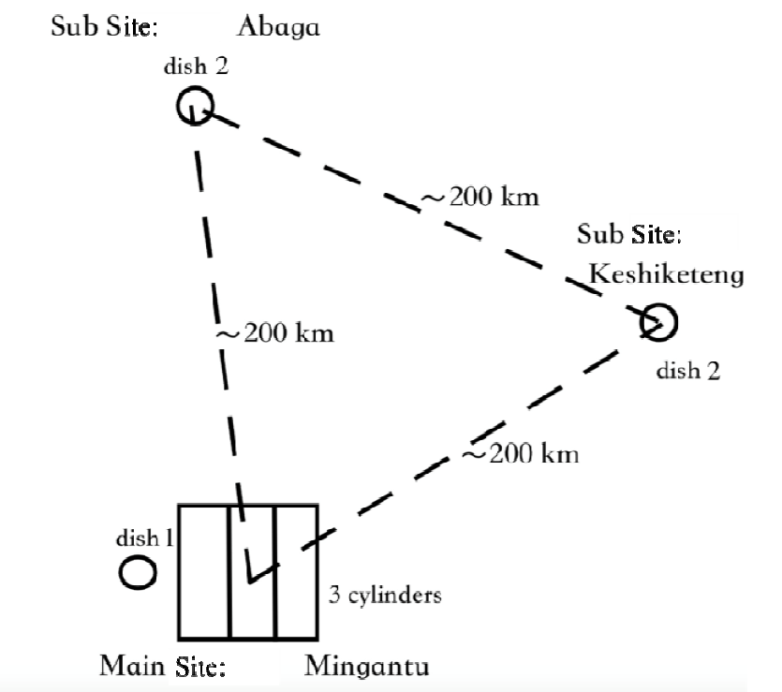
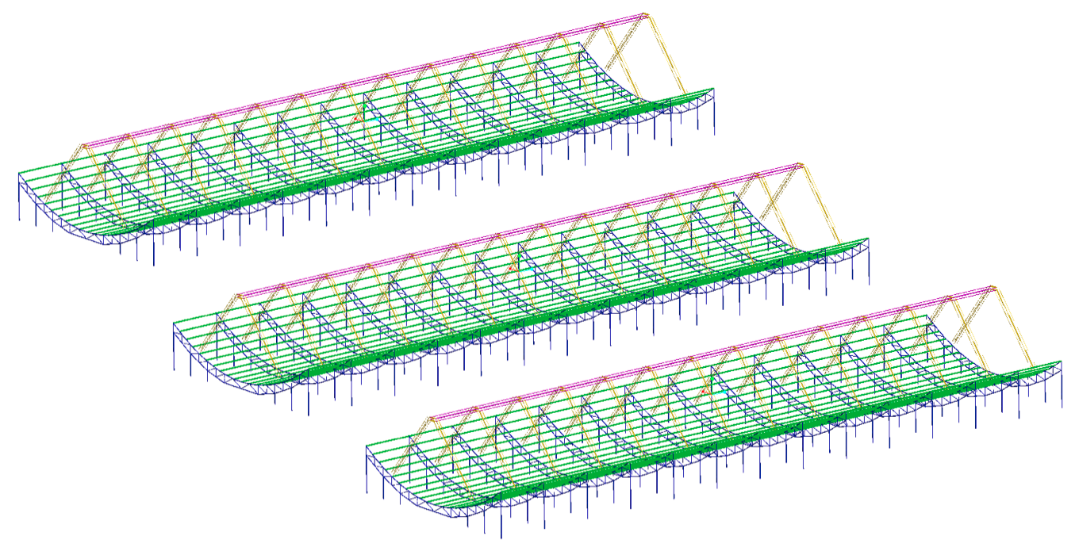
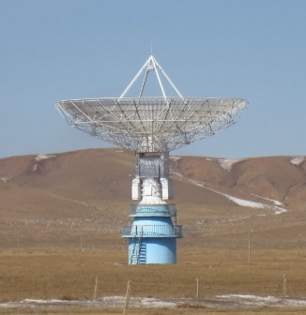
Chinese Three-Station IPS Telescopes
Φ~20m steerable parabolic antenna
Φ~20m steerable parabolic antenna
40m
W
140m
N
Φ20m steerable parabolic antenna
140m
E
S

Slide 5
System Main Specifications
Antenna | Cylinder: 3× 140m×40m
 | Dish: 1 ×Ø20m & 2×Ø16m
Frequency | 327MHz, 654 MHz,1420MHz
Frequency Band | 40MHz
Frequency Resolution | 39 KHz
Beam | Cylinder: 36(3×12) 1.6°×27’@327MHz 0.8°× 13.7’ @ 654 MHz
 | Dish (20m): 0.74°@ 1420MHz
 | Dish(16m): 4°@327MHz 2°@654MHz 0.9°@1420MHz
System Temperature | Cylinder: ~110K
 | Dish: ~ 120K
System Gain | ~80dB
AD | 12bits @ 100MSPS
Sensitivity | ~4.4 mJy@1s with efficiency of 65%
 | ~261mJy@1s with efficiency of 70%

Slide 6
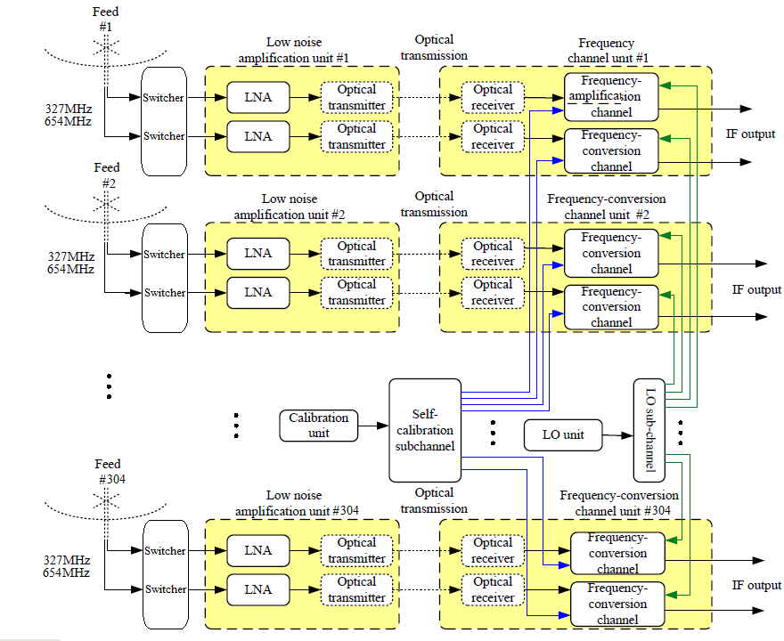
Analog Receiver Design Consideration for Cylinder Antenna
Front-end
Back-end

Slide 7
Digital Receiver Design Consideration Data flow

Slide 8
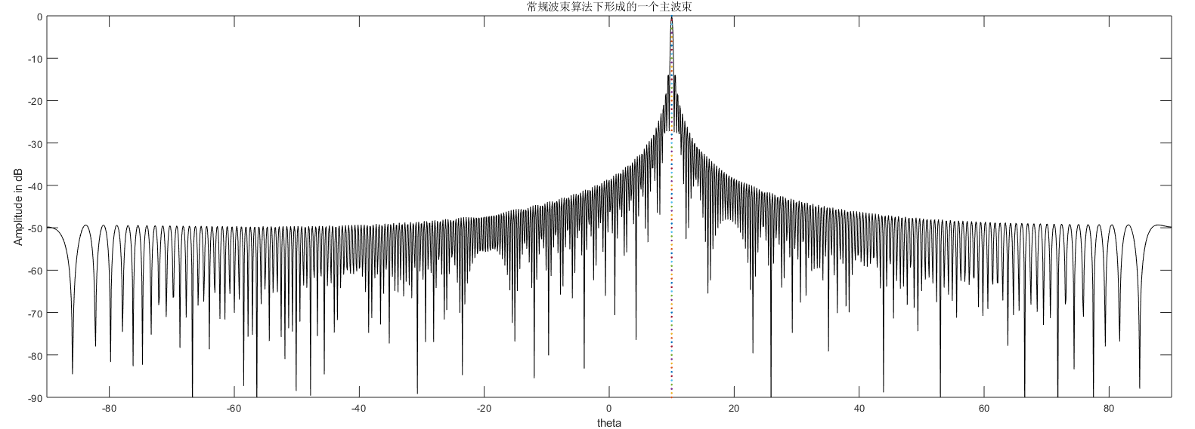
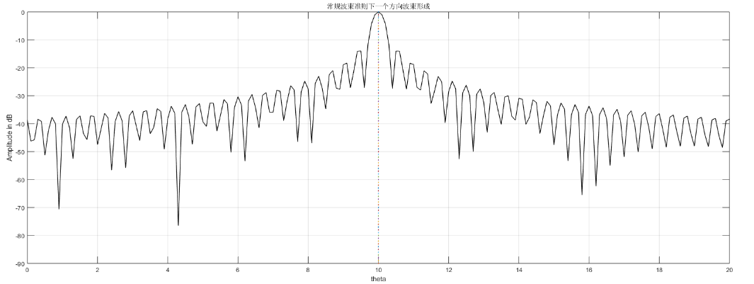
Beamforming Simulations for one Cylinder
Sidelobe requirements: <-20dB

Slide 9
Beamforming Simulations

Slide 10
Beamforming Scheme-Subarray
Antenna
Analog Beamforming
Subarray
Digital Beamforming

Slide 11
Beamforming Scheme-Subarray
Four-feed subarray Eight-feed subarray
 | Original Array | Subarray I （4 elements） | Subarray II （8 elements）
Array Element | 304 | 76 | 38
Analog Phase Shifter | 0 | 76×3 | 38×7
AD | 304 | 76 | 38
Data Rate | 304×100MB | 76×100MB | 38×100MB
Weighting Vector | 304×1 | 76×1 | 38×1

Slide 12
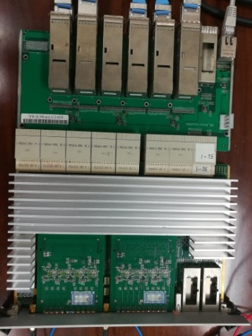
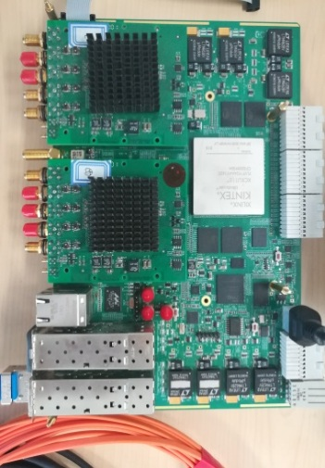
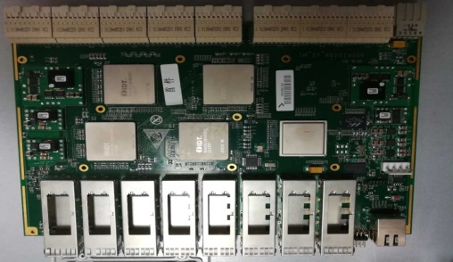
Hardware Prototype of Digital Receiver
V6-FPGA Pre-processing Board
Snap2 HP Processing Board
Switching Board

Slide 13
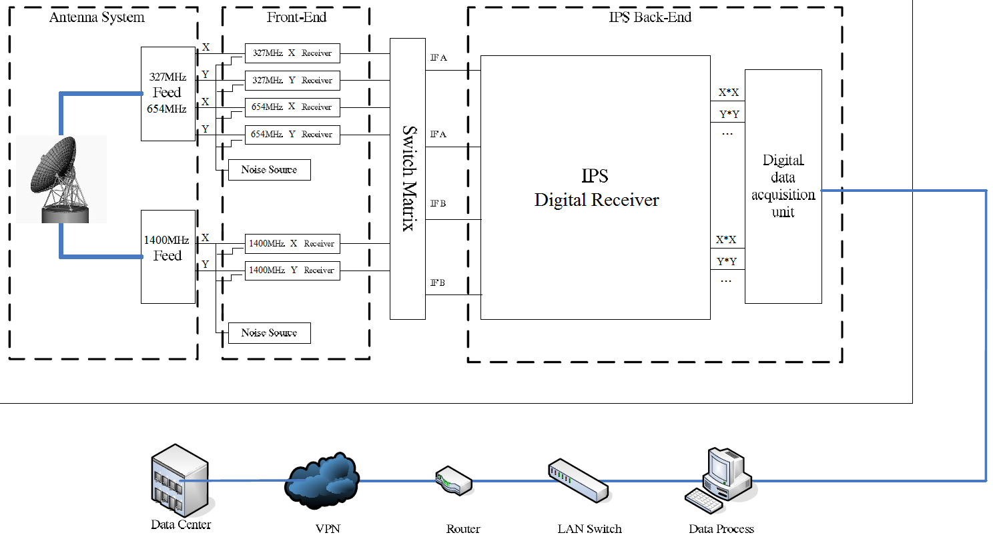
Receiver System for IPS Dish Antenna
Offline Correlation with Other Dishes or Cylinder

Slide 14
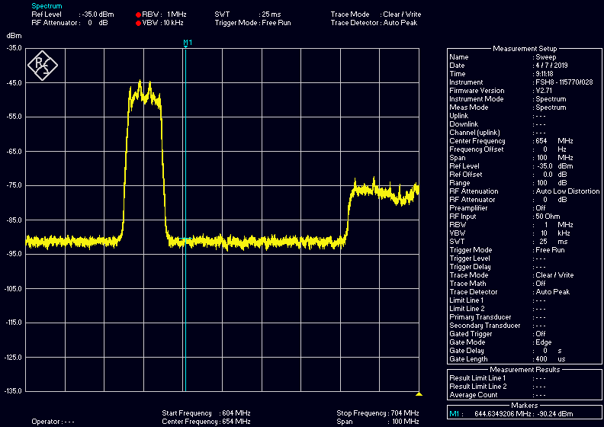
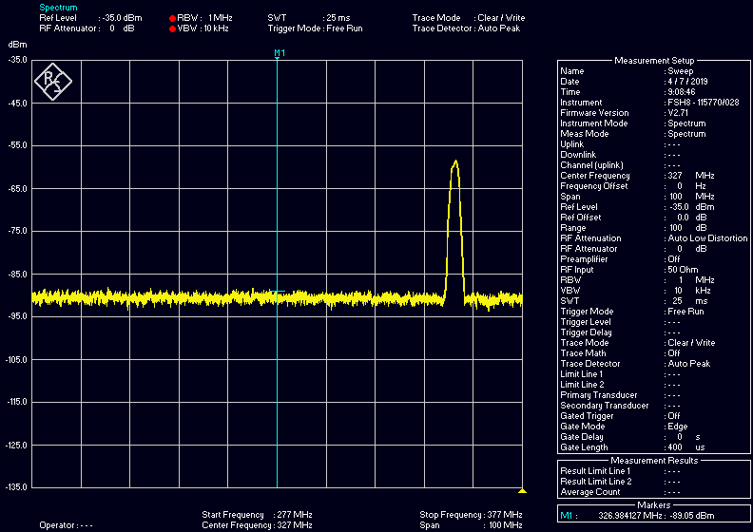
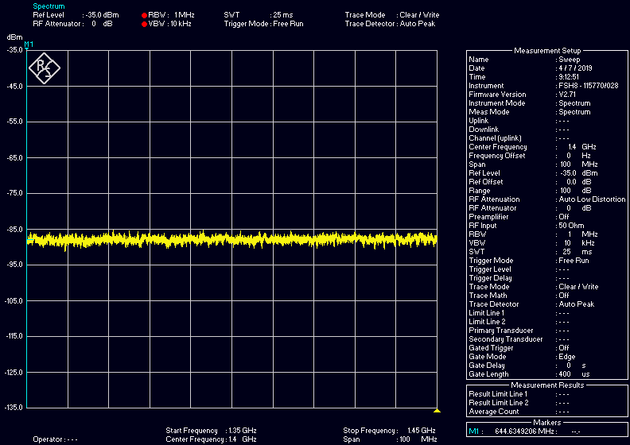
RFI Investigations
Sub-station 1

Slide 15
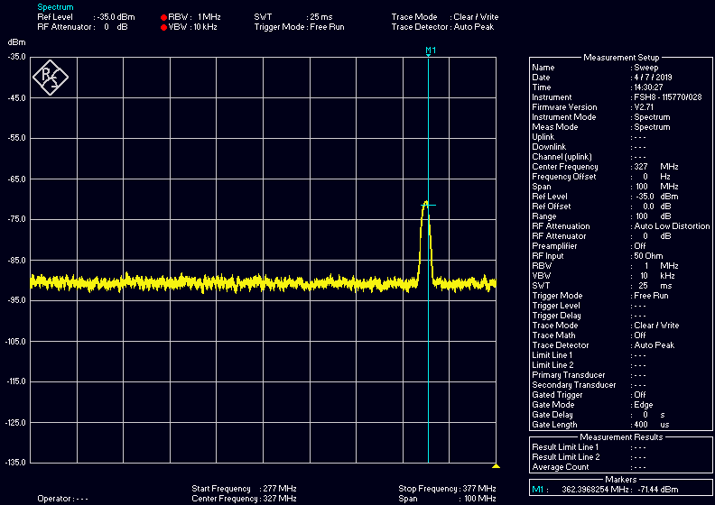
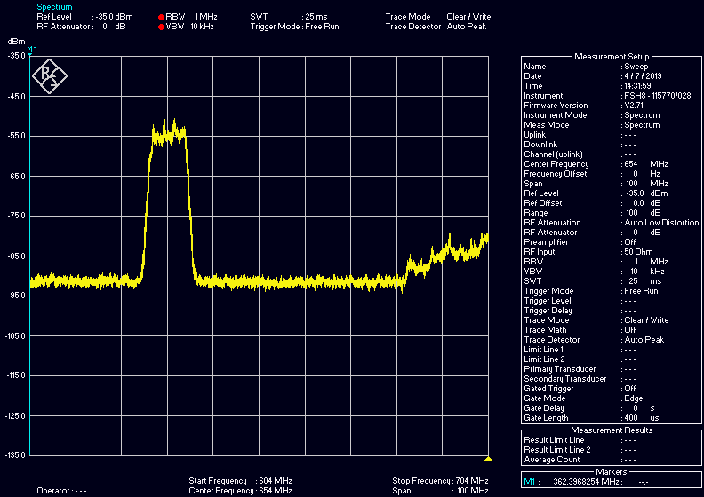
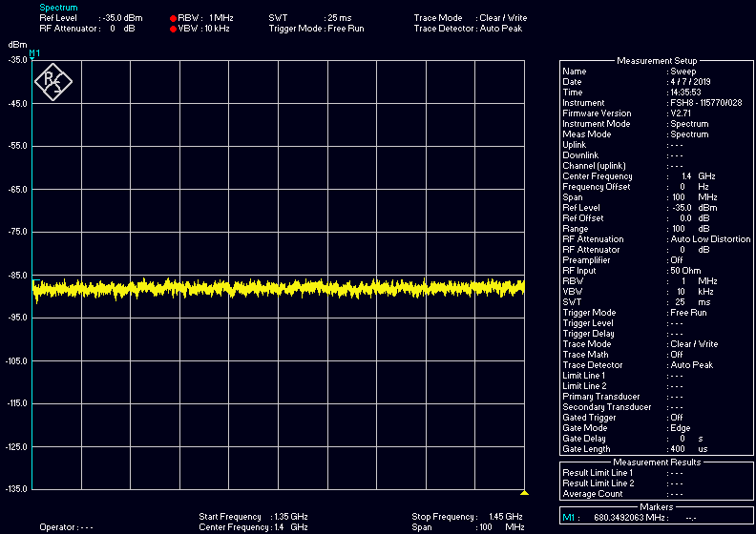
RFI Investigations
Sub-station 2

Slide 16
Summary
A new IPS telescope has been proposed:
Some main specifications have been defined.
Preliminary receiver design has been done.
RFI situations have been investigated.
Detailed design will begin soon.
THANKS!

