Slide 1

Antenna design for Chinese IPS telescope
Wei Wang, IPS team
National Astronomical Observatories, Chinese Academy of Sciences

Slide 2
Outline
Introduction and specification
Design of Antennas
Summary

Slide 3
Introduction
IPS telescope consists of 3 stations, one main station and 2 sub-station at different sites.
Cylinder in main and dish in sub
Antenna at each station observe with dual frequency independently, also in multi-station mode.
As sensitive as Ooty, multi-station mode like ISEE IPS telescope

Slide 4
Specifications
Antenna | Cylinder: 3 × 140m×40m
 | Dish: 1 × Ø20m and 2 × Ø20m
Frequency | 327 MHz, 654 MHz, 1420 MHz(*)
Total Bandwidth | 40 MHz
Beam size | Main site Cylinder: 1.6°× 27’ @ 327 MHz 0.8°× 13.7’ @ 654 MHz
 | Sub sites 20m Dishes: 4° @ 327MHz 2° @ 654MHz 0.9° @ 1420MHz
System Temperature | Cylinder: ~110K
 | Dish: ~ 120K
System Gain | ~80 dB
ADC | 12bits @ 100 Msps
Sensitivity | Main-site: ~4.4 mJy@1s with 65% efficiency
 | Sub sites: ~261mJy@1s with 70% efficiency

Slide 5
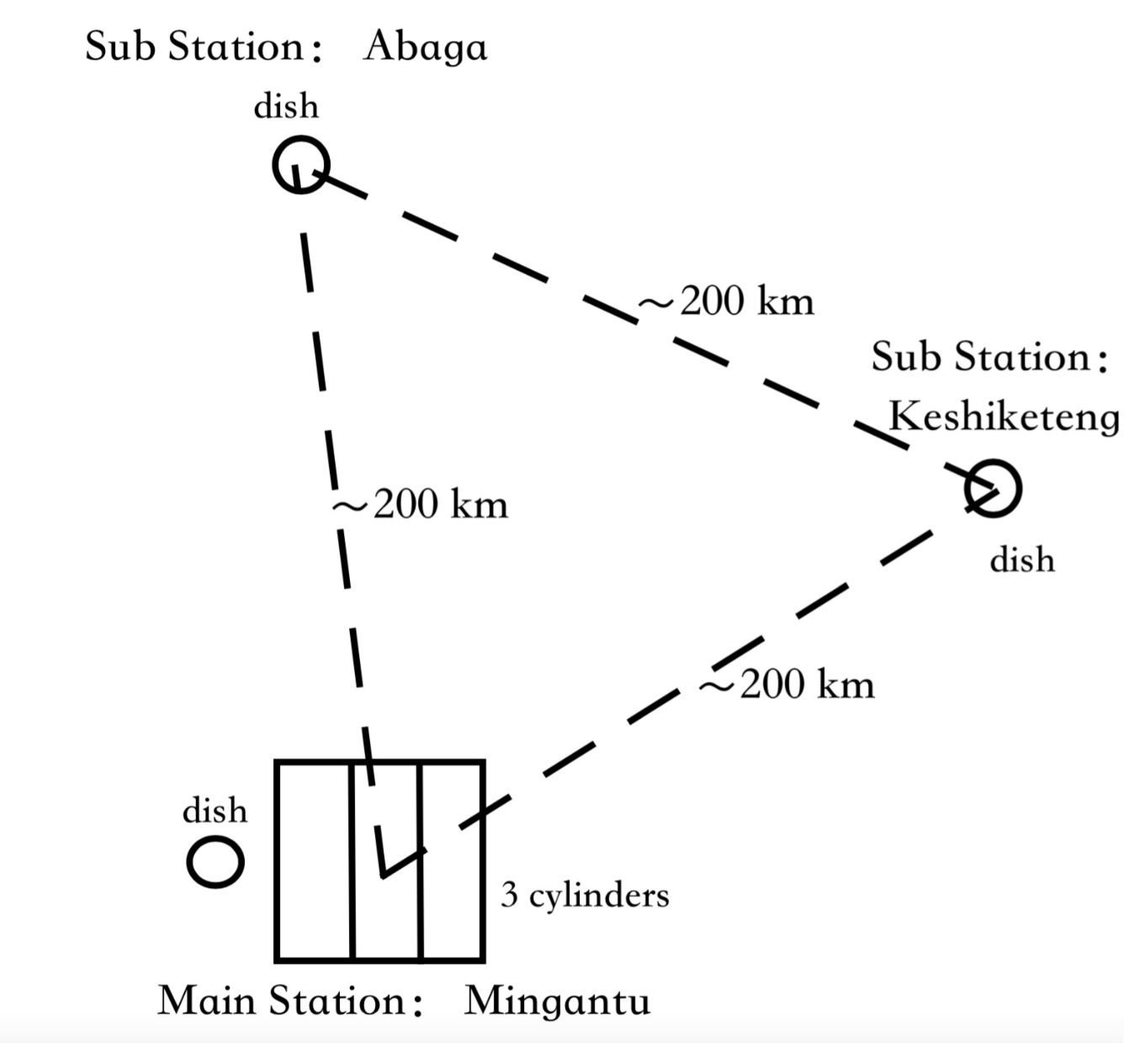
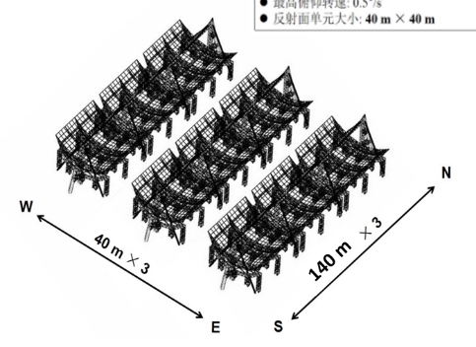
Meteorological station
Astronomical observing station
Notes:
Array configuration, 3 cylinder are placed side by side, two dishes will build at these two meteorological stations, the baseline is about 200 km, the configuration of this array is like a equi lateral triangle,

Slide 6
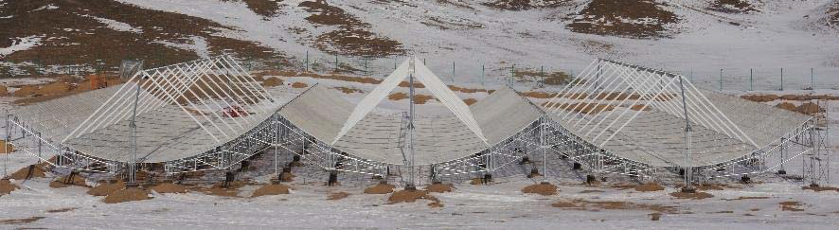
Cylinder antenna in China
Tianlai pathfinder experiment, to map the density of universe in large cells.
3x15mx40m cylinders,96 dual polarization receiver units
Frequency: 0.4-1.4GHz
Notes:
Actually, there is a small cylinder antenna array in china, The purpose of this project is to map the density^^^^

Slide 7
Technical requirements
High sensitivity;
Be steerable;
High aperture efficiency;
Two polarizations, H and V;
Easy maintenance;
High reliability;
Low cost;
Notes:
We are Trying to meet the these requirements, although some of these conflict with each other. So, now, we have 3 preliminary design for the big cylinder antenna

Slide 8
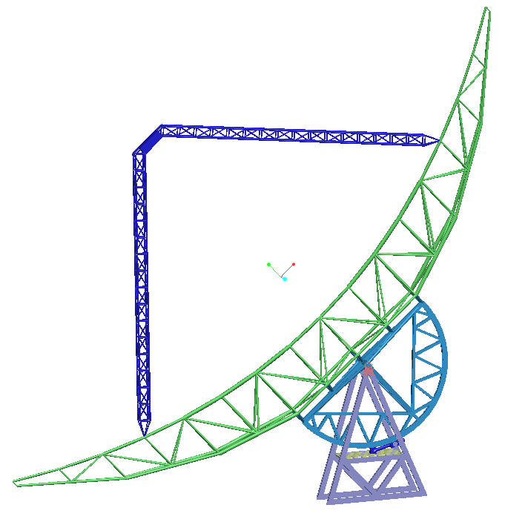
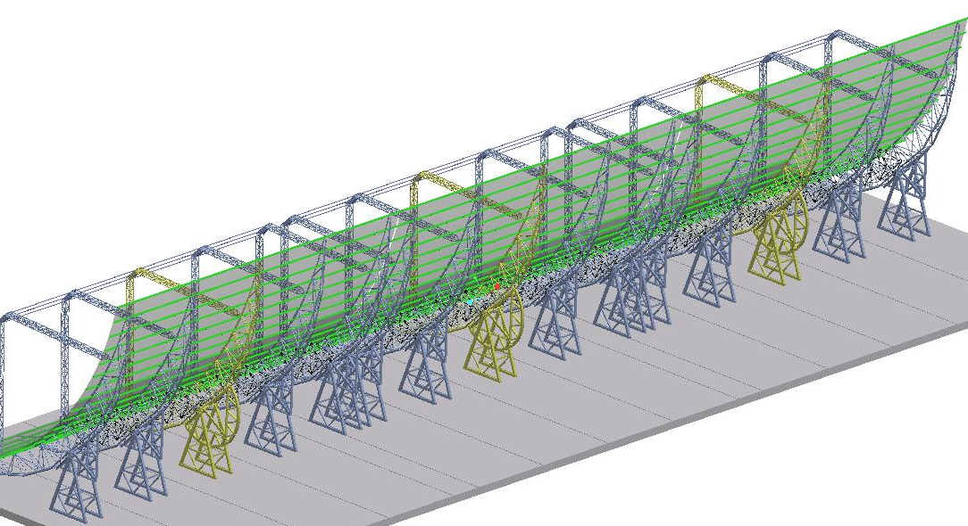
Preliminary design 1: symmetric cylinder
Notes:
This slide shows the first design of this cylinder antenna. Typical or classical design, From the side-view, it looks like a parabolic dish, front feed dish.

Slide 9
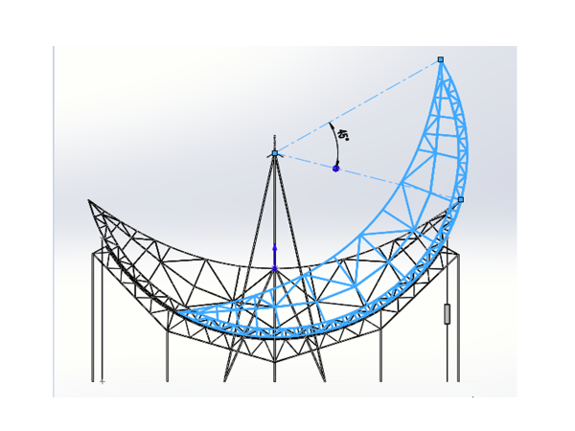
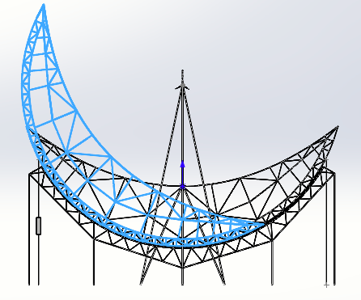
Preliminary Design 2:
Rolling shaft, no rotation axis, crescent
movable structure
Support structure
Notes:
there are two parts in this antenna, Support structure and movable structure, looks like a crescent, Lower surface of this structure is Spherical, and the upper surface is parabolic. Can move along the track with rolling shaft

Slide 10
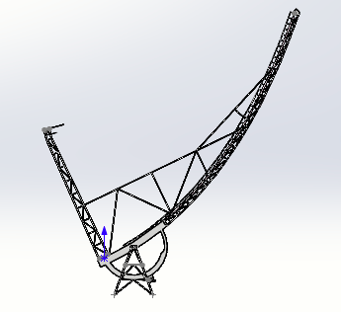
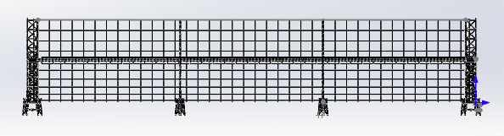
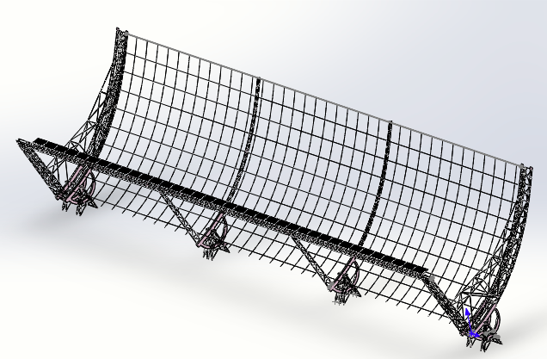
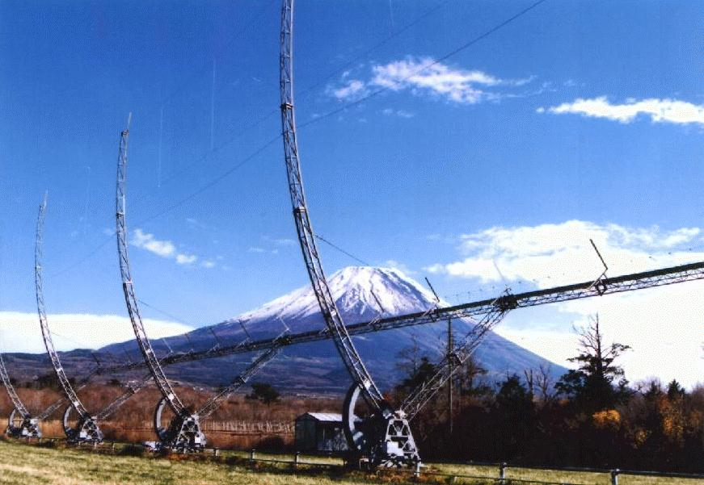
Preliminary design 3:
Unsymmetric cylinder
ISEE IPS telescope
Notes:
Just follow the design of IPS antenna in japan.

Slide 11

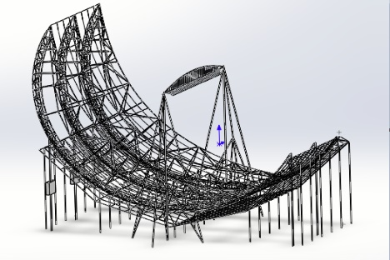

Comparison of 3 cylinder designs
 | Design 1 | Design 2 | Design 3
Rotation axis | Yes | No | Yes
Point of support | Single | Many | Single
Forces (gravity, wind, snow) | Concentrate | Not concentrate | Concentrate
Rotational inertia | Medium | Small | Large
Balance weight | Medium | Easy | Complicated
Power of driving system | Medium | Low | Large
Maintenance | Hard | Easy | Easy
Cost | High | Low | Medium
Notes:
We have compared some items in this sheet. Is there a rotational axis, how many support points, whether the force from self gravity, wind and snow concentrate on axis? Rotational inertia is small or big, whether balance weight is easy or not easy, also how about electronic power. And the most important item is cost. According to this comparison, I think the 2nd design should be better than the others.

Slide 12
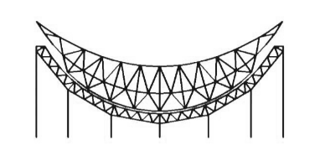
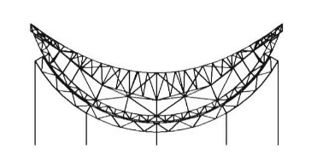
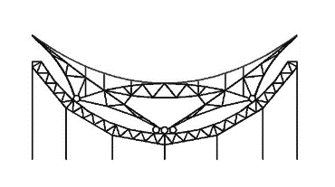
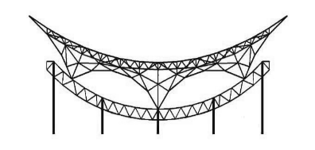
Antenna structure optimization
Truss structure
Improved Truss structure
260 tons per cylinder
Composite Structure
Improved Truss structure
Notes:
We have optimized the structure of the antenna. From truss structure to improved truss structure to composite structure, The weight of the antenna reduced to 260 tons.

Slide 13
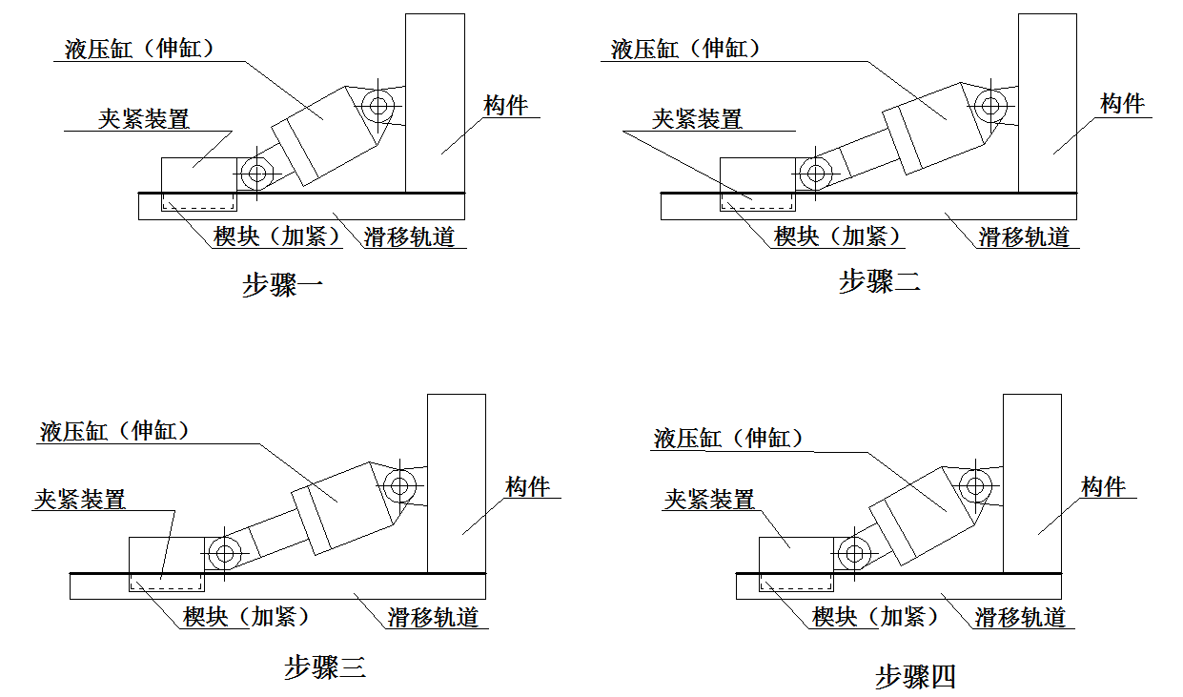
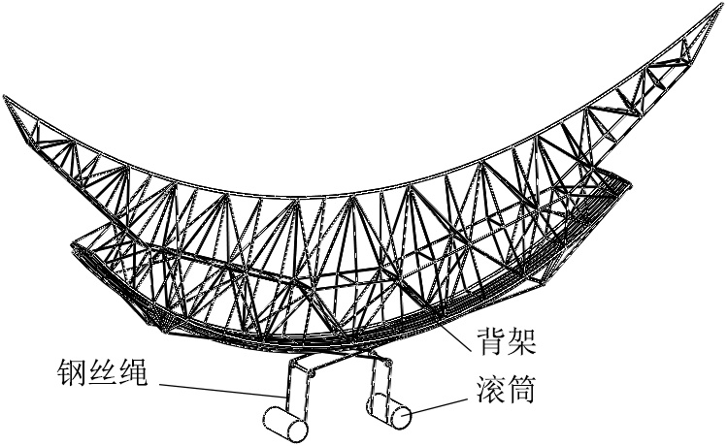
Drive method
Chain and Gear
Hydropress
Steel cable
Notes:
Also the drive method, we consider a couple of ways, including chain and gear, hydropress and steel cable,

Slide 14
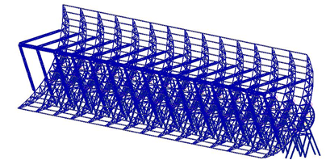
Mechanical Performance
Building finite-element model and analysis
Deformation exerted by
  gravity weight of itself
  Snow
  Wind load
Heavy snow
Strong wind
FEM model
Notes:
About mechanical performance , we also build finite element model to analyze these designs. We evaluate the sensitivity loss due to deformation caused by gravity and snow and wind load. Maybe sometimes, there are some heavy snow in the antenna site, but actually, maybe it is not serious.

Slide 15
Deformation
Gravity
Gravity+snow
Gravity+snow+wind
Gravity+snow+gale
Courtesy of Zhiping Chen

Slide 16
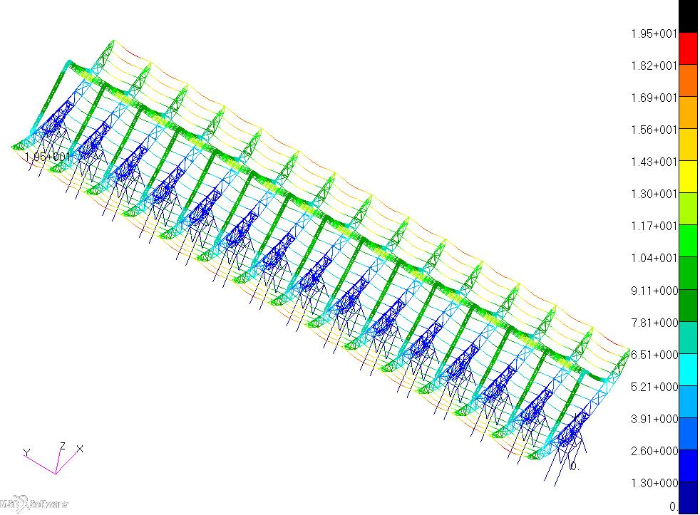
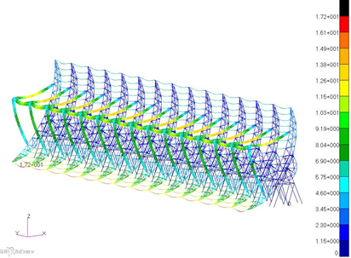
Deformation
Gravity Elevation 90°
Gravity Elevation 30°
Elevation | Max displacement（mm） |  | Max stress（MPa） | Surface RMS（mm）
 | Panel | Feed
90° | 19.5 | 12.5 | 53.3 | 5.07
30° | 17.2 | 12.5 | 42.1 | 3.67
Courtesy of Jingchao Geng
Notes:
The surface rms error is about several millimeter, which can cause sensitivity loss about 1 or 2 percent at 3 twenty seven MHz.

Slide 17
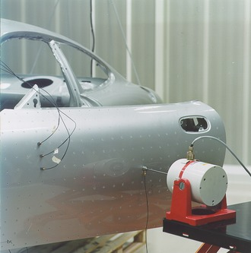
Modal Analysis
the study of the dynamic properties of systems in the frequency domain.
Measuring, calculating and analyzing during external excitation
Modal frequency
  Several Hertz
  Requirement of IPS Obs.
Measuring the vibration of a car's body when it is attached to an shaker.
(From Wikipedia)
Notes:
Why do we need to talk about modal analysis? The reason is resonant frequency. For radio telescope, the resonant frequency is about several hertz. Because for ips observation, we need to care about the fluctuation of power spectrum, maybe the vibration mix up with ips signals.

Slide 18
Resonant frequency
First order：4.5Hz
Second order：4.6Hz

Slide 19
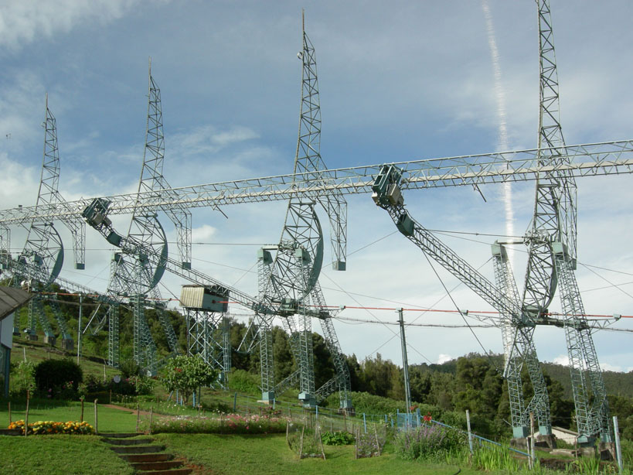
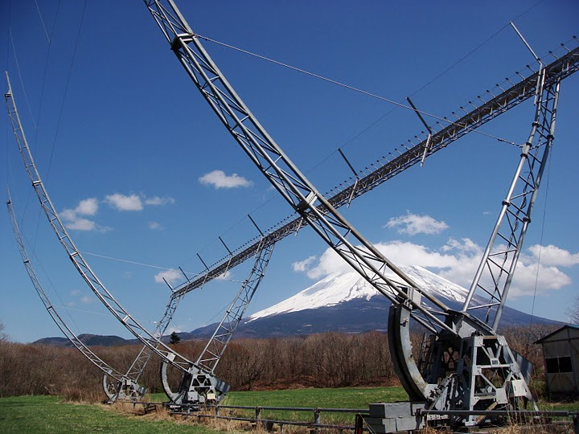
Feeds
Dipoles as feed in Ooty and ISEE IPS Array.
Frequency: 327MHz
Efficiency of antenna: 60~70%
Goal: Better efficiency with affordable cost!
http://rac.ncra.tifr.res.in/index.html
http://stsw1.isee.nagoya-u.ac.jp/jpg/FIT.jpg
Notes:
The cylinder has a line focus, along which is placed an array of more than 300 feeds in each cylinder antenna. Dipoles are being used as feed. Besides dipole, we also consider some new type of antenna to be used as the feed.

Slide 20
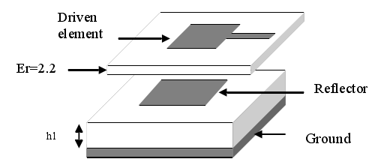
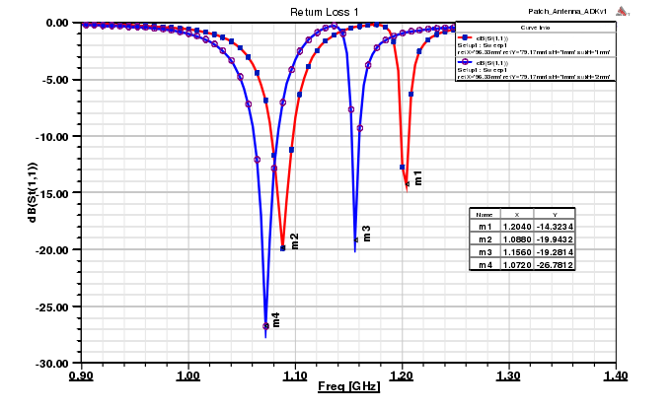
Yagi-Uda microstrip
(Grayd, Lu Junwei, and Thieldv, 1998)
an antenna fabricated using microstrip techniques on a printed circuit board (PCB)
Better directivity, illuminating angle, Maybe better efficiency

Slide 21
The radiation patterns in different parameters
(different colors show different parameters)
E plane
H plane
(f=327MHz)

Slide 22
The radiation patterns of different parameters
(different colors show different parameters)
E plane
H plane
(f=654MHz)

Slide 23
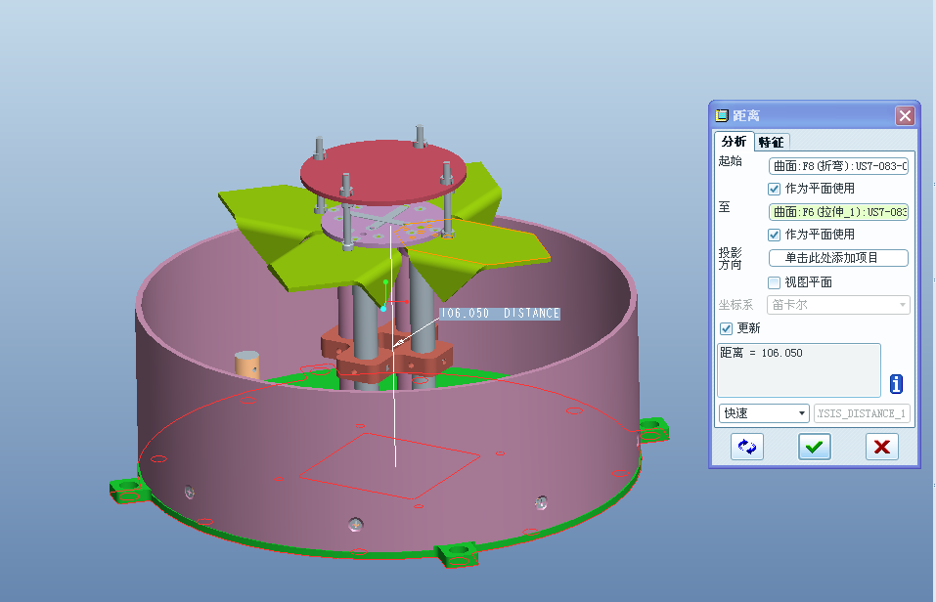
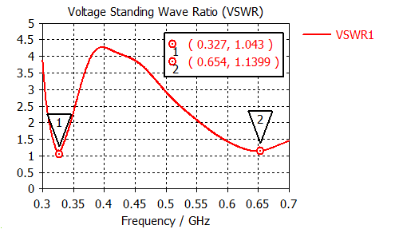
New type of Dipole
Folded dipole
resonant cavity
Notes:
Folded dipole, with a resonant cavity. This feed can be optimized at two frequency points and get some good results.

Slide 24
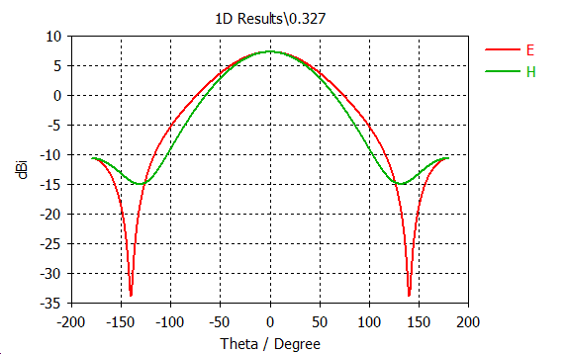
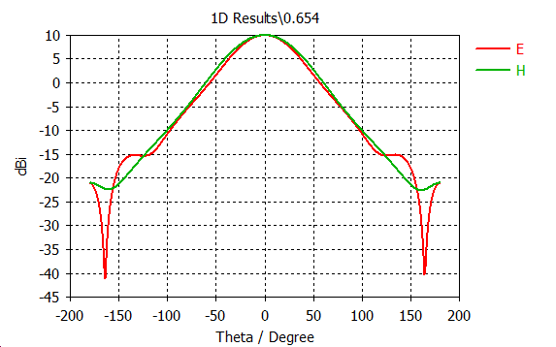
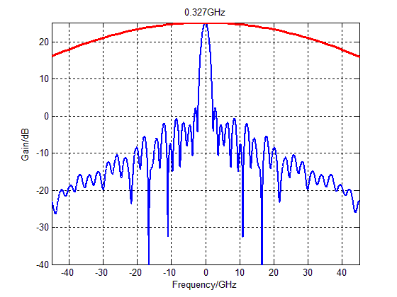
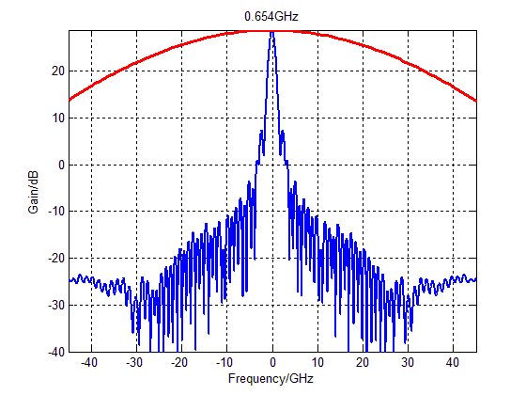
Simulation
Notes:
We are doing some simulation on these 3 feeds to evaluate the performance.

Slide 25
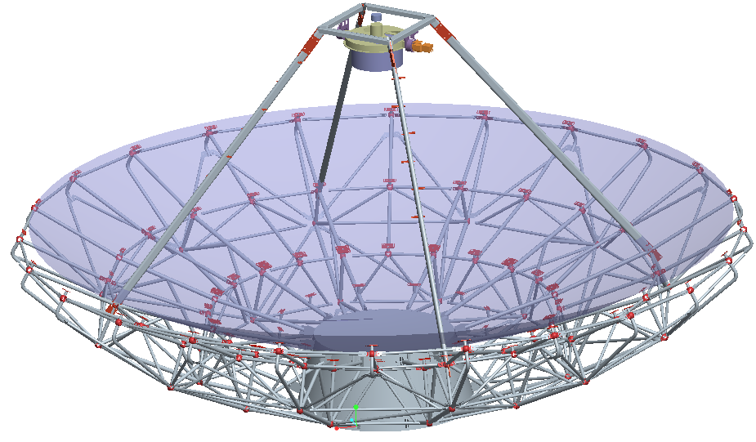
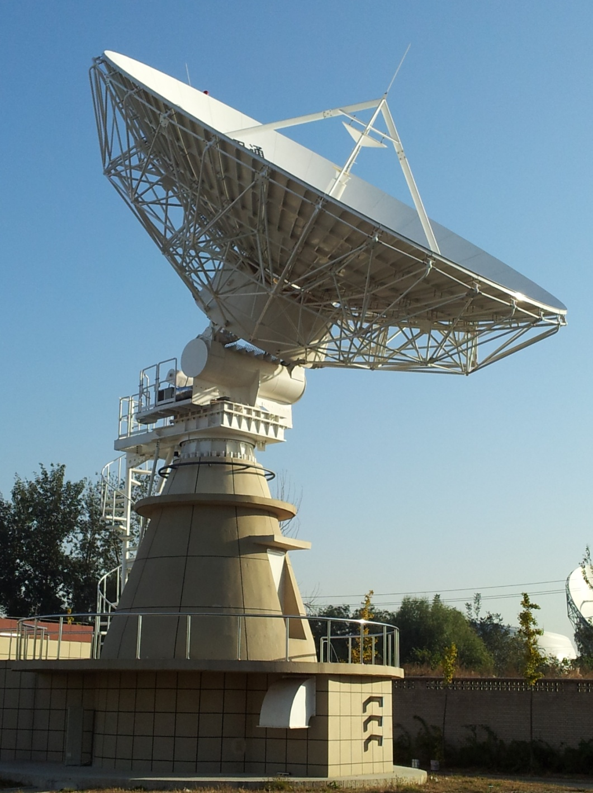
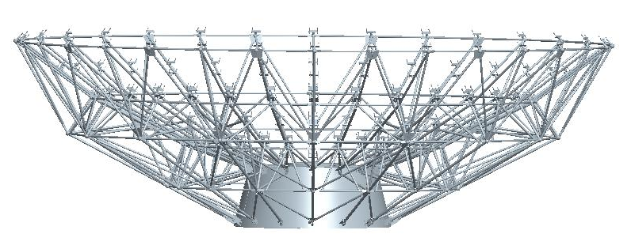
Dish in sub-station
Frequency: 327, 654, 1420MHz
Proven techniques
Notes:
For the 20 meters dish in sub-station, almost the proven techniques, needn’t more discussion about that, there are many 20 m antennas in china at L band.

Slide 26
Summary
Several designs of antennas have been proposed for IPS telescope.
Some technical details need to be further studied in the near future.
  Aperture efficiency, deformation, and modal frequency, structure optimize, drive method.
Thanks!

